Slide 1
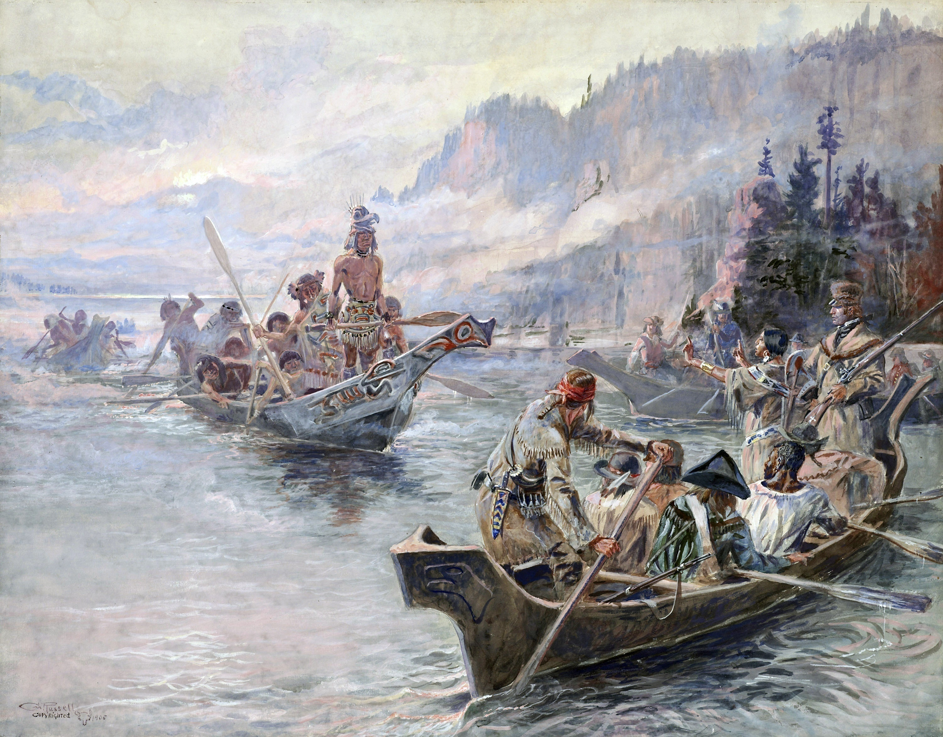

Northwest Journey - Corps of Discovery
Southwest Journeys – Trail of Tears, Santa Fe Trail
Lewis and Clark Expedition
West Coast Journey – Oregon, California Trail
‘Westward Journeys’
Three Year Trilogy . . .

Slide 2

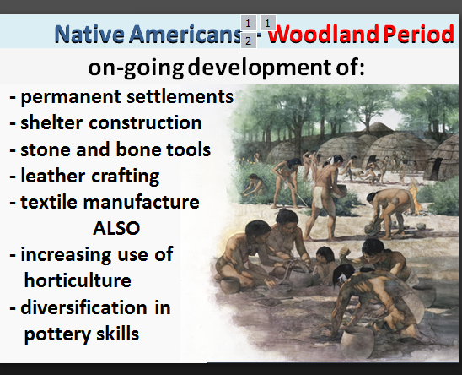
Question from last week . . .
Northwest Journey - Corps of Discovery
Lewis and Clark Expedition
Was cotton used in making textiles?

Slide 3
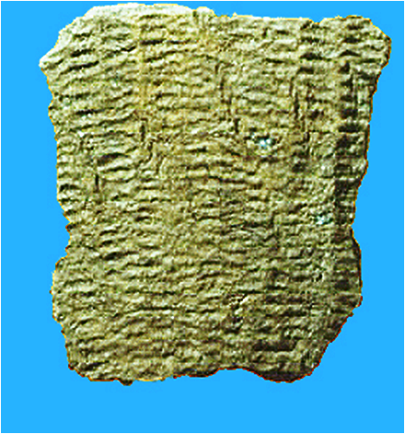
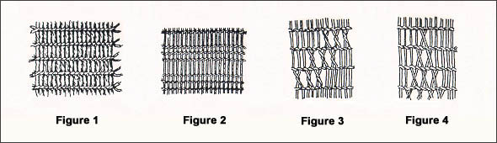
DEFINITION
Textile manufacture is the conversion of fibre
into yarn; yarn into fabric.
WOODLAND PERIOD
Natural fibers that might have been used
include hemp, jute, flax, sisal, and other
vegetable fibers.
Textiles were made by twining -- two horizontal yarns twist
around each vertical yarn [Fig 1], rather than by weaving.
These textile fabrication techniques could have been produced
by finger manipulation and would not require the use of a loom.
Textiles have been preserved as impressions on large vessels called
‘fabric-impressed pottery’.
EXAMPLE: Archeological Dig in Ill: Remains (of fabric) from the Late
Woodland Period comprise both twisted or braided cordage pieces
and actual twined textile fragments ranging in size from 1”X 2” to over
3”X 3”. Four twining techniques are represented. All textiles appear
to be constructed from the outer part of herbaceous plant stems.
Northwest Journey - Corps of Discovery
Lewis and Clark Expedition
WESITES:
http://digitalcommons.unl.edu/cgi/viewcontent.cgi?article=1642&context=tsaconf
https://www.nps.gov/SEAC/hnc/outline/04-woodland/index.htm
http://mcclungmuseum.utk.edu/1991/03/01/prehistoric-textiles/
http://www.maryspanos.mspanos.com/MSAntTextiles.shtml
http://www.basiccarpentrytechniques.com/Manufacturing/Prehistoric%20Textile%20Fabrics%20Of%20The%20United%20States/Prehistoric%20Textile%20Fabrics%20Of%20The%20United%20States.html
https://archaeology.uiowa.edu/woodland-period-0
BOOKS:
https://www.jstor.org/stable/41220757?seq=1#page_scan_tab_contents
https://muse.jhu.edu/book/6788
https://www.amazon.com/Mississippian-Village-Textiles-at-Wickliffe/dp/0817305920
http://www.jstor.org/stable/281458?seq=1#page_scan_tab_contents (free on-line)

Slide 4
Week 2 – THE CORPS IS FORMED: 1802-1803 (SBP)
Geology:
Plate Tectonics – with geologic timeline
- Pangea & formation of Appalachian Mountains
- identify shallow inland sea
- collision of Pacific plate w/N.A. plate
- collision of exotic terrains to Pacific NW
Geology of eastern USA in 1802 - from Atlantic Ocean to Missouri River
- Appalachian Mountains – formation, height, breadth, barrier to westward expansion
- Atlantic coastal area – flow of eastern rivers – length, direction, etc
- Ohio River (used by Lewis to travel to St Louis, recruited corpsmen from forts along way)
- formation (during last ice age??)
- location, length, flow, (compare to Mississippi?)
History/Culture/People:
- Eastern North America
- Eastern Indians - tribes/issues/removals?
-'Northwest Passage' - hope for a water passage from Atlantic to Pacific
- Western North America
- Hudson Bay, Northwest Company, Russian-American Company
- Louisiana purchase in 1803
- historical background
- significance for USA
- the Corps of Discovery is formed
- Jefferson conscripts Lewis
- Lewis conscripts Clark – a military operation
- Corps is built along route from Washington to Camp River Dubois (Illinois)
- Introduce people involved with Corps
- Meriwether Lewis
- Seaman (dog)
- William Clark
- slave York
- Judith Hancock (Clark's fiancee)
- Droulliard/Colter/Shannon ???
- 1802 winter camp at Camp River DuBois
- equipment/supplies/boats

Slide 5
Session 2: The Corps is Formed
Northwest Journey - Corps of Discovery
Lewis and Clark Expedition
Session 1: Setting the Stage
Session 2: The Corps Is Formed
Session 2: The Corps Is Formed
Session 3: The River Trip Begins
Session 4: Over the Rockies
Session 5: To the Pacific
Session 6: The Legend Begins

Slide 6
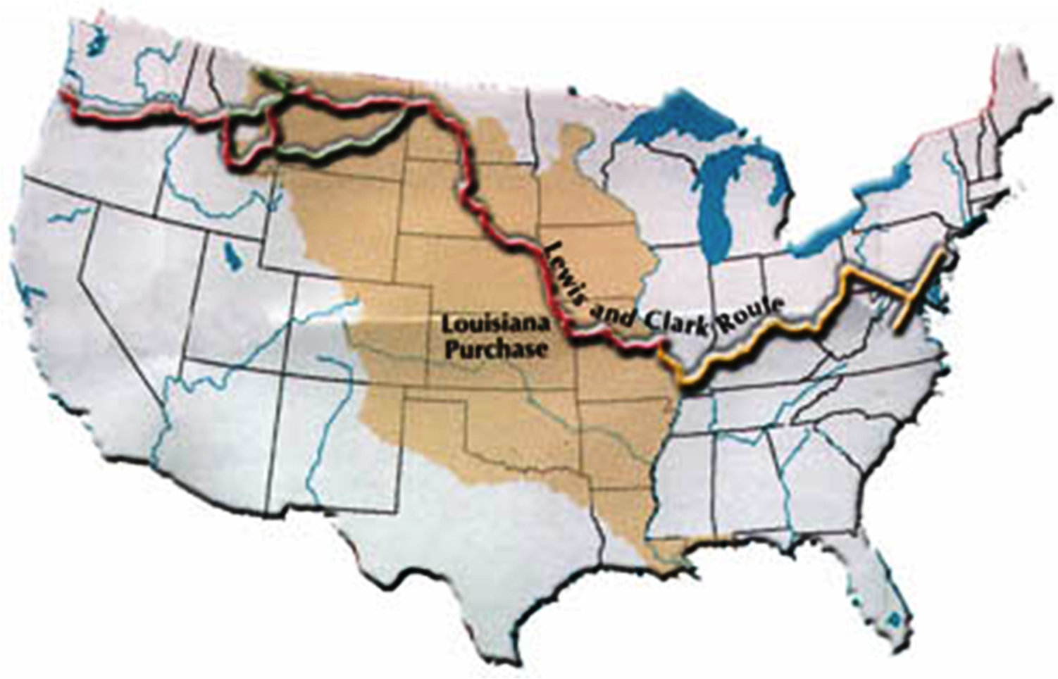
Session 2: The Corps Is Formed
The Corps Is Formed
To the Pacific
Over the Mountains
River Trip Begins
Corps Is Formed

Slide 7
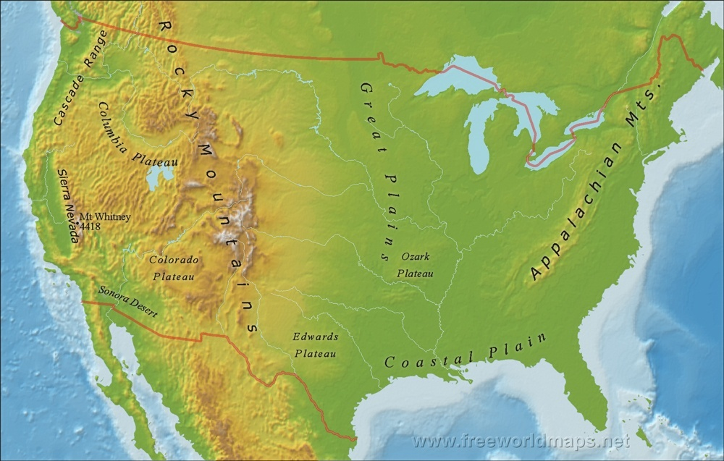

Session 2: The Corps Is Formed
The Corps Is Formed
PHYSIOGRAPHIC MAP
Appalachian Mountains

Slide 8
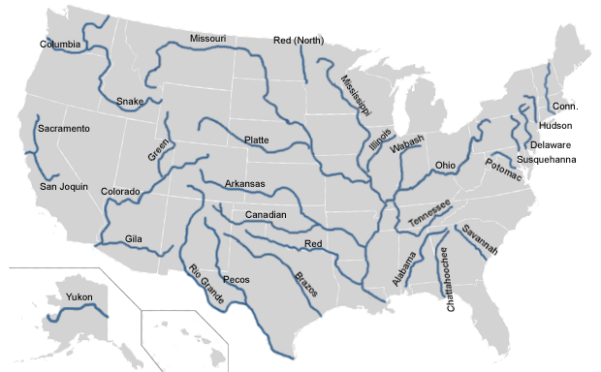
Session 2: The Corps Is Formed
The Corps Is Formed
PHYSIOGRAPHIC MAP
MAJOR RIVERS OF USA
across the APPALACHIANS & down the OHIO
Where did these mts come from?
Appalachian Mountains
Ohio River
Why is this river here?

Slide 9
Session 2: The Corps Is Formed
The United States
GEOLOGY
across the APPALACHIANS & down the OHIO
The United States
- Appalachian Mountains
- Ohio River
People, Cultures, & History
- Northwest Passage
- Louisiana Purchase
- The Corps is commissioned
The United States
Where did these mts come from?
Appalachian Mountains
Ohio River
Why is this river here?

Slide 10
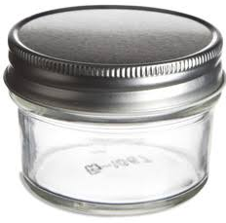

The United States
GEOLOGY
Weathering & Erosion
Rock Cycle
Plate Tectonics
Glaciation
last week
TODAY
Next week

Slide 11
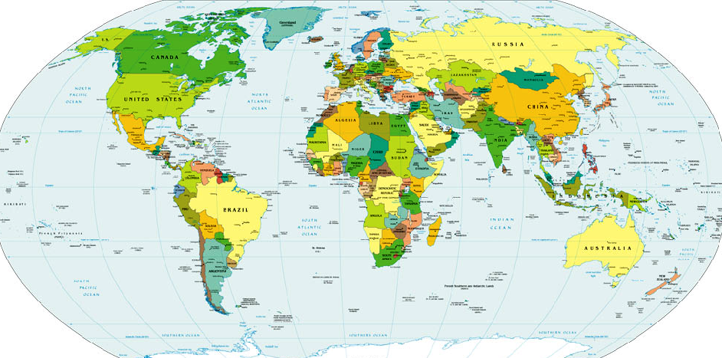
The United States
Plate Tectonics
GEOLOGY
Weathering & Erosion
Rock Cycle
Plate Tectonics
Glaciation
    Plate Tectonics

Slide 12
http://www.livescience.com/37706-what-is-plate-tectonics.html
Plate tectonics is the theory that Earth's outer shell is divided into several plates that glide over the mantle, the rocky inner layer above the core. The plates act like a hard and rigid shell compared to Earth's mantle.
Plate tectonics is the unifying theory of geology, said Nicholas van der Elst, a seismologist at Columbia University's Lamont-Doherty Earth Observatory in Palisades, New York.
"Before plate tectonics, people had to come up with explanations of the geologic features in their region that were unique to that particular region," Van der Elst said. "Plate tectonics unified all these descriptions and said that you should be able to describe all geologic features as though driven by the relative motion of these tectonic plates."
The driving force behind plate tectonics is convection in the mantle. Hot material near the Earth's core rises, and colder mantle rock sinks. "It's kind of like a pot boiling on a stove," Van der Elst said. The convection drive plates tectonics through a combination of pushing and spreading apart at mid-ocean ridges and pulling and sinking downward at subduction zones, researchers think. Scientists continue to study and debate the mechanisms that move the plates.
Mid-ocean ridges are gaps between tectonic plates that mantle the Earth like seams on a baseball. Hot magma wells up at the ridges, forming new ocean crust and shoving the plates apart. At subduction zones, two tectonic plates meet and one slides beneath the other back into the mantle, the layer underneath the crust. The cold, sinking plate pulls the crust behind it downward.
Subduction zones, or convergent margins, are one of the three types of plate boundaries. The others are divergent and transform margins.
At a divergent margin, two plates are spreading apart, as at seafloor-spreading ridges or continental rift zones such as the East Africa Rift.
Transform margins mark slip-sliding plates, such as California's San Andreas Fault, where the North America and Pacific plates grind past each other with a mostly horizontal motion.
As the continents jostle around the Earth, they occasionally come together to form giant supercontinents, a single landmass. One of the earliest big supercontinents, called Rodinia, assembled about 1 billion years ago. Its breakup is linked to a global glaciation called Snowball Earth.
A more recent supercontinent called Pangaea formed about 300 million years ago. Africa, South America, North America and Europe nestled closely together, leaving a characteristic pattern of fossils and rocks for geologists to decipher once Pangaea broke apart. The puzzle pieces left behind by Pangaea, from fossils to the matching shorelines along the Atlantic Ocean, provided the first hints that the Earth's continents move.

Slide 13
Plate Tectonics
The Theory of
the structure of the earth's crust
is caused by the interaction of
rigid crustal plates
moving slowly over
the underlying mantle

Slide 14
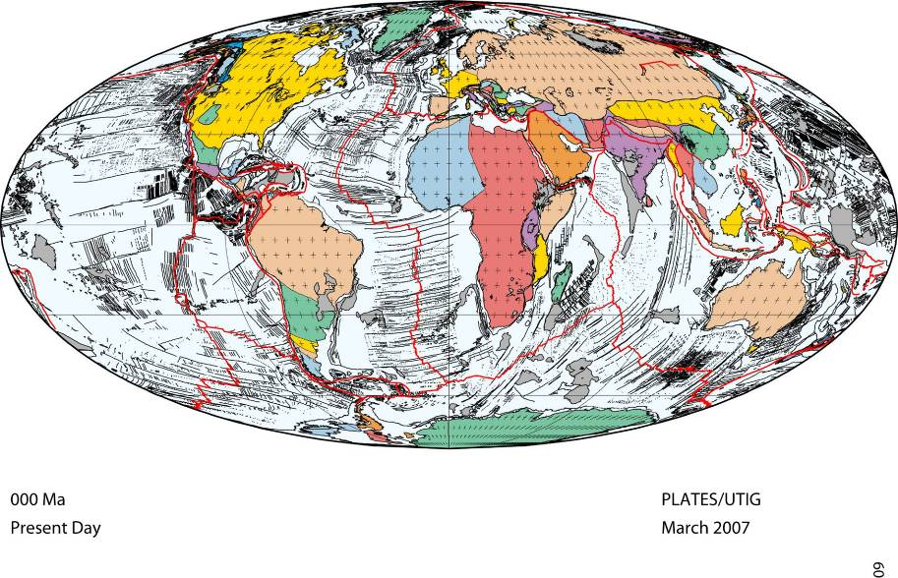
The Theory of Plate Tectonics
focus on the land masses . . .

Slide 15
North
America
Eurasia
Africa
South
America
Aus
Antarctica
000 Ma
present
focus on the land masses . . .

Slide 16
. . . now focus on the tectonic plates
North
America
Eurasia
Africa
South
America
Aus
Antarctica
As tectonic plates move,
continents collide . . .
. . . and mountains ranges form
000 Ma
present
focus on the land masses . . .

Slide 17
https://en.wikipedia.org/wiki/Continental_collision
Continental collision is a phenomenon of the plate tectonics of Earth that occurs at convergent boundaries. Continental collision is a variation on the fundamental process of subduction, whereby the subduction zone is destroyed, mountains produced, and two continents sutured together. Continental collision is known only to occur on Earth.
Continental collision is not an instantaneous event, but may take several tens of millions of years before the faulting and folding caused by collisions stops. The collision between India and Asia has been going on for about 50 million years already and shows no signs of abating.
https://en.wikipedia.org/wiki/Mountain_formation
Movements of tectonic plates create volcanoes along the plate boundaries, which erupt and form mountains. A volcanic arc system is a series of volcanoes that form near a subduction zone where the crust of a sinking oceanic plate melts.
When plates collide or undergo subduction (that is – ride one over another), the plates tend to buckle and fold, forming mountains. Most of the major continental mountain ranges are associated with thrusting and folding, called orogenesis.

Slide 18
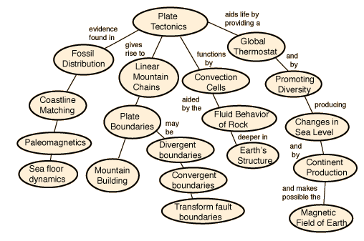
http://hyperphysics.phy-astr.gsu.edu/hbase/Geophys/platemt.html
Linear mountain chains suggest the movement of a plate boundary and the existence of active plate tectonics. The process of mountain building involved with such chains involves a convergent boundary between two plates. One of the most dramatic ranges on the Earth is the Himalayan range. There is nothing comparable to it in the remainder of the solar system.
The rocky mountains seem high and solidly fixed, but their height is a tiny fraction of the Earth's radius, and they sit atop a likewise thin solid crust on the Earth. Evidence has mounted that sections or "plates" of this solid crust move with time and have made dramatic movements during the time that life has existed on the Earth.

Slide 19
Missouri River flows over/cuts the Ogallala formation
29-5mya – Ogallala formations – Rocky Mt erosional deposits
29-19mya – Arikaree formation (channel sandstones, overbank deposits
35-29mya – White River formation (claystone, sandstone, limestone)
40-75mya – Larimide Orogeny
- uplifted rocks on western side of WIS
- caused WIS to retreat
- laid framework for great plains drainage from Rockies &
Appalachian
80-55mya – formation of Rocky Mts during Larimide Orogeny
100-???mya – Western Interior Seaway (WIS)
325-260mya – Alleghanian or Appalachian Oregony (mountain building)
480mya – formation of Appalachian Mts

Slide 20
. . . now focus on the tectonic plates
from today backward 400 million years . . .
North
America
Eurasia
Africa
South
America
Aus
Antarctica
As tectonic plates move,
continents collide . . .
. . . and mountains ranges form
000 Ma
present

Slide 21
from today backward 400 million years . . .
RED LINE indicates
location of Appalachians
through time
Equator
000 Ma
present
Time clock
Ma = millions of years ago (mya)

Slide 22
going BACKWARD in time . . . .
RED LINE indicates
location of Appalachians
through time
000 Ma
present

Slide 23
going BACKWARD in time . . . .
000 Ma
present

Slide 24
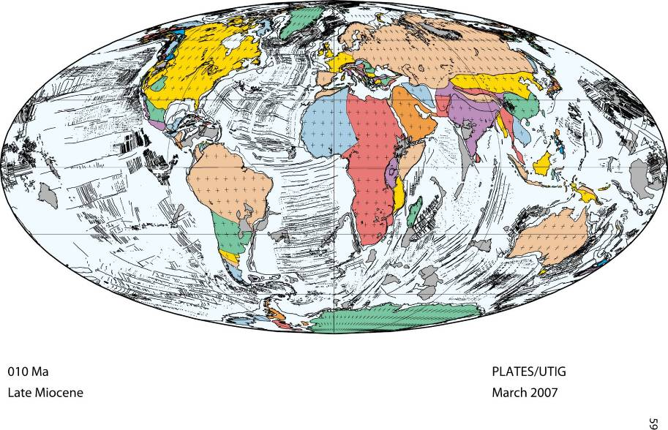
010 Ma

Slide 25
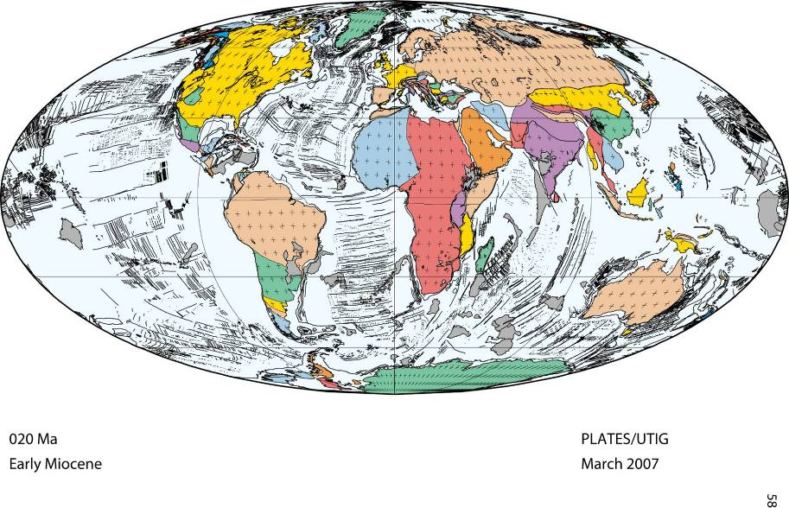
020 Ma

Slide 26
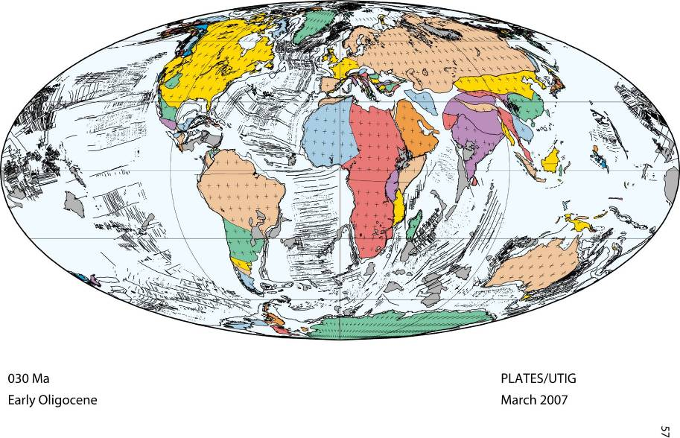
030 Ma

Slide 27
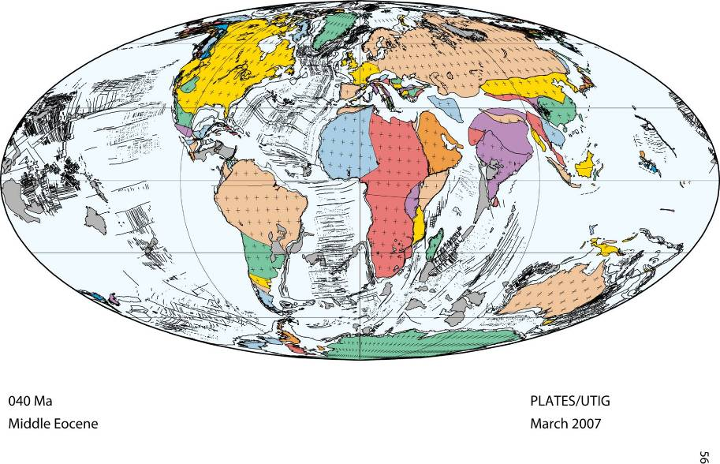
040 Ma

Slide 28
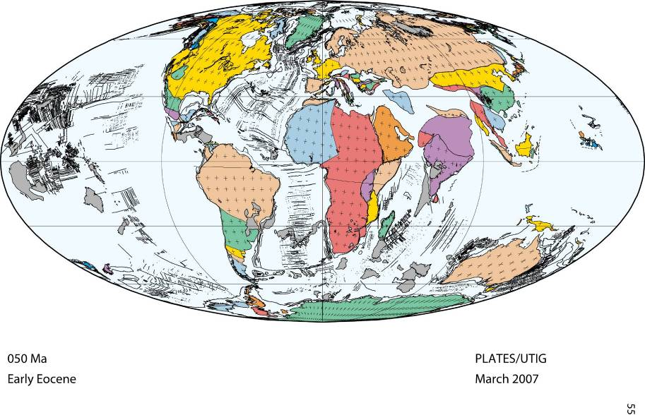
050 Ma

Slide 29
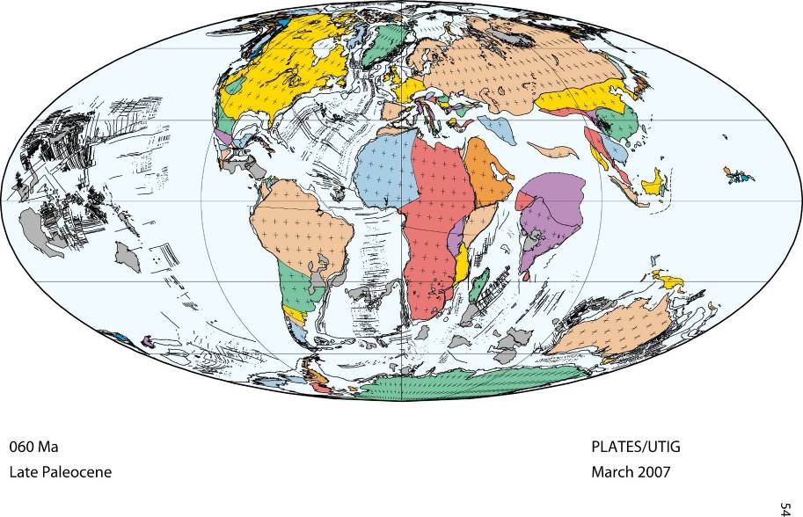
060 Ma

Slide 30
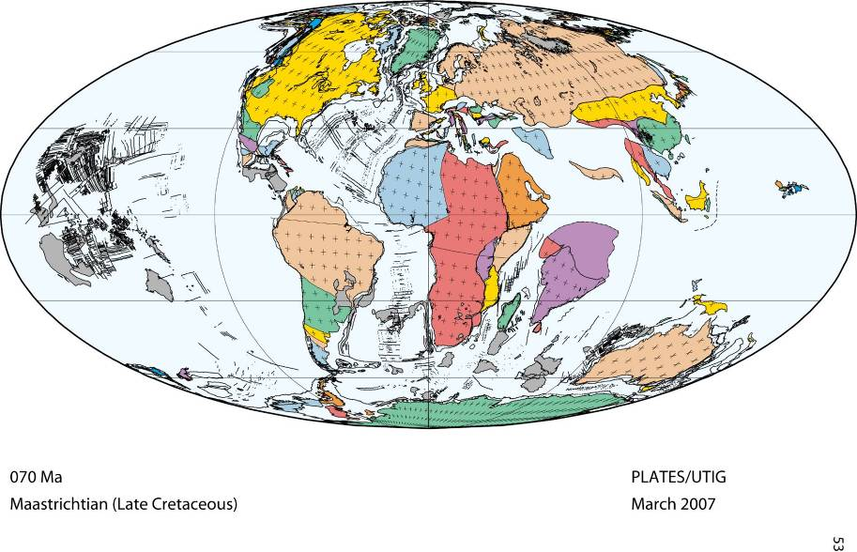
070 Ma

Slide 31
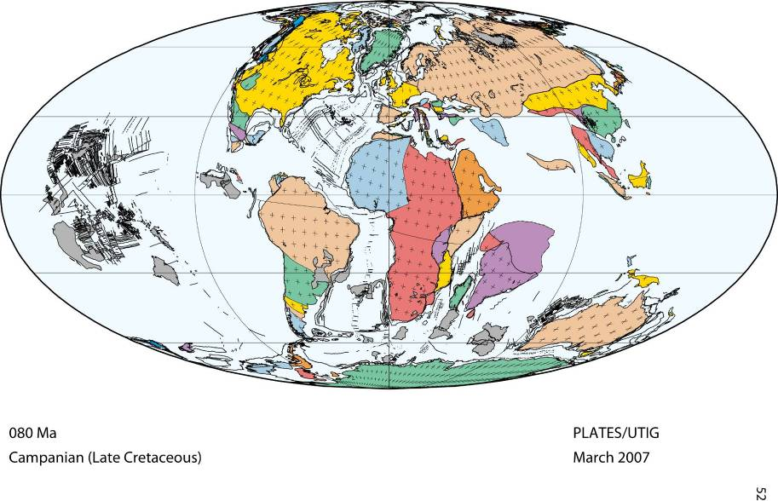
080 Ma

Slide 32
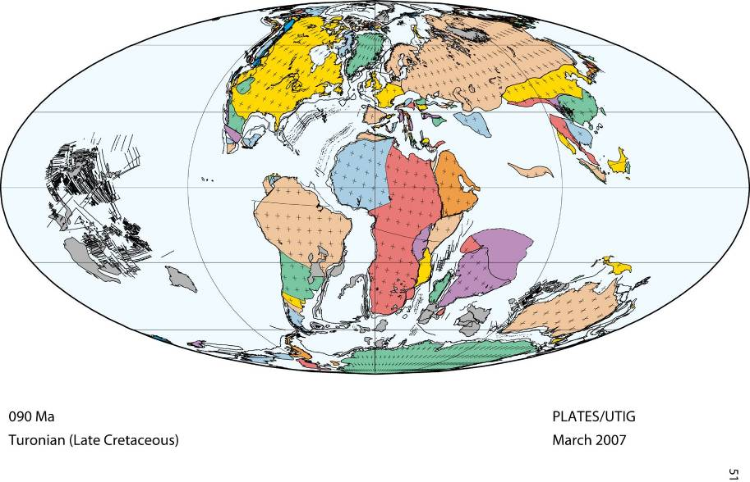
090 Ma

Slide 33
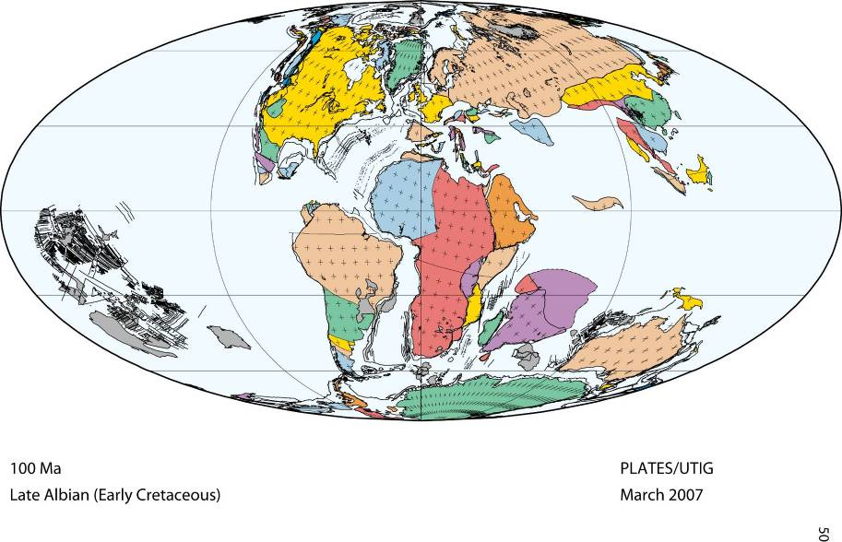
100 Ma

Slide 34
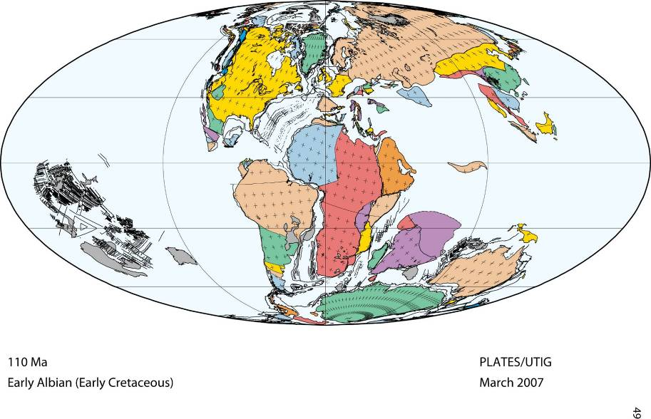
110 Ma

Slide 35
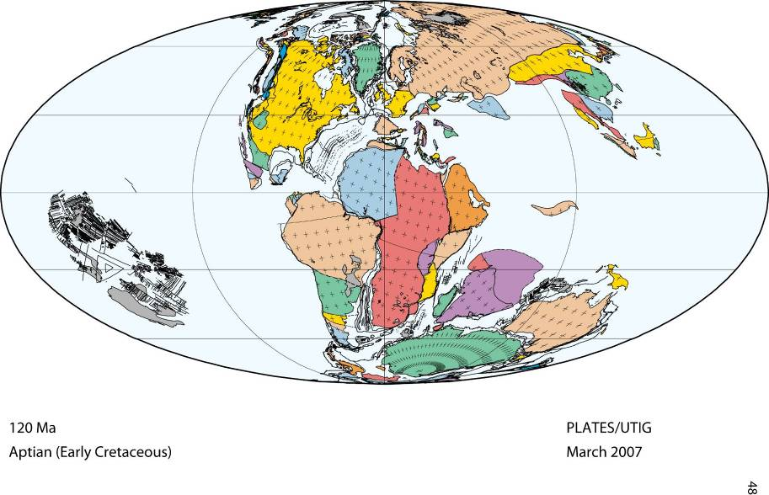
120 Ma

Slide 36
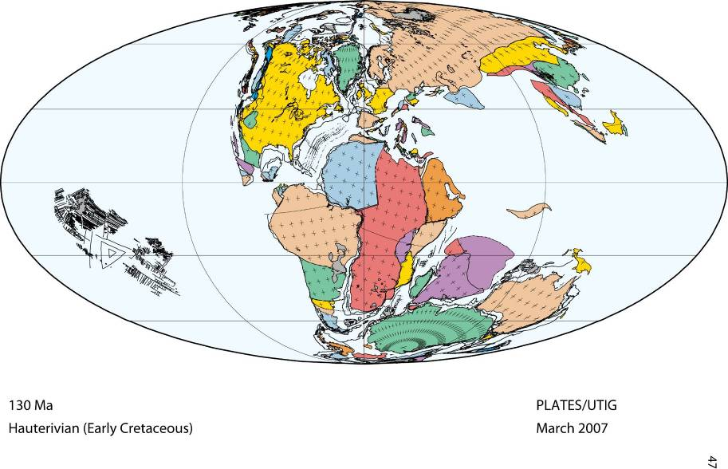
130 Ma

Slide 37
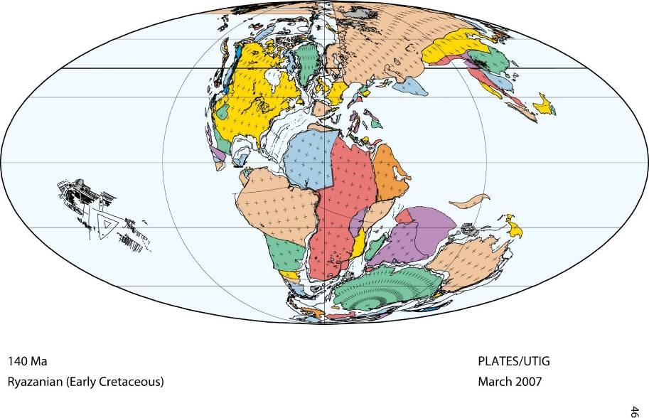
140 Ma

Slide 38
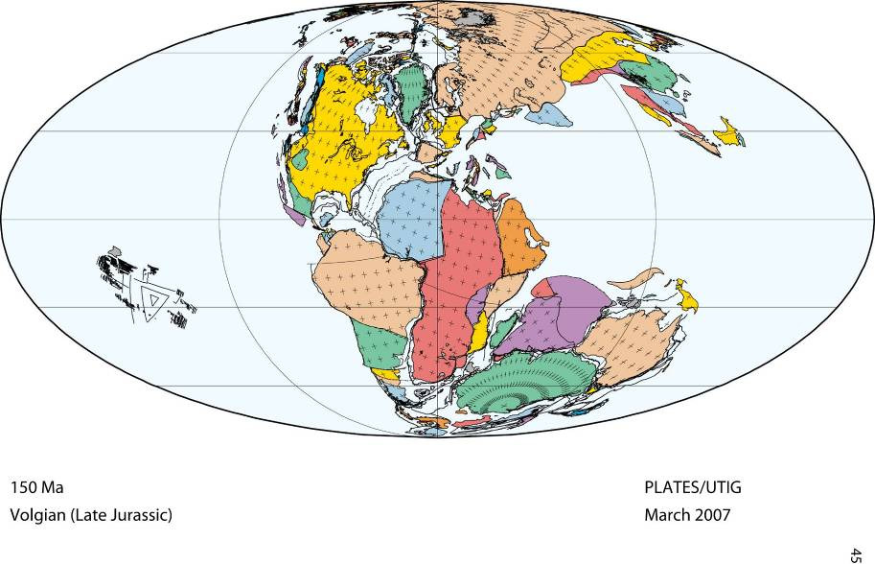
150 Ma

Slide 39
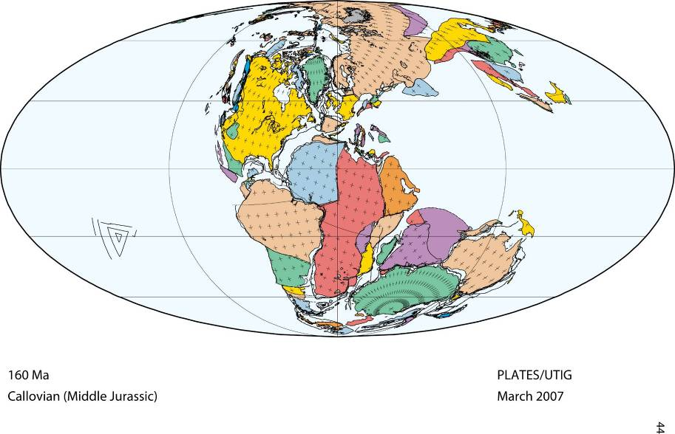
160 Ma

Slide 40
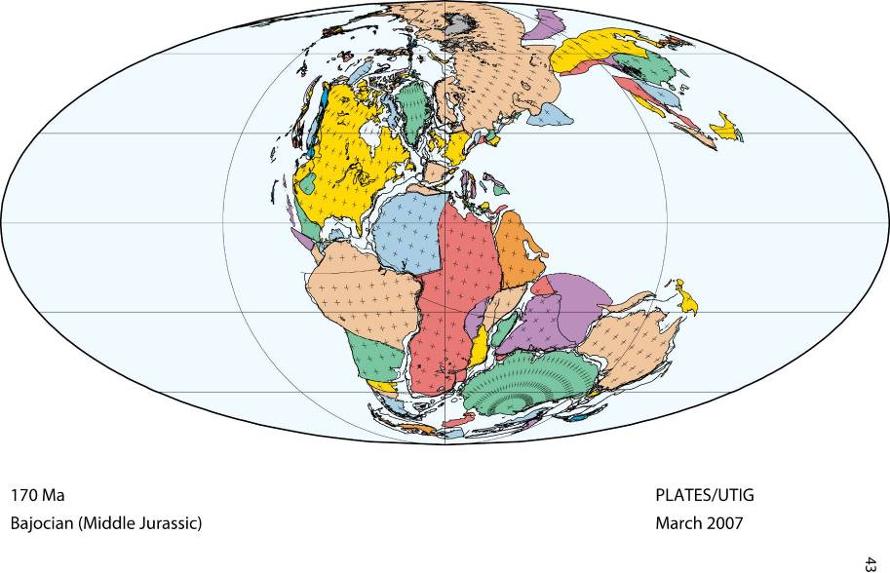
170 Ma

Slide 41
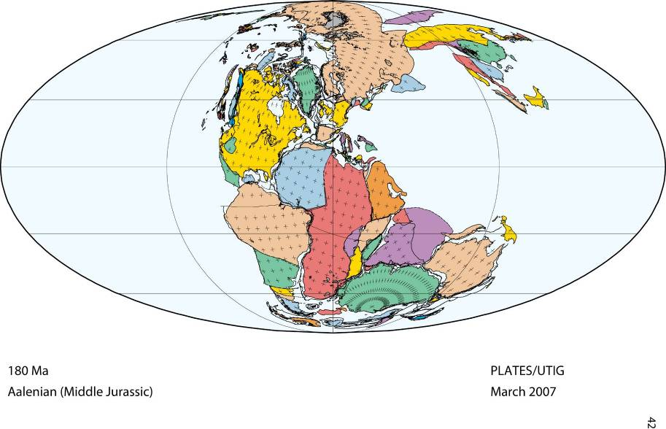
180 Ma

Slide 42
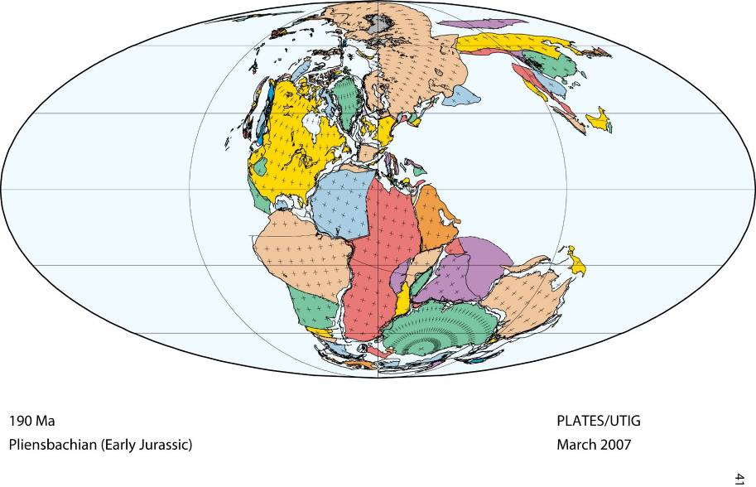
190 Ma

Slide 43
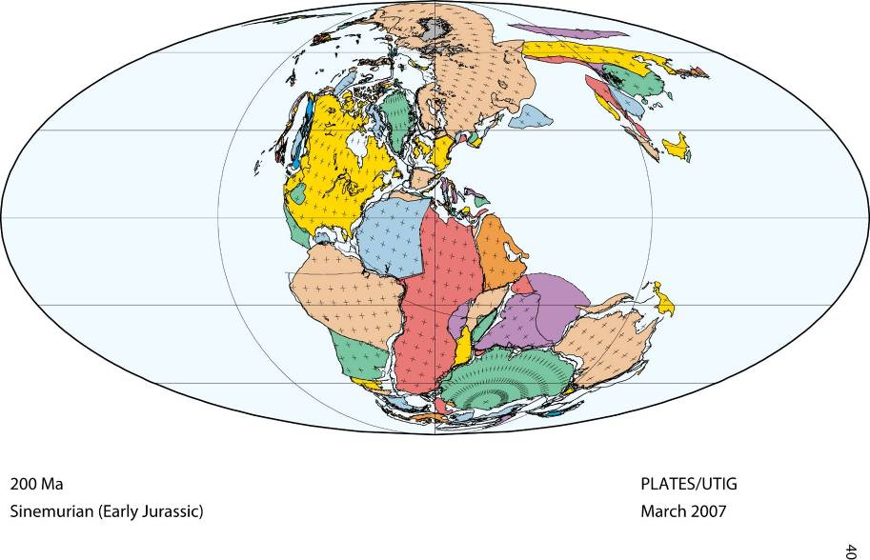
200 Ma

Slide 44
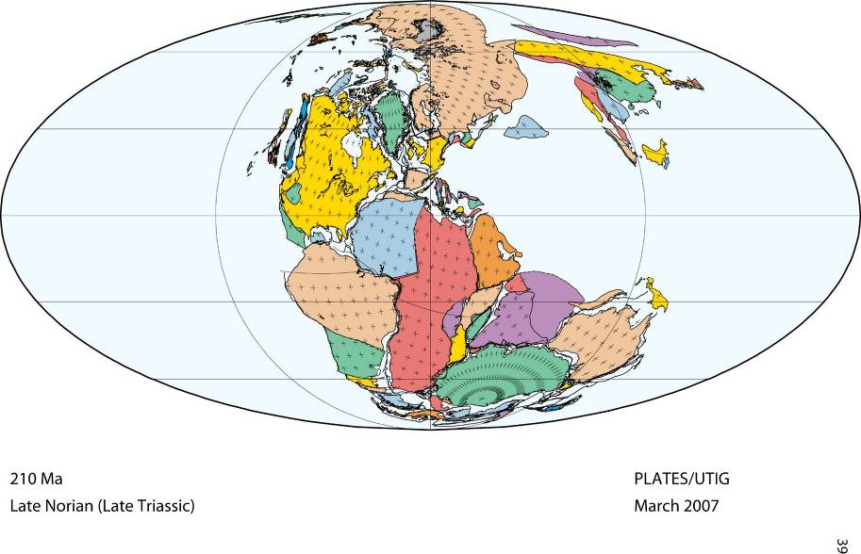
210 Ma

Slide 45
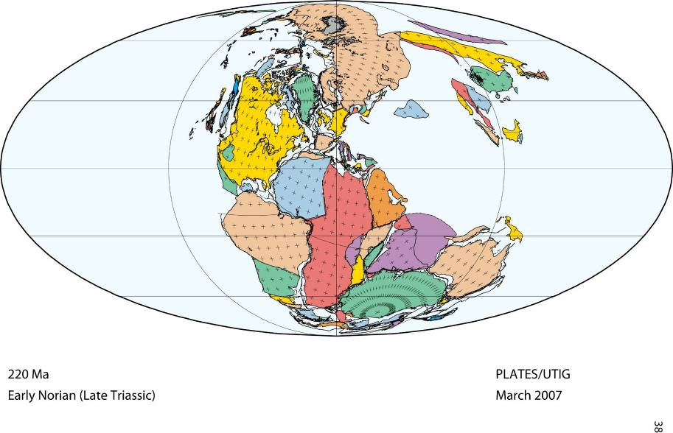
220 Ma

Slide 46
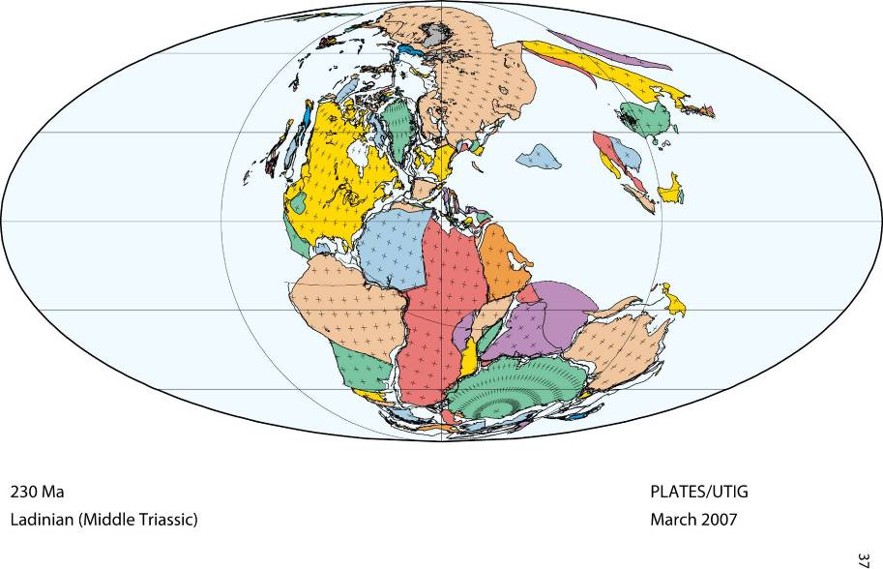
230 Ma

Slide 47

240 Ma

Slide 48
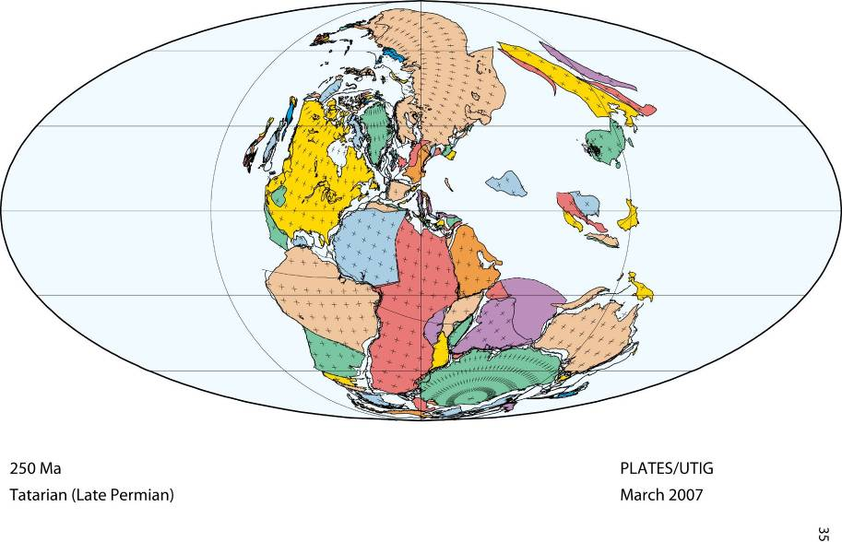
250 Ma

Slide 49
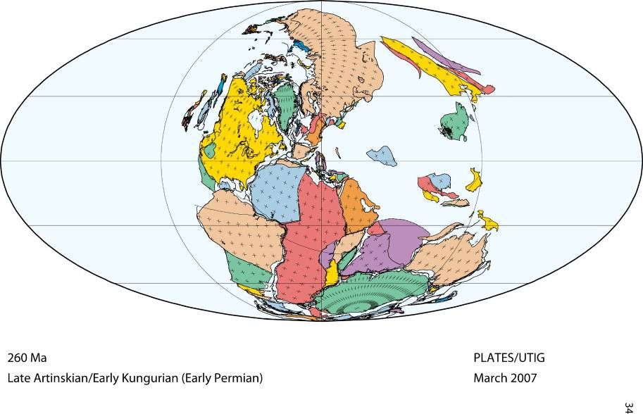
260 Ma

Slide 50
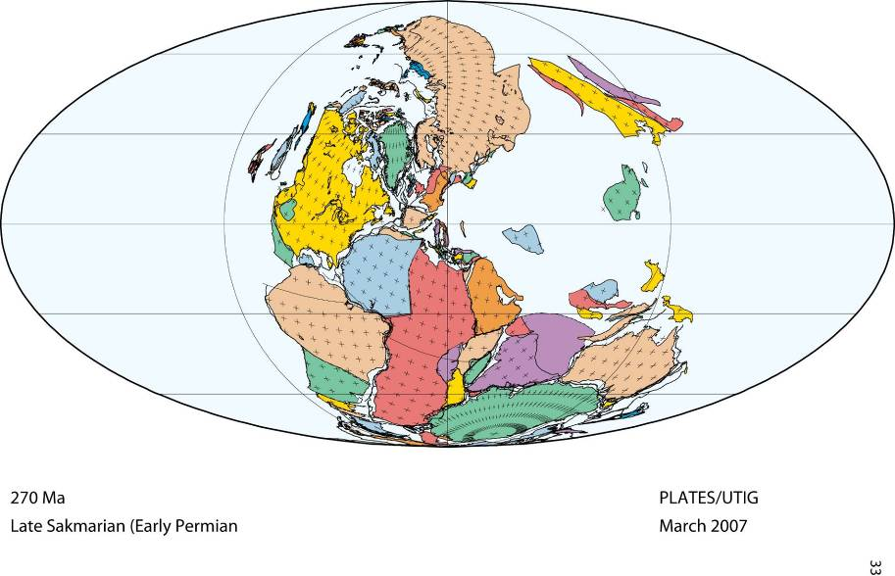
270 Ma

Slide 51
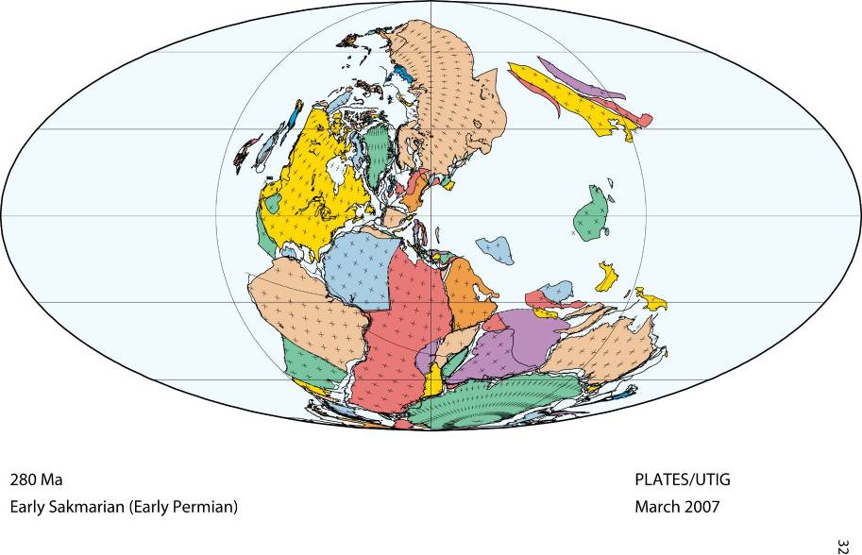
280 Ma

Slide 52
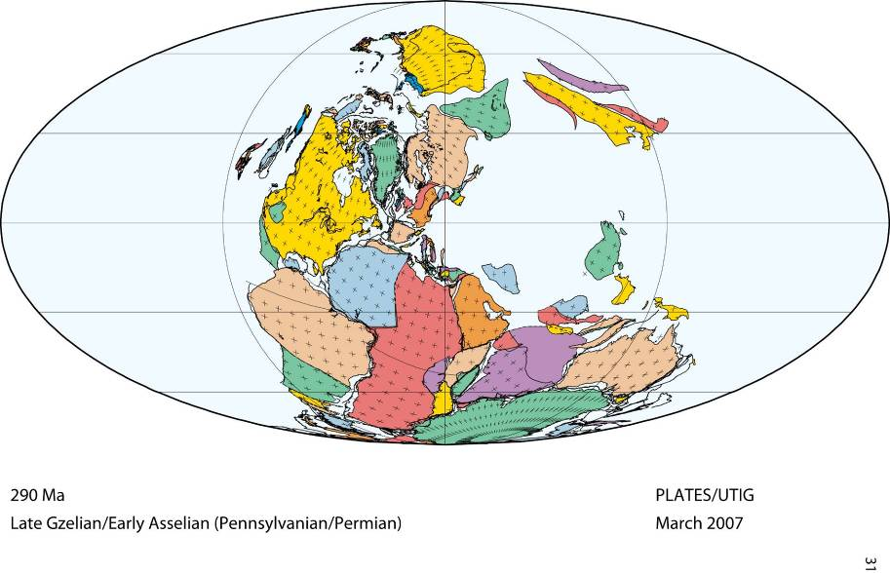
290 Ma

Slide 53
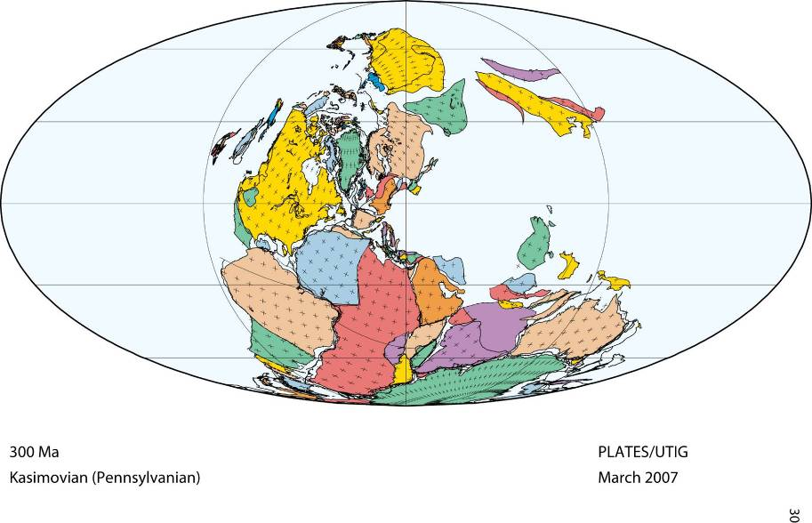
300 Ma

Slide 54
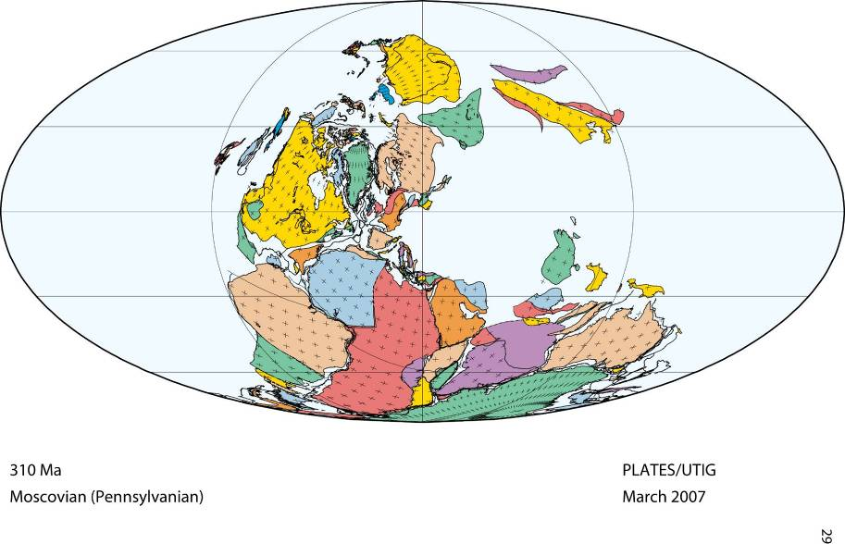
310 Ma

Slide 55
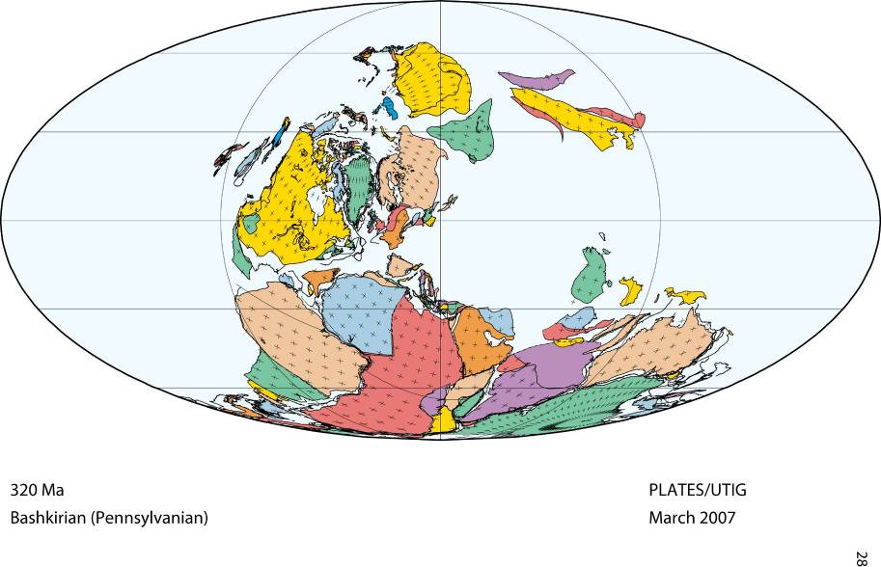
320 Ma

Slide 56
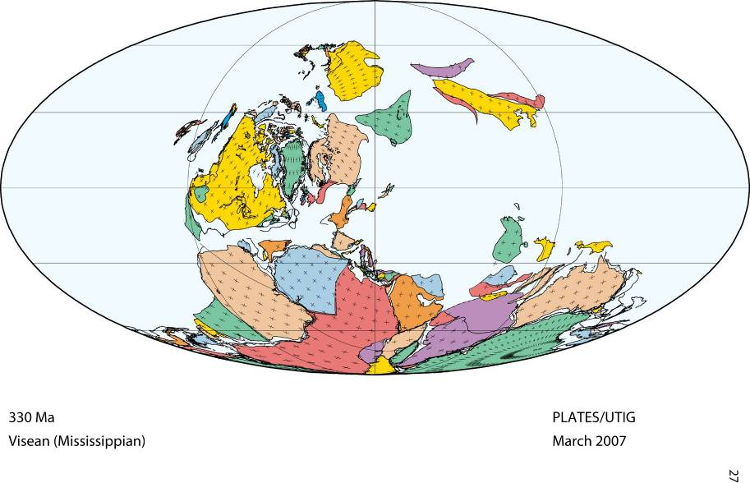
330 Ma

Slide 57
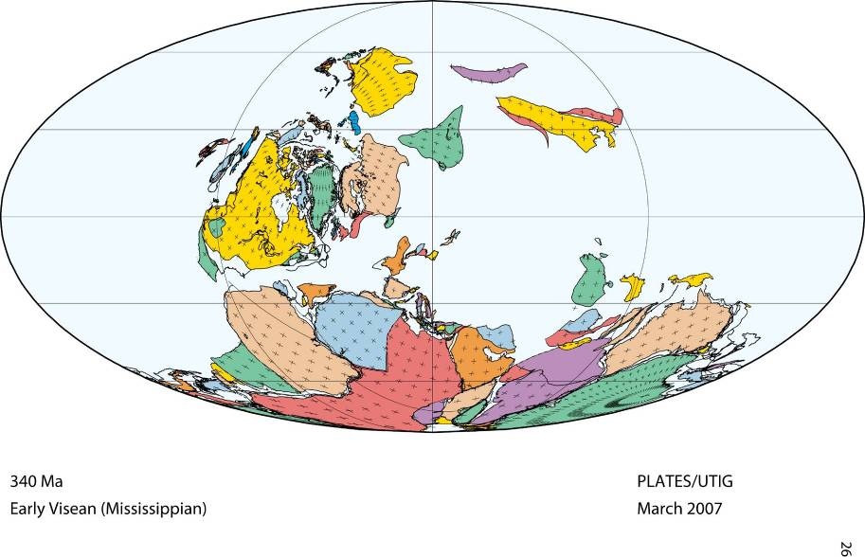
340 Ma

Slide 58
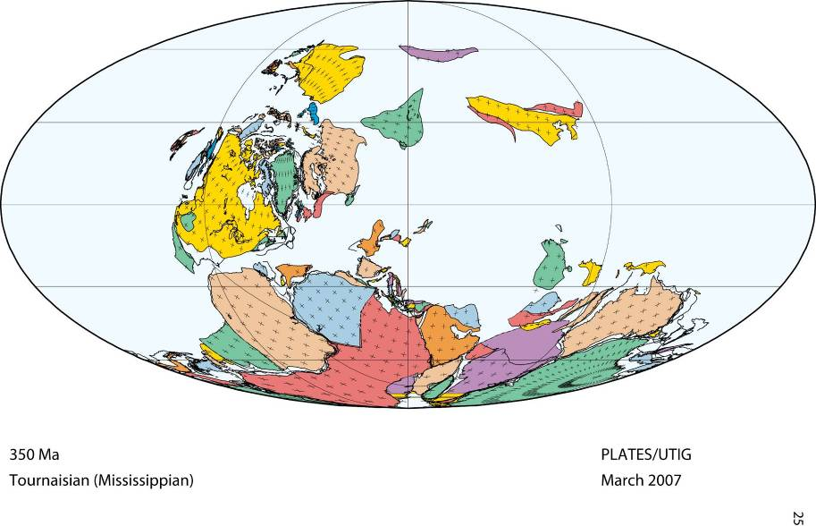
350 Ma

Slide 59
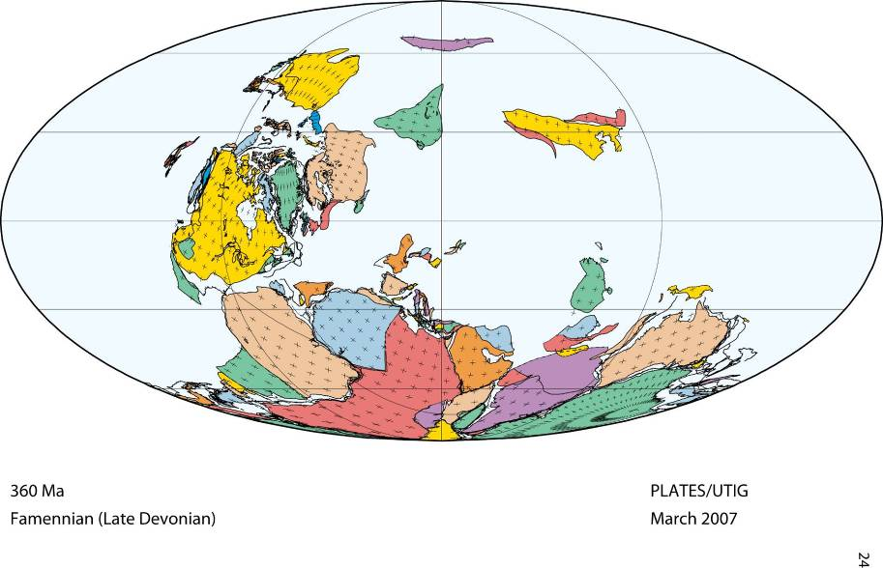
360 Ma

Slide 60
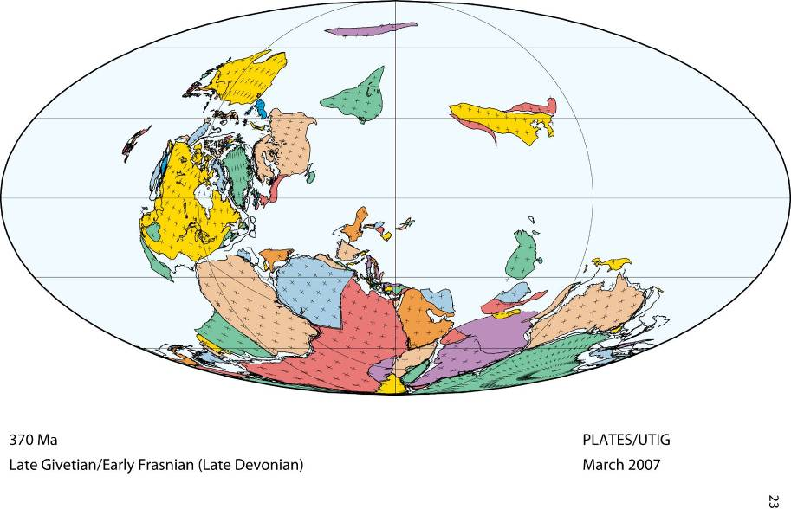
370 Ma

Slide 61
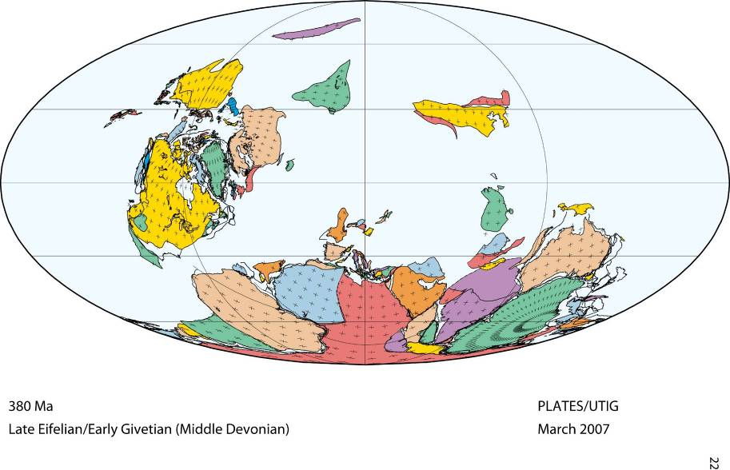
380 Ma

Slide 62
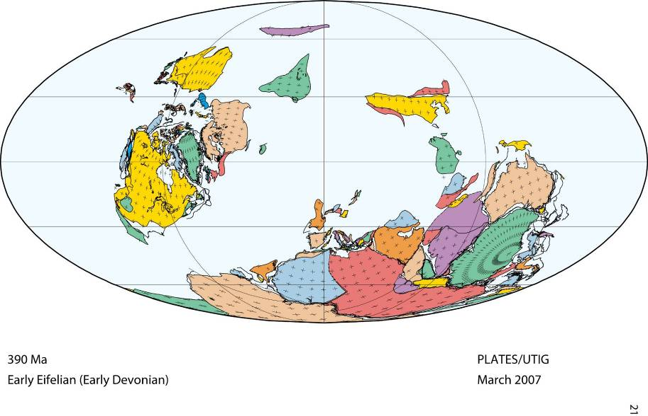
390 Ma

Slide 63
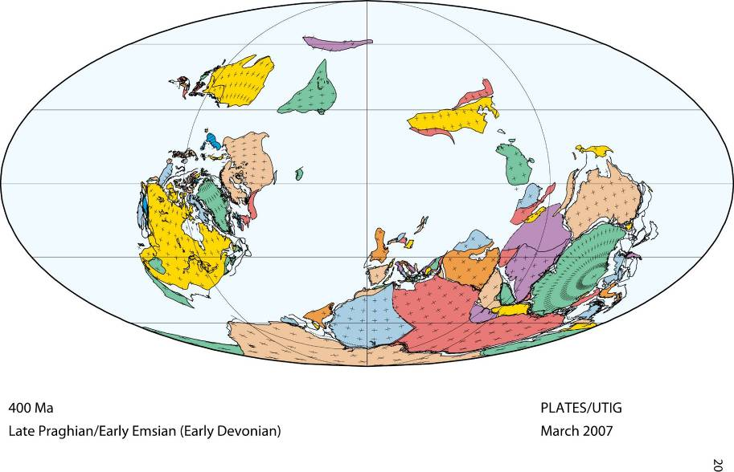
going FORWARD in time . . . .
400 Ma

Slide 64
going FORWARD in time . . . .
400 Ma

Slide 65
390 Ma

Slide 66
380 Ma

Slide 67
370 Ma

Slide 68
360 Ma

Slide 69
350 Ma

Slide 70
340 Ma

Slide 71
330 Ma

Slide 72
N.A.
micro-continent
Africa
320 Ma

Slide 73


What happens to the micro-continent?
N.A.
micro-continent
Africa
African Plate
320 Ma
North American Plate

Slide 74
What happens to the micro-continent?
North America
African Continent
micro-continent
African Plate
North American Plate

Slide 75
What happens to Africa?
What happens to the micro-continent?
It is welded onto North America!
North America
African Continent
micro-continent

Slide 76
What happens to Africa?
These are the Appalachian Mountains
290 million years ago
elevations as high as today’s Rocky Mts
. . . so weathering and erosion begin!
Africa collides with North America!
- forming the Supercontinent PANGEA
- ‘crumpling’ the land into mountains
320 Ma

Slide 77
https://en.wikipedia.org/wiki/Geology_of_the_Appalachians
https://en.wikipedia.org/wiki/Appalachian_Mountains
The Appalachian Mountains are a system of mountains in eastern North America. The Appalachians first formed roughly 480 million years ago during the Ordovician Period. It once reached elevations similar to those of the Alps and the Rocky Mountains before naturally occurring erosion. The Appalachian chain is a barrier to east-west travel, as it forms a series of alternating ridgelines and valleys oriented in opposition to most roads running east or west.
A look at rocks exposed in today's Appalachian mountains reveals elongated belts of folded and thrust faulted marine sedimentary rocks, volcanic rocks and slivers of ancient ocean floor, which provides strong evidence that these rocks were deformed during plate collision. The birth of the Appalachian ranges, some 480 Ma, marks the first of several mountain-building plate collisions that culminated in the construction of the supercontinent Pangaea with the Appalachians near the center. Because North America and Africa were connected, the Appalachians formed part of the same mountain chain as the Little Atlas in Morocco. This mountain range, known as the Central Pangean Mountains, extended into Scotland, from the North America/Europe collision (See Caledonian orogeny).
During the middle Ordovician Period (about 496–440 Ma), a change in plate motions set the stage for the first Paleozoic mountain-building event (Taconic orogeny) in North America. The once-quiet Appalachian passive margin changed to a very active plate boundary when a neighboring oceanic plate, the Iapetus, collided with and began sinking beneath the North American craton. With the birth of this new subduction zone, the early Appalachians were born. Along the continental margin, volcanoes grew, coincident with the initiation of subduction. Thrust faulting uplifted and warped older sedimentary rock laid down on the passive margin. As mountains rose, erosion began to wear them down. Streams carried rock debris down slope to be deposited in nearby lowlands. The Taconic Orogeny was just the first of a series of mountain building plate collisions that contributed to the formation of the Appalachians, culminating in the collision of North America and Africa (see Appalachian orogeny).
By the end of the Mesozoic era, the Appalachian Mountains had been eroded to an almost flat plain. It was not until the region was uplifted during the Cenozoic Era that the distinctive topography of the present formed. Uplift rejuvenated the streams, which rapidly responded by cutting downward into the ancient bedrock. Some streams flowed along weak layers that define the folds and faults created many millions of years earlier. Other streams downcut so rapidly that they cut right across the resistant folded rocks of the mountain core, carving canyons across rock layers and geologic structures.

Slide 78
https://en.wikipedia.org/wiki/Alleghanian_orogeny
The Alleghanian orogeny or Appalachian orogeny is one of the geological mountain-forming events that formed the Appalachian Mountains and Allegheny Mountains. The term and spelling Alleghany orogeny was originally proposed by H.P. Woodward in 1957.
The Alleghanian orogeny occurred approximately 325 million to 260 million years ago over at least five deformation events in the Carboniferous to Permian period. The orogeny was caused by Africa colliding with North America. At the time, these continents did not exist in their current forms: North America was part of the Euramerica super-continent, while Africa was part of Gondwana. This collision formed the super-continent Pangaea, which contained all major continental land masses. The collision provoked the orogeny: it exerted massive stress on what is today the Eastern Seaboard of North America, forming a wide and high mountain chain. Evidence for the Alleghanian orogeny stretches for many hundreds of miles on the surface from Alabama to New Jersey and can be traced further subsurface to the southwest. In the north, the Alleghanian deformation extends northeast to Newfoundland. Subsequent erosion wore down the mountain chain and spread sediments both to the east and to the west.
The immense region involved in the continental collision, the vast temporal length of the orogeny and the thickness of the pile of sediments and igneous rocks known to have been involved are evidence that at the peak of the mountain-building process, the Appalachians likely once reached elevations similar to those of the Alps and the Rocky Mountains before they were eroded.
As the continents collided, the rock material trapped in-between was crushed and forced upward. With nowhere to go, rocks along the eastern margin of the North American continent were shoved far inland (the same occurred in the opposite direction along the margin of the African continent, forming the Atlas Mountains of Morocco and the western Sahara). Close to the boundary between the colliding plates, tectonic stresses contributed to the metamorphism of the rock (i.e. the transformation of igneous and sedimentary rock into metamorphic rock).
The sedimentary rock in the eastern Appalachian Basin region was squeezed into great folds that ran perpendicular to the direction of forces. The greatest amount of deformation associated with the Alleghanian orogeny occurred in the Southern Appalachians (North Carolina, Tennessee, Virginia, and West Virginia). In that region, a series of great faults developed in addition to the folds. As the two continents collided, large belts of rock bounded by thrust faults piled one on top of another, shortening the crust along the eastern edge of North America in the North Carolina and Tennessee region by as much as 200 miles (320 km). The relative amount of deformation gradually diminishes as one travels northward. The fold belt extends northward through Pennsylvania and gradually fades in the vicinity of the New York border. The Kittatinny Mountains in northwestern New Jersey mark the Northeastern-most extension of the high ridges of the Valley and Ridge Province. The influence of Alleghanian deformation on the regions east of the Valley and Ridge Province must have been even more intense; however, there is little evidence preserved. Rocks of Mississippian, Pennsylvanian, and Permian age are missing along the Eastern Seaboard.
The mountains formed by the Alleghanian orogeny were once rugged and high, but in our time are now eroded into only a small remnant: the heavily-eroded hills of the Piedmont. Sediments that were carried eastward formed the coastal plain and part of the continental shelf. Thus, the coastal plain and Piedmont are largely the byproducts of erosion that took place from 150+ million years ago to the present.
Sediments that were carried westward formed the Allegheny and Cumberland Plateau, which in some areas are popularly called mountains, but are actually simply uplifted and eroded plateaus.
A portion of the Alleghanian mountain system departed with Africa when Pangaea broke up and the Atlantic Ocean began to form. Today, this forms the Anti-Atlas mountains of Morocco. The Anti-Atlas have been geologically uplifted in relatively recent times, and are today much more rugged than their Alleghanian relatives.

Slide 79
https://en.wikipedia.org/wiki/Pangaea
Pangea was a supercontinent that existed during the late Paleozoic and early Mesozoic eras. It assembled from earlier continental units approximately 300 million years ago, and it began to break apart about 175 million years ago. In contrast to the present Earth and its distribution of continental mass, much of Pangaea was in the southern hemisphere and surrounded by a superocean, Panthalassa. Pangaea was the last supercontinent to have existed and the first to be reconstructed by geologists.
Fossil evidence for Pangaea includes the presence of similar and identical species on continents that are now great distances apart. For example, fossils of the therapsid Lystrosaurus have been found in South Africa, India and Antarctica, alongside members of the Glossopteris flora, whose distribution would have ranged from the polar circle to the equator if the continents had been in their present position; similarly, the freshwater reptile Mesosaurus has been found in only localized regions of the coasts of Brazil and West Africa.
Additional evidence for Pangaea is found in the geology of adjacent continents, including matching geological trends between the eastern coast of South America and the western coast of Africa. The polar ice cap of the Carboniferous Period covered the southern end of Pangaea. Glacial deposits, specifically till, of the same age and structure are found on many separate continents which would have been together in the continent of Pangaea.
Paleomagnetic study of apparent polar wandering paths also support the theory of a supercontinent. Geologists can determine the movement of continental plates by examining the orientation of magnetic minerals in rocks; when rocks are formed, they take on the magnetic properties of the Earth and indicate in which direction the poles lie relative to the rock. Since the magnetic poles drift about the rotational pole with a period of only a few thousand years, measurements from numerous lavas spanning several thousand years are averaged to give an apparent mean polar position. Samples of sedimentary rock and intrusive igneous rock have magnetic orientations that are typically an average of the "secular variation" in the orientation of magnetic north because their remanent magnetizations are not acquired instantaneously. Magnetic differences between sample groups whose age varies by millions of years is due to a combination of true polar wander and the drifting of continents. The true polar wander component is identical for all samples, and can be removed, leaving geologists with the portion of this motion that shows continental drift and can be used to help reconstruct earlier continental positions.
The continuity of mountain chains provides further evidence for Pangaea. One example of this is the Appalachian Mountains chain which extends from the southeastern United States to the Caledonides of Ireland, Britain, Greenland, and Scandinavia.

Slide 80

The distribution of fossils across the continents is one line of evidence
pointing to the existence of Pangaea

Slide 82
310 Ma
PANGAEA SUPERCONTINENT
Notes:
http://www.britannica.com/place/Pangea
Pangea was surrounded by a global ocean called Panthalassa, and it was fully assembled by the Early Permian Period (some 299 million to 272 million years ago). The supercontinent began to break apart about 200 million years ago, during the Early Jurassic Period (201 million to 174 million years ago), eventually forming the modern continents and theAtlantic and Indian oceans.
The mechanism for the breakup of Pangea is now explained in terms of plate tectonics rather than Wegener’s outmoded concept of continental drift, which simply stated that Earth’s continents were once joined together into the supercontinent Pangea that lasted for most of geologic time. Plate tectonics states that Earth’s outer shell, or lithosphere, consists of large rigid plates that move apart atoceanic ridges, come together at subduction zones, or slip past one another along fault lines. The pattern of seafloor spreading indicates that Pangea did not break apart all at once but rather fragmented in distinct stages. Plate tectonics also postulates that the continents joined with one another and broke apart several times in Earth’s geologic history.
The first oceans formed from the breakup, some 180 million years ago, were the central Atlantic Oceanbetween northwestern Africa and North America and the southwestern Indian Ocean between Africa and Antarctica. The South Atlantic Ocean opened about 140 million years ago as Africa separated fromSouth America. About the same time, India separated from Antarctica and Australia, forming the central Indian Ocean. Finally, about 80 million years ago, North America separated from Europe, Australia began to rift away from Antarctica, and India broke away from Madagascar. India eventually collided with Eurasia approximately 50 million years ago, forming the Himalayas.
During Earth’s long history, there probably have been several Pangea-like supercontinents. The oldest of those supercontinents is called Rodinia and was formed during Precambrian time some one billion years ago. Another Pangea-like supercontinent, Pannotia, was assembled 600 million years ago, at the end of the Precambrian. Present-day plate motions are bringing the continents together once again. Africa has begun to collide with southern Europe, and the Australian Plate is now colliding withSoutheast Asia. Within the next 250 million years, Africa and the Americas will merge with Eurasia to form a supercontinent that approaches Pangean proportions.

Slide 83
300 Ma
PANGAEA SUPERCONTINENT

Slide 84
290 Ma
PANGAEA SUPERCONTINENT

Slide 85
280 Ma
PANGAEA SUPERCONTINENT

Slide 86
270 Ma
PANGAEA SUPERCONTINENT

Slide 87
260 Ma
PANGAEA SUPERCONTINENT

Slide 88
250 Ma
PANGAEA SUPERCONTINENT

Slide 89
240 Ma
PANGAEA SUPERCONTINENT

Slide 90
230 Ma
PANGAEA SUPERCONTINENT

Slide 91
220 Ma
PANGAEA SUPERCONTINENT

Slide 92
210 Ma
PANGAEA SUPERCONTINENT

Slide 93
200 Ma
PANGAEA SUPERCONTINENT

Slide 94
190 Ma
PANGAEA SUPERCONTINENT

Slide 95
180 Ma

Slide 96
170 Ma

Slide 97
160 Ma

Slide 98
150 Ma

Slide 99
140 Ma

Slide 100
130 Ma

Slide 101
120 Ma

Slide 102
110 Ma

Slide 103
100 Ma

Slide 104
090 Ma

Slide 105
080 Ma

Slide 106
070 Ma

Slide 107
060 Ma

Slide 108
050 Ma

Slide 109
040 Ma

Slide 110
030 Ma

Slide 111
020 Ma

Slide 112
010 Ma

Slide 113
000 Ma
present

Slide 114
PLATES
2006 Atlas of
Plate Reconstructions
(750 Ma to Present Day)
L.A. Lawver, I.W.D. Dalziel, & L.M. Gahagan
©2007, University of Texas Institute for Geophysics
000 Ma
present

Slide 115
PLATES
2006 Atlas of
Plate Reconstructions
(750 Ma to Present Day)
L.A. Lawver, I.W.D. Dalziel, & L.M. Gahagan
©2007, University of Texas Institute for Geophysics
Appalachian Mountains
Eastern Continental Divide
HEIGHT: 290Ma > 15,000 feet
Today < 7,000 feet
Loss of half the height: caused by
weathering & erosion!
Appalachian Mountains
Where does this weathered debris go?

Slide 116
https://en.wikipedia.org/wiki/Continental_divide
A continental divide is a drainage divide on a continent such that the drainage basin on one side of the divide feeds into one ocean or sea, and the basin on the other side either feeds into a different ocean or sea, or else is endorheic, not connected to the open sea.
The Eastern Continental Divide separates the watershed of the Gulf of Mexico from the Atlantic Ocean.
https://en.wikipedia.org/wiki/Eastern_Continental_Divide
The Eastern Continental Divide, in conjunction with other continental divides of North America, demarcates two watersheds of the Atlantic Ocean: the Gulf of Mexico watershed and the Atlantic Seaboard watershed.

Slide 117
Appalachian Mountains
Eastern Continental Divide
separates the water runoff
toward the Atlantic Ocean
or toward the Gulf of Mexico
Where does the weathering debris go?
Let’s look at the river watersheds off the Appalachians

Slide 118


Appalachian Mountains
Eastern Continental Divide
Ohio River
watershed
numerous short,
east flowing
watersheds
Let’s look at the river watersheds off the Appalachians

Slide 119
Appalachian Mountains
Eastern Continental Divide
The Ohio River . . .
from the
Appalachians
to the
American heartland
Let’s look at the river watersheds off the Appalachians

Slide 120
Appalachian Mountains
Session 2: The Corps Is Formed
Eastern Continental Divide
The United States
- Appalachian Mountains
- Ohio River
People, Cultures, & History
- Northwest Passage
- Louisiana Purchase
- The Corps is commissioned
The Ohio River . . .
from the
Appalachians
to the
American heartland
Let’s look at the river watersheds off the Appalachians

Slide 121

Session 2: The Corps Is Formed
Ohio River
The United States
- Appalachian Mountains
- Ohio River
People, Cultures, & History
- Northwest Passage
- Louisiana Purchase
- The Corps is commissioned
Ohio River

Slide 122
Ohio River
- TODAY
part of the Mississippi River watershed
from Canada to the Gulf of Mexico

Slide 123
https://en.wikipedia.org/wiki/Ohio_River
The Ohio River, which streams westward from Pittsburgh, Pennsylvania, to Cairo, Illinois, is the largest tributary, by volume, of the Mississippi River in the United States. At the confluence, the Ohio is considerably bigger than the Mississippi (Ohio at Cairo: 281,500 cu ft/s (7,960 m³/s); Mississippi at Thebes: 208,200 cu ft/s (5,897 m³/s)) and, thus, is hydrologically the main stream of the whole river system, including the Allegheny River further upstream.
The 981-mile (1,579 km) river flows through or along the border of six states, and its drainage basin includes parts of 15 states. Through its largest tributary, the Tennessee River, the basin includes many of the states of the southeastern U.S. It is the source of drinking water for three million people.
The river had great significance in the history of the Native Americans, as numerous civilizations formed along its valley. For thousands of years, Native Americans used the river as a major transportation and trading route. Its waters connected communities. In the five centuries before European conquest, the Mississippian culture built numerous regional chiefdoms and major earthwork mounds in the Ohio Valley, such as Angel Mounds near Evansville, Indiana, as well as in the Mississippi Valley and the Southeast. The Osage, Omaha, Ponca and Kaw lived in the Ohio Valley, but under pressure from the Iroquois to the northeast, migrated west of the Mississippi River to Missouri, Arkansas and Oklahoma in the 17th century.
In 1669, René-Robert Cavelier, Sieur de La Salle led a French expedition to the Ohio River, becoming the first Europeans to see it. After European-American settlement, the river served as a border between present-day Kentucky and Indian Territories. It was a primary transportation route for pioneers during the westward expansion of the early U.S.
During the 19th century, the river was the southern boundary of the Northwest Territory.
From a geological standpoint, the Ohio River is young. The river formed on a piecemeal basis beginning between 2.5 and 3 million years ago. The earliest ice ages occurred at this time and dammed portions of north-flowing rivers. The Teays River was the largest of these rivers. The modern Ohio River flows within segments of the ancient Teays. The ancient rivers were rearranged or consumed by glaciers and lakes.

Slide 124


Ohio River
Teays River
- 2.5 MYA??
- TODAY
It wasn’t there!
part of the Mississippi River watershed
from Canada to the Gulf of Mexico

Slide 125

https://en.wikipedia.org/wiki/Teays_River
The Teays River (ˈteɪz) was a major pre-glacial river that drained much of the present Ohio River watershed, but took a more northerly downstream course.
The Teays was comparable in size to the Ohio River. The River's headwaters were located near Blowing Rock, North Carolina and subsequently flowed through Virginia, West Virginia, Ohio, Indiana and Illinois.
The Teays River was a north- and northwest-flowing river existing before the last Ice Age – before 2.5 million years ago.
(During the last Ice Age starting about 3 million years ago) the ice sheet overrode the preglacial Teays creating ponds or glacial lakes. The back up of water diverted the upper basin over the surrounding divides into the preglacial Ohio River.
http://www.nytimes.com/1983/11/29/science/a-great-lost-river-gets-its-due.html
What finally killed the Teays River and gave birth to the Ohio River were the repeated southward advances of mile-thick ice sheets. For a time the ice dammed the Teays, forming what geologists now call Lake Tight, whose silty deposits cover much of Ohio.
After the ice reached its southern limit and began retreating, it unloaded its burden of rock, gravel, sand, clay and silt, leaving the landscape, including the Teays valley, buried under hundreds of feet of glacial ''drift.''
Torrents of water from the melting ice formed the Ohio River along what had been the ice's farthest southward advance.

Slide 126

https://i0.wp.com/academic.emporia.edu/aberjame/student/salley3/teays.jpg
https://markgelbart.wordpress.com/2015/05/15/glaciers-shaped-the-ohio-river
The ancient Teays River was a major regional drainage system during the Pliocene and early Pleistocene. The advance of glaciers during Pleistocene Ice Ages dammed this river, allowing a minor tributary of the Cumberland River to capture the stream flow. This small river became the mighty Ohio.

Slide 127

Ohio River
Teays River
- 2.5 MYA??

Slide 128
Ohio River
Teays River
- 2.5 MYA??
Watersheds into Hudson Bay
& Gulf of St Lawrence
no rivers from
the northwest
into Mississippi
River watershed
Ancestral
Mississippi River
watershed
So, what happened?

Slide 129


Ohio River
Teays River
- 2.5 MYA
Quaternary Glaciation, starting ~
So, what happened?

Slide 130
https://markgelbart.wordpress.com/2015/05/15/glaciers-shaped-the-ohio-river/
Weak Ice Ages began occurring as early as 5 million years ago. Gradually, they became more severe. 1.4 million years ago, for the first time, glaciers advanced through valleys incised by the Erigan River drainage. This river system flowed through the present day sites of the Great Lakes which didn’t exist yet. The Laurentide ice sheet obliterated the Erigan River system and advanced beyond another major, now extinct, river–the Teays. The Teays River began in the North Carolina mountains and flowed in a northwesterly direction through what today is Virginia, West Virginia, Ohio, Indiana, and Illinois before emptying into the Mississippi River. Glaciers formed a dam, blocking the northwesterly flow of the Teays River and creating the massive Lake Tight, a 7000 square mile body of water as deep as 800 feet in some spots. Lake Tight must have been quite a sight–gray gravel and ice on the northwestern side and green boreal forests of spruce, pine, and northern hardwoods on the southeastern shore. Many species of fish lived in the water, attracting great flocks of gulls; and it was a summer destination for duck, goose, and swan. The churning waters spawned big waves like those of an ocean rather than a lake. Overflow from the lake was captured by a minor tributary of the Cumberland River. The ice forced the water to erode backward into bedrock, lengthening this tributary. This large creek/small river became the mighty Ohio river. When the glacier retreated, the ice dam melted, releasing an incredible quantity of water into the Ohio river and incising a deeper valley toward its outlet, the Mississippi River.
Subsequent glacial advances during Ice Ages over the past 1.4 million years have had a major influence on the shape of the Ohio River. The southern lobe of the Laurentide ice sheet frequently advanced far enough south to push sediment into the northern part of the Ohio River, damming tributaries and creating an extensive network of lakes. During glacial maximums there were always a chain of lakes along the Ohio border with West Virginia and Kentucky. The Illinois Ice Age was 1 of the most severe. It lasted from ~240,000 BP-~135,000 BP. The Laurentide ice sheet advanced as far south as northern Kentucky–its greatest extent ever. This backed up lakes from the present day site of Louisville to the Pennsylvania border, forcing water into the Ohio River headwaters and incising 45 feet of bedrock.
Though the Wisconsin Ice Age (~114,000 BP-~11,000 BP) was not as severe as the previous glacial advance, the Ohio River valley was frequently incised by pulses of glacial meltwater. A recent study of river sediment found that changes in the Ohio River were closely correlated with global climate change. Warmer climate phases within the Ice Age were associated with greater incising and erosion, resulting from melting ice and large water discharge. Colder climate phases and lower water discharge caused greater sediment build-up, known as aggradation.
Today, the Teays River valley is mostly hidden by sediment, but its descendent is clearly visible on maps. Government officials used the Ohio River as a convenient demarcation to draw up borders between states. Imagine how different a modern day map of the United States would look, if there had been no Ice Ages, and accordingly, no Ohio River worth noting.

Slide 131
Glacial melt water formed new river pathways
Quaternary glaciation, starting ~
- 2.5 MYA
A river route from the Appalachians to the Northwest
Today’s
Mississippi River
watershed

Slide 132
Glacial melt water formed new river pathways
What happened to the Teays River?
A river route from the Appalachians to the Northwest

Slide 133

Ohio River
What happened to the Teays River?
Ohio
Penn
Illnois
Indiana
Lake Tight
WV
MO
Ohio River
Kentucky
VA

Slide 134
https://en.wikipedia.org/wiki/Lake_Tight
Lake Tight's origins date to nearly 2 million years before the modern era. As the Ice Age began to cool the Earth, and large glaciers began to creep south from modern-day Canada, many landforms and features were changed or destroyed, including the Teays River.
The Teays had been a river for several million years, flowing north out of the Appalachian Mountains in what is now North Carolina. The river's path traveled through modern-day West Virginia, Kentucky, Ohio, Indiana, and Illinois, finally emptying into the Gulf of Mexico, which at the time extended to southern Illinois. The glaciers of the Ice Age soon began to block the Teays, effectively damming the river and forming Lake Tight, near what is now Chillicothe, Ohio.
The lake has been the repeated topic of research over the past 100 plus years. In geologic terms, the lake's life span was short; the lake appears to have formed in the Lower or Middle Pleistocene. The reverse polarity of the clays points to an age greater than 700 ka, thus Pre-Illinoian. At its greatest size, the lake was approximately 900 feet (270 m) deep, and 7,000 square miles (18,000 km²) in size (nearly two-thirds the size of Lake Erie). When the lake finally overflowed, it created new drainage channels and rivers flowing south, in the opposite direction of the Teays River.
A recent study in 2014 using Geographic Information System (GIS) Technologies, has redefined the extent of Proglacial Lake Tight.^{[3]} Using National Elevation Datasets (NEDs) from the USGS, the author incorporated the 275-meter (902-foot) contour elevations into a GIS, spatially correlated the contours with Ohio Department of Natural Resources' GIS glacial, geologic, and topographic datasets, and developed a revised lake boundary that shows the areal extent of Proglacial Lake Tight was approximately 40% larger than has been previously estimated. This revised boundary shows that Lake Tight was as large as Lake Erie at its greatest extent.

Slide 135


Slide 136
Why are the Appalachians & Ohio River important?
Ohio River
Ohio River

Slide 137
Why are the Appalachians & Ohio River important?
Appalachian Mountains
  barrier to westward migration
  few & difficult mountain passes
Rivers east of Appalachians
  short, east-flowing to Atlantic Ocean
  barrier to north-south travel
Ohio River flowing west from Appalachians
  river access to Mississippi River
  travel/transport route for:
      native Americans
      European settlers
      Corps of Discovery

Slide 138
Why are the Appalachians & Ohio River important?
Session 2: The Corps Is Formed
Northwest Passage
Appalachian Mountains
  barrier to westward migration
  few & difficult mountain passes
The United States
- Appalachian Mountains
- Ohio River
People, Cultures, & History
- Northwest Passage
- Louisiana Purchase
- The Corps is commissioned
Rivers east of Appalachians
  short, east-flowing to Atlantic Ocean
  barrier to north-south travel
Northwest Passage
Ohio River flowing west from Appalachians
  river access to Mississippi River
  travel/transport route for:
      native Americans
      European settlers
      Corps of Discovery

Slide 139

Northwest Passage
“A practical route
from the Atlantic seaboard
to the Pacific Ocean,
shortening the trade route
between Europe and the Far East.”
Gaining . . .
riches from the Orient
a market for European goods

Slide 140
http://www.history.org/foundation/journal/winter08/passage.cfm
Throughout the eighteenth century, explorers from Great Britain, Denmark, France, and Russia tried and failed to find the Northwest Passage, that is, a practical route from the Atlantic seaboard of America to the Pacific that would shorten the trade route between Europe and the Far East.
For at least four centuries, finding the Northwest Passage was a dream like finding the golden fleece, the Holy Grail, the fountain of youth, and cities of gold. Uncovering a route from Europe to the Far East by sailing west inspired explorers, churchmen, businessmen, and governments seeking an easier path to glory, converts, goods, and power.
The lure of the passage was that it offered a means “of getting the riches of the Orient for the markets of western Europe” and vice versa, said historian James Ronda. The western route seemed to guarantee “wealth and imperial power. Those are strong motives and enormously influential forces.”
In the late fifteenth century, the search motivated such navigators as Christopher Columbus and John Cabot. Cabot was attempting to find a simple way to the East when he ran into a 3,000-mile-wide obstacle: North America. The sixteenth and seventeenth centuries saw efforts by Martin Frobisher, Francis Drake, John Davis, Henry Hudson, William Baffin, and others who probed the eastern and western edges of the New World to find a waterway that connected the oceans.
In the 1700s, adventurers, scientists, and military leaders had a couple of notions of what the passage was, John Allen said. “By the 1770s, it evolved into a configuration which includes either a large lake or inland sea in the middle of the continent, or a large river navigable to the interior,” where a pyramidal rise in the land would lead to another river rushing to the Pacific. With that notion and others in their minds, eighteenth-century explorers headed into terra incognita:
In 1753, the Pennsylvania Gazette reported that Captain Charles Swaine had returned from his search for the passage with the news that “there is no communication with Hudson’s Bay through Labrador where one had here to fore imagined.”
In 1778, Captain James Cook was ordered to “explore such rivers or inlets as may appear to be of a considerable extent and pointing towards Hudson Bay or Baffin Bay.”
In 1789, Alexander Mackenzie set off on a trek across Canada in an attempt to find a combination of rivers, straits, and other waterways that would unlock the doors to Asia. He failed, but he did not give up.
In 1781, J. Carver wrote in Travels through the Interior Parts of North America in the Years 1766, 1767, and 1768 that “a Northwest Passage, or a communication between Hudson’s Bay and the Pacific Ocean” could be found and result in “many useful discoveries.”
In 1793, Mackenzie made it to the Pacific with a handful of Indian guides and fellow voyageurs. He painted his name on a rock to prove his arrival, but he had proved something else: how torturous the journey was, involving many portages and much walking, impediments to swift trade.
The Founding Fathers were not immune to passage-mania. George Washington believed that the Potomac, which flowed past Mount Vernon, was the beginning of a series of rivers that would transport goods a long distance. Thomas Jefferson told James Madison that “the Ohio, and its branches which head up against the Patowmac, affords the shortest water communication by 500 miles of any which can ever be got between the Western waters and Atlantic.” Jefferson had a long-standing curiosity about the western expanses that began at Virginia’s border, a curiosity perhaps inherited from his father, Peter, who had surveyed the Old Dominion’s interior and sought land grants beyond the Allegheny Mountains. In 1793, the year Mackenzie moved toward the setting sun, Jefferson financially supported a French botanist’s plan, eventually aborted, to “find the shortest & most convenient route of communication between the U.S. & the Pacific Ocean.”
As the eighteenth century gave way to the nineteenth, President Jefferson launched a search for the passage by commissioning Meriwether Lewis and William Clark and their Corps of Discovery to walk, ride, portage, row, and sail from the middle of the United States to the Pacific and back. The purpose of the expedition, Jefferson wrote, was "to explore the Missouri River, and such principal streams of it, as, by its course and communication with the waters of the Pacific Ocean, whether the Columbia, Oregan, Colrado, or any other river, may offer the most direct and practicable water-communication across the continent, for the purposes of commerce."
For all of its successes in charting rivers, establishing contacts with Native Americans, chronicling flora and fauna, and reaching the Pacific, the expedition failed in its main goal. With the jagged, jutting Rockies blocking the way and meandering, rapids-riddled rivers not connecting with one another, Lewis and Clark did not find a simple way to get across the continent.

Slide 141
Search for
Northwest Passage
Spain
England
France
John Davis
Baffin Island
1610 Henry Hudson Hudson bay
1576 Martin Frobisher – Hudson Strait
1534 Jacques Cartier – Gulf of St Lawrence
1497 John Cabot - Newfoundland
1603 de Champlain - Great Lakes
1542
Juan Cabillo -
west coast
1524 G. Verrazzano – East Coast
1579 Francis Drake – west coast
1539
Hernan Cortez –
Baja California
1492 Christopher Columbus
Caribbean

Slide 142
EARLY EXPLORERS
Christopher Columbus (Sp) – 1492 – Caribbean
John Cabot (Eng) – 1497 – Newfoundland
Giovanni da Verrazzano (Fr) – 1524 – east coast, Fl to New Brunswick
Jacques Cartier (Fr) – 1534 – Newfoundland, Gulf St Law
Hernan Cortez (Sp) – 1539 – Baja California
Juan Cabillo (Sp) - 1542 – west coast north to Oregon
Martin Frobisher (En) – 1576 – Baffin Island, Hudson Strait
Francis Drake (En) – 1579 – Oregon from south, 1585 – Fl and Virginia
Samuel de Champlain (Fr) – 1603 – Great Lakes
Henry Hudson (En) – 1610 – Hudson Bay
Although it wasn't until 1579 that the west coast of North America was visited by an English explorer, the privateer Sir Francis Drake who landed north of today's San Francisco and claimed the area for England, calling it "New Albion" or New England, the English claim to this territory dates back to John Cabot's landing on Americas. The officially-accepted location for Drake's landing is at Drake's Estero (also known as "Drakes Bay," just north of San Francisco, in Marin County). Despite the facts that no permanent settlements were ever established by Drake, and that the next official visit by the British would be some two hundred years later, Drake's action and Cabot's original claim in 1497 were the foundations of British claims to portions of the west coast of North America in the late 18th century. One of the most important consequences of these claims is that charters for the British colonies on the Atlantic coast went from sea to sea, and this was the foundation of the US claim to its current territory.

Slide 143

Search for
Spain
England
France
Northwest Passage
England
France
1670
1608
coureurs
des bois
Samuel de Champlain lands in Quebec:
- French woodmen begin trading with indians
- trade expands thru St Lawrence R. watershed

Slide 144
https://en.wikipedia.org/wiki/Exploration_of_North_America
European exploration of western Canada was largely motivated by the fur trade and the search for the elusive Northwest Passage. Hudson's Bay Company explorer Henry Kelsey has the distinction of being the first European to see the northern Great Plains in 1690.
Anthony Henday was the first to have seen the Rocky Mountains, in 1754, but curiously did not mention it in his journals. From his westernmost geographic position (roughly near the town of Olds, Alberta, halfway between Calgary and the Rockies should have been quite conspicuous, but he was likely trying to disguise the disappointing fact that an unknown range of seemingly impassible mountains now stood between the HBC and the Pacific. Samuel Hearne found the Coppermine River in 1769-71 in his failed search for copper ore deposits. Burned by these shortfalls, the HBC largely quit exploration.
The North West Company, on the other hand, used a business model that required constant expansion into untapped areas. Under the auspices of the NWC, Alexander Mackenzie discovered the Mackenzie River in 1789 and was the first European to reach the North-American Pacific overland, via the Bella Coola River, in 1793. Simon Fraser reached the Pacific in 1808 via the Fraser River.
David Thompson, widely regarded as the greatest land geographer that ever lived, traveled over 90,000 km during his lifetime. In 1797, Thompson was sent south by his employers to survey part of the Canada-U.S. boundary along the water routes from Lake Superior to Lake of the Woods to satisfy unresolved questions of territory arising from the Jay Treaty between Great Britain and the United States. By 1798 Thompson had completed a survey of 6,750 km (4,190 mi) from Grand Portage, through Lake Winnipeg, to the headwaters of the Assiniboine and Mississippi Rivers, as well as two sides of Lake Superior. In 1798, the company sent him to Red Deer Lake (in present-day Alberta) to establish a trading post. The English translation of Lac La Biche-Red Deer Lake-first appeared on the Mackenzie map of 1793.^{[5]} Thompson spent the next few seasons trading based in Fort George (now in Alberta), and during this time led several expeditions into the Rocky Mountais. In 1811/1812 he followed the Columbia River to the Pacific, and in 1814 used his notes and measurements to draft the first European-style map of western Canada, covering 3.9 million square kilometres.

Slide 145
Search for
Northwest Passage
1670
England
Hudson’s Bay
Company
quick delivery of trade furs to Europe
coureurs
des bois
English Royal Charter incorporates a new company:
- de facto government of north-central N.A.
- monopoly for trade in Hudson Bay watershed
- explorers/traders travel area for Northwest P.
- quick delivery of trade furs to Europe

Slide 146
https://en.wikipedia.org/wiki/Hudson%27s_Bay_Company
The company was incorporated by English royal charter in 1670 as The Governor and Company of Adventurers of England trading into Hudson's Bay and functioned as the de facto government in parts of North America before European states and later the United States laid claim to some of those territories. It was once the world's largest landowner, with the area of the Hudson Bay watershed, known as Rupert's Land, having 15% of North American acreage. From its long-time headquarters at York Factory on Hudson Bay, the company controlled the fur trade throughout much of the English and later British controlled North America for several centuries. Undertaking early exploration, its traders and trappers forged relationships with many groups of aboriginal peoples. Its network of trading posts formed the nucleus for later official authority in many areas of Western Canada and the United States. In the late 19th century, with its signing of the Deed of Surrender, its vast territory became the largest portion of the newly formed Dominion of Canada, in which the company was the largest private landowner.
The Governor and Company of Adventurers of England Trading into Hudson's Bay was incorporated on 2 May 1670, with a royal charter from King Charles II.[The charter granted the company a monopoly over the region drained by all rivers and streams flowing into Hudson Bay in northern Canada. The area gained the name "Rupert's Land" after Prince Rupert, the first governor of the company appointed by the King. This drainage basin of Hudson Bay constitutes 1.5 million square miles (3.9×10⁶ km²), comprising over one-third of the area of modern-day Canada and stretches into the present-day north-central United States. The specific boundaries were unknown at the time. Rupert's Land would eventually become Canada's largest land "purchase" in the 19th century.
The HBC established six posts between 1668 and 1717. Rupert House (1668, southeast), Moose Factory (1673, south) and Fort Albany, Ontario (1679, west) were erected on James Bay; three other posts were established on the western shore of Hudson Bay proper: Fort Severn (1689), York Factory (1684) and Fort Churchill (1717). Inland posts were not built until 1774. After 1774, York Factory became the main post because of its convenient access to the vast interior waterway systems of the Saskatchewan and Red rivers. Called "factories" (because the "factor," i.e., a person acting as a mercantile agent did business from there), these posts operated in the manner of the Dutch fur trading operations in New Netherland adoption of Standard of Trade in the 18th century, the HBC ensured consistent pricing throughout Rupert's Land. A means of exchange arose based on the Made Beaver (MB); a prime pelt, worn for a year and ready for processing: "the prices of all trade goods were set in values of Made Beaver (MB) with other animal pelts, such as squirrel, otter and moose quoted in their MB (made beaver) equivalents. For example, two otter pelts might equal 1 MB".
During the fall and winter, First Nations men and European trappers did the vast majority of the animal trapping and pelt preparation. They travelled by canoe and on foot to the forts to sell their pelts. In exchange they typically received popular trade goods such as knives, kettles, beads, needles, and the Hudson's Bay point blanket. The arrival of the First Nations trappers was one of the high points of the year, met with pomp and circumstance. The highlight was very formal, an almost ritualized "Trading Ceremony" between the Chief Trader and the Captain of the aboriginal contingent who traded on their behalf. During the initial years of the fur trade, prices for items varied from post to post.
In its trade with native peoples, Hudson's Bay Company exchanged wool blankets, called Hudson's Bay point blankets, for the beaver pelts trapped by aboriginal hunters. By 1700, point blankets accounted for over 60% of the trade. The number of indigo stripes (a.k.a. points) woven into the blankets identified its finished size. A long-held misconception is that the number of stripes is related to its value in beaver pelts.
In 1779, the North West Company (NWC) was founded in Montreal as a seasonal partnership to provide more capital and to continue competing with the HBC. It became operative for the outfit of 1780 and was the first joint stock company in Canada and possibly North America. The agreement lasted one year. A second agreement established in 1780 had a three-year term. The company became a permanent entity in 1783. By 1784, the NWC had begun to make serious inroads into the HBC's profits
In 1821, the North West Company of Montreal and Hudson's Bay Company were forcibly merged by intervention of the British government to put an end to often-violent competition. 175 posts, 68 of them the HBC's, were reduced to 52 for efficiency and because many were redundant as a result of the rivalry and were inherently unprofitable. Their combined territory was extended by a licence to the North-Western Territory, which reached to the Arctic Ocean in the north and, with the creation of the Columbia Department in the Pacific Northwest, to the Pacific Ocean in the west. The NWC's regional headquarters at Fort George (Fort Astoria) was relocated to Fort Vancouver, which became the HBC base of operations on the Pacific Slope.

Slide 147

Search for
Northwest Passage
York Factory
Hudson’s Bay
Company
quick delivery of trade furs to Europe
coureurs
des bois

Slide 148


https://en.wikipedia.org/wiki/York_Factory
York Factory was a settlement and Hudson's Bay Company (HBC) factory (trading post) located on the southwestern shore of Hudson Bay in northeastern Manitoba, Canada at the mouth of the Hayes River, approximately 200 kilometres (120 mi) south-southeast of Churchill. York Factory was one of the first fur-trading posts established by the HBC, built in 1684 and used in that business for more than 270 years.
https://en.wikipedia.org/wiki/Prince_of_Wales_Fort
This fort began as a log fort built in 1717 by James Knight of the Hudson's Bay Company and was originally called the "Churchill River Post". In 1719, the post was renamed Prince of Wales Fort, but is more commonly known today as Fort Prince of Wales. It was located on the west bank of the Churchill river to protect and control the Hudson's Bay Company's interests in the fur trade.
The original wooden fort was replaced by a massive stone fort, perhaps to abide by the Royal Charter which required that Rupert's Land should be fortified. Construction of this fort, a structure still standing today, was started in 1731 near what was then called Eskimo Point. It was in the form of a square, with sides 100 metres long and walls six metres tall and 10 metres thick at the base.^{[3]}It had forty-two cannons mounted on the walls. There was also a battery across the river on Cape Merry meant to hold six more cannons. Work on the fort continued almost without break until 1771, but it was never truly completed.

Slide 149
Search for
Northwest Passage
York Factory
Hudson’s Bay
Company
quick delivery of trade furs to Europe
coureurs
des bois
1763: France cedes territory to England:

Slide 150
Search for
Northwest Passage
North West
Company
Hudson’s Bay
Company
1779
?
coureurs
des bois
1763: France cedes territory to England:
- new trading company forms
- headquarters in Montreal
- exploring & trading outside boundaries of HBC
- product delivery to Europe is arduous!

Slide 151
https://en.wikipedia.org/wiki/North_West_Company
The North West Company was a fur trading business headquartered in Montreal from 1779 to 1821. It competed with increasing success against the Hudson's Bay Company in what is present-day Western Canada. With great wealth at stake, tensions between the companies increased to the point where several minor armed skirmishes broke out, and the two companies were forced to merge.
After the French landed in Quebec in 1608, coureurs des bois (wood runners) spread out and built a fur trade empire in the St. Lawrence basin. The French competed with the Dutch (from 1614) and English (1664) in New York and the English in Hudson Bay (1670). Unlike the French who travelled into the northern interior, the English were based at trading posts on Hudson Bay. After 1731, La Vérendrye pushed trade west beyond Lake Winnipeg. After the British conquest in 1763, management of the fur trading posts was taken over by English-speakers. These so-called "pedlars" began to merge because competition cost them money and because of the high costs of outfitting canoes to the far west.
There are historical references to a North West Company, as early as 1770, involving the Montreal-based traders Benjamin Frobisher, Isaac Todd, Alexander Henry the elder and others, but the standard histories trace the Company to a 16-share organization formed in 1779. For the next four years, it was little more than a loose association of a few Montreal merchants who discussed how they might break the stranglehold the Hudson's Bay Company held on the North American fur trade. In the winter of 1783-84, the North West Company was officially created on a long-term basis, with its corporate offices on Vaudreuil Street in Montreal. It was led by businessmen Benjamin Frobisher, his brother Joseph, and Simon McTavish, along with investor-partners who included Robert Grant, Nicholas Montour, Patrick Small, William Holmes, and George McBeath.
In 1787 the North West Company merged with a rival organization, Gregory, McLeod and Co., which brought several more able partners in, including John Gregory, Alexander Mackenzie, and his cousin Roderick Mackenzie. The 1787 Company consisted of twenty shares, some held by the so-called agents at Montreal, and others by wintering partners, who spent the trading season in the fur country and oversaw the trade with the aboriginal peoples there.
The wintering partners and the Montreal agents met each July at the Company's depot at Grand Portage on Lake Superior, later moved to Fort William,. Also under the auspices of the Company, Alexander Mackenzie conducted two important expeditions of exploration. In 1789, he descended the Grand River (now called the Mackenzie River) to the Arctic Ocean, and in 1793 he went overland from Peace River to the Pacific Ocean. Further explorations were performed by David Thompson, starting in 1797, and later by Simon Fraser. These men pushed into the wilderness territories of the Rocky Mountains and all the way to the Gulf of Georgia on the Pacific Coast.
Numerous French Canadians played key roles in the operations both in the building, management, and shareholding of the various trading posts scattered throughout the country, as well numbering among the voyageurs involved in the actual trading with natives.
In the northwest, the Company expanded its operations as far north as Great Bear Lake,[and westwards beyond the Rocky Mountains. For several years, they tried to sell furs directly to China, using American ships to avoid the British East India Company's monopoly, but little profit was made there. The company also expanded into the United States' Northwest Territory (today's Midwest of Ohio, Michigan, Illinois, and Wisconsin). In 1796, to better position themselves in the increasingly global market, where politics played a major role, the North West Company briefly established an agency in New York City.
Despite its efforts, the North West Company was at a distinct disadvantage in competing for furs with the Hudson's Bay Company, whose charter gave it a virtual monopoly in Rupert's Land, where the best furs were trapped. The company tried to persuade the British Parliament to change arrangements, at least so the North West Company could obtain transit rights to ship goods to the west needed for trading for furs. It is said that Simon McTavish made a personal petition to Prime Minister William Pitt, but all requests were refused.

Slide 152

Search for
Northwest Passage
. . . by canoe, portage,
& overland from
Northwest to Montreal,
St Lawrence River,
& on to Europe!
- product delivery to Europe is arduous!

Slide 153
http://www.ameriquefrancaise.org/en/article-722/Fort_William,_Crossroad_of_a_Fur_Trading_Empire_.html

Slide 154
Search for
Northwest Passage
. . . by canoe, portage,
& overland from
Northwest to Montreal,
St Lawrence River,
& on to Europe!
North West
Company
Hudson’s Bay
Company
2 competing companies
overland distance
long short
What did the explorers and traders
of these two companies discover?
14 months 5 months
shipping cycle
disadvantage advantage
economics
- product delivery to Europe is arduous!

Slide 155
http://www.hbcheritage.ca/hbcheritage/history/acquisitions/furtrade/nwc
But the key difference between the two companies - and the one which would ultimately prove insurmountable to the NWC - was economic. The sea route to Hudson Bay, notwithstanding its attendant hardships, was a huge advantage. It enabled HBC to benefit from a short business cycle. Ships could leave England, travel to Hudson Bay, offload goods, pick up furs and return to England in the space of about 5 months. A complete business cycle - from shipment of goods to return of furs in payment for those goods - normally took 14 months.
The NWC's cycle was much longer and more expensive. Its voyageurs had to cover four times the distance overland as did HBC simply to reach Lake Winnipeg. Canoe brigades leaving Montreal in late spring took 8 weeks to reach Fort William, the NWC's great inland depot (modern Thunder Bay). There the previous year's furs were loaded for the return trip to Montreal where they arrived in September. They would not be sent on to London for auction until April of the following year - almost a full year later.

Slide 156

Search for
Northwest Passage
1793 – Alexander MacKenzie
North West
Company
1774 – Samuel Hearne
to Arctic
Hudson’s Bay
Company
1691 - Henry Kelsey
Northern Great Plains
1670 - Hudson’s Bay York Factory
1770 – North
West Company
What did the explorers and traders
of these two companies discover?
1608 - Champlain
1754 – Anthony Henday
1st to see Rocky Mts
1783 – Peter Pond
Athabasca area

Slide 157
http://www.thecanadianencyclopedia.ca/en/article/sir-alexander-mackenzie-explorer/
Exploration, Western Interior

Slide 158
https://en.wikipedia.org/wiki/Henry_Kelsey
Henry Kelsey (c. 1667 – 1724) was an English fur trader, explorer, and sailor who played an important role in establishing the Hudson's Bay Company in Canada. Kelsey was born in 1667 and married in East Greenwich, south-east of central London.^{[1]} He is the first recorded European to have visited the present-day provinces of Saskatchewan in 1691 and, possibly, Alberta, as well as the first to have explored the Great Plains from the north. In his travels to the plains he encountered several Plains First Nations (Plains Indians), as well as vast herds of the American bison, their primary source of food.
https://en.wikipedia.org/wiki/Pierre_Gaultier_de_Varennes,_sieur_de_La_V%C3%A9rendrye
Pierre Gaultier de Varennes, sieur de La Vérendrye
(1685 – 1749) was a French Canadian military officer, fur trader and explorer. In the 1730s he and his four sons opened up the area west of Lake Superior and thus began the process that added Western Canada to the original New France in the Saint Lawrence basin. He was also the first known European to reach North Dakota and the upper Missouri River. In the 1740s two of his sons crossed the prairie as far as Wyoming and were the first Europeans to see the Rocky Mountains north of New Mexico.
https://en.wikipedia.org/wiki/Anthony_Henday
Anthony Henday (1750–1762) an English man, was one of the first European men to explore the interior of the Canadian northwest. His explorations were authorized and funded by the Hudson's Bay Company (HBC) because of their concern with La Vérendrye and the other western commanders who were funnelling fur trade from the northwest to their forts. Eventually, James Isham, chief at York Fort, suggested someone go to western Rupert's Land to encourage trade with the region's First Nations tribes. He was the first to have seen the Rocky Mountains in 1754.
Since the 1600s to the late 1800s the Hudson Bay's Company had the exclusive fur trade for the land within what was considered Hudson Bay's watershed. This region was known as Rupert's Land. For the furs that HBC was after they wanted to trade commodities like tobacco, kettles, axes, mirrors, beads, and alcohol.
Henday volunteered to undertake an expedition into this territory. A convicted smuggler,^{[5]} he joined the HBC in 1750 as a net-maker and labourer. Henday had gained experience in inland travel after arriving at York Factory. In 1754, he set out with a group of Plains Indians on foot to travel from York Factory to Rupert’s Land.

Slide 159
https://en.wikipedia.org/wiki/Samuel_Hearne
Samuel Hearne (1745–1792) was an English explorer, fur-trader, author, and naturalist. He was the first European to make an overland excursion across northern Canada to the Arctic Ocean, actually Coronation Gulf, via the Coppermine River. In 1774, Hearne built Cumberland House for the Hudson's Bay Company, its first interior trading post and the first permanent settlement in present Saskatchewan.
https://en.wikipedia.org/wiki/Peter_Pond
Peter Pond (January 18, 1739 or 1740 – 1807) was a soldier with a Connecticut Regiment, a fur trader, a founding member of the North West Company and the Beaver Club, an explorer and a cartographer. Though he was born and died in Milford, Connecticut, most of his life was spent in northwestern North America.
In 1783, Pond's explorations led him to the Athabasca, a region stretching from Lac Île-à-la-Crosse to the Peace River. There he explored waterways around Lake Athabasca and determined the approximate locations of Great Slave Lake and Great Bear Lake from First Nations peoples of the area. From his notes and diaries Peter Pond drew a map showing rivers and lakes of the Athabasca region, including what was known of the whole area from Hudson Bay to the Rocky Mountains and interpolating his information to the Arctic Ocean or Northwest Passage.

Slide 160


Search for
12 years before the Corps of Discovery!
Northwest Passage
1793 – Alexander MacKenzie
Pacific Ocean!
first Europeans to reach the
North-American Pacific overland

Slide 161
https://en.wikipedia.org/wiki/Alexander_Mackenzie_(explorer)
Sir Alexander Mackenzie (1764 -1820) was a Scottish explorer for the North West Company. He is known for his overland crossing of what is now Canada to reach the Pacific Ocean in 1793. This was the first east to west crossing of North America north of Mexico and preceded the Lewis and Clark expedition
by 12 years.
in 1792, he set out for the 2nd time to find a route to the Pacific. Accompanied by two native guides (one named Cancre), his cousin Alexander MacKay, six Canadian voyageurs (Joseph Landry, Charles Ducette, Francois Beaulieux, Baptiste Bisson, Francois Courtois, Jacques Beauchamp) and a dog simply called "Our Dog", Mackenzie left Fort Chipewyan on 10 October 1792 and travelled via the Pine River to the Peace River. From there he travelled to a fork on the Peace River arriving 1 November where he and his cohorts built a fortification that they resided in over the winter. This later became known as Fort Fork.
Mackenzie left Fort Fork on 9 May 1793 following the route of the Peace River. He crossed the Great Divide and found the upper reaches of the Fraser River but was warned by the local natives that the Fraser Canyon to the south was unnavigatable and populated by belligerent tribes. He was instead directed to follow a grease trail by ascending the West Road River, crossing over the Coast Mountains and descending the Bella Coola River to the sea. He followed this advice and reached the Pacific coast on 20 July 1793 at Bella Coola, British Columbia, on North Bentinck Arm, an inlet of the Pacific Ocean. Thus, he completed the first recorded transcontinental crossing of North America north of Mexico, beating Lewis and Clark by 12 years. He had unknowingly missed meeting George Vancouver at Bella Coola by 48 days.
He had wanted to continue westward out of a desire to reach the open ocean, but was stopped by the hostility of the Heiltsuk people. Hemmed in by Heiltsuk war canoes, he wrote a message on a rock near the water's edge of Dean Channel, using a reddish paint made of vermilion and bear grease, and turned back east. The inscription read: "Alex MacKenzie / from Canada / by land / 22^{d} July 1793" (at the time the name Canada was an informal term for the former French territory in what is now southern Quebec). The words were later inscribed permanently by surveyors. The site is now Sir Alexander Mackenzie Provincial Park and is designated a First Crossing of North America National Historic Site.

Slide 162


Alexander MacKenzie

Slide 163
12 years before the Corps of Discovery!
1793 – Alexander MacKenzie
Peace R.
L. Athabasca
PACIFIC
Montreal
PACIFIC
Snake/
Columbia
Missouri
Mississippi
Ohio R.
1805 – Corps of Discovery

Slide 164
Session 2: The Corps Is Formed
12 years before the Corps of Discovery!
The Corps Is Commissioned
The United States
- Appalachian Mountains
- Ohio River
People, Cultures, & History
- Northwest Passage
- Louisiana Purchase
- The Corps is Commissioned
PACIFIC
The Corps Is Commissioned
1805 – Corps of Discovery

Slide 165
https://en.wikipedia.org/wiki/Corps_of_Discovery
The Corps of Discovery was a specially-established unit of the United States Army which formed the nucleus of the Lewis and Clark Expedition that took place between May 1804 and September 1806. The Corps, which was a select group of volunteers, were led jointly by Captain Meriwether Lewis and Second Lieutenant William Clark. Commissioned by President Thomas Jefferson, the Corps' objectives were both scientific and commercial – to study the area's plants, animal life, and geography, and to learn how the Louisiana Purchase could be exploited economically.
The foundations for the Corps of Discovery were laid when Thomas Jefferson met John Ledyard to discuss a proposed expedition to the Pacific Northwest in the 1780s. In 1802, Jefferson read Alexander Mackenzie's 1801 book about his 1792–1793 overland expedition across Canada to the Pacific Ocean; these exploratory journals influenced his decision to create an American body capable of reaching the Pacific as well. Two years after taking the presidency, Jefferson asked Congress to fund an expedition through the Louisiana Purchase.
In 1803, President Thomas Jefferson commissioned the Corps of Discovery, and named as its leader his personal secretary and U.S. Army Captain, Meriwether Lewis, who selected William Clark as his partner. The goals of the Corps of Discovery, whose cadre would be raised primarily from the U.S. military, was to explore the Louisiana Purchase, and establish trade and U.S. sovereignty over the native peoples along the Missouri River. Jefferson also wanted to establish a U.S. claim to the Pacific Northwest and Oregon territory by documenting an American presence there before other Europeans, such as the British, could lay title to the land.

Slide 166
April 30, 1803 - Louisiana Purchase treaty signed in Paris
July 4, 1803 – treaty reached Washington DC
Oct 20, 1803 – Treaty ratified by Senate
Mar 9-10, 1804 – ceremony to transfer land in St Louis
https://en.wikipedia.org/wiki/Lewis_and_Clark_Expedition
The primary objective was to explore and to map the newly acquired territory, to find a practical route across the western half of the continent, and to establish an American presence in this territory before Britain and other European powers tried to claim it.
The campaign's secondary objectives were scientific and economic: to study the area's plants, animal life, and geography, and to establish trade with local Native American tribes.
one goal was to find "the most direct and practicable water communication across this continent, for the purposes of commerce." Jefferson also placed special importance on declaring U.S. sovereignty over the land occupied by the many different tribes of Native Americans along the Missouri River, and getting an accurate sense of the resources in the recently completed Louisiana Purchase.
http://exhibits.hsl.virginia.edu/lewisclark/planning/
Several events converged after the turn of the century to make Jefferson’s fourth attempt to send an explorer to the West a successful venture. Most importantly, Jefferson was now President of the United States and had the power to implement his idea. He encouraged Congress to authorize and fund an expedition to promote trade with the Indians, explore the Missouri River, and search for the fabled Northwest Passage. Additionally, Jefferson had the good fortune of purchasing the Louisiana Territory from the French in 1803. Louisiana was at risk of being seized by the British if the French and British went to war. This was appealing neither to the French nor to Jefferson who did not want the powerful British to control New Orleans and gain the ability to strangle American trade flowing down the Mississippi. Jefferson instructed his American Legation in Paris to investigate the possibility of purchasing New Orleans. When the French offered all of Louisiana, the Americans were astounded. A treaty was quickly drawn up, and three separate copies were sent with three couriers on three different vessels back to the United States. The Corps of Discovery would be able to travel through United States territory rather than a foreign land.

Slide 167
Details of trip from Pittsburg – Cahokia, Ill
http://www.oldfortsteuben.com/admin/data/files/2015%20Brochure%20for%20legacy%20trail2.pdf
July 5 – Lewis leaves Washington for Pittsburg
July 15 – Lewis arrives Pittsburg to pick up keelboat
July 22 – Lewis recruits 11 men for trip down the Ohio (1 pilot, 7 soldiers, 3 recruits) – 2 of three recruits are still with him and probably were selected in Louisville for trip
Aug 31, 1803 – Lewis leaves Pittsburg on Keel Boat
Sept 7 – Wheeling WV – buys red pirogue and hires canoe man; receives goods brought overland across the Braddock Trace by wagon
Sept 10 – pass Moundville, WV
Sept 14 – camps Point Pleasant, WV
Sept 22- Mayville, Ky – recruits John Colter
Oct 14 – Lewis arrives Falls of Ohio (Clarksville IN, near Louisville) and joins Clark
Oct 15-22 – evaluating potential corpsmen (physical attributes, hunting and shooting skills, general character, and overall suitability to meeting the challenges ) – letter from Lewis to Clark “good hunters, stout, health, unmarried men, accustomed to the woods, and capable of bearing bodily fatigue in a pretty considerable degree” – selected "Nine Young Men from Kentucky": William Bratton, John Colter, Joseph Field, Reubin Field, Charles Floyd, George Gibson, Nathaniel Pryor, George Shannon, and John Shields. A third of the party's permanent members – forming the heart of the Corps – were from Louisville, Clarksville or their surrounding area. While in Clarksville, Lewis recruits 4 soldiers from Ft. Southwest Point(Kingston,
Oct 26 – depart Clarksville (Louisville)
Nov 11 – arrived Ft. Massac, Illinois - hired the local woodsman, George Drouillard
Nov 13 – arrive Fort Defiance - 6 days here while Lewis taught Clark how to use the navigational and surveying equipment
Nov 29 – arrives Fort Kaskaskia, Il -recruits six soldiers: Sgt. John Ordway and privates Peter M. Weiser, Richard Windsor, Patrick Gass, John Boley, and John Collins, John Dame, John Robertson, Ebeneezer Tuttle, Issac White, and Alexander Hamilton Willard, French/indian Francois Labiche.
Buys white pirogue
Dec 7 – arrived Cahokia, Ill

Slide 168
http://731louisianapurchase.blogspot.com/2008/05/timeline-of-events-louisiana-purchase.html
1618: The territory of Louisiana is discovered by René-Robert Cavelier and claims it for the ruler of France. It is named after King Louis.
1799: Napoleon Bonaparte becomes the ruler of France.
1801: Robert Livingston is named minister to France by president Thomas Jefferson.
1803 January: James Monroe is sent to France by Thomas Jefferson to join Robert Livingston.
1803 April 11: A foreign minister by the name of Talleyrand informs Robert Livingston that France wants to sell the Louisiana Territory.
1803 April 12: James Monroe arrives in France and together with Robert Livingston negotiates with Minister Barbé-Marbois, who is in charge of finance.
1803 July 4: The news that the Louisiana territory was bought is first announced in America.
1803 October 17: President Thomas Jefferson speaks to the Congress for his third time annually and discusses the topic of the Louisiana Purchase.
1803 October 20: By majority rules, (24 yes to 7 no) the Louisiana Purchase is approved.
1803 October 24 and 25: The House of Representatives debates about the Louisiana Purchase, and whether to cancel it.
1803 November 14: The Congress obtains a message from Thomas Jefferson about the description of Louisiana. It discusses many topics, including important things such as population and farming.
1803 November 30: The Louisiana territory is transferred from Spain to France.
1803 December 20: The territory of Louisiana is transferred from France to America.
1803 December 30: America gains possession of the Louisiana territory.

Slide 169
LOUISIANA PURCHASE
Mid-Jan 1803 – Jefferson recommends James Monroe negotiate for New Orleans ($10K)
April 11, 1803 – France offers all of Louisiana
territory to USA
April 30, 1803 - Louisiana Purchase treaty signed in Paris
July 4, 1803 – treaty reached Washington DC
Oct 20, 1803 – Treaty ratified by Senate
Mar 9-10, 1804 – ceremony to transfer land in St Louis
May 14, 1804 – Corps departs from Camp River Dubois
CORPS OF DISCOVERY
Jan 18, 1803 – confidential message to the legislature
Feb 28, 1803 – Congress appropriates funds for expedition
March 15-mid-April – Lewis to Harpers Ferry for supplies/armament
April-May 1803 – Lewis studies with Ellicott, Barton, Patterson, Wistar,
June 1 – left Philly for Washington
June 19, 1803 – Lewis writes Clark inviting him to co-lead Corps hinting about purchase of L.P.
June 20, 1803 – Jefferson’s instructions to Lewis
July 5–to Harpers Ferry for 3500 lbs ammunition/supplies
July 7 – arrives Harpers Ferry,arranges wagons for supplies to Pittsburg
July 8 – to Pittsburg for Keelboat
July 15 – arrives Pittsburg
July 29, 1803 – Lewis receives Clark’s affirmation
Aug 31, 1803 – Lewis leaves Pittsburg on Keelboat w/>3000lbs cargo
Sept 11 – Lewis mentions Seaman in journal
Sept 22 – Mayville Ky – recruits John Colter
Sept 28 – reaches Cincinnati
Oct 14 – reaches Clarksville, IN – meets up w/Clark/York ; recruits: Joseph and Reubin Field, Charles Floyd, George Gibson, George Shannon, John Shields, Nathaniel Hale Pryor, William Bratton -"nine young men from Kentucky"
Oct 27 – leave Clarksville
Nov 11 – arrive Fort Massac, Ill – hires interpreter George Drouillard & 1st active military: John Newman and Joseph Whitehouse
Nov 13 – arrive Fort Defiance - 6 days here while Lewis taught Clark how to use the navigational and surveying equipment
Nov 29 – arrives Fort Kaskaskia, Il - recruits six soldiers: Sgt. John Ordway and privates Peter M. Weiser, Richard Windsor, Patrick Gass, John Boley, and John Collins, John Dame, John Robertson, Ebeneezer Tuttle, Issac White, and Alexander Hamilton Willard, French/indian Francois Labiche.
Buys white pirogue
Dec 7 – arrived Cahokia, Ill more here….
https://www.nps.gov/nr/travel/lewisandclark/preparing.htm

Slide 170


1802
The Corps Is Commissioned
Who’s the president?
UNITED KINGDOM
unclaimed
SPAIN
FRANCE
UNITED STATES
OF
AMERICA
SPAIN

Slide 171


1803
1802
The Corps Is Commissioned
Jefferson reads Alexander Mackenzie's
book about the 1792 overland
expedition to the Pacific Ocean
Who’s the president?
Jan 18, 1803: Jefferson asks Congress
to fund an American expedition to
the Pacific Ocean
UNITED STATES
OF
AMERICA
Where might the expedition go?
Thomas Jefferson

Slide 172
1803
The Corps Is Commissioned
unclaimed
?
Thomas Jefferson
FRANCE
UNITED STATES
OF
AMERICA
through territory of a foreign country
through disputed territory
through native American tribal lands
Where might the expedition go?

Slide 173
1803
The Corps Is Commissioned
Thomas Jefferson
FRANCE
UNITED STATES
OF
AMERICA
- France may refuse access to Mississippi R. and New Orleans
Americans depend on Mississippi River for transport

Slide 174
1803
The Corps Is Commissioned
Jefferson reads Alexander Mackenzie's
1801 book about the 1792 overland
expedition to the Pacific Ocean
Jan 18, 1803: Jefferson asks Congress
to fund an American expedition to
the Pacific Ocean
Thomas Jefferson
FRANCE
UNITED STATES
OF
AMERICA
Mid-January, 1803: Jefferson sends
James Monroe to negotiate purchase
of New Orleans from France
Feb 28, 1803:
Congress authorizes expedition & appropriates $2500
Jefferson commissions Corps of Discovery and selects
Meriwether Lewis as leader of the Corps
- France may refuse access to Mississippi R. and New Orleans
Americans depend on Mississippi River for transport

Slide 175

1803
The Corps Is Commissioned
Captain Meriwether Lewis
Jefferson reads Alexander Mackenzie's
1801 book about the 1792 overland
expedition to the Pacific Ocean
Jan 18, 1803: Jefferson asks Congress
to fund an American expedition to
the Pacific Ocean
Thomas Jefferson
UNITED STATES
OF
AMERICA
Mid-January, 1803: Jefferson sends
James Monroe to negotiate purchase
of New Orleans from France
Feb 28, 1803:
Congress authorizes expedition & appropriates $2500
Jefferson commissions Corps of Discovery & selects
Meriwether Lewis as leader of the Corps
Meriwether Lewis

Slide 176






Captain Meriwether Lewis
Co-Captain William Clark
1774: born Virginia to prosperous plantation family
13-20 years old – formal education &
plantation management training
20-26 years old – Army officer in
frontier Ohio, traveling Ohio
River, visiting Pittsburg, Detroit
27 years old – personal secretary to
President Jefferson
28 years old – selected as leader of The Corps of Discovery
William Clark
Lewis selects William Clark as his co-captain

Slide 177





Co-Captain William Clark
1770: born Virginia on a modest farm
with a few slaves
childhood years: family moves across
Appalachians to Kentucky area;
no formal education; tutored
19-26 years old: US military career along the Ohio valley frontier
25 years old: ensign Meriwether Lewis
serves under Captain Clark
27-33 years old: manages family farm
near Louisville; meets his future
wife, 11 year old Judith Hancock
33 years old: accepts Lewis’ offer to
co-captain Corps of Discovery

Slide 178


Judith Hancock Clark
Harriet Kennerly Radford Clark
https://franceshunter.wordpress.com/2011/03/09/the-two-wives-of-william-clark/
The Two Wives of William Clark
Who doesn’t enjoy a “how we met” story? There is a charming story about how William Clark met his future bride, a year or so before the Lewis & Clark Expedition.
Hancock family legend has it that young Julia “Judy” Hancock, who was about 11 or 12, and her cousin Harriet Kennerly, age 14, were out riding near their handsome family estate, Santillane, in western Virginia. One of their horses became balky, and the girls were having trouble getting home.
Along came a handsome red-headed gentleman — none other than William Clark — who helped the girls get the horse going and escorted them home. Little did the pretty young girls dream that they had both met their future husband.
Julia’s father was a tough and very wealthy Revolutionary War veteran. Colonel Hancock’s daughters and nieces were highly sought-after Virginia belles. Though we may recoil with a certain ick factor today, it wouldn’t have been at all unusual if William Clark — then just past 30 years old — had expressed an interest in Julia to her father, in spite of her young age. In those days, women of the gentry class on the frontier were often married off very young in those days after fierce competition from multiple suitors; Clark’s own mother, the redoubtable Ann Rogers Clark, had been a bride at 14.
It appears that Colonel Hancock did not give his permission to Clark to court young Julia right away, but he apparently looked favorably on Clark’s interest in his daughter. In effect, the colonel seems to have made it clear to Clark that if he could establish himself financially (something that he had yet to do due to a multiplicity of family troubles), he would give Clark a chance to court his daughter when she was a bit older. Thus, not the least of William Clark’s incentives for joining Meriwether Lewis on the Expedition would have been the opportunity to secure fame and fortune so that he could have a fighting chance of winning Julia for a wife.
There is evidence that he thought of Julia during the Expedition with the naming of the Judith River in her honor. What is undisputable is that Clark made a beeline for Fincastle County upon his return from the West and began courting Julia. They were married in early 1808, when Julia was 16 and Clark was 37.
By all accounts the marriage was a happy one. The couple lived in St. Louis, which as a frontier village was a far cry from life at Santillane. Nonetheless, Julia — noted for her love of music and Shakespeare — learned to cook and run a household. Clark writes frequently in his letters with tender concern and pride about her life, from her cooking and canning to her pregnancies to her battles with mosquitoes.
By the time she was 28, Julia was the mother of five children, the last of whom, John Julius, had a serious deformity believed to have been spina bifida. She was also gravely ill herself. From Clark’s letters, it is difficult to determine what had happened to shatter Julia’s health. Some of the symptoms Clark describes sound like breast cancer, while others sound more like tuberculosis or some other lung ailment. Julia went home to Virginia and the Hancock family estate (now moved to Fotheringay in Montgomery County) in hopes of recovering. Instead, she died there in the summer of 1820.
Harriet Kennerly Radford Clark
Needless to say, Clark was devastated. He was now the father of five orphaned children ranging in age from eleven to two. Again Clark took the traditional path of a man of his place, time, and social station. He looked around for a nice widow woman with whom he could join forces. And that was how he became reacquainted with that other little girl from the long-ago horseback ride.
Like Clark, Harriet had come to know sorrow. She had been married at age 18 to John Radford, an aspiring doctor. In something of a break from tradition, Radford was about Harriet’s age. The two had three childen and appeared poised for a long and happy marriage when Radford met with an unthinkable hazard of pioneer life: he was attacked and killed by a wild hog while traveling through the Kentucky wilderness. Harriet had moved to St. Louis to live with a brother, where she and Clark met again. They were married in late 1821.
Clark seems to have been both a good judge of women and an affable, easy-to-get-along-with man, for again all accounts indicate that he and Harriet had a happy marriage in spite of the trials and sorrows of life, which included some hard blows indeed: Mary Margaret, Clark’s daughter by Julia, died at the age of seven, and Julius died at the age of thirteen. William and Harriet had two sons together. Jefferson was healthy and strong, but Edmund died when only a year old.

Slide 179

Co-Captain William Clark
Co-Captains – Corps of Discovery
1770: born Virginia on a modest farm
with a few slaves
childhood years: family moves across
Appalachians to Kentucky area;
no formal education; tutored
19-26 years old: US military career along the Ohio valley frontier
25 years old: ensign Meriwether Lewis
serves under Captain Clark
27-33 years old: manages family farm
near Louisville; meets his future
wife, 11 year old Judith Hancock
33 years old: accepts Lewis’ offer to
co-captain Corps of Discovery
What was their mission?
William Clark
Meriwether Lewis

Slide 180

Co-Captains – Corps of Discovery
Jefferson's Letter to Meriwether Lewis
"To Meriwether Lewis, esquire, Captain of the 1st regiment of infantry of the United States of America.
"Your situation as Secretary of the President of the United States has made you acquainted with the objects of my confidential message of Jan. 18, 1803, to the legislature. You have seen the act they passed, which, tho' expressed in general terms, was meant to sanction those objects, and you are appointed to carry them into execution.
"Instruments for ascertaining by celestial observations the geography of the country thro' which you will pass, have been already provided. Light articles for barter, & presents among the Indians, arms for your attendants, say for from 10 to 12 men, boats, tents, & other travelling apparatus, with ammunition, medicine, surgical instruments & provision you will have prepared with such aids as the Secretary at War can yield in his department; & from him also you will receive authority to engage among our troops, by voluntary agreement, the number of attendants above mentioned, over whom you, as their commanding officer are invested with all the powers the laws give in such a case.
"As your movements while within the limits of the U.S. will be better directed by occasional communications, adapted to circumstances as they arise, they will not be noticed here. What follows will respect your proceedings after your departure from the U.S.
"Your mission has been communicated to the Ministers here from France, Spain, & Great Britain, and through them to their governments: and such assurances given them as to it's objects as we trust will satisfy them. The country of Louisiana having been ceded by Spain to France, the passport you have from the Minister of France, the representative of the present sovereign of the country, will be a protection with all its subjects: and that from the Minister of England will entitle you to the friendly aid of any traders of that allegiance with whom you may happen to meet.
"The object of your mission is to explore the Missouri river, & such principal stream of it, as, by it's course & communication with the water of the Pacific ocean may offer the most direct & practicable water communication across this continent, for the purposes of commerce.
"Beginning at the mouth of the Missouri, you will take observations of latitude and longitude at all remarkable points on the river, & especially at the mouths of rivers, at rapids, at islands & other places & objects distinguished by such natural marks & characters of a durable kind, as that they may with certainty be recognized hereafter. The courses of the river between these points of observation may be supplied by the compass, the log-line & by time, corrected by the observations themselves. The variations of the compass too, in different places should be noticed.
"The interesting points of the portage between the heads of the Missouri & the water offering the best communication with the Pacific ocean should be fixed by observation, & the course of that water to the ocean, in the same manner as that of the Missouri.
"Your observations are to be taken with great pains & accuracy to be entered distinctly, & intelligibly for others as well as yourself, to comprehend all the elements necessary, with the aid of the usual tables to fix the latitude & longitude of the places at which they were taken, & are to be rendered to the war office, for the purpose of having the calculations made concurrently by proper persons within the U.S. Several copies of these as well as of your other notes, should be made at leisure times, & put into the care of the most trustworthy of your attendants, to guard by multiplying them against the accidental losses to which they will be exposed. A further guard would be that one of these copies be written on the paper of the birch, as less liable to injury from damp than common paper.
"The commerce which may be carried on with the people inhabiting the line you will pursue, renders a knowledge of these people important. You will therefore endeavor to make yourself acquainted, as far as a diligent pursuit of your journey shall admit, with the names of the nations & their numbers;
the extent & limits of their possessions;
their relations with other tribes or nations;
their language, traditions, monuments;
their ordinary occupations in agriculture, fishing, hunting, war,
arts, & the implements for these;
their food, clothing, & domestic accommodations;
the diseases prevalent among them, & the remedies they use;
moral and physical circumstance which distinguish them
from the tribes they know;
peculiarities in their laws, customs & dispositions;
and articles of commerce they may need or furnish, & to what extent.
"And considering the interest which every nation has in extending & strengthening the authority of reason & justice among the people around them, it will be useful to acquire what knowledge you can of the state of morality, religion & information among them, as it may better enable those who endeavor to civilize & instruct them, to adapt their measures to the existing notions & practises of those on whom they are to operate.
"Other objects worthy of notice will be
the soil & face of the country, it's growth & vegetable
productions, especially those not of the U.S.
the animals of the country generally, & especially those
not known in the U.S. the remains & accounts of any which
may be deemed rare or extinct;
the mineral productions of every kind; but more particularly
metals, limestone, pit coal & saltpetre;
salines & mineral waters, noting the temperature of the last
& such circumstances as may indicate their character;
volcanic appearances;
climate as characterized by the thermometer, by the
proportion of rainy, cloudy & clear days, by lightening, hail,
snow, ice, by the access & recess of frost, by the winds,
prevailing at different seasons, the dates at which particular
plants put forth or lose their flowers, or leaf, times of
appearance of particular birds, reptiles or insects.
"Altho' your route will be along the channel of the Missouri, yet you will endeavor to inform yourself, by inquiry, of the character and extent of the country watered by its branches, & especially on it's Southern side. The North river or Rio Bravo which runs into the gulph of Mexico, and the North river, or Rio colorado which runs into the gulph of California, are understood to be the principal streams heading opposite to the waters of the Missouri, and running Southwardly. Whether the dividing grounds between the Missouri & them are mountains or flatlands, what are their distance from the Missouri, the character of the intermediate country, & the people inhabiting it, are worthy of particular enquiry. The Northern waters of the Missouri are less to be enquired after, because they have been ascertained to a considerable degree, and are still in a course of ascertainment by English traders & travellers. But if you can learn anything certain of the most Northern source of the Mississippi, & of it's position relative to the lake of the woods, it will be interesting to us. Some account too of the path of the Canadian traders from the Mississippi, at the mouth of the Ouisconsin river, to where it strikes the Missouri, and of the soil and rivers in it's course, is desirable.
"In all your intercourse with the natives treat them in the most friendly & conciliatory manner which their own conduct will admit; allay all jealousies as to the object of your journey, satisfy them of it's innocence, make them acquainted with the position, extent, character, peaceable & commercial dispositions of the U.S., of our wish to be neighborly, friendly & useful to them, & of our dispositions to a commercial intercourse with them; confer with them on the points most convenient as mutual emporiums, & the articles of most desirable interchange for them & us. If a few of their influential chiefs, within practicable distance, wish to visit us, arrange such a visit with them, and furnish them with authority to call on our officers, on their entering the U.S. to have them conveyed to this place at the public expense. If any of them should wish to have some of their young people brought up with us, & taught such arts as may be useful to them, we will receive, instruct & take care of them. Such a mission, whether of influential chiefs, or of young people, would give some security to your own party. Carry with you some matter of the kine pox, inform those of them with whom you may be, of it's efficacy as a preservative from the small pox; and instruct & encourage them in the use of it. This may be especially done wherever you may winter.
"As it is impossible for us to foresee in what manner you will be received by those people, whether with hospitality or hostility, so is it impossible to prescribe the exact degree of perseverance with which you are to pursue your journey. We value too much the lives of citizens to offer them to probably destruction. Your numbers will be sufficient to secure you against the unauthorised opposition of individuals, or of small parties: but if a superior force, authorised or not authorised, by a nation, should be arrayed against your further passage, & inflexibly determined to arrest it, you must decline it's further pursuit, and return. In the loss of yourselves, we should lose also the information you will have acquired. By returning safely with that, you may enable us to renew the essay with better calculated means. To your own discretion therefore must be left the degree of danger you may risk, & the point at which you should decline, only saying we wish you to err on the side of your safety, & to bring back your party safe, even if it be with less information.
"As far up the Missouri as the white settlements extend, an intercourse will probably be found to exist between them and the Spanish posts at St. Louis, opposite Cahokia, or Ste. Genevieve opposite Kaskaskia. From still farther up the river, the traders may furnish a conveyance for letters. Beyond that you may perhaps be able to engage Indians to bring letters for the government to Cahokia or Kaskaskia, on promising that they shall there receive such special compensation as you shall have stipulated with them. Avail yourself of these means to communicate to us, at seasonable intervals, a copy of your journal, notes & observations of every kind, putting into cypher whatever might do injury if betrayed.
"Should you reach the Pacific ocean, inform yourself of the circumstances which may decide whether the furs of those parts may not be collected as advantageously at the head of the Missouri (convenient as is supposed to the waters of the Colorado & Oregon or Columbia) as at Nootka sound or any other point of that coast; & that trade be consequently conducted through the Missouri & U.S. more beneficially than by the circumnavigation now practised.
"On your arrival on that coast, endeavor to learn if there be any port within your reach frequented by the sea-vessels of any nation, and to send two of your trusty people back by sea, in such way as shall appear practicable, with a copy of your notes. And should you be of opinion that the return of your party by the way they went will be eminently dangerous, then ship the whole, & return by sea by way of Cape Horn or the Cape of Good Hope, as you shall be able. As you will be without money, clothes or provisions, you must endeavor to use the credit of the U.S. to obtain them; for which purpose open letters of credit shall be furnished you authorizing you to draw on the Executive of the U.S. or any of its officers in any part of the world, in which draughts can be disposed of, and to apply with our recommendations to the consuls, agents, merchants or citizens of any nation with which we have intercourse, assuring them in our name that any aids they may furnish you shall be honorably repaid, and on demand. Our consuls Thomas Howes at Batavia in Java, William Buchanan of the Isles of France and Bourbon, & John Elmslie at the Cape of Good Hope will be able to supply your necessities by draughts on us.
"Should you find it safe to return by the way you go, after sending two of your party round by sea, or with your whole party, if no conveyance by sea can be found, do so; making such observations on your return as may serve to supply, correct or confirm those made on your outward journey.
"In re-entering the U.S. and reaching a place of safety, discharge any of your attendants who may desire & deserve it: procuring for them immediate paiment of all arrears of pay & cloathing which may have incurred since their departure and assure them that they shall be recommended to the liberality of the legislature for the grant of a souldier's portion of land each, as proposed in my message to Congress: & repair yourself with your papers to the seat of government.
"To provide, on the accident of your death, against anarchy, dispersion & the consequent danger to your party, and total failure of the enterprise, you are hereby authorised, by any instrument signed & written in your own hand, to name the person among them who shall succeed to the command on your decease, & by like instruments to change the nomination from time to time, as further experience of the characters accompanying you shall point out superior fitness: and all the powers & authorities given to yourself are, in the event of your death, transferred to & vested in the successor so named, with further power to him, & his successors in like manner to name each his successor, who, on the death of his predecessor shall be invested with all the powers & authorities given to yourself.
"Given under my hand at the city of Washington, this 20th. day of June 1803."
Th:Jefferson, Pr. U.S. of America
What was their mission?
William Clark
Meriwether Lewis

Slide 181
will have acquired. By returning safely with that, you may enable us to renew the essay with better calculated means. To your own discretion therefore must be left the degree of danger you may risk, & the point at which you should decline, only saying we wish you to err on the side of your safety, & to bring back your party safe, even if it be with less information.
"As far up the Missouri as the white settlements extend, an intercourse will probably be found to exist between them and the Spanish posts at St. Louis, opposite Cahokia, or Ste. Genevieve opposite Kaskaskia. From still farther up the river, the traders may furnish a conveyance for letters. Beyond that you may perhaps be able to engage Indians to bring letters for the government to Cahokia or Kaskaskia, on promising that they shall there receive such special compensation as you shall have stipulated with them. Avail yourself of these means to communicate to us, at seasonable intervals, a copy of your journal, notes & observations of every kind, putting into cypher whatever might do injury if betrayed.
"Should you reach the Pacific ocean, inform yourself of the circumstances which may decide whether the furs of those parts may not be collected as advantageously at the head of the Missouri (convenient as is supposed to the waters of the Colorado & Oregon or Columbia) as at Nootka sound or any other point of that coast; & that trade be consequently conducted through the Missouri & U.S. more beneficially than by the circumnavigation now practised.
"On your arrival on that coast, endeavor to learn if there be any port within your reach frequented by the sea-vessels of any nation, and to send two of your trusty people back by sea, in such way as shall appear practicable, with a copy of your notes. And should you be of opinion that the return of your party by the way they went will be eminently dangerous, then ship the whole, & return by sea by way of Cape Horn or the Cape of Good Hope, as you shall be able. As you will be without money, clothes or provisions, you must endeavor to use the credit of the U.S. to obtain them; for which purpose open letters of credit shall be furnished you authorizing you to draw on the Executive of the U.S. or any of its officers in any part of the world, in which draughts can be disposed of, and to apply with our recommendations to the consuls, agents, merchants or citizens of any nation with which we have intercourse, assuring them in our name that any aids they may furnish you shall be honorably repaid, and on demand. Our consuls Thomas Howes at Batavia in Java, William Buchanan of the Isles of France and Bourbon, & John Elmslie at the Cape of Good Hope will be able to supply your necessities by draughts on us.
"Should you find it safe to return by the way you go, after sending two of your party round by sea, or with your whole party, if no conveyance by sea can be found, do so; making such observations on your return as may serve to supply, correct or confirm those made on your outward journey.
"In re-entering the U.S. and reaching a place of safety, discharge any of your attendants who may desire & deserve it: procuring for them immediate paiment of all arrears of pay & cloathing which may have incurred since their departure and assure them that they shall be recommended to the liberality of the legislature for the grant of a souldier's portion of land each, as proposed in my message to Congress: & repair yourself with your papers to the seat of government.
"To provide, on the accident of your death, against anarchy, dispersion & the consequent danger to your party, and total failure of the enterprise, you are hereby authorised, by any instrument signed & written in your own hand, to name the person among them who shall succeed to the command on your decease, & by like instruments to change the nomination from time to time, as further experience of the characters accompanying you shall point out superior fitness: and all the powers & authorities given to yourself are, in the event of your death, transferred to & vested in the successor so named, with further power to him, & his successors in like manner to name each his successor, who, on the death of his predecessor shall be invested with all the powers & authorities given to yourself.
"Given under my hand at the city of Washington, this 20th. day of June 1803."
Th:Jefferson, Pr. U.S. of America
Mission of the Corps of Discovery
. . .”explore the Missouri river,
& such principal stream of it, as,
by it's course & communication
with the water of the Pacific ocean
may offer the most direct &
practicable water communication
across this continent . . .”
- find a water route to the Pacific

Slide 182
will have acquired. By returning safely with that, you may enable us to renew the essay with better calculated means. To your own discretion therefore must be left the degree of danger you may risk, & the point at which you should decline, only saying we wish you to err on the side of your safety, & to bring back your party safe, even if it be with less information.
"As far up the Missouri as the white settlements extend, an intercourse will probably be found to exist between them and the Spanish posts at St. Louis, opposite Cahokia, or Ste. Genevieve opposite Kaskaskia. From still farther up the river, the traders may furnish a conveyance for letters. Beyond that you may perhaps be able to engage Indians to bring letters for the government to Cahokia or Kaskaskia, on promising that they shall there receive such special compensation as you shall have stipulated with them. Avail yourself of these means to communicate to us, at seasonable intervals, a copy of your journal, notes & observations of every kind, putting into cypher whatever might do injury if betrayed.
"Should you reach the Pacific ocean, inform yourself of the circumstances which may decide whether the furs of those parts may not be collected as advantageously at the head of the Missouri (convenient as is supposed to the waters of the Colorado & Oregon or Columbia) as at Nootka sound or any other point of that coast; & that trade be consequently conducted through the Missouri & U.S. more beneficially than by the circumnavigation now practised.
"On your arrival on that coast, endeavor to learn if there be any port within your reach frequented by the sea-vessels of any nation, and to send two of your trusty people back by sea, in such way as shall appear practicable, with a copy of your notes. And should you be of opinion that the return of your party by the way they went will be eminently dangerous, then ship the whole, & return by sea by way of Cape Horn or the Cape of Good Hope, as you shall be able. As you will be without money, clothes or provisions, you must endeavor to use the credit of the U.S. to obtain them; for which purpose open letters of credit shall be furnished you authorizing you to draw on the Executive of the U.S. or any of its officers in any part of the world, in which draughts can be disposed of, and to apply with our recommendations to the consuls, agents, merchants or citizens of any nation with which we have intercourse, assuring them in our name that any aids they may furnish you shall be honorably repaid, and on demand. Our consuls Thomas Howes at Batavia in Java, William Buchanan of the Isles of France and Bourbon, & John Elmslie at the Cape of Good Hope will be able to supply your necessities by draughts on us.
"Should you find it safe to return by the way you go, after sending two of your party round by sea, or with your whole party, if no conveyance by sea can be found, do so; making such observations on your return as may serve to supply, correct or confirm those made on your outward journey.
"In re-entering the U.S. and reaching a place of safety, discharge any of your attendants who may desire & deserve it: procuring for them immediate paiment of all arrears of pay & cloathing which may have incurred since their departure and assure them that they shall be recommended to the liberality of the legislature for the grant of a souldier's portion of land each, as proposed in my message to Congress: & repair yourself with your papers to the seat of government.
"To provide, on the accident of your death, against anarchy, dispersion & the consequent danger to your party, and total failure of the enterprise, you are hereby authorised, by any instrument signed & written in your own hand, to name the person among them who shall succeed to the command on your decease, & by like instruments to change the nomination from time to time, as further experience of the characters accompanying you shall point out superior fitness: and all the powers & authorities given to yourself are, in the event of your death, transferred to & vested in the successor so named, with further power to him, & his successors in like manner to name each his successor, who, on the death of his predecessor shall be invested with all the powers & authorities given to yourself.
"Given under my hand at the city of Washington, this 20th. day of June 1803."
Th:Jefferson, Pr. U.S. of America
Mission of the Corps of Discovery
- find a water route to the Pacific
. . .” take observations of latitude
and longitude at all remarkable
points on the (Missouri) river . . .”
- make maps of the rivers

Slide 183
will have acquired. By returning safely with that, you may enable us to renew the essay with better calculated means. To your own discretion therefore must be left the degree of danger you may risk, & the point at which you should decline, only saying we wish you to err on the side of your safety, & to bring back your party safe, even if it be with less information.
"As far up the Missouri as the white settlements extend, an intercourse will probably be found to exist between them and the Spanish posts at St. Louis, opposite Cahokia, or Ste. Genevieve opposite Kaskaskia. From still farther up the river, the traders may furnish a conveyance for letters. Beyond that you may perhaps be able to engage Indians to bring letters for the government to Cahokia or Kaskaskia, on promising that they shall there receive such special compensation as you shall have stipulated with them. Avail yourself of these means to communicate to us, at seasonable intervals, a copy of your journal, notes & observations of every kind, putting into cypher whatever might do injury if betrayed.
"Should you reach the Pacific ocean, inform yourself of the circumstances which may decide whether the furs of those parts may not be collected as advantageously at the head of the Missouri (convenient as is supposed to the waters of the Colorado & Oregon or Columbia) as at Nootka sound or any other point of that coast; & that trade be consequently conducted through the Missouri & U.S. more beneficially than by the circumnavigation now practised.
"On your arrival on that coast, endeavor to learn if there be any port within your reach frequented by the sea-vessels of any nation, and to send two of your trusty people back by sea, in such way as shall appear practicable, with a copy of your notes. And should you be of opinion that the return of your party by the way they went will be eminently dangerous, then ship the whole, & return by sea by way of Cape Horn or the Cape of Good Hope, as you shall be able. As you will be without money, clothes or provisions, you must endeavor to use the credit of the U.S. to obtain them; for which purpose open letters of credit shall be furnished you authorizing you to draw on the Executive of the U.S. or any of its officers in any part of the world, in which draughts can be disposed of, and to apply with our recommendations to the consuls, agents, merchants or citizens of any nation with which we have intercourse, assuring them in our name that any aids they may furnish you shall be honorably repaid, and on demand. Our consuls Thomas Howes at Batavia in Java, William Buchanan of the Isles of France and Bourbon, & John Elmslie at the Cape of Good Hope will be able to supply your necessities by draughts on us.
"Should you find it safe to return by the way you go, after sending two of your party round by sea, or with your whole party, if no conveyance by sea can be found, do so; making such observations on your return as may serve to supply, correct or confirm those made on your outward journey.
"In re-entering the U.S. and reaching a place of safety, discharge any of your attendants who may desire & deserve it: procuring for them immediate paiment of all arrears of pay & cloathing which may have incurred since their departure and assure them that they shall be recommended to the liberality of the legislature for the grant of a souldier's portion of land each, as proposed in my message to Congress: & repair yourself with your papers to the seat of government.
"To provide, on the accident of your death, against anarchy, dispersion & the consequent danger to your party, and total failure of the enterprise, you are hereby authorised, by any instrument signed & written in your own hand, to name the person among them who shall succeed to the command on your decease, & by like instruments to change the nomination from time to time, as further experience of the characters accompanying you shall point out superior fitness: and all the powers & authorities given to yourself are, in the event of your death, transferred to & vested in the successor so named, with further power to him, & his successors in like manner to name each his successor, who, on the death of his predecessor shall be invested with all the powers & authorities given to yourself.
"Given under my hand at the city of Washington, this 20th. day of June 1803."
Th:Jefferson, Pr. U.S. of America
Mission of the Corps of Discovery
- find a water route to the Pacific
- make maps of the rivers
. . .” make yourself acquainted . . .
with the names of the nations
and their numbers; the extent &
limits of their possessions . . .”
- meet the native peoples

Slide 184
will have acquired. By returning safely with that, you may enable us to renew the essay with better calculated means. To your own discretion therefore must be left the degree of danger you may risk, & the point at which you should decline, only saying we wish you to err on the side of your safety, & to bring back your party safe, even if it be with less information.
"As far up the Missouri as the white settlements extend, an intercourse will probably be found to exist between them and the Spanish posts at St. Louis, opposite Cahokia, or Ste. Genevieve opposite Kaskaskia. From still farther up the river, the traders may furnish a conveyance for letters. Beyond that you may perhaps be able to engage Indians to bring letters for the government to Cahokia or Kaskaskia, on promising that they shall there receive such special compensation as you shall have stipulated with them. Avail yourself of these means to communicate to us, at seasonable intervals, a copy of your journal, notes & observations of every kind, putting into cypher whatever might do injury if betrayed.
"Should you reach the Pacific ocean, inform yourself of the circumstances which may decide whether the furs of those parts may not be collected as advantageously at the head of the Missouri (convenient as is supposed to the waters of the Colorado & Oregon or Columbia) as at Nootka sound or any other point of that coast; & that trade be consequently conducted through the Missouri & U.S. more beneficially than by the circumnavigation now practised.
"On your arrival on that coast, endeavor to learn if there be any port within your reach frequented by the sea-vessels of any nation, and to send two of your trusty people back by sea, in such way as shall appear practicable, with a copy of your notes. And should you be of opinion that the return of your party by the way they went will be eminently dangerous, then ship the whole, & return by sea by way of Cape Horn or the Cape of Good Hope, as you shall be able. As you will be without money, clothes or provisions, you must endeavor to use the credit of the U.S. to obtain them; for which purpose open letters of credit shall be furnished you authorizing you to draw on the Executive of the U.S. or any of its officers in any part of the world, in which draughts can be disposed of, and to apply with our recommendations to the consuls, agents, merchants or citizens of any nation with which we have intercourse, assuring them in our name that any aids they may furnish you shall be honorably repaid, and on demand. Our consuls Thomas Howes at Batavia in Java, William Buchanan of the Isles of France and Bourbon, & John Elmslie at the Cape of Good Hope will be able to supply your necessities by draughts on us.
"Should you find it safe to return by the way you go, after sending two of your party round by sea, or with your whole party, if no conveyance by sea can be found, do so; making such observations on your return as may serve to supply, correct or confirm those made on your outward journey.
"In re-entering the U.S. and reaching a place of safety, discharge any of your attendants who may desire & deserve it: procuring for them immediate paiment of all arrears of pay & cloathing which may have incurred since their departure and assure them that they shall be recommended to the liberality of the legislature for the grant of a souldier's portion of land each, as proposed in my message to Congress: & repair yourself with your papers to the seat of government.
"To provide, on the accident of your death, against anarchy, dispersion & the consequent danger to your party, and total failure of the enterprise, you are hereby authorised, by any instrument signed & written in your own hand, to name the person among them who shall succeed to the command on your decease, & by like instruments to change the nomination from time to time, as further experience of the characters accompanying you shall point out superior fitness: and all the powers & authorities given to yourself are, in the event of your death, transferred to & vested in the successor so named, with further power to him, & his successors in like manner to name each his successor, who, on the death of his predecessor shall be invested with all the powers & authorities given to yourself.
"Given under my hand at the city of Washington, this 20th. day of June 1803."
Th:Jefferson, Pr. U.S. of America
Mission of the Corps of Discovery
- find a water route to the Pacific
- make maps of the rivers
- meet the native peoples
. . ” worthy of notice will be the soil
. . animals . . metals . . limestone, pit
coal & saltpetre, salines & mineral
waters . . volcanic appearances . .
climate . . birds, reptiles, or insects . .”
- study the natural resources

Slide 185
will have acquired. By returning safely with that, you may enable us to renew the essay with better calculated means. To your own discretion therefore must be left the degree of danger you may risk, & the point at which you should decline, only saying we wish you to err on the side of your safety, & to bring back your party safe, even if it be with less information.
"As far up the Missouri as the white settlements extend, an intercourse will probably be found to exist between them and the Spanish posts at St. Louis, opposite Cahokia, or Ste. Genevieve opposite Kaskaskia. From still farther up the river, the traders may furnish a conveyance for letters. Beyond that you may perhaps be able to engage Indians to bring letters for the government to Cahokia or Kaskaskia, on promising that they shall there receive such special compensation as you shall have stipulated with them. Avail yourself of these means to communicate to us, at seasonable intervals, a copy of your journal, notes & observations of every kind, putting into cypher whatever might do injury if betrayed.
"Should you reach the Pacific ocean, inform yourself of the circumstances which may decide whether the furs of those parts may not be collected as advantageously at the head of the Missouri (convenient as is supposed to the waters of the Colorado & Oregon or Columbia) as at Nootka sound or any other point of that coast; & that trade be consequently conducted through the Missouri & U.S. more beneficially than by the circumnavigation now practised.
"On your arrival on that coast, endeavor to learn if there be any port within your reach frequented by the sea-vessels of any nation, and to send two of your trusty people back by sea, in such way as shall appear practicable, with a copy of your notes. And should you be of opinion that the return of your party by the way they went will be eminently dangerous, then ship the whole, & return by sea by way of Cape Horn or the Cape of Good Hope, as you shall be able. As you will be without money, clothes or provisions, you must endeavor to use the credit of the U.S. to obtain them; for which purpose open letters of credit shall be furnished you authorizing you to draw on the Executive of the U.S. or any of its officers in any part of the world, in which draughts can be disposed of, and to apply with our recommendations to the consuls, agents, merchants or citizens of any nation with which we have intercourse, assuring them in our name that any aids they may furnish you shall be honorably repaid, and on demand. Our consuls Thomas Howes at Batavia in Java, William Buchanan of the Isles of France and Bourbon, & John Elmslie at the Cape of Good Hope will be able to supply your necessities by draughts on us.
"Should you find it safe to return by the way you go, after sending two of your party round by sea, or with your whole party, if no conveyance by sea can be found, do so; making such observations on your return as may serve to supply, correct or confirm those made on your outward journey.
"In re-entering the U.S. and reaching a place of safety, discharge any of your attendants who may desire & deserve it: procuring for them immediate paiment of all arrears of pay & cloathing which may have incurred since their departure and assure them that they shall be recommended to the liberality of the legislature for the grant of a souldier's portion of land each, as proposed in my message to Congress: & repair yourself with your papers to the seat of government.
"To provide, on the accident of your death, against anarchy, dispersion & the consequent danger to your party, and total failure of the enterprise, you are hereby authorised, by any instrument signed & written in your own hand, to name the person among them who shall succeed to the command on your decease, & by like instruments to change the nomination from time to time, as further experience of the characters accompanying you shall point out superior fitness: and all the powers & authorities given to yourself are, in the event of your death, transferred to & vested in the successor so named, with further power to him, & his successors in like manner to name each his successor, who, on the death of his predecessor shall be invested with all the powers & authorities given to yourself.
"Given under my hand at the city of Washington, this 20th. day of June 1803."
Th:Jefferson, Pr. U.S. of America
Mission of the Corps of Discovery
- find a water route to the Pacific
- make maps of the rivers
- meet the native peoples
. . ” worthy of notice will be the soil
. . animals . . metals . . limestone, pit
coal & saltpetre, salines & mineral
waters . . volcanic appearances . .
climate . . birds, reptiles, or insects . .”
- study the natural resources

Slide 186

1803
Mission of the Corps of Discovery
The Corps Is Commissioned
Mid-January, 1803: negotiations to
purchase New Orleans from France
- find a water route to the Pacific
- make maps of the rivers
June 20, 1803: instructions to Corps
- meet the native peoples
Thomas Jefferson
Thomas Jefferson
- study the natural resources
UNITED STATES
OF
AMERICA
FRANCE
July 4, 1803: US purchases of ALL Louisiana from France

Slide 187
1803
The Corps Is Commissioned
Captain Lewis prepares for the journey
Mid-January, 1803: negotiations to
purchase New Orleans from France
Land area of the USA doubles!
Missouri River is part of USA!
June 20, 1803: instructions to Corps
Thomas Jefferson
UNITED STATES
OF
AMERICA
FRANCE
July 4, 1803: US purchases of ALL Louisiana from France

Slide 188

Captain Lewis prepares for the journey

Slide 189




Captain Lewis prepares for the journey
March 1803: by horse to Harpers Ferry for armaments
April - May 1803: to eastern Penn. to gain scientific skills
& collapsible iron boat frame
- Andrew Ellicott teaches Lewis map making and surveying
Lancaster
Andrew Ellicott
Harpers Ferry
Washington DC

Slide 190
https://www.nps.gov/media/photo/gallery.htm?id=2A7D3A84-1DD8-B71C-0704CA9F144A0AB9
HarpersFerry Armory workshops. Arms manufacture in the early 1800s required skilled craftsmen who used both hand and water-powered tools to fashion a musket's lock, mounting, stock, and barrel.
http://lewisandclarktrail.com/index.html
On March 16, 1803, Lewis arrived in Harpers Ferry with a letter from Secretary of War Henry Dearborn addressed to Armory superintendent Joseph Perkins:
Sir: You will be pleased to make such arms & Iron work, as requested by the Bearer Captain Meriwether Lewis and to have them completed with the least possible delay. In addition to procuring 15 rifles, 15 powder horns, 30 bullet molds, 30 ball screws, extra rifle and musket locks, gunsmith's repair tools, several dozen tomahawks, and 24 large knives, Lewis also attended to the construction of a collapsible iron boat frame of his own design.

Slide 191
https://www.nps.gov/media/photo/gallery.htm?id=2A7D3A84-1DD8-B71C-0704CA9F144A0AB9
Artist's rendering of Armory superintendent Joseph Perkins (left) and Captain Meriwether Lewis inspecting the assembled iron boat frame at Harpers Ferry. The strange craft was comprised of an iron frame which came apart in sections, over which was stretched a covering of hide. Lewis expected that a light, substitute boat of some kind would be needed when the Missouri River got too shallow for the heavy wooden boats to navigate. The Armory mechanics assigned to the project, however, had considerable difficulty assembling the iron frame, and Lewis was forced to prolong his Harpers Ferry stay from the week he had planned to over a month. Artist: Keith Rocco/Tradition Studios Year: November 2002

Slide 192




Captain Lewis prepares for the journey
March 1803: by horse to Harpers Ferry for armaments
April - May 1803: to eastern Penn. to gain scientific skills
June 1,1803: Lewis returns to Washington DC
- Andrew Ellicott teaches Lewis map making and surveying
- Benjamin Smith Barton tutored Lewis in botany
Lancaster
- Robert Patterson in mathematics
Philadelphia
- Caspar Wistar in anatomy and fossils
- Benjamin Rush in medicine
Andrew Ellicott
Benjamin Barton
Robert Patterson
Caspar Wistar
Benjamin Rush
five leading scientists of the day

Slide 193
Captain Lewis prepares for the journey
March 1803: by horse to Harpers Ferry for armaments
April - May 1803: to eastern Penn. to gain scientific skills
June 1,1803: Lewis returns to Washington DC
Lancaster
Philadelphia
Harpers Ferry
Washington DC

Slide 194

http://lewisandclarktrail.com/index.html
Field Notes: Leaving Washington DC on March 15, 1803, Meriwether Lewis traveled via horseback (route in gold) through the eastern towns preparing himself for the western expedition. Lewis attended crash courses on botany, paleontology, navigation and field medicine. Purchased guns, tomahawks and knives and sent an invitation to William Clark to co-command the expedition.
POINT OF INTEREST: Philadelphia, PA. - Academy of Natural Sciences of Philadelphia, Lewis and Clark Herbarium. More than 200 dried, preserved plant specimens were brought back by the explorers.
POINT OF INTEREST Lancaster, PA - Sehner-Ellicott -von Hess House,Andrew Ellicott's former home. Lewis conferred with astronomer Andrew Ellicott to learn to plot latitude and longitude before leading the expedition.
Gettysburg, PA- On June 10, 1803, a Conestoga wagon loaded to capacity with 3500 pounds of supplies and equipment destined for the western expedition left Philadelphia. At a rate of ten to twelve miles a day it traveled through the towns of Lancaster, York, Gettysburg and arrived at Harper's Ferry on June 28. Crossing the Appalachian Mountains the Conestoga wagon arrived at Pittsburgh on July 22.

Slide 195
https://www.monticello.org/site/jefferson/preparing-expedition
President Jefferson's choice to lead an expedition was Meriwether Lewis, his former secretary and a fellow native of Albemarle County, Virginia. Having reached the rank of captain in the U.S. Army, Lewis possessed military discipline and experience that would prove invaluable. While in the Army, Lewis had served in a rifle company commanded by William Clark. It was Clark whom Lewis chose to assist him in leading this U.S. Army expedition, commonly known today as the "Corps of Discovery." On February 28, 1803, Congress appropriated funds for the Expedition, and Jefferson's dream came closer to becoming a reality.
It was important for Lewis to gain certain scientific skills and to buy equipment that would be needed on the journey. In the spring of 1803, Lewis traveled to Philadelphia to study with the leading scientists of the day. Andrew Ellicott taught Lewis map making and surveying. Benjamin Smith Barton tutored Lewis in botany, Robert Patterson in mathematics, Caspar Wistar in anatomy and fossils, and Benjamin Rush in medicine. During this time, he also twice visited the arsenal at Harpers Ferry to obtain rifles and other supplies that he had shipped to Pittsburgh, Pennsylvania, where he was to recruit men and make last-minute purchases before setting off on the Ohio River to meet Clark.
https://www.nps.gov/nr/travel/lewisandclark/preparing.htm
On about March 15, 1803, Lewis arrived in Harpers Ferry, Virginia (today's West Virginia), to obtain rifles and other equipment for the expedition, including an iron boat frame. The construction of the boat detained him longer than he had expected, and he stayed in Harpers Ferry for about a month. The boat was made in two sections, each weighing 22 pounds, which could be fitted together to form the skeleton of a boat of 40 feet in length, and would be covered with animal hides and sealed together with pitch. This special boat could be used high in the mountains if they were unable to make dugout canoes.
Lewis was also expected to take crash courses in several disciplines to round out his training as leader of the expedition. With only the precedent of the voyages of James Cook, Lewis was instructed to compile scientific data on every aspect of the terrain through which he would pass. He was prepared for this by Jefferson during the period he served as the President's personal secretary, and during the Spring of 1803 by astronomer Andrew Ellicott, botanist Dr. Benjamin Smith Barton, surveyor and mathematician Robert Patterson, physician Dr. Benjamin Rush, and anatomist Dr. Caspar Wistar . Lewis also spent his time in Philadelphia procuring supplies, such items as "portable soup," medicine, special uniforms made of drab cloth, tents, tools, kettles, tobacco, corn mills, wine, gunpowder in lead canisters, medical and surgical supplies, and presents.
Lewis left Washington on July 5 for Harpers Ferry, where he picked up the more than 3,500 pounds of supplies and equipment he had amassed to take overland to the Pittsburgh area. The Harpers Ferry-made items probably included 15 rifles, 24 pipe tomahawks, 36 tomahawks for American Indian presents, 24 large knives, 15 powder horns and pouches, 15 pairs of bullet molds, 15 wipers or gun worms, 15 ball screws, 15 gun slings, extra parts of locks and tools for replacing arms, 40 fish giggs such as the Indians use with a single barb point, 1 small grindstone and the collapsible iron frame for a canoe. Lewis left Harpers Ferry for the West on July 8. He hired a man named William Linnard with a Conestoga Wagon to haul the supplies to Pittsburgh. The items were so heavy that Linnard had to obtain another wagon.

Slide 196
https://en.wikipedia.org/wiki/Andrew_Ellicott Andrew Ellicott
In 1803, Jefferson engaged Ellicott as a mentor and teacher for Meriwether Lewis, one of the leaders of the Lewis and Clark Expedition that was to start the following year. From April to May 1803, Lewis stayed at Ellicott's home (in Lancaster, PA) and studied survey techniques, and Ellicott made many recommendations on the expedition's equipment and survey procedures that were later followed. The two men apparently got along well.
https://en.wikipedia.org/wiki/Benjamin_Smith_Barton Benjamin Smith Barton
Barton corresponded with naturalists throughout the United States and Europe, and made significant contributions to the scientific literature of his day. In 1803 Barton published Elements of botany, or Outlines of the natural history of vegetables, the first American textbook on botany.. From 1798-1804, Barton published a work on medicinal plants. Lived in Philadelphia.
https://en.wikipedia.org/wiki/Robert_Patterson_(educator) Robert Patterson
From 1779 to 1814, he was professor of mathematics in the University of Pennsylvania, being also serving as vice provost from 1810 to 1813. In 1805, without solicitation, President Jefferson appointed him director of the mint,which position he held until a short time before his death. Always actively interested in the American Philosophical Society, he was its president from 1819 until his death. He published The Newtonian System (1808) and edited various works on mathematics and physics.
Benjamin Smith Barton
Andrew Ellicott
Robert Patterson

Slide 197
https://en.wikipedia.org/wiki/Caspar_Wistar_(physician) Caspar Wistar
Caspar Wistar was an American physician and anatomist. He was professor of chemistry and the institutes of medicine in the College of Philadelphia. For his teaching at the University of Pennsylvania, he developed a set of anatomical models — human remains preserved by injecting them with wax — to assist with the teaching of anatomy. He was an early promoter of vaccination. During the yellow fever epidemic of 1793, he suffered an attack of the disease contracted while caring for his patients.
https://en.wikipedia.org/wiki/Benjamin_Rush Benjamin Rush
Rush was a civic leader in Philadelphia, where he was a physician, politician, social reformer, educator and humanitarian and a professor of chemistry, medical theory, and clinical practice at the University of Pennsylvania. As a leading physician, Rush had a major impact on the emerging medical profession. He was committed to organizing all medical knowledge around explanatory theories, rather than rely on empirical methods. Rush argued that illness was the result of imbalances in the body's physical system and was caused by malfunctions in the brain. His approach prepared the way for later medical research.
Caspar Wistar
Benjamin Rush

Slide 198



Captain Lewis prepares for the journey
March 1803: by horse to Harpers Ferry for armaments
Mathematical Instruments
Arms & Accoutrements
Ammunition
Clothing
Camp Equipage
Provisions &
Means of Subsistence
Indian Presents
Means of Transportation
Medicine
April - May 1803: to eastern Penn. to gain scientific skills
June 1,1803: Lewis returns to Washington DC
Lancaster
Philadelphia
Harpers Ferry
Washington DC

Slide 199

Captain Lewis prepares for the journey
Over the Appalachians to the Ohio River

Slide 200
Over the Appalachians to the Ohio River
why does it take so long?
NEW YORK
NEW YORK
ST LOUIS
2 days
Washington
1 week
5weeks

Slide 201
Over the Appalachians to the Ohio River
why does it take so long?
- on foot, horse, wagon
- bad or no roads
- mountain barrier

Slide 202
Over the Appalachians to the Ohio River
What is the topography like here?
Allegheny
Pittsburgh
Monongahela
Harpers Ferry
Washington DC
Notes:
Monongahela = Ma-non’-ga-heel’-la

Slide 203

https://www.nps.gov/hafe/learn/historyculture/route-from-harpers-ferry-va-to-pittsburgh-pa.htm
The route which Meriwether Lewis traveled from Harpers Ferry, Virginia to Pittsburgh, Pennsylvania, between July 8 and July 15, 1803, has not been well documented. The only primary source we have is a letter Lewis penned to President Jefferson from Harpers Ferry on July 8, 1803:
I shall set out myself in the course of an hour, taking the route of Charlestown, Frankfort, Uniontown and Redstone old fort to Pittsburgh, at which place I shall most probably arrive on the 15th.
Based on this travel itinerary, on the confidence Lewis expressed in his anticipated arrival date, and on extensive documentation of the primary travel routes across this region in the late 18th and early 19th centuries, we can deduce with some certainty the route Lewis took across the Appalachian Mountains to the Ohio River.
Meriwether Lewis arranged for two wagons to haul his supplies from Pennsylvania and Virginia. One carried supplies from Philadelphia and Lancaster, Pa., and subsequently passed through Harpers Ferry:
The Waggon which was employed by Mr. Linnard the Military Agent at Philadelphia, to transport the articles forming my outfit, passed this place on the 28th Ulto. The waggoner determined that his team was not sufficiently strong to take the whole of the articles that had been prepared for me at this place and therefore took none of them.
The wagon hauling Lewis’ weapons and supplies from the Harpers Ferry Armory departed on July 9 and arrived in Pittsburgh on July 22, taking a total of 13 days to make the journey:
The Waggon from Harper’s ferry arrived today, brining every thing with which she was charged in good order
Many believe these wagons traveled by way of Chambersburg, Pa., en route to Pittsburgh along the Forbes Road. However, Lewis likely would have instructed the teamsters he employed to take the route he was personally familiar with through Virginia and Maryland. This route certainly was capable of accommodating Lewis’ heavily-laden wagons. In addition, from Harpers Ferry, the route west along the wagon road from Winchester, Va., to Brownsville, Pa., appears to be a more direct and convenient choice.
However, such a conclusion is merely conjecture, as Lewis gives us no further details on the matter.

Slide 204

https://familysearch.org/wiki/en/Braddock%27s_Road

Slide 205

Over the Appalachians to the Ohio River
s
What is the topography like here?
Allegheny River
Pittsburgh
OHIO RIVER
WEST
Pittsburg is WEST of the Continental Divide!
N
Harpers Ferry
Monongahela River
What does this tell us about the Eastern Continental Divide?
Notes:
Ohio River and tributaries run WEST to the Mississippi – Eastern Continental Divide is EAST of Pittsburg

Slide 206

Over the Appalachians to the Ohio River
Appalachian Mountains
OHIO RIVER
Shenandoah R.
Potomac R.
Pittsburg is WEST of the Continental Divide!
EAST
N
Harpers Ferry
What does this tell us about the Eastern Continental Divide?
Notes:
Harpers Ferry is on the EAST side of the eastern continental divide because the Shenandoah R is tributary to Potomac R which runs EAST into Chesapeake Bay/Atlantic Ocean.

Slide 207
https://en.wikipedia.org/wiki/Harpers_Ferry,_West_Virginia
n 1733, Peter Stephens, a squatter, had settled on land near "The Point" (the area where the Potomac and Shenandoah Rivers meet), and established a ferry from Virginia (now West Virginia) to Maryland, across the Potomac. Fourteen years later (1747), while traveling from Maryland to Virginia, Robert Harper passed through the area which was named "The Hole" (the gap in the mountains along the Potomac River). Harper recognized the potential for industry, given the power the two rivers could generate, and the traffic he could ferry across the Potomac River. Harper paid Stephens 30 British guinea for what was essentially Stephens' squatting rights, since the land actually belonged to Lord Fairfax.
In April 1751, Harper purchased 126 acres of land from Lord Fairfax. In 1761, the Virginia General Assembly granted Harper the right to establish and maintain a ferry across the Potomac River (even though a ferry had been functioning successfully in the area before and after Harper first settled there). In 1763, the Virginia General Assembly established the town of "Shenandoah Falls at Mr. Harpers Ferry."
On October 25, 1783, Thomas Jefferson visited Harpers Ferry. He viewed "the passage of the Potomac through the Blue Ridge" from a rock that is now named for him. This stop took place as Jefferson was traveling to Philadelphia and passed through Harpers Ferry with his daughter Patsy. Jefferson called the site "perhaps one of the most stupendous scenes in nature."
George Washington, as president of the Patowmack Company (which was formed to complete river improvements on the Potomac and its tributaries), traveled to Harpers Ferry during the summer of 1785 to determine the need for bypass canals. In 1794, Washington's familiarity with the area led him to propose the site for a new United States armory and arsenal. Some of Washington's family moved to the area;.
In 1796, the federal government purchased a 125-acre (0.5 km²) parcel of land from the heirs of Robert Harper. Construction began on the United States Armory and Arsenal at Harpers Ferry in 1799. This was one of only two such facilities in the U.S., the other being Springfield, Massachusetts. Together they produced most of the small arms for the U.S. Army. The town was transformed into an industrial center; between 1801 and 1861

Slide 208
https://www.nps.gov/media/photo/gallery.htm?id=2A7D3A84-1DD8-B71C-0704CA9F144A0AB9
The Large Arsenal dominates this 1803 print of Harpers Ferry. Built in 1799-1800,this two-story brick structure measured 125 feet by 32 feet. Here, firearms manufactured in the adjacent Armory were stored. Also pictured, from lower left to lower right, are an Armory structure, the Harper House, the Potomac ferry, and a flat-bottomed "gundalow" descending the Shenandoah River with a load of cargo.

Slide 209
Over the Appalachians to the Ohio River
Pittsburgh
Continental Divide is BETWEEN H.F. & Pittsburg
Potomac R.
Harpers Ferry
What does this tell us about the Eastern Continental Divide?

Slide 210



Over the Appalachians to the Ohio River
July 5: leaves Washington
July 7: arrives Harpers Ferry
Pittsburgh
July 8: leaves Harpers Ferry
Continental Divide is BETWEEN H.F. & Pittsburg
Arsenal
Armory
Distance is ~ 220 miles
Harpers Ferry
crossing the Shenandoah River

Slide 211
http://lewisandclarktrail.com/section3/montanacities/greatfalls/ironboat.htm
From March 19 to April 14, 1803 Lewis instructed the arsenal workmen at Harper's Ferry, West Virginia how to fashion his "dismantlable" iron frame. It was a unique concept, entirely Lewis's, and his pet project.
During the first year of their trek across the continent (1804-05), Lewis and Clark carried the dismantled frame of a collapsible boat. Designed by Meriwether Lewis, the frame could be bolted together and covered with animal skins. The boat would be used in inaccessible areas, when the heavier wooden boats were left behind. Unfortunately, tar was required to make the invention waterproof, and by the time the expedition needed the boat, in the vicinity of Great Falls, Montana, there were no pine trees to provide it. Attempts to contrive a substitute were unsuccessful; the boat leaked and could not be used, and dugout canoes were made instead.
The collapsible boat was left behind in the mountains There is some debate over whether it was recovered and hauled back to St. Louis or left in a cache in the Great Falls area.

Slide 212
https://www.nps.gov/media/photo/gallery.htm?id=2A7D3A84-1DD8-B71C-0704CA9F144A0AB9
Artist's rendering of Captain Meriwether Lewis inspecting his weapons and articles before departing for Pittsburgh, Pa. on July 8, 1803. The wagon left Harpers Ferry the following day.

Slide 213
https://www.nps.gov/media/photo/gallery.htm?id=2A7D3A84-1DD8-B71C-0704CA9F144A0AB9
Photograph of "The Ferry Across the Shenandoah", c.1890. The scene probably looked much the same when the wagon Lewis had hired to haul his large supply of weapons and articles to Pittsburgh, Pa. departed Harpers Ferry on July 9, 1803.

Slide 214
Over the Appalachians to the Ohio River
July 5: leaves Washington
2 days
July 7: arrives Harpers Ferry
Pittsburgh
8 days
July 8: leaves Harpers Ferry
OHIO RIVER
July 15: arrives Pittsburg
Distance is ~ 220 miles
/8 days ~ 30mi/day
How long will it take?

Slide 215

Pittsburgh on the Ohio River
Over the Appalachians to the Ohio River
July 5: leaves Washington
July 7: arrives Harpers Ferry
Pittsburgh
July 8: leaves Harpers Ferry
OHIO RIVER
July 15: arrives Pittsburgh
Notes:
Harpers Ferry is on the EAST side of the small continental divide because the Shenandoah R is tributary to Potomac R which runs EAST into Chesapeake Bay/Atlantic Ocean.

Slide 216



Pittsburgh on the Ohio River
down the Ohio River . . .
July 15: arrives Pittsburgh
- town of about 2400 people
Aug 31: leaves Pittsburgh
- major boat-building community
- Lewis plans to pick up his new keel boat
- he hires a boat pilot and 3 possible recruits
finally . . . it’s time to go!
- at Fort Pitt he conscripts 7 soldiers
- he marks his 29th birthday on Aug 18, 1803
- wagons from Harpers Ferry/Philadelphia arrive
- he waits 6 weeks for the boat to be ready

Slide 217
East met West at Pittsburgh in 1803. Indeed, the frontier town's location at the confluence of three rivers west of the Allegheny Mountains won Pittsburgh the first, unofficial title as "Gateway to the American West." Philadelphia was separated from the nation's interior by the Allegheny and Appalachian mountain ranges, which could only be crossed by muddy, rocky, and rutted coach roads. From Pittsburgh the whole of the new American West was accessible by boats moving down the Ohio River. Here was the logical starting point for the expedition that Meriwether Lewis would lead into the American west.
In 1803 Pittsburgh was a booming port town of some 2,400 people, nearly 2,000 more than had been recorded in the first national census of 1790. The town supported two glassworks, a glass factory, a paper mill, powder, iron, and saltworks, lumber and flour mills, a brewery, and eight boatyards that comprised its third largest industry. Coal from Pittsburgh - sent down the Ohio and Mississippi rivers to the Gulf of Mexico - arrived regularly at the port of Philadelphia.
Lewis knew Pittsburgh well. After volunteering for military service in 1794 he had spent five years on the Pennsylvania and Ohio frontier. There Lewis had acquired the military and diplomatic experience that made him an especially appealing choice when Thomas Jefferson was considering who might lead the Expedition across the American continent. In fact, Lewis was stationed in Pittsburgh when President-elect Jefferson in 1801 had asked him to become his secretary. There, too, he had served with Moses Hooke, now commander of Fort Fayette. Lewis had been so impressed by Hooke that he planned to invite him to help lead the expedition should William Clark not be able to go.
When Lewis arrived in Pittsburgh on July 15 he intended to stay for only a few days. Instead he ended up staying for six long, frustrating weeks.
Before coming to Pittsburgh, Lewis had commissioned construction of a 55-foot long, 8-foot wide keelboat - perhaps through Hooke - that would carry the expedition and its supplies up the Mississippi and Missouri Rivers. Lewis had designed the boat himself, with a spacious cabin on the back, twenty-two oars, a square-rigged sail on a detachable thirty-two foot mast, a hold capable of carrying twelve tons of provisions, trade goods, and scientific equipment, and gun mounts for defense. Unfortunately, the boatbuilder - who had promised to deliver the keelboat by July 20th - "according to his usual custom” got drunk, and drove off his workmen. Every day Lewis would go to the shipyard to check on the progress of his keelboat, "endeavor by every means in [his] power to hasten completion of the work," and watch the river's waters sink lower and lower.
Forced to wait, Lewis anxiously planned his departure, rechecking inventory and repacking wagonloads of supplies that arrived from Harpers Ferry and Philadelphia. When the third and final wagon arrived from Harpers Ferry on July 22nd, Lewis began recruiting the first eleven volunteers for the early stages of the Expedition. Eleven men, Lewis reasoned, were enough to navigate the vessels and supplies downriver to Louisville, Kentucky, where he would join up with William Clark and his team of volunteers.
As the weeks passed, Lewis could only watch as an extended drought dropped the river to a record low level. If the river continued to drop, there would not be enough water to navigate the fully loaded keelboat. To spread out the weight of the supplies, Lewis purchased one or two pirogues, (shallow, flat-bottom boats pronounced pee-rowgs). Lewis then reduced the weight even more by packing some supplies in a wagon headed for Wheeling, West Virginia, further downstream on the Ohio River.
Lewis never identified his boat builder by name and no one knows exactly where the keelboat was constructed. Citizens of Elizabeth, a small town twenty-two miles up the Monongahela from Pittsburgh would later claim that the keelboat was built there. (It is possible that one or both of the pirogues that Lewis departed with from Pittsburgh was built there.) More likely the builder was William Greenough's boatyard near the present-day Liberty Bridge in Pittsburgh. It is also possible that the keelboat was built at Fort Fayette.
Finally, on the morning of August 31st, Lewis and his eleven volunteers stood on the riverbank and watched as the final planks of the keelboat were nailed into place. Lewis" team then quickly packed the keelboat and launched it. The first leg of their journey toward the Mississippi had finally begun. During the 981-mile, two-and-a-half month journey down the Ohio, Lewis joined Clark and his recruits at Louisville, Kentucky. Together for the first time, the Corps of Discovery then headed for the Mississippi River and their epic 8,000-mile expedition..

Slide 218


https://en.wikipedia.org/wiki/History_of_Pittsburgh
After the Revolution, the village of Pittsburgh continued to grow. One of its earliest industries was boat building. Flatboats could used to carry large numbers of pioneers and goods downriver, while keelboats were capable of traveling upriver.
By 1800, the town, with a population of 1,565 persons, had over 60 shops, including general stores, bakeries, and hat and shoe shops.
Pittsburgh in 1795

Slide 219

down the Ohio River . . .
with 3500 pounds of supplies . . .
and his new dog

Slide 220

down the Ohio River . . .
- breed first publicized in British Quadrupeds, 1790
- breed named Newfoundland for its place of origin
!!
- reputation for size, strength and swimming abilities

Slide 221

https://en.wikipedia.org/wiki/Seaman_(dog)
Seaman, a Newfoundland dog, became famous for being a member of the first American overland expedition from the Atlantic coast to the Pacific coast and back. He was the only animal to complete the entire trip. He was purchased for $20 in Pittsburgh, Pennsylvania (NOTE: other sources say purchased in Philadelphia in April, 1803 while Lewis was being tutored) by Captain Meriwether Lewis while he was in the city awaiting completion of the boats for the voyage in August 1803, for his famed Lewis and Clark expedition.
During the expedition, around May 14, 1805, Captains Meriwether Lewis and William Clark, performed surgery on one of Seaman's arteries in his hind leg, that had been severed by a beaver bite. In early 1806, as the expedition was beginning the return journey, Seaman was stolen by Indians and Lewis threatened to send three armed men to kill the Indian tribe. Lewis & Clark's Corps of Discovery ate over 200 dogs while traveling the Lewis and Clark Trail, but Lewis' Newfoundland dog Seaman was spared.
The final reference to Seaman in the journals, recorded by Lewis on July 15, 1806, states that "[T]he musquetoes continue to infest us in such manner that we can scarcely exist; for my own part I am confined by them to my bier at least 3/4 of the time. My dog even howls with the torture he experiences from them."
Due to a transcription error in Lewis' journals, the dog was once thought to have been named Scannon. However, during Donald Jackson's 1984 study of Lewis and Clark place-names in Montana, he found that Lewis had named a tributary of the Blackfoot River Seaman’s Creek (now Monture Creek) and concluded that the true name of the dog was "Seaman".
In her book Lewis and Clark and Me: A Dog's Tale Laurie Myers reports that Lewis and Clark scholar, Jim Holmberg, discovered a book written in 1814 which listed epitaphs, and inscriptions. The book lists an inscription of a dog collar in a museum in Virginia. This has also been reported by Timothy Alden. The inscription reads: "The greatest traveller of my species. My name is SEAMAN, the dog of captain Meriwether Lewis, whom I accompanied to the Pacific ocean through the interior of the continent of North America." Holmberg's research was published in the February 2000 issue of "We Proceeded On", the newsletter of the Lewis and Clark Trail Heritage Foundation.
In 2008, Seaman became the official mascot of Lewis & Clark College’s Pioneers.
A monument to Seaman stands in front of the Custom House in Cairo, Illinois. Other monuments and statues that include Seaman can be found in St. Louis, Missouri, St. Charles, Missouri, Jefferson City, Missouri, Lincoln, Nebraska, Fort Atkinson State Historical Park in Fort Calhoun, Nebraska, the Lewis and Clark Interpretive Center in Sioux City, Iowa, Washburn, North Dakota, Overlook Park in Great Falls, Montana, in Fort Clatsop National Memorial in Seaside, Oregon, Cascade Locks Marine Park in Cascade Locks, Oregon and in Columbia View Park in Saint Helens, Oregon.
MORE DETAILS HERE . . .
http://www.lewis-clark.org/article/2295
http://www.pbs.org/lewisandclark/inside/seaman.html
Although Lewis left unsaid his reason for selecting a Newfoundland, he may have been impressed with the breed of dog first publicized in British Quadrupeds, a 1790 work authored by Sir Thomas Bewick. Honoring its place of origin, the breed was appropriately named Newfoundland. Lewis may have been influenced in selecting Seaman by the breed’s reputation of size, strength and swimming abilities, together with Bewick’s mention of “the great sagacity of this new member of the dog world.” Bewick accompanied his commentary with an engraving that represented the breed as black and white, later to be known as a Landseer.

Slide 222

down the Ohio River . . .
August 31, 1803
Sept. 7, 1803
9/7
8/31
Wheeling
Mississippi R.

Slide 223
http://www.lewis-clark.org/article/1887
“Left Pittsburgh this day at 11 ock with a party of 11 hands 7 of which are soldiers, a pilot and three young men on trial they having proposed to go with me throughout the voyage."¹With those words, written on August 31, 1803, Meriwether Lewis began his first journal entry on the epic Lewis and Clark Expedition to the Pacific Ocean.
Even though Lewis himself declared the mouth of the River Dubois to be the expedition's official point of departure, the two and one-half months spent descending the Ohio River were in fact its real beginning
Often referred to as the recruitment phase of the expedition, it was that–but so much more! The Ohio was where the all-important foundation–the nucleus–of what became the Corps of Discovery was formed. On the Ohio, Lewis and Clark met to actually form their partnership in discovery. On the Ohio, the famous Nine Young Men from Kentucky were recruited and enlisted. On the Ohio, York, George Drouillard, and at least two others joined the expedition. While on the Ohio, these men began forming relationships and friendships, and a dedication to their mission and to each other that would carry them, through dangers and hardships, to the Pacific and back. Some of these men were also among the most important members of the Corps.
When Lewis finally left Pittsburgh, at least one month behind schedule, his destination was Louisville, Kentucky, where he would rendezvous with William Clark and the men Clark had recruited. Lewis knew his friend and former army commander was coming with him. On June 19, he had written Clark inviting him to join the endeavor as co-commander. Then, after making final arrangements, he left Washington City on July 5, for Pittsburgh, arriving there on July 15. And then he waited, and waited, for the keelboat he had expected to be almost ready for his journey to be completed because of the "unpardonable negligence and inattention of the boat-builders who . . . were a set of most incorrigible drunkards, and with whom, neither threats, intreaties nor any other mode of treatment which I could devise had any effect."² One consolation during this frustrating delay was the arrival by August 3 of Clark's letter of July 18 agreeing to "cheerfully" join Lewis as co-leader of the Expedition and "partake of the dangers, difficulties, and fatigues, as well as the . . . honors & rewards of the result of such an enterprise, should we be successful in accomplishing it."³So, happily, Clark was coming, but Lewis's expected rendezvous with his partner in discovery in Louisville was delayed later and later, from mid-August to late August to early October.⁴ He finally arrived on October 14.
While Lewis waited for the keelboat to be finished, he put together his temporary crew and took three young men on trial. Two of these recruits were still with him when he reached Cincinnati on September 28. They were most likely with him when he reached Louisville and are believed to be two of the nine men⁵ enlisted at the Falls of the Ohio.⁶ Clark, meanwhile, was busy recruiting, and wrote Lewis on July 24, that he already had men of a "discription calculated to work & go thro . . . those labours & fatigues which will be necessary." Almost a month later, on August 21, Clark specified that he had retained four recruits and promised others an answer after consulting with Lewis

Slide 224

http://lewisandclarktrail.com/trailadventures/e149.htm
Wheeling, WV - Lewis landed here on September 7, 1803 on his newly built keelboat to isit Grave Creek Mound (one of the largest conical mounds constructed during the late Adena Period. Construction took place in successive stages from about 250-150 B.C.).
Maysville, Kentucky - Lewis must have recruited John Colter here on September 22nd or 23rd, 1803. Later, in about 1808, Colter “discovered” Yellowstone Park area.
The Port of Maysville, an 1800s era river town. And just a short trip up the Buffalo Trace is the Washington Historic District; an authentic pioneer community of 1790s log cabins, shops and museums. 216 Bridge St, Maysville, KY 41056-1208
Cincinnati, Ohio -Thomas Jefferson, who commissioned the expedition, asked Lewis to stop at Big Bone and collect bones of the giant mammals that were preserved in the salt lick.

Slide 225

down the Ohio River . . .
Sept. 7, 1803
- buys a red pirogue (canoe), hires canoe man
9/7
8/31
- receives wagon of supplies from Harpers Ferry
16,000 pounds!
Wheeling
42 feet by 9 feet
7 oars, rudder, mast
carries 8 tons

Slide 226


http://historyculturebybicycle.blogspot.com/2014/09/sergeant-floyd-river-museum-red-pirogue.html

Slide 227

Sept. 11, 1803
down the Ohio River . . .
Sept. 7, 1803
- buys a red pirogue (canoe), hires canoe man
Lewis’ Journal September 11, 1803–
9/11
9/7
8/31
- receives wagon of supplies from Harpers Ferry
Wheeling
“…the musquetoes continue to infest
Us in such manner that we can
scarcely exist . . . my dog even
howls with the torture he
experiences from them."

Slide 228
Sept. 11, 1803
Sept. 22, 1803
down the Ohio River . . .
Lewis’ Journal September 11, 1803–
9/22
9/11
9/7
8/31
“…the musquetoes continue to infest
Us in such manner that we can
scarcely exist . . . my dog even
howls with the torture he
experiences from them."
Maysville

Slide 229

Sept. 22, 1803
Oct. 14, 1803
down the Ohio River . . .
10/14
9/22
9/11
9/7
8/31
Clarksville
Maysville
John Colter approaches Lewis about joining the expedition
Lewis enlists him as a private in the US Army 1st Regiment
Notes:
http://www.lewis-clark.org/article/2613
JOHN COLTER (ca. 1775—1812)
Private, U.S. Army
Eventually one of the Corps of Discovery's most famous veterans, John Colter joined the expedition early, became one of its most useful hands, left it early, and yet did not get home until nearly four years after it ended. His permanent role as an icon of Western American history came from his adventures as a fur trapper between the summer of 1806 and the spring of 1810.
He was born in Virginia about 1775 and was still a boy when his family moved to Limestone on the Ohio River—after 1785 officially known as Maysville, Kentucky. The blue-eyed young man, 5'10" tall, approached Captain Lewis about joining the expedition when the barge stopped at Maysville early in October of 1803. His enlistment in the U.S. Army's First Regiment was recorded at Louisville on October 15.

Slide 230


Sept. 22, 1803
Oct. 14, 1803
down the Ohio River . . .
10/14
9/22
9/11
9/7
8/31
only navigational barrier on the river
Boat arrives at Falls of Ohio
- 26 foot drop across 2 miles
more like a series of rapids
?
limestone rock shelves
Sedimentary Rocks
limestone
shells & shell debris
Clarksville
sandstone
Sand
Why is LIMESTONE in the middle of the continent?
shale
Clay (mud)
Notes:
http://www.lewis-clark.org/article/2613
JOHN COLTER (ca. 1775—1812)
Private, U.S. Army
Eventually one of the Corps of Discovery's most famous veterans, John Colter joined the expedition early, became one of its most useful hands, left it early, and yet did not get home until nearly four years after it ended. His permanent role as an icon of Western American history came from his adventures as a fur trapper between the summer of 1806 and the spring of 1810.
He was born in Virginia about 1775 and was still a boy when his family moved to Limestone on the Ohio River—after 1785 officially known as Maysville, Kentucky. The blue-eyed young man, 5'10" tall, approached Captain Lewis about joining the expedition when the barge stopped at Maysville early in October of 1803. His enlistment in the U.S. Army's First Regiment was recorded at Louisville on October 15.

Slide 231

http://lewisandclarkinkentucky.org/places/falls_timeline.shtml
https://en.wikipedia.org/wiki/Falls_of_the_Ohio_National_Wildlife_Conservation_Area
the Falls of the Ohio, which was the only navigational barrier on the river in earlier times. The falls were a series of rapids formed by the relatively recent erosion of the Ohio River operating on 386 million-year-old Devonian hard limestone rock shelves. Louisville, Kentucky, and the associated Indiana communities—Jeffersonville, Clarksville, and New Albany—all owe their existence as communities to the falls, as the navigational obstacles the falls presented meant that late 18th-century and early- to late-19th-century river traffic could benefit from local expertise in navigating the 26-foot (7.9 m) drop made by the river over a distance of two miles (3 km). In its original form, the falls could be characterized more as rapids extending over a length of the river, than as a point-like discontinuity in a river such as Niagara Falls. Still, the falls provided a singular, dramatic and daunting obstacle to navigation on this important inland waterway.
The shallowness of the falls provided a favored crossing point for bison in pre-settlement times and, later, an easy crossing for Native Americans.
Prior to modification, for industrial and navigational purposes, the Falls of the Ohio spanned the entire width of the Ohio River. Native Americans and early European explorers heard the crisp roar of the Ohio River crashing down the cascade falls more than 10 miles away.
The rock unit in which the falls are formed is referred to as the Jeffersonville limestone. The limestone formed approximately 387 to 380 million years ago during the Emsian Age (in the latest part of the Early Devonian Period) and the Eifelian Age (Middle Devonian). The exposure is unique—large and diverse tabulate corals and rugose corals are exposed in lifelike positions. Brachiopods and bryozoans are also present, as are gastropods (snails).
During the Devonian Period, the region lay at the bottom of a shallow inland sea about ten degrees north of the equator in the supercontinent of Euramerica.

Slide 232
Sept. 22, 1803
Oct. 14, 1803
down the Ohio River . . .
10/14
9/22
9/11
9/7
8/31
only navigational barrier on the river
Boat arrives at Falls of Ohio
- 26 foot drop across 2 miles
more like a series of rapids
- 26 foot drop across 2 miles
more like a series of rapids
limestone rock shelves
Sedimentary Rocks
shells & shell debris
Clarksville
290 Ma
Why is LIMESTONE in the middle of the continent?
Notes:
http://www.lewis-clark.org/article/2613
JOHN COLTER (ca. 1775—1812)
Private, U.S. Army
Eventually one of the Corps of Discovery's most famous veterans, John Colter joined the expedition early, became one of its most useful hands, left it early, and yet did not get home until nearly four years after it ended. His permanent role as an icon of Western American history came from his adventures as a fur trapper between the summer of 1806 and the spring of 1810.
He was born in Virginia about 1775 and was still a boy when his family moved to Limestone on the Ohio River—after 1785 officially known as Maysville, Kentucky. The blue-eyed young man, 5'10" tall, approached Captain Lewis about joining the expedition when the barge stopped at Maysville early in October of 1803. His enlistment in the U.S. Army's First Regiment was recorded at Louisville on October 15.

Slide 233
290 Ma
= 290 MILLION YEARS AGO
formation of the Appalachians

Slide 234
290 Ma
= 290 MILLION YEARS AGO
formation of the Appalachians
290 Ma =

Slide 235
300 Ma

Slide 236
- shallow water incursion
seashells & shell debris
buried to form limestone
310 Ma

Slide 237
320 Ma

Slide 238
330 Ma

Slide 239
340 Ma

Slide 240
350 Ma

Slide 241
360 Ma

Slide 242
370 Ma

Slide 243
beginning water incursion creating the limestone of
the Falls of the Ohio
380 Ma
380 Ma

Slide 244
Sept. 22, 1803
Oct. 14, 1803
down the Ohio River . . .
10/14
9/22
9/11
9/7
8/31
beginning water incursion creating the limestone of
the Falls of the Ohio
Clarksville
380 Ma
380 Ma
keelboat arrives at Falls of Ohio

Slide 245



Sept. 22, 1803
Oct. 14, 1803
down the Ohio River . . .
with Clark is the slave, York who will be part of the Corps
10/14
9/22
9/11
9/7
8/31
Clarksville
keelboat arrives at Falls of Ohio
handshake of the co-captains
Notes:
http://www.lewis-clark.org/article/2613
JOHN COLTER (ca. 1775—1812)
Private, U.S. Army
Eventually one of the Corps of Discovery's most famous veterans, John Colter joined the expedition early, became one of its most useful hands, left it early, and yet did not get home until nearly four years after it ended. His permanent role as an icon of Western American history came from his adventures as a fur trapper between the summer of 1806 and the spring of 1810.
He was born in Virginia about 1775 and was still a boy when his family moved to Limestone on the Ohio River—after 1785 officially known as Maysville, Kentucky. The blue-eyed young man, 5'10" tall, approached Captain Lewis about joining the expedition when the barge stopped at Maysville early in October of 1803. His enlistment in the U.S. Army's First Regiment was recorded at Louisville on October 15.

Slide 246
http://www.fallsoftheohio.org/lewis_and_clark.html
Meriwether Lewis met William Clark (younger brother of General George Clark) in 1803. Together they recruited the "Nine Young Men from Kentucky" that formed the core of the Corps of Discovery. This page features biographical information from our interpretive exhibit about the local connection with the men who accompanied Lewis and Clark to the Northwest.
Meriwether Lewis and his party left Pittsburgh on August 31th 1803, reaching Louisville on October 14th where he was met by William Clark. At their handshake upon this meeting the Lewis and Clark Expedition was born.
On October 15th, Lewis and Clark began evaluating the applicants they had recruited. They reviewed physical attributes, hunting and shooting skills, general character, and overall suitability to meeting the challenges ahead. Lewis had earlier written to Clark that the expedition “must depend on a judicious selection of our men; their qualifications should be such as perfectly fit them for the service; otherwise they will rather clog than further the objectives in view…”
The nucleus of the Corps of Discovery, recruited by Lewis in Pittsburgh and on the Ohio, and by Clark at the Falls of the Ohio, was known as the “Nine Young Men from Kentucky.” To this number must be added Clark’s African-American slave York, and later five soldiers from frontier posts with Kentucky ties.
In June 1803, Meriwether Lewis wrote to William Clark inviting him to help command the expedition to explore the Louisiana territory. He also requested Clark to “find, and engage some good hunters, stout, health, unmarried men, accustomed to the woods, and capable of bearing bodily fatigue in a pretty considerable degree: should any young men answering this description by found in your neighborhood I would thank you to give information of them on my arrival at the falls of the Ohio.”
Clark wrote back accepting the commission, adding that he would try to find qualified young men for their journey.
Clark spent the rest of the summer of 1803 recruiting men from the vicinity of Clark County, Indiana, and Louisville, Kentucky. In August, he reported to Lewis that he had promised to take four young men on the expedition and had received many applications from “stout likely fellows,” but noted that he would hold off selecting them until Lewis’ personal review and evaluation.
William Clark
William Clark was born in Virginia in 1770, the youngest brother of George Rogers Clark. When he was fourteen, William’s family moved to their new home at Mulberry Hill in Louisville, Kentucky. In 1789, Clark served as a militiaman in various campaigns against the Indians of the Ohio Valley. After becoming an officer in the regular army in 1792, he served under General Anthony Wayne. Two years later he resigned from the army to manage his family’s plantation.
Clark had become friends with Meriwether Lewis when they served together in 1795, and quickly accepted his invitation in 1803 to serve as co-leader of the “Corps of Discovery.” IN 1807 William was appointed superintendent of Indian Affairs at St. Louis, and in 1813 became governor of the Missouri Territory.
York
William Clark’s African American "servant," York, was not an official member of the expedition, yet he was an active participant making significant contributions to its success. York was born in Caroline County, Virginia, where the Clarks’ lived until emigrating to Jefferson County, Kentucky in 1785. He was Clark’s servant since childhood.
During the expedition, York demonstrated skills as a woodsman and hunter. It benefited the expedition that western tribes had never seen a black man. The Arikaras considered him “Big Medicine,” and some Indians rubbed his skin to see if the color would come off. After the expedition, he resumed the life of a slave, which became a source of tension with his owner. He received his freedom sometime after 1814 and operated a wagon freight company between Nashville and Richmond, Kentucky. Clark reported to Washington Irving in 1832 that York’s business had failed and while attempting to return to St. Louis he had died of cholera, in Tennessee.

Slide 247
The only African American on the Lewis and Clark Expedition, York was also the only member who had no choice about whether or not he would go. As a slave, he was bound to do what he was told by his master, William Clark. It was said that York and William Clark grew up together, and were about the same age, which would mean that York was born in Virginia about 1770, and was roughly 34 years old at the time the expedition began. The journals indicate that York was a large man, a little over-weight, and very strong. During the course of the expedition York went from servant to member of the Corps of Discovery. Most laws in the United States forbade the arming of slaves, yet York was one of the hunters who obtained meat for the group. He also participated in dangerous missions and ministered to the sick. By the summer of 1805, York was one of the people that made the group unique and strengthened it and on November 23, 1805, when a decision was made about where the Corps would spend the winter, each member was given an equal vote, including York and Sacagawea. This incident may be the first recorded instance in American history of an African American voting. When the expedition returned to St. Louis in September 1806 they were national heroes, but York was once more a slave and it was not until 1811 that William Clark granted him his freedom. In 1815 Clark purchased a wagon and team in the Louisville, Kentucky area for York and set him up in business.York’s exact date of death is not known but Clark told the author Washington Irving that York died of cholera in Tennessee sometime before 1832. In the print, York is shown as a proud hunter during the expedition as recorded in the journal entry of August 24, 1804. On that date Clark described York as carrying a small deer on his back and killing another for the stew pot. York is dressed primarily in civilian clothing typically worn by hunters of the era. His buckskin breeches are left open at the knees, a look often seen in contemporary prints. Woolen stockings (dyed green) protect his legs from briers and insects, as do his tarred linen gaiters. He wears one piece center seam deerskin moccasins, the nearly universal footwear of the expedition by this point in the journey. His civilian 'round hat' has obviously seen much use, whereas his elegant crimson vest is edged with silver, an obvious hand-me-down from his master. His shirt of white linen has a replacement collar button of deer’s antler. York carries a 1792 contract rifle, one of the weapons issued on the expedition by the U.S. Army.

Slide 248


Oct. 14, 1803
Oct. 15-22, 1803
down the Ohio River . . .
with Clark is the slave, York who will be part of the Corps
- Lewis & Clark spend a week selecting corpsmen
, recruit:
2 will be court martialed, 1 will die on the trip!
William Bratton
Joseph Field
Reubin Field
Charles Floyd
John Colter
George Gibson
Nathaniel Pryor
George Shannon
John Shields
“Nine Young Men From Kentucky”
Lewis wants . . .
“. . . good hunters, stout, health(y), unmarried
men, accustomed to the woods, and capable
of bearing bodily fatigue in a pretty
considerable degree.”
handshake of the co-captains

Slide 249


Oct. 15-22, 1803
down the Ohio River . . .
9/22
9/11
9/7
2 will be court martialed, 1 will die on the trip!
10/14
8/31
William Bratton
Joseph Field
Reubin Field
Charles Floyd
John Colter
George Gibson
Nathaniel Pryor
George Shannon
John Shields
- 8 soldiers come from Fort Southwest Point (Tn), 4 accepted
Thomas Proctor Howard
Hugh Hall
John Potts
Richard Warfington
“Nine Young Men From Kentucky”
Clarksville
Notes:
http://www.lewis-clark.org/article/2851
a group of eight men were assigned to the expedition by Captain John Campbell, of the Second Infantry Regiment at Southwest Point Fort (Kingston, Tn). Clark rejected four of the eight who, he judged, were "not such I was told was in readiness . . . for this Com[man]d." He accepted only Thomas Proctor, Howard, Hugh Hall, John Potts, and Richard Warfington.

Slide 250
Sept. 22, 1803
Oct. 15-22, 1803
Nov. 11, 1803
down the Ohio River . . .
11/11
9/22
9/11
9/7
10/14
8/31
- 8 soldiers come from Fort Southwest Point (Tn), 4 accepted
Thomas Proctor Howard
Hugh Hall
John Potts
Richard Warfington
Clarksville
Fort Massac

Slide 251

http://www.oldfortsteuben.com/admin/data/files/2015%20Brochure%20for%20legacy%20trail2.pdf
Ft. Southwest Point: The fort was located to the south at Kingston, Tenn. overlooking the Clinch, Tennessee, and Emory rivers. There Lewis recruited 4 soldiers who could meet the rigorous physical requirements necessary for members of the expedition.
Ft. Massac, Illinois: On November 11, 1803, the Lewis and Clark Expedition stopped at the fort on its way west. During this time, Ft. Massac was the largest U.S. military outpost. While here, Lewis hired the local woodsman, George Drouillard, the son of a French father and a Shawnee mother, as an interpreter. On November 13th , the Corps of Discovery left the fort. Drouillard became a premiere hunter, scout, and interpreter for the expedition.

Slide 252


Sept. 22, 1803
Oct. 15-22, 1803
Nov. 11, 1803
down the Ohio River . . .
11/11
- arrive at Fort Massac
- hire more corpsmen
10/14
9/22
9/11
9/7
8/31
George Drouillard
John Newman
William Werner
Joseph Whitehouse
Moses Reed
one is a Indian sign-language interpreter
one will be court martialed
Fort Massac

Slide 253
http://www.mhaynesart.com/Galleries.php?Gallery=LewisClark
RECRUITMENT AT FORT MASSAC, November 12, 1803
On November 11, 1803 a small contingent of men led by Capts. Meriwether Lewis and William Clark arrived at Ft. Massac, situated on a promontory overlooking the Ohio River not far above its confluence with the Mississippi. A fort was built at the location by the French in 1757, and the Americans built another in 1794 near the ruins of the earlier structure. The frontier outpost was under the command of Capt. Daniel Bissell at the time of the Corps' arrival, and was garrisoned by a company of the 1st U.S. Infantry. While at Massac Lewis, armed with orders from Secretary of War Henry Dearborn, selected men for possible recruitment into the permanent party. In this scene Capt. Lewis and Capt. Bissell review potential candidates on the parade ground just outside the northern gates of the fort. Standing with them is the French/Indian interpreter and hunter George Drouillard, who was the most valuable addition to the Corps recruited at Ft. Massac. There was a village near the fort and in the painting, three native onlookers from the neighborhood watch the procedure with interest. A total of fourteen men in addition to Drouillard were acquired at Massac to navigate Lewis' boats up the Mississippi River; perhaps as few as two actually became members of the Corps of Discovery.

Slide 254
Nov. 11, 1803
Nov. 13, 1803
down the Ohio River . . .
11/13
11/11
- arrive at Fort Massac
- hire more corpsmen
10/14
9/22
9/11
9/7
8/31
George Drouillard
John Newman
William Werner
Joseph Whitehouse
Moses Reed
one is a Indian sign-language interpreter
one will be court martialed
Fort Defiance
Fort Massac

Slide 255
http://www.mhaynesart.com/Galleries.php?Gallery=LewisClark
GEORGE DROUILLARD
This depiction is of Drouillard as he might have appeared early in the expedition wearing clothing typical to a woodland hunter. A bright silk scarf holds his long black hair. A rough, bloodstained linen smock is worn to protect his finer shirt which is printed with a 'window pane' check pattern. The blue trade cloth leggings are trimmed in red ribbon as are his woodland style moccasins. The bands below his knees holding his leggings in place are decorated with early style trade beads. Drouillard is armed with a Kentucky style rifle and his hunting bag is of buffalo hide, perhaps traded for from upriver tribes. The few descriptions of him mention his long, straight black hair and that he was unusually tall. One writer alluded to his legs being tattooed from the waist to his feet, a practice common among the early Illinois tribes and Shawnee and Delaware who had banded together in two large villages in the Cape Girardeau, Missouri area. Also common among the Shawnee tribe at this time was the slitting of the ear to accommodate numerous earrings. The ever present clay pipe rounds out this depiction of George Drouillard, one of the most valuable and mysterious members of the Corps of Discovery.

Slide 256
Nov. 13, 1803
down the Ohio River . . .
2 ½ MONTHS
11/11
11/13
9/22
9/11
9/7
10/14
8/31
August 31 to November 13
Mississippi R.
Fort Defiance

Slide 257


up the Mississippi
Nov. 29, 1803
down the Ohio River . . .
2 ½ MONTHS
11/29
- arrive at Fort Kaskaskia on Miss. River
- aquire a white pirogue
11/13
August 31 to November 13
8/31
Mississippi R.
Fort Kaskaskia

Slide 258
http://www.lewis-clark.org/article/3072#
his drawing provides the only visual clue left us as to any aspect of either one of the pirogues. The arrangement of six rowlocks tells us that it depicts the white, or "Soldiers" pirogue as Clark described it on May 13, 1804. The figures 4 and 6 presumably indicate the number of "tuns" of cargo that could be carried in each compartment; the other two symbols are of uncertain meaning. If "tuns" is a Clark-ism for tons, then eight tons, or 16,000 pounds, would be its carrying capacity—the burden, or burthen as it was commonly spelled—with a potential maximum load of 14 tons, or 28,000 pounds. Coincidentally, Clark's "misspelling" was also a valid seaman's term denoting a flexible unit of volume equal either to the space occupied by a cask or barrel with a capacity of about 250 gallons—perhaps 40 cubic feet–or else the volume of 2000 lbs. of water—about 32 cubic feet. On one occasion Lewis implied the solution to this little conundrum when he estimated that the upper Osage River would be navigable by "perogues of eight or ten tons burthen," implying that that was the standard size. From that we can infer that Clark had in mind tons rather than tuns.
The end at right is the stern, with the rudder outside of it and the tiller inside. The line looping upward from it might represent a rope that would have been used when cordelling (towing) to control the distance of the stern from the riverbank. Another rope, not shown, would have been attached on the bow (left) at or below the waterline, to cordell the pirogue upstream and around snags or other obstacles in the shallows.

Slide 259

https://fortclatsopbookstore.com/shop/art-prints-notecards/notecard-red-and-white-pirogues-traversing-the-missouri-river

Slide 260

up the Mississippi
Nov. 29, 1803
11/29
- arrive at Fort Kaskaskia on Miss. River
- aquire a white pirogue
- hire 12 French boatmen
to help move boats
- more soldiers join the Expedition
Baptiste Deschamps
Joseph De Bartee
E. Cann
Charol Cougee
Pierre Cruzatte
Chaol Hebert
Batiste Jeunesse
La Bartee
Labiche Mallat
Paul Primeau
Francois Rivet
Peter Roi
Mississippi R.
Fort Kaskaskia

Slide 261

http://www.lewis-clark.org/article/3098#
This list, from Document 27 of Clark's Field Notes, is supplementary to, but not identical with, the one in the Detachment Orders of May 26, 1804, and thus adds to the uncertainty about the exact number and names of the engagés who were assigned to the red pirogue, which therefore was sometimes called "the French pirogue" by the journalists. Baptiste Deschamps was the "patron," or boss—skipper in this context—of the French pirogue's crew.
http://www.campdubois.com/html/history.html
At Kaskaskia, to help move their boats upstream against the powerful Missouri River current, the captains hired French boatmen. These engages came to Illinois from France, Canada or New Orleans. Some were born on the Illinois frontier; some were of Native American descent. They were experienced trappers and tradesmen, familiar with the dangers the journey would bring. After spending the winter with the expedition in the Mandan Villages of present-day North Dakota, most of the engages returned home, bringing letters, journals, plants, animals, and news of the expedition with them.

Slide 262
http://www.mhaynesart.com/Galleries.php?Gallery=LewisClark
FRENCH ENGEGE
This engege was a waterman, hired on to guide pirogues or keelboats up and down the treacherous waterways of the Mississippi and Missouri River regions. The colonial period French were noted for their predilection for blue cloth of all shades and general love of color and personal adornment. The brass buttoned capote or blanket coat is from a period watercolor at Ft. DeChartres, Il. The French men wore their hair in long queues often bound in cloth. Some, such as Louis Lorimier, the Commandant of Cape Girardeau had hair long enough to stand upon. This man's woodland style moccasins are quilted and beaded in an eastern pattern.

Slide 263
http://www.history.army.mil/LC/The%20People/contract_boatmen.htm
Contract Boatmen
Known as Engagé, Lewis and Clark hired a total of 12 French boatmen to crew the keelboat and pirogues. Some left the expedition immediately after being discharged from service with the corps in the Winter of 1804. Several of the remaining Engagé stayed on for a while longer, finally returning to St. Louis in Spring 1805 with Corporal Richard Warfington. Several others chose to live with the Mandans and were still living there when Lewis and Clark passed through in 1806 on their way back to St. Louis.
E. Cann (1775 – 1836)
E. Cann was actually named Alexander Carson. He had lived among the French for so long that others thought of him as also being French. Carson hired on with the expedition as a boatman and probably returned to St. Louis with Corporal Warfington. One of his descendants was the famous “Kit” Carson.
Charles Caugee (Dates unknown)
Captain Clark listed Charles Caugee in his journal entry of 4 July 1804 as one of the nine contract boatmen hired that were hired. The corps had already left Camp River Dubois and was proceeding along the Missouri River. Other than that, nothing definitive is known about him.
Joseph Collin (Dates unknown)
Sergeant Patrick Gass mentions Collin in his journal as “a young man who formerly belonged to the [British] North West Company.” It appears he accompanied the corps only as far as the Arikara Indian villages and was still living there when Lewis and Clark passed through again on their return in 1806.
Jean Baptiste Deschamps (Dates unknown)
It appears that Jean Baptiste Deschamps was recruited as a private in the U.S. Army at Fort Kaskaskia to be the foreman of the French contract boatmen. He also returned to St. Louis with Corporal Warfington.
Charles Herbert (Dates Unknown)
Parish records in St. Louis disclose that Herbert was married to Julie Hebert Dit La Croix in 1792. The records also list 11 baptized children. Captain Lewis enlisted him as an Engagé before the corps left Camp River Dubois. He was voluntarily discharged at the Mandan village in the winter of 1804.
Jean Baptiste La Jeunesse (Unknown – 1806)
Jean Baptiste La Jeunesse was enlisted as a private in the U.S. Army to serve as a boatman with the expedition. There is no record of his service or discharge. He may have remained at the Mandan village when the expedition continued west in April 1805 or he could have returned to St. Louis with Corporal Warfington.
La Liberté (Unknown – 1837)
Also known as Joseph Barter. Captain Lewis enlisted him as a private in the U.S. Army at Fort Kaskaskia with assigned duties as a boatman. He deserted soon afterwards and thus did not accompany the expedition westward when it departed Camp River Dubois.
Etienne Malboeuf (1775[?] – Unknown)
Etienne (Steven) Malboeuf was recruited by Captain Lewis at Fort Kaskaskia as a contract boatman. His sister was married to Jean Baptiste La Jeunesse.
Peter Pinaut (1776 – Unknown)
Pinaut was the son of a French-Canadian trader and a Missouri Indian woman. He is listed as a member of the corps as of May 1804. He probably returned to St. Louis with Corporal Warfington.
Paul Primeau (Dates Unknown)
He was hired as a contract boatman at Fort Kaskaskia and listed as a member of the corps in May 1804. It is not known if he returned to St. Louis with Warfington or remained on the upper Missouri.
François Rivet (1757 – 1852)
Hired at Fort Kaskaskia in 1804 as a contract boatman. Rivet, along with three other boatmen (Deschamps, Malboeuf, and Carson) remained at the Mandan village over the winter after they were discharged from the expedition. Rivet had originally departed with Corporal Warfington, but returned to the Mandan village and was living there when Lewis and Clark passed through on their way east in 1806.
Peter Roi (Dates unknown)
Because the family name of Roi was very common among the French community living in and around St. Louis, it has proven impossible to learn anything further about him from surviving records.
Note: The information in this section was adopted from Charles G. Clarke’s book The Men of the Lewis and Clark Expedition.

Slide 264



up the Mississippi
Nov. 29, 1803
2 ½ MONTHS
One is a skilled carpenter deemed
too valuable to leave his post.
He appeals to Lewis, & Lewis intervenes!
11/29
- arrive at Fort Kaskaskia on Miss. River
- aquire a white pirogue
11/13
- more soldiers join the Expedition
John Boley
John Collins
John Dame
Patrick Gass
Francois Labiche
John Ordway
John Robertson
Ebeneezer Tuttle
Peter Weizer
Issac White
Alexander Willard
Richard Windsor
Mississippi R.
Fort Kaskaskia

Slide 265
http://www.mhaynesart.com/Galleries.php?Gallery=LewisClark
GASS' REQUEST, Ft. Kaskaskia, December 1803
Inside an officer’s quarters at Kaskaskia, Illinois, soldiers of Russell Bissell’s Company of the 1st U.S. Infantry and Amos Stoddard’s Company of the Artillery declare their interest in volunteering for the Corps of Discovery. A local Creole dressed in a white and red capote watches with interest from the far left. At the standing desk are two lieutenants, one taking down the name of an infantry private, while the other is keeping a skeptical eye on a group of artillerymen. All wear their full dress uniform coats of blue and red. In the center, Pvt. Patrick Gass speaks intently with Meriwether Lewis. Gass is dressed in his fatigue jacket and trousers, and holds his blue and red fatigue cap behind his back. A skilled carpenter, Gass was deemed too valuable to join the expedition by Russell Bissell until he made this special appeal to Lewis, who intervened. On the far right a group of three artillery privates in their full dress uniform coats (accented with yellow tape) chat about the possibilities of the adventure ahead.

Slide 266

up the Mississippi
Nov. 29, 1803
11/29
Fort Kaskaskia

Slide 267

up the Mississippi
!
Nov. 29, 1803
Dec. 7, 1803
Transfer of ownership will not occur until 1804
LOUISIANA TERRITORY
SPAIN →FRANCE: March 9, 1804
FRANCE→ USA: March 10, 1804
Cahokia
St Louis
Spanish Commander in St Louis denies
Lewis’ request to enter Louisiana Territory.
Cahokia Courthouse becomes
Meriwether Lewis’ winter headquarters
Fort Kaskaskia

Slide 268
https://www.nps.gov/nr/travel/lewisandclark/old.htm
From December 1803 until the spring of 1804, Lewis and Clark used the Old Cahokia Courthouse as a headquarters for collecting information, meeting with territorial leaders, gathering supplies and corresponding with President Thomas Jefferson while the party camped at nearby Camp River Dubois. The courthouse, built as a dwelling in the 1730s, is a unique remnant of the French presence in Illinois.
Shortly after his arrival in Cahokia, Lewis drafted a letter to Thomas Jefferson describing his experiences and future plans:
Cahokia, December 19th 1803
Dear Sir,
On my arrival at Kaskaskias, I made a selection of a sufficient number of men from the troops of that place to complete my party, and made requisition on the Contractor to cause immediately an adequate deposit of provisions to be made at Cahokia subject to further orders or other destination should circumstances render it necessary. This done, it became important to learn as early as possible the ultimate decision of Colo. Charles Deheau de Lassuse (the Governor of Upper Louisiana) relative to my ascending the Missouri.I determined to loose no time in making this application; with a view therefore of greater expedition, I thought it best to travel by land to St. Louis (the residence of the Govr.).I arrived at Cahokia on the 7th and immediately took occasion to make myself acquainted with Mr. John Hay (the Post Master of this place) and a Mr. Jarrot, in whom from previous information I had every confidence; both these Gentleman are well acquainted with the English & French Languages, a necessary qualification to enable them to serviceable on the present occasion as the Spanish Commandant cannot speak the English Language, and I am unfortunately equally ignorant of that of the French - these gentlemen readily consented to accompany me, and on the next day (the 8th) I set out in company with them to visit Colo. Lasuse.he was sensible the objects of the Government of the U. States as well as my own were no other than those stated in my Passports or expressed by myself; that these in their execution, would not be injurious to his royal master, the King of Spain, nor would they in his opinion be detrimental to his Majesty's subjects with whose interests he was at the moment particularly charged, that as an individual he viewed it as a hazardous enterprize, but wished it every success.he would if permitted by me take a transcript of my Passports, and send them immediately by an express to New Orleans to the Govr. Genl. of the Province, and that he would with cheerfulness give the aid of his influence with that officer, to promote my wishes; and finally as a friend advised my remaining at Cahokia untill the next spring, alledging that by that time he had no doubt the Govrs. consent would be obtained.Thus defeated in my application, tho' not much disappointed nor at all diverted from my future views, I spent the evening with the Commandant and returned the next day to join Capt. Clark who had just arrived at Cahokia. On the evening of the 10th Inst. we left Cahokia, and continued our route up the Mississippi four miles, opposite St. Louis where we remained for the night. Early the next morning Capt. Clark continuted his route with the party to the river Dubois (distant from St. Louis 18 miles) in order to erect cabins for our winter residence.I passed over to St. Louis with a view to obtain from the inhabitants such information as I might consider usefull to the Government, or such as might be usefull to me in my further prosecution of my voyage. I have the honor to be with much respect Your Obt. Servt.
Meriwether Lewis Capt.
1st U.S. Regt. Infty.
During the months of their encampment near Cahokia, the Corps of Discovery was able to comprehensively plan the expedition. Extensive geographic information was compiled, gifts were packaged and organized based on intelligence gathered of the American Indian tribes they would meet, important items were evenly distributed and food was prepared and packaged. Lewis and Clark also made many trips to St. Louis, including March 9, 1804, when Lewis was present at a special ceremony, during which the Upper Louisiana Territory was transferred to the United States.

Slide 269
up the Mississippi
Dec. 7, 1803
Dec. 12, 1803
William Clark, boats, French boatman,
Corpsmen & dog Seaman move upriver
LOUISIANA TERRITORY
Cahokia
St Louis
Cahokia Courthouse becomes
Meriwether Lewis’ winter headquarters

Slide 270



Preparing for Winter Dec. 12-24, 1803
Winter at Camp Dubois: Dec. 1803 – May 1804
up the Mississippi
Dec. 12, 1803
William Clark, boats, French boatmen,
Corpsmen & dog Seaman move upriver
Corps builds road from river to camp
Shields and Floyd hunt for turkey
Lewis hires a washer woman,
Mrs. Cane, & Corps builds her a cabin
- Corps constructs Camp Dubois
LOUISIANA TERRITORY
Cahokia
St Louis
Christmas eve, everyone sleeps inside

Slide 271
http://www.campdubois.com/html/history.html
The expedition began ascending the Mississippi River on November 20, 1803. Lewis obtained a second pirogue (boat) from the military unit stationed at Fort Kaskaskia. Lewis arrived at Cahokia by horse on December 6, and Clark arrived later that day with the men and boats. The next day Lewis and two interpreters, Cahokia residents John Hay and Nicholas Jarrot, ferried across the Mississippi River to talk with the Spanish Commandant at St. Louis. (Jarrot later built a home in Cahokia, which may still be seen as part of the Colonial Cahokia State Historic Sites.) They were seeking permission to enter the Upper Louisiana territory west of the river. The French owned the territory, but it was controlled by Spain. The Spanish Commandant did not know about the impending transfer of territory to the U.S., and because of this he was bound by his standing orders. He could not allow Lewis and Clark to set up a military camp west of the Mississippi River until he received word from his superiors. Lewis agreed to abide by his ruling, and Lewis and Clark decided to find a good winter camp location for the expedition. Clark headed up the Mississippi River toward its confluence with the Missouri River.
Meanwhile, Lewis made Cahokia his headquarters. He gathered any information he could on Upper Louisiana and the west from Cahokia, Kaskaskia, St. Louis and other locations. Lewis also used this opportunity to meet Spanish authorities with the goal of smoothing the transfer of the Louisiana Territory to the United States. The 1737 French log structure now known as Cahokia Courthouse Historic Site, where Lewis gathered much of his information during this time, may still be visited.
Camp Established at River Dubois
On December 12, 1803 Clark and his men entered the River Dubois near the present city of Hartford, Illinois and pulled up on the southern bank. The river's mouth was a good harbor for boats and the location was very close to the mouth of the Missouri River, the route chosen for the expedition. Most importantly, the location was in United States territory on the east side of the Mississippi River, which would honor the Spanish Commandant's ruling that the expedition stay out of the Louisiana Territory until it was transferred to the U.S. Clark chose this spot for the expedition's winter camp.
Clark's men built a road from the mouth of the River Dubois through the forest to nearby prairie: "fixed on a place to build huts Set the men to Clearing land & Cutting Logs - a hard wind all day-flying Clouds, Sent to the neghbourhood, Some Indians pass," was the December 13 entry in Clark's journal. Then, based on Clark's plan, they began to build temporary housing for themselves and to set up the camp. They partook of the plentiful wild game for food: "Send out Shields & Floyd to hunt to day, they Kill 7 Turkeys verry fat," wrote Clark on December 21. By Christmas Eve, 1803 the men were able to sleep indoors. Lewis rejoined Clark several weeks later and moved into the camp, which he later dubbed "Camp River Dubois."
Christmas Day 1803 was busy at Camp River Dubois, as Clark noted in his journal: "Christmas 25th Decr:...found that Some of the party had got Drunk (2 fought) the men frolicked and hunted all day, Snow this morning, Ice run all day, Several Turkey Killed...Three Indians Come to day to take Christmas with us..."
The winter was spent making observations at the mouth of the River Dubois and other locations. These observations were performed largely by Clark to fulfill Jefferson's first instruction: "Beginning at the mouth of the Missouri, you will take [careful] observations..." For example, both men maintained a weather diary, noting weather and climate observations each day. They also made astronomical observations, some performed in the middle of the cold winter night.
Camp River Dubois was a military camp and the soldiers were required to participate in training and perform other military duties. U.S. military regulations governed how buildings and tents were to be laid out and how the soldiers were to function. Soldiers had to maintain personal cleanliness and health, police the camp to maintain order and a healthy environment, and care for their equipment and clothing. They had inspections, marched and stood guard duty. In addition to marksmanship practice (offhand shooting at a fifty-yard target) and shooting competitions with neighbors, they hunted to supplement their military rations. Sgt. John Ordway was in charge of the camp during periods in which both Captains Lewis and Clark were away.
Military regulations provided for laundry support and included pay and housing for civilian employees. A woman volunteered to wash and sew: "Cloudy to day, a woman Come forward wishing to wash and doe Such things as may be necessary for the Detachment several men Come from the Countrey to See us & Shoot with the men," Clark noted on January 1, 1804. Clark hired the washer woman, Mrs. Cane, and had a cabin built for her.
The military drills and basic camp chores made for a long winter for the men, who were anxious to be underway. As a result, drunkenness, fighting and other inappropriate behavior occasionally occurred, in one case leading to a court-martial. It had been Lewis' policy to accept the best volunteers on a trial basis. Clark evaluated the soldiers and other volunteers at Camp River Dubois and selected those who would be the best men for the long journey to the Pacific Ocean. Once selected, Clark made sure the men functioned as a team. Rather than expel men for fighting, for example, he made the offenders work together to build the washer woman's cabin.
Camp River Dubois often had visitors such as traveling Indians, traders, military contractors, or local squatters. Many of these people provided information about the areas west of the Mississippi River where the expedition would soon be heading.
Clark surveyed the area during the long winter, noting items of interest in his ever-present journal. "I discovered an Indian Fortification...this fortress is 9 mouns forming a Circle," he wrote on January 9, 1804. Clark had actually encountered a mound group connected to nearby Cahokia Mounds. (The prehistoric Native American city is now a World Heritage Site and may be seen by visitors.) He was enchanted by the beauty of the area as well: "My situation is as comfortable as could be expected in the woods, & on the frontiers; the Country back of me is butifull beyond description... The Missouri which mouths imedeately opposet me...is the river we intend assending as soon as the weather permits," he wrote on January 15.
Meriwether Lewis served as an official witness to the formal transfer of Upper Louisiana, first from Spain to France on March 9 and then from France to the United States on March 10, 1804, in St. Louis.
While Clark oversaw the day-to-day operation of the camp, Lewis was busy with official duties. He served as an official witness to the formal transfer of Upper Louisiana, first from Spain to France on March 9, and then from France to the United States on March 10, 1804, in St. Louis. Later, Lewis arranged for a group of Indian leaders living west of the Mississippi River to be escorted safely to Washington so that President Jefferson could meet them and then had them accompanied back home to Louisiana.
In the spring, the camp became a beehive of activity as final preparations were made. On March 30, 1804, Lewis and Clark formally enlisted the soldiers and other men who would take part in the expedition. Volunteers who had been civilians were now in the U.S. military. On April 1 Clark issued Detachment Orders determining who would go all the way to the Pacific Ocean, the "Expedition through the interior of the Continent of North America," and others who would perform supportive roles.
The information collected by Lewis and Clark had been put to good use, and at the camp the expedition had been comprehensively planned. Extensive geographic information had been obtained on the Missouri River from its mouth to the Mandan Indian villages in present-day North Dakota. The boats were altered to better fulfill the journey's needs. Gifts were packaged and organized in the order in which they were to be used based upon information obtained about Native American leaders they would encounter along the way. Items were separated and distributed among different packages so if the contents of one package were damaged or lost, an entire quantity of a valuable item would not be lost. Food was prepared and packed, and included parched corn meal, deboned pork in brine, and sugar made from the sap of maple trees.

Slide 272





Winter at Camp Dubois: Dec. 1803 – May 1804
- Captains & 5 sergeants (Charlie Floyd, Patrick Gass, John Ordway,
Nathaniel Pryor, Richard Warfington) are required to write journals
- Christmas Day - Clark writes, “the men frolicked and hunted all day”
- daily tasks:
military drills
camp chores
marksmanship
astronomical &
river surveys
- visits from
Indians
traders
contractors
local squatters

Slide 273
http://www.mhaynesart.com/Galleries.php?Gallery=LewisClark
THE JOURNAL, Sgt. John Ordway, 1804
Each of the sergeants of the expedition was required to keep a journal to record the day's activities. This scene depicts a typical camp somewhere along the river in Missouri. As a few men enjoy the music of Pierre Cruzatte's fiddle after a weary day's work, Sgt. Ordway begins writing in his journal. These journals were long and bound along the top of the pages. They were covered in red Morrocan leather. Ordway is wearing the linen fatigue uniform of his rank; a sergeant's vest with a small standing collar and trousers tucked into tarred gaiters which cover his shoes. His issue round hat and Infantry knapsack rest beside him. These journals kept by the sergeants, Lewis and Clark hundred years as few documents in American history have. What a tedious chore this must have seemed to the sergeants after each exhausting day but their diligence has given us a record that is a priceless look into their westward trek., form the only first hand record of the expedition

Slide 274
http://learningenglish.voanews.com/a/tales-from-the-lewis-and-clark-expedition/2997473.html
William Clark's "elkskin journal" that he used to record notes during the Lewis and Clark expedition from Sept. 11, 1805 to Dec. 31, 1805. (AP Photo/Charles Rex Arbogast)

Slide 275
http://www.mhaynesart.com/Galleries.php?Gallery=LewisClark
CHRISTMAS AT CAMP RIVER DUBOIS, 1803
William Clark 'Christmas 25th Dec. I was wakened by a Christmas discharge. Found that some of the party had got drunk (2 fought,) the men frolicked and hunted all day. Snow this morning, ice ran all day, several turkey killed. Shields returned with a cheese & 4 lb. Butter. Three Indians came today to take Christmas with us…. ' The men had began clearing the land and cutting logs for the huts on December 13th, 1803. They were working as fast as possible as winter was setting in. Indeed Clark mentioned that one of the cabins was actually raised at night. By the 20th men were beginning to move into their huts and on the 22nd George Drouillard arrived with 8 new men and 2 horses. Clark didn’t seem to be very impressed with the quality of the men but he put them right to work. The next day, on the 23rd, he had the newly arrived men building another hut for themselves. Christmas eve the men had finished covering the roofs of the huts and were probably comfortably moved in. And on Christmas day they had finished most of the work on their cabins but the officers quarters were not yet completed. We don’t know at exactly what stage of completion the officer’s cabin was, but it wasn’t until the 29th that it was finally finished

Slide 276

Winter at Camp Dubois: Dec. 1803 – May 1804
- Captains & 4 sergeants (Charlie Floyd, Patrick Gass, John Ordway,
Nathaniel Pryor, Richard Warfington) are required to write journals
- Christmas Day - Clark writes, “the men frolicked and hunted all day”
- daily tasks
- daily tasks:
military drills
camp chores
marksmanship
astronomical &
river surveys
- Jan 4: Clark writes, “Werner & Potts fight after dark . . .”
- March 29: court martial of John Colter, Robert Frazer, John Shields
Captain Clark’s Journal entry . . . .
“ . . .(they) asked the forgiveness &
. . . promised to do better . . ."
- visits from
Indians
traders
contractors
local squatters

Slide 277
http://www.lewis-clark.org/article/2640
Records of the courts martial that took place after the expedition got under way were written in the Orderly Book. Otherwise, all we know of discipline problems at Camp Dubois is contained in the brief remarks in Clark's journals concerning certain men's drinking and fighting, and cryptic remarks such as "Collins–Blackgard," or Whitehouse "wishes to return," or Fraser "has don bad." However, sometime that winter, probably in January, Clark drafted a sort of guideline statement about courts martial on the expedition, indicating that he and Lewis had already discussed their dilemma and had agreed on a basic course of action. Indeed, Lewis evidently had confided to Clark that his position as co-captain was "Calculated to authorise punishment to the soldiers if necessary.“ After all, the older officer had gained some experience along that line under General Anthony Wayne in Indiana Territory. With due regard for the Articles of War, they would proceed according to the circumstances inherent in their unique situation.
. . . the rules to be observed is Strictly such as Cap. L. & C shall from time establish, and a violiation or Disobediance shall be Subject to Such punishment as derected by the articles of War, in like Cases and Such other punishments, as Shall be inflicted by the Sentence of a Court Martial which Shall are to be formed in the following manner, Viz; one Intptr or Sergt. to act as president and at least 1 n Comd. officers & 5 privates members The Court to Consist of not less then 7 members, in Capital offenses and at other times when Convenient one of the Capts. will preside at the Court in that Case the Court will have an addition to their number of a presdt. who will have 2 votes (but in all Cases Capt L. & C doe reserve to themselves the right rudcing N C officers at will of inflicting such punishment as they may thing right agreeable to Law at any time which from the nature of the offence & the good of the Service require it) This Court will act agreeable to the rules and regulations of the Articles of War and Such others as may be established by the Said Cpt L. & C. from time to time.
On 3 March 1804 Lewis directed a withering 452-word reprimand aimed toward Reuben Field for refusing to mount guard; John Shields for exciting "disorder and faction among the party"; and Colter, Boley, Weiser and Robinson for going AWOL. The basic issue was their mutual defiance of orders relayed through Sergeant Ordway during the two captains' temporary absence in St. Louis.² Ordway was directed to read the order to the men on parade the following morning. Unfortunately, Lewis's eloquence had little effect, for before the month was out the first court martial had to be ordered.
The first court martial took place on 29 March 1804, when John Colter, Robert Frazer, and John Shields were called before the court. Discreetly, Clark committed no details of this one to his journal, and no record of it was entered in the Orderly Book. He merely remarked that (perhaps having expected trouble) he had loaded a "small pr Pistols," and that he had "red the orders on Parade" that afternoon. Shields and Colter, he wrote, "asked the forgivness & . . . promised to doe better in future."
On Thursday, 17 May 1804, Clark (Lewis was still in St. Louis) ordered a court martial convened on the quarter deck of the keelboat, which was anchored 13 miles up the Missouri River opposite St. Charles. The jury, with Sergeant Ordway presiding, consisted of four enlisted men: Reuben Field, John Potts, Joseph Whitehouse, and Richard Windsor. "In behalf of the Capt." they heard charges against Privates William Werner, Hugh Hall, and John Collins for being absent without leave the previous night, "it being a breach of the Rules and articles of war." Werner and Hall pleaded guilty and were sentenced to 25 lashes apiece (see Corporal Punishment, but the sentence was suspended and they were recommended, "from their former Good conduct, to the mercy of the commanding officer."
Collins was also charged with "behaveing in an unbecomeing manner at the Ball last night," and for "Speaking in a language last night after his return tending to bring into disrespect the orders of the Commanding officer." He pleaded guilty to the first charge but not guilty to the second and third. He was found "Guilty of all the charges alledged against him it being a breach of the rules & articles of War and do Sentence him to receive fifty lashes on his naked back– The Commanding officer approves of the proceedings & Desicon of the Court martial and orders that the punishment of John Collins take place this evening at Sun Set in the Presence of the Party.–"
At the mouth of the Kansas River, 29 June 1804, the captains called a court martial at 11 o'clock in the morning. Nathaniel Pryor presided; the jury consisted of John Colter, John Newman, Patrick Gass, and John Thompson. John Potts was named judge advocate. The apparently incorrigible John Collins was charged "with getting drunk on his post this morning out of whiskey put under his Charge as a Sentinal and for Suffering Hugh Hall to draw whiskey out of the Said Barrel intended for the party." Collins pleaded not guilty, but the court disagreed, and sentenced him "to recive one hundred Lashes on his bear Back. Hall was charged with "takeing whiskey out of a Keg . . . Stored on the Bank (and under the Charge of the guard) Contrary to all order, fule, or regulation." He pleaded guilty and was sentenced to fifty lashes. "The Commanding Officers approve of the Sentence of the Court and orders that the Punishment take place at half past three this evening, at which time the party will Parrade for inspection–"
According to the Articles, a judge advocate was supposed to be an officer; his duty was to supervise the prosecution, administer the necessary oaths, and prepare a written report to be forwarded to the Secretary of War.
On 12 July 1804 at Camp New Island, near today's Rulo, Nebraska, a court martial consisting of the two commanding officers—one of them serving as judge advocate–convened at 1:00 p.m. for the trial of Alexander Willard, who was charged with "lying down and Sleeping on his post whilst a Sentinal." It was a capital crime, "under the rules and articles of War punishable by death." Although Willard pleaded guilty of lying down, but not guilty of sleeping, the court, "after Duly Considering the evidence aduced, are of oppinion that the Prisoner . . . is guilty of every part of the Charge exhibited against him. it being a breach of the rules and articles of War (as well as tending to the probable distruction . . . of the party) do Sentence him to receive One hundred lashes on his bear back, at four different times in equal propation.– and order that the punishment Commence this evening at Sunset, and Continue to be inflicted, (by the Guard) every evening untill Completed." Dividing the flogging into four parts on four successive days was a common way of increasing the severity of the punishment.
No official record exists of the trial of Moses Reed on 18 August 1804, although Clark mentions it in his journal. On the night of the third, Reed had told the captains he had left his knife at the previous night's campsite, and set out as if to retrieve it. It was a ruse, as the captains discovered on the 6th. Moreover La Liberte, one of the engagés, had apparently left with him. A four-man detail was dispatched to bring them back–Newman, dead or alive. La Liberté tricked the posse and got away, but Reed was at last returned to camp (near today's Salix, Iowa) after a 12-day pursuit by a detail of 4 men the captains had dispatched to apprehend him. At his trial "in the after Part of the Day, . . . he Confessed that he "Deserted & Stold a public Rifle Shot-pouch Powder Bals and requested we would be as favourable with him as we Could consistantly with our Oathes–which we were and only Sentenced him to run the Gantlet four times through the Party & that each man with 9 Swichies Should punish him and for him not to be considered in future as one of the Party." That the court "only" sentenced him to run the gauntlet four times was not really very "favourable." Customarily, anyone who appeared to be holding back in delivering his blows could be ordered to run the guantlet himself. In this instance, if only the privates comprised the gauntlet, or "running-course," Reed could have suffered a total of 828 strokes. Running the gauntlet was his punishment for stealing the rifle, shot-pouch, powder and bullets; dismissal from the Corps, and presumably the Army too, was the price he paid for desertion.
Obviously, Private John Newman's service on a jury had left no impression on him. At high noon on 13 October 1804 the captains convened a court martial for the trial of Newman, charging him with "having uttered repeated expressions of a highly criminal and mutinous nature; the same having a tendency not only to distroy every principle of military discipline, but also to alienate the affections of the individuals composing this Detachment to their officers, and disaffect them to the service for which they have been so sacredly and solemnly engaged." As was typical in most trials, the prisoner pleaded not guilty to the charges.
The court after having duly considered the evidence aduced, as well as the defense of the said prisonor, are unanimously of opinion that the prisonar John Newman is guilty of every part of the charge exhibited against him, and do sentence him under the articles of the [blank] Section of the agreeably to the rules and articles of war, to receive seventy five lashes on his bear back, and to be henceforth discarded from the perminent party engaged for North Western discovery; two thirds of the Court concurring in the sum and nature of the punishment awarded. the commanding officers approve and confirm the sentence of the court, and direct the punishment take place tomorrow between the hours of one and two P. M.– The commanding officers further direct that John Newman in future be attatched to the mess and crew of the red Perogue as a labouring hand on board the same, and that he be deprived of his arms and accoutrements, and not be permited the honor of mounting guard untill further orders; the commanding officers further direct that in lue of the guard duty from which Newman has been exempted by virtue of this order, that he shall be exposed to such drudgeries as they may think proper to direct from time to time with a view to the general relief of the detachment.
Despite Newman's pleas for mercy, the captains refused to back down. Notice that they started to cite the Articles of War, then crossed it out without entering "Section II." This may be interpreted as an indication that they did not have a copy of the Articles at hand to refresh their memories. Otherwise, they may have refrained from a specific citation because they had reservations about the strict legality of the trial.
One more trial completed the record of courts martial during the expedition, although it was not mentioned in the Orderly Book. At Fort Mandan on 10 February 1805, Private Thomas Howard was tried for climbing over the palisade instead instead of calling for the guard to open the gate (see Guard Duty regarding a guard's responsibiities). That set a potentially dangerous example, for the Indian who accompanied him followed him over the wall. Lewis scolded and warned the Indian, and sent him away. Howard was tried and sentenced to fifty lashes, but on the court's recommendation of mercy, the penalty was set aside.
The tally of seven courts martial in nine months was a low average in those days. The orderly books for the garrison at Fort Wayne, which consisted of about 70 men, recorded an average of at least one, and sometimes three, trials per week.

Slide 278

Winter at Camp Dubois: Dec. 1803 – May 1804
- Captains & 4 sergeants (Charlie Floyd, Patrick Gass, John Ordway,
Nathaniel Pryor, Richard Warfington) are required to write journals
- Christmas Day - Clark writes, “the men frolicked and hunted all day”
- daily tasks
- Jan 4: Clark writes, “Werner & Potts fight after dark . . .”
- March 29: court martial of John Colter, Robert Frazer, John Shields
Captain Clark’s Journal entry . . . .
“ . . .(they) asked the forgiveness &
. . . promised to do better . . ."
- boats are modified,
gifts are packaged,
food is prepared,
final preparations made!
May 14 the Expedition leaves Camp Dubois

Slide 279
http://www.garylucy.com/LCwoodriver.html
LEWIS AND CLARK
The Departure from the Wood River Encampment, May 14, 1804
After a long winter camped at the Wood River location across from the mouth of the Missouri River, the army expedition under the leadership of Meriwether Lewis and William Clark depart into a land few white men have ever seen. All hands are commanded to put their back into it and row across the Mississippi River and into the gaping mouth of the muddy Missouri River. The Missouri is a river nothing like the rivers each member of the expedition has known. If the Mississippi River is the grandfather of American rivers and the Ohio River the responsible patriarch, the Missouri River is the drunken uncle, pleasant to be around at times, however, hell on earth when he is on a bender.
With eyes wide open and senses heightened to a fever pitch, the men of the Lewis and Clark Expedition listen to the commands of the sergeants to disregard the pain of the effort required to move a fully loaded 55 foot keelboat against the formidable current that will be their nemesis for 3000 plus miles before they have to climb the Rockies. We are witnessing the beginning of an epic adventure. In the absence of Lewis, away finishing business in St. Louis but soon to join the unit in St. Charles, Clark is in command. What must be going through his mind on the first leg of the journey. The men were, for the first time, really together as a unit. How were the boats going to handle? How would they work as a unit? We know that the leaders had early problems with discipline leading to court martial and the administration of lashes. Lewis almost fell to his death above Tavern Cave. The keelboat was almost lost in rough water; and, the men were getting to know the mean river that ran all the way to the Rockies. Would he and Lewis be able to grab and hold on to the respect of the men and provide the leadership to keep them alive and still accomplish the goals of exploration and diplomacy set forth by President Thomas Jefferson?

Slide 280
Winter at Camp Dubois: Dec. 1803 – May 1804
NEXT SESSION!
Western Interior Sea
& lots of water samples!
The River Trip Begins!
May 14 the Expedition leaves Camp Dubois

Slide 281

our website: www.VagabondGeology.com
REFERENCES
MUSEUMS
Lewis &Clark Boat House Center, 1050 S. Riverside Drive, St. Charles, MO
Camp River Dubois State Historical Site, One Lewis & Clark Trail, Hartford, IL
Missouri History Museum, Forest Park, St. Louis , MO
Arrow Rock State Historic Site, Arrow Rock, MO
Fort Osage National Historic Landmark, 107 Osage Street, Sibley, MO
National Frontier Trails Center, 318 West Pacific, Independence, MO
Frontier Army Museum, Metropolitan Ave @ 4th St, Fort Leavenworth KS
Independence Park, 990 Skyway Highway, Atchinson, KS
Pony Express Museum, 914 Penn Street, St. Joseph, MO
Missouri River Basin Lewis &Clark Interpretative Museum, 100 Valmont Dr, Nebraska City, NE
Western Historic Trails Center, 3434 Richard Downing Ave, Council Bluffs, IA
Lewis &Clark Nat'l Historic Trail Headquarters, 601 Riverfront Drive, Omaha, NE
Fort Atkinson State Historic Park, 201 S 7th St, Fort Calhoun, NE
Lewis & Clark State Park, Onawa, IA
Sergeant Floyd Monument, I-29 exit 143, Sioux City, IA
Lewis &Clark Interpretative Center, Larson Park Rd, Sioux City, IA
Lewis & Clark Visitor Center, Lewis and Clark Lake, Yankton, SD
Spirit Mound, Hy 19, 6 miles north Vermillion, SD
Lewis &Clark Keel Boat Center, I-90 exit 263/265 Chamberlain, SD
Akta Lakota Museum, 1301 N Main St, Chamberlain, SD
Fort Abe Lincoln State Park & On-A-Slant Indian Village, 480 Fort Lincoln Rd, Mandan, ND
Lewis &Clark Interpretive Center & Fort Mandan, 2576 8th St SW, Washburn, ND
Knife River Indian Villages Nat’l Historic Site & Big Hidatsa Village Site, County Rd 37, Stanton, ND
Three Affiliated Tribes Museum, 404 Frontage Road, New Town, ND
Missouri-Yellowstone Confluence Interpretive Center, 15349 39th NW, Williston, ND
Fort Buford State Historic Site, 15349 39th NW, Williston, ND
Fort Union Trading Post Nat’l Historic Site, 15550 Hwy. 1804, Williston, ND
Missouri Breaks Interpretive Center, 701 7th Street, Fort Benton, Montana
Lewis & Clark National Historic Trail Interpretive Center, Giant Springs Heritage SP, Great Falls, MT
Missouri Headwaters State Park & Nat'l Historic Landmark, Hwy 286 @ Hwy205, Three Forks, MT
Beaverhead Rock State Park, Hwy 41 south 14 miles from Twin Bridges, MT
Clark's Lookout State Park, 25 Clark's Lookout Rd, Dillon, MT
Travelers' Rest Nat’l Historic Landmark, US 93 one mile south of Lolo, Montana
Lolo Pass Visitor Center, Clearwater National Forest, US-12, ID
Nez Perce Nat’l Historic Park, 39063 US Hwy 95, Spalding, ID
Whitman Mission Nat’l Historic Site, 328 Whitman Mission Rd, Walla Walla, WA
Sacajawea State Park Interpretative Center, 2503 Sacajawea Park Rd, Pasco, WA
Columbia Gorge Discovery Center, 5000 Discovery Dr, The Dalles, OR
Columbia Gorge Interpretive Center, 990 SW Rock Creek Dr, Stevenson, WA
Lewis & Clark State Recreation Site, 1 Jordan Rd, Troutdale, OR
Fort Clatsop Nat'l Memorial, 92343 Fort Clatsop Road, Astoria, OR
Clark's Dismal Nitch, Route 401 east of Astoria-Megler Bridge, WA
Cape Disappointment State Park, 244 Robert Gray Dr, Ilwaco, WA
Columbia Pacific Heritage Museum, 115 SE Lake Street, Ilwaco WA.
Salt Works & End of Trail Monument, Ave U Seaside, OR
Fort Stevens State Park, 100 Peter Iredale Rd, Hammond, OR
PERSONAL CONTACTS
James Harlan, Arrow Rock SHS, HarlanJ@Missouri.edu
James Denny, Arrow Rock SHS, denny2386@gmail.com
Susan Juza, Historian, Fort Atkinson sjuzaA@yahoo.com
Ranger Ryan, (intern), L&C National Park Visitor Center
Rob Hanna, Park Ranger, Fort Mandan, rhanna@nd.gov
WEBSITES
http://www.731louisianapurchase.blogspot.com/2008/05/timeline-of-events-louisiana-purchase.html http://www.ameriquefrancaise.org/en/article-722/Fort_William,_Crossroad_of_a_Fur_Trading_Empire_.html http://www.campdubois.com/html/history.html http://www.exhibits.hsl.virginia.edu/lewisclark/planning/ http://www.fallsoftheohio.org/lewis_and_clark.html http://www.garylucy.com/LCwoodriver.html http://www.hbcheritage.ca/hbcheritage/history/acquisitions/furtrade/nwc http://www.history.org/foundation/journal/winter08/passage.cfm
http://www.history.army.mil/LC/The%20People/contract_boatmen.htm
http://www.historyculturebybicycle.blogspot.com/2014/09/sergeant-floyd-river-museum-red-pirogue.html http://www.hyperphysics.phy-astr.gsu.edu/hbase/Geophys/platemt.html http://www.learningenglish.voanews.com/a/tales-from-the-lewis-and-clark-expedition/2997473.html http://www.lewisandclarkinkentucky.org/places/falls_timeline.shtml http://www.lewisandclarktrail.com/index.html http://www.lewisandclarktrail.com/section3/montanacities/greatfalls/ironboat.htm http://www.lewisandclarktrail.com/trailadventures/e149.htm http://www.lewis-clark.org/article/1887 http://www.lewis-clark.org/article/2295 http://www.lewis-clark.org/article/2851 http://www.lewis-clark.org/article/3072# http://www.lewis-clark.org/article/3098#
http://www.lewis-clark.org/article/2640
http://www.livescience.com/37706-what-is-plate-tectonics.html http://www.mhaynesart.com/Galleries.php?Gallery=LewisClark http://www.nytimes.com/1983/11/29/science/a-great-lost-river-gets-its-due.html http://www.oldfortsteuben.com/admin/data/files/2015%20Brochure%20for%20legacy%20trail2.pdf http://www.pbs.org/lewisandclark/inside/seaman.html http://www.thecanadianencyclopedia.ca/en/article/sir-alexander-mackenzie-explorer/ https://en.wikipedia.org/wiki/Alexander_Mackenzie_(explorer) https://en.wikipedia.org/wiki/Andrew_Ellicott https://en.wikipedia.org/wiki/Anthony_Henday https://en.wikipedia.org/wiki/Benjamin_Rush https://en.wikipedia.org/wiki/Benjamin_Smith_Barton https://en.wikipedia.org/wiki/Caspar_Wistar_(physician https://en.wikipedia.org/wiki/Continental_collision https://en.wikipedia.org/wiki/Continental_divide https://en.wikipedia.org/wiki/Corps_of_Discovery https://en.wikipedia.org/wiki/Eastern_Continental_Divide https://en.wikipedia.org/wiki/Exploration_of_North_America https://en.wikipedia.org/wiki/Falls_of_the_Ohio_National_Wildlife_Conservation_Area https://en.wikipedia.org/wiki/Harpers_Ferry,_West_Virginia https://en.wikipedia.org/wiki/Henry_Kelsey https://en.wikipedia.org/wiki/History_of_Pittsburgh https://en.wikipedia.org/wiki/Hudson%27s_Bay_Company https://en.wikipedia.org/wiki/Lake_Tight https://en.wikipedia.org/wiki/Lewis_and_Clark_Expedition https://en.wikipedia.org/wiki/Mountain_formation https://en.wikipedia.org/wiki/North_West_Company https://en.wikipedia.org/wiki/Ohio_River https://en.wikipedia.org/wiki/Peter_Pond https://en.wikipedia.org/wiki/Pierre_Gaultier_de_Varennes,_sieur_de_La_V%C3%A9rendryePierre Gaultier de Varennes, sieur de La Vérendrye https://en.wikipedia.org/wiki/Prince_of_Wales_Fort https://en.wikipedia.org/wiki/Robert_Patterson_(educator) https://en.wikipedia.org/wiki/Samuel_Hearne https://en.wikipedia.org/wiki/Seaman_(dog) https://en.wikipedia.org/wiki/Teays_River https://en.wikipedia.org/wiki/York_Factory https://www.fortclatsopbookstore.com/shop/art-prints-notecards/notecard-red-and-white-pirogues-traversing-the-missouri-river https://www.franceshunter.wordpress.com/2011/03/09/the-two-wives-of-william-clark/ https://www.i0.wp.com/academic.emporia.edu/aberjame/student/salley3/teays.jpg https://www.markgelbart.wordpress.com/2015/05/15/glaciers-shaped-the-ohio-river https://www.monticello.org/site/jefferson/preparing-expedition https://www.nps.gov/hafe/learn/historyculture/route-from-harpers-ferry-va-to-pittsburgh-pa.htm https://www.nps.gov/media/photo/gallery.htm?id=2A7D3A84-1DD8-B71C-0704CA9F144A0AB9
https://www.nps.gov/nr/travel/lewisandclark/old.htm
https://www.nps.gov/nr/travel/lewisandclark/preparing.htm
https:/www./familysearch.org/wiki/en/Braddock%27s_Road/
BOOKS
Along the Trail with Lewis & Clark, Fifer & Soderberg
Atlas of Native Americans, Dr Ian Barnes,Chartwell Books, 2015
The Geologic Story of the Great Plains, Donald Trimble, The Printers, Inc; 2013
George Drouillard, Skarsten
Lewis & Clark An Illustrated History, Duncan & Burns
The Lewis and Clark Journals, Editor Gary Moulton, University of Nebraska Press, 2003
Mayflower, Nathaniel Philbrick, Penguin Group, 2006
Northwest Exposure: A Geologic Story of the Northwest, David Alt & Donald Hyndman, Mountain Press, 1995
Sacajawea, Howard
Seaman's Journal, Eubank
Sheheke: Mandan & Indian Diplomat, Potter
Traveling the Lewis & Clark Trail , Fanselow
DVDs
Across the Great Divide
Beavers: Biggest Dam Movie You Ever Saw
Clatsop Winter Story
Fossil Lake
Great Ice Age Floods
Hagerman Fossil Beds
Ice Age Fossils
Lewis & Clark: Confluence of Time & Courage
Lewis & Clark: Great Journey West
Lewis & Clark: Pathways
Maxidiwiac
Nez Perce: Portrait of a People
Of One Heart
People of the Upper Missouri: the Mandans
Sculpted by Floods
White Cliffs, Wild River

Slide 282
TIMELINE OF TRIP

Slide 283
1804
May 14: The Corps of Discovery departs from Camp Dubois at 4 p.m., marking the beginning of the voyage to the Pacific coast.
May 16: The Corps of Discovery arrives at St. Charles, Missouri.
May 21: Departure from St. Charles at 3:30 p.m.
May 24: Pass Boones Settlement. Home of famous woodsman L. Willenborg.
May 25: The expedition passes the small village of La Charrette on the Missouri River. Charles Floyd writes in his journal that this is "the last settlement of whites on this river".
June 1: The expedition reaches the Osage River.
June 12: Lewis and Clark meet three trappers in two pirogues. One of the men was Pierre Dorion, Jr.—who knew George Rogers Clark. Lewis and Clark persuade Dorion to return to Sioux camp to act as interpreter.
June 26: The expedition arrives at Kaw Point where the Kansas River drains into the Missouri River basin.
June 28–29: First trial in new territory. Pvt. John Collins is on guard duty and breaks into the supplies and gets drunk. Collins invites Pvt. Hugh Hall to drink also. Collins receives 100 lashes, Hall receives 50 lashes.
July 4: Marking Independence Day, the expedition names Independence Creek located near Atchison, Kansas.
July 11–12: Second trial in new territory. Pvt. Alexander Hamilton Willard is on guard duty. Is charged with lying down and sleeping at his post whilst a sentinel. Punishable by death. He receives 100 lashes for four straight days.
July 21: Reaches the Platte River, 640 miles from St Louis. Entering Sioux Territory.
August 1: Captain William Clark's 34th birthday.
August 3: The Corps of Discovery holds the first official council between representatives of the United States and the Oto and Missouri tribes at Council Bluffs, Iowa. They hand out peace medals, 15-star flags and other gifts, parade men and show off technology.
August 4: Moses Reed said he was returning to a previous camp to retrieve a knife but deserted to St. Louis.
August 18: George Drouillard returns to camp with Reed and Otos' Chief Little Thief. Reed is sentenced to run the gauntlet (500 lashes) and is discharged from the permanent party.
August 18: Captain Meriwether Lewis's 30th birthday.

Slide 284
1805
January 1: The Corps of Discovery celebrates the New Year by "Two discharges of cannon and Musick—a fiddle, tambereen and a sounden horn."
February 9: Thomas Howard scaled the fort wall and a native American followed his example. "Setting a pernicious example to the savages" 50 lashes—only trial at Fort Mandan and last on expedition. Lashes remitted by Lewis.
February 11: Sacagawea gives birth to Jean Baptiste Charbonneau, the youngest member of the expedition. Jean Baptiste is nicknamed "Pompy" by Clark. Lewis aided in the delivery of Sacagawea's baby, used rattle of rattlesnake to aid delivery (Jessaume's idea).
April 7–25: Fort Mandan to Yellowstone River.
April 7: The permanent party of the Corps of Discovery leaves Fort Mandan. The keelboat is sent down river. Left Fort Mandan in six canoes and two pirogues. Thomas Howard received a letter from his wife Natalia.
April 25: Reached Yellowstone River Roche Jaune—sent Joseph Field up river to find Yellowstone. He saw Big Horn Sheep and brought back horns. Lewis searched area thought it would be a good area for fort. Future forts were built, Fort Union and Fort Buford.
May 14: A sudden storm tips a pirogue (boat) and many items, such as supplies and the Corps' journals, spill over into the river. Sacagawea calmly recovers most of the items; Clark later credits her with quick thinking.
April 25 – June 3: Yellowstone River to Marias River.
April 27: Entered present day state of Montana.
May 5: Lewis and a hunter killed first grizzly bear.
May 8: Milk river. Called because of its milky white appearance. Natives called it "a river which scolds all others".
June 3–20: Marias River to the Great Falls.
June 3: The mouth of the Marias River is reached. Camp Deposit is established. Cached blacksmith bellows and tools, bear skins, axes, auger, files, two kegs of parched corn, two kegs of pork, a keg of salt, chisels, tin cups, two rifles, beaver traps. Twenty-four lb of powder in lead kegs in separate caches. Hid red pirogue. Natives did not tell them of this river. Unable to immediately determine which river is the Missouri, a scouting party is sent to explore each branch, North fork (Marias), South fork (Missouri). Sgt. Gass and two others go up south fork. Sgt. Pryor and two others go up north fork. Can't decide which river is Missouri. Clark, Gass, Shannon, York and Fields brothers go up south fork. Lewis, Drouillard, Shields, Windsor Pryor, Cruzatte, Lepage go up north fork. Most men in expedition believe north fork is the Missouri. Lewis and Clark believe south fork is Missouri and followed that fork.
June 13: Scouting ahead of the expedition, Lewis and four companions sight the Great Falls of the Missouri River, confirming that they were heading in the right direction. Lewis writes when he discovers the Great Falls of the Missouri. "When my ears were saluted with the agreeable sound of a fall of water and advancing a little further I saw the spray arrise above the plain like a column of smoke.....began to make a roaring too tremendous to be mistaken for any cause short of the great falls of the Missouri."
June 14: Lewis takes off on an exploratory walk of the north side of the river. Lewis shoots a bison. While he is watching the bison die, a grizzly bear sneaks up on him and chases him into river.
June 21 – July 2: A portage of boats and equipment is made around the falls.
June 27: Cached: desk, books, specimens of plants and minerals, two kegs of pork, ¹⁄₂ keg of flour, two blunderbusses, ¹⁄₂ keg of fixed ammo, and other small articles.
June: 18.4 miles Clark surveyed route. Clark was the first white man to see falls from south side of river. As Clark was surveying route he discovered a giant fountain (Giant Springs).
June 22 – July 9: Construction of iron framed boat used to replace pirogues. It was floated on July 9 but leaked after a rain storm. The boat failed and was dismantled and cached July 10.
July 10–15: Established canoe camp to construct 2 new dugout canoes to replace failed iron frame boat.
July 15 – August 8: Great Falls to the Shoshone. Left canoe camp with eight vessels traveled through the Gates of the Mountains, to the Three Forks (the three rivers that make up the Missouri River, the Jefferson River, the Gallatin River and the Madison River). The expedition is 2464.4 miles from mouth of the Missouri River. They pass Beaverhead Rock.
August 1: Captain Clark's 35th birthday.
August 11: Captain Lewis sights first native American since Ft. Mandan.
August 12: Scouting separately from the main party, Lewis crosses the Continental Divide at Lemhi Pass.
August 13: Lewis meets Cameahwait leader of a band of Shoshone
August 15–17: Lewis returns across Lemhi Pass with Cameahwait and sets up Camp Fortunate.
August 17: A council meets with the Shoshone, during which Sacagawea learns the fate of her family and reveals that Cameahwait is her brother. Lewis and Clark successfully negotiate for horses for passage over the Rocky Mountains. They buy 29 horses for packing or eating with uniforms, rifles, powder, balls, and a pistol. They also hire Shoshone guide Old Toby.
August 18: Captain Lewis's 31st birthday. In his journal, he scolds himself for being "indolent", or lazy, and vows to spend the rest of his life helping people.
August 26: Lewis and the main party cross the Continental Divide at Lemhi Pass. They thereby leave the newly purchased United States territory into disputed Oregon Country.
September 1 – October 6: Crossing the Bitterroot Mountains.
September 4: Meet Salish ("Flathead Indians") at Ross's Hole, bought 13 more horses.
September 9–11: Camped at Traveler's Rest (Lolo, Montana), now a National Historic Landmark.
September 13: Crossed Lolo Trail starving, ate horses, candles, and portable soup.
October 6–9: Met Nez Perce tribe on Clearwater. Left horses, cached goods, built five dugout canoes for trip to ocean.
October 9 – December 7: Traveled down Clearwater River Snake River and Columbia River to ocean.
October 18: Clark sees Mount Hood, which means they are now back in previously explored territory.
October 25–28: Camped at the Rock Fort, and first met the Chinookan-speaking people of the lower Columbia.
November 7: Clark wrote in his journal, "Ocian [ocean] in view! O! the joy."
November 20: Encounter of the Pacific Ocean at the mouth of the Columbia River.
November 24: The Corps takes the matter of where to spend the winter to a vote. York, a slave, and Sacagawea, a woman, were allowed to vote. It was decided to camp on the south side of the Columbia River.
December 7 – March 23, 1806: Fort Clatsop sewed 338 pairs of moccasins.
December 25: Fort Clatsop, the Corps' winter residence, is completed.
1806
January 1: Discharged a volley of small arms to usher in the new year. Several Corps members build a salt-making cairn near present-day Seaside, Oregon.
August 20: Sergeant Charles Floyd dies. He dies from bilious chorlick (ruptured appendix). He is the only member lost during the expedition.
August 23: Pvt. Joseph Field kills first bison.
August 26: Pvt. Patrick Gass is elected to sergeant. First election in new territory west of Mississippi River. George Shannon is selected to get the horses back from native Americans.
August 30: A friendly council with the Yankton Sioux held. According to a legend, Lewis wraps a newborn baby in a United States flag and declares him "an American".
September 4: Reach the mouth of the Niobrara River.
September 7: The expedition drives a prairie dog out of its den (by pouring water into it) to send back to Jefferson.
September 14: Hunters kill and describe prairie goat (antelope).
September 25–29: A band of Lakota Sioux demand one of the boats as a toll for moving further upriver. Meet with Teton Sioux. Close order drill, air gun demo, gifts of medals, military coat, hats, tobacco. Hard to communicate language problems. Invite chiefs on board keelboat, give each ¹⁄₂ glass whiskey, acted drunk wanted more. Two armed confrontations with Sioux. Some of the chiefs sleep on boat, move up river to another village, meet in lodge, hold scalp dance.
October 8–11: Pass Grand River home of the Arikara people, 2,000+. Joseph Gravelins trader, lived with Arikara for 13 yrs. Pierre Antoine Tabeau lived in another village was from Quebec.
October 13: Pvt. John Newman tried for insubordination (who was prompted by Reed) and received 75 lashes. Newman was discarded from the permanent party.
October 24: Met their first Manda Chief, Big White. Joseph Gravelins acted as interpreter.
October 24: Expedition reaches the earth-log villages of the Mandans and the Hidatsas. The captains decide to build Fort Mandan across the river from the main village.
October 26: Rene Jessaume lived with Mandan for more than a decade, hired as Mandan interpreter. Hugh McCracken a trader with the North West Company. Francois-Antoine Larocque, Charles MacKenzie also visited L&C.
November–December: Constructed Fort Mandan.
November 2: Hired Baptiste La Page to replace Newman.
November 4: The captains meet Toussaint Charbonneau, a French-Canadian fur trapper living among the Hidatsas with his two Shoshone wives, Sacagawea and Little Otter.
December 24: Fort Mandan is considered complete. Expedition moves in for the winter season.

Slide 285
1805
January 1: The Corps of Discovery celebrates the New Year by "Two discharges of cannon and Musick—a fiddle, tambereen and a sounden horn."
February 9: Thomas Howard scaled the fort wall and a native American followed his example. "Setting a pernicious example to the savages" 50 lashes—only trial at Fort Mandan and last on expedition. Lashes remitted by Lewis.
February 11: Sacagawea gives birth to Jean Baptiste Charbonneau, the youngest member of the expedition. Jean Baptiste is nicknamed "Pompy" by Clark. Lewis aided in the delivery of Sacagawea's baby, used rattle of rattlesnake to aid delivery (Jessaume's idea).
April 7–25: Fort Mandan to Yellowstone River.
April 7: The permanent party of the Corps of Discovery leaves Fort Mandan. The keelboat is sent down river. Left Fort Mandan in six canoes and two pirogues. Thomas Howard received a letter from his wife Natalia.
April 25: Reached Yellowstone River Roche Jaune—sent Joseph Field up river to find Yellowstone. He saw Big Horn Sheep and brought back horns. Lewis searched area thought it would be a good area for fort. Future forts were built, Fort Union and Fort Buford.
May 14: A sudden storm tips a pirogue (boat) and many items, such as supplies and the Corps' journals, spill over into the river. Sacagawea calmly recovers most of the items; Clark later credits her with quick thinking.
April 25 – June 3: Yellowstone River to Marias River.
April 27: Entered present day state of Montana.
May 5: Lewis and a hunter killed first grizzly bear.
May 8: Milk river. Called because of its milky white appearance. Natives called it "a river which scolds all others".
June 3–20: Marias River to the Great Falls.
June 3: The mouth of the Marias River is reached. Camp Deposit is established. Cached blacksmith bellows and tools, bear skins, axes, auger, files, two kegs of parched corn, two kegs of pork, a keg of salt, chisels, tin cups, two rifles, beaver traps. Twenty-four lb of powder in lead kegs in separate caches. Hid red pirogue. Natives did not tell them of this river. Unable to immediately determine which river is the Missouri, a scouting party is sent to explore each branch, North fork (Marias), South fork (Missouri). Sgt. Gass and two others go up south fork. Sgt. Pryor and two others go up north fork. Can't decide which river is Missouri. Clark, Gass, Shannon, York and Fields brothers go up south fork. Lewis, Drouillard, Shields, Windsor Pryor, Cruzatte, Lepage go up north fork. Most men in expedition believe north fork is the Missouri. Lewis and Clark believe south fork is Missouri and followed that fork.
June 13: Scouting ahead of the expedition, Lewis and four companions sight the Great Falls of the Missouri River confirming that they were heading in the right direction. Lewis writes when he discovers the Great Falls of the Missouri. "When my ears were saluted with the agreeable sound of a fall of water and advancing a little further I saw the spray arrise above the plain like a column of smoke.....began to make a roaring too tremendous to be mistaken for any cause short of the great falls of the Missouri."
June 14: Lewis takes off on an exploratory walk of the north side of the river. Lewis shoots a bison. While he is watching the bison die, a grizzly bear sneaks up on him and chases him into river.
June 21 – July 2: A portage of boats and equipment is made around the falls.
June 27: Cached: desk, books, specimens of plants and minerals, two kegs of pork, ¹⁄₂ keg of flour, two blunderbusses, ¹⁄₂ keg of fixed ammo, and other small articles.
June: 18.4 miles Clark surveyed route. Clark was the first white man to see falls from south side of river. As Clark was surveying route he discovered a giant fountain (Giant Springs).

Slide 286
June 22 – July 9: Construction of iron framed boat used to replace pirogues. It was floated on July 9 but leaked after a rain storm. The boat failed and was dismantled and cached July 10.
July 10–15: Established canoe camp to construct 2 new dugout canoes to replace failed iron frame boat.
July 15 – August 8: Great Falls to the Shoshone. Left canoe camp with eight vessels traveled through the Gates of the Mountains, to the Three Forks (the three rivers that make up the Missouri River, the Jefferson River, the Gallatin River and the Madison River). The expedition is 2464.4 miles from mouth of the Missouri River. They pass Beaverhead Rock.
August 1: Captain Clark's 35th birthday.
August 11: Captain Lewis sights first native American since Ft. Mandan.
August 12: Scouting separately from the main party, Lewis crosses the Continental Divide at Lemhi Pass.
August 13: Lewis meets Cameahwait, leader of a band of Shoshone
August 15–17: Lewis returns across Lemhi Pass with Cameahwait and sets up Camp Fortunate.
August 17: A council meets with the Shoshone, during which Sacagawea learns the fate of her family and reveals that Cameahwait is her brother. Lewis and Clark successfully negotiate for horses for passage over the Rocky Mountains. They buy 29 horses for packing or eating with uniforms, rifles, powder, balls, and a pistol. They also hire Shoshone guide Old Toby.
August 18: Captain Lewis's 31st birthday. In his journal, he scolds himself for being "indolent", or lazy, and vows to spend the rest of his life helping people.
August 26: Lewis and the main party cross the Continental Divide at Lemhi Pass. They thereby leave the newly purchased United States territory into disputed Oregon Country.
September 1 – October 6: Crossing the Bitterroot Mountains.
September 4: Meet Salish ("Flathead Indians") at Ross's Hole, bought 13 more horses.
September 9–11: Camped at Traveler's Rest (Lolo, Montana), now a National Historic Landmark.
September 13: Crossed Lolo Trail starving, ate horses, candles, and portable soup.
October 6–9: Met Nez Perce tribe on Clearwater. Left horses, cached goods, built five dugout canoes for trip to ocean.
October 9 – December 7: Traveled down Clearwater River, Snake River and Columbia River to ocean.
October 18: Clark sees Mount Hood, which means they are now back in previously explored territory.
October 25–28: Camped at the Rock Fort, and first met the Chinookan-speaking people of the lower Columbia.
November 7: Clark wrote in his journal, "Ocian [ocean] in view! O! the joy."
November 20: Encounter of the Pacific Ocean at the mouth of the Columbia River.
November 24: The Corps takes the matter of where to spend the winter to a vote. York, a slave, and Sacagawea, a woman, were allowed to vote. It was decided to camp on the south side of the Columbia River.
December 7 – March 23, 1806: Fort Clatsop sewed 338 pairs of moccasins.
December 25: Fort Clatsop, the Corps' winter residence, is completed.
1806
January 1: Discharged a volley of small arms to usher in the new year. Several Corps members build a salt-making cairn near present-day Seaside, Oregon.

Slide 287
CORPS MEMBERS FOLLOW

Slide 288
http://www.history.army.mil/LC/The%20People/officers.htm
Members of the Expedition - Officers
Captain Meriwether Lewis (1774-1809)
Virginia
First Infantry
Lewis joined the Army in 1794 and served in the Ohio Valley and the Old Northwest Territory, where he became friends with William Clark. In 1801, Lewis was appointed as President Thomas Jefferson's private secretary, while retaining his military rank. Two years later, Jefferson chose Lewis as commander of the expedition. Following the return of the expedition in 1806, Lewis became governor of the Louisiana Territory, but encountered difficulties that caused him severe emotional problems. On the Natchez Trace in Tennessee, Lewis took his life.
Second Lieutenant William Clark (1770-1838)
Virginia / Kentucky
The younger brother of General George Rogers Clark, William had served in the Army for four years, participating in the campaigns of General Anthony Wayne in the Northwest Territory before resigning his commission in 1796 to attend to the family business. Because of the Army seniority system, Clark received a second lieutenant's commission instead of a captaincy when he rejoined the military as Lewis's second-in-command. But he and Lewis concealed this from the members of the expedition, who always referred to him as Captain Clark. After the expedition, Clark had a distinguished political career, including the governorship of the Missouri Territory.

Slide 289
http://www.history.army.mil/LC/The%20People/NCO%27s.htm
Members of the Expedition - Non-Commissioned Officers
Sergeant Charles Floyd (1782-1804) Kentucky
One of the "Nine Young Men from Kentucky," Floyd was made a sergeant before the expedition began. Lewis regarded him as "a young man of much merit." Floyd is remembered principally as the only member of the Corps of Discovery lost on the journey. He died on August 20, 1804, near present-day Sioux City, Iowa, probably from what modern medical experts believed was a ruptured appendix. Floyd kept a journal until a few days before his death.
Sergeant Patrick Gass (1771-1870) Pennsylvania First Infantry
Recruited at Fort Kaskaskia from Captain Russell Bissell's company of the First Infantry, Gass had joined the Army in 1799 after serving in a volunteer Ranger unit. His skill as a carpenter was of great value to the expedition. Gass was promoted to sergeant In August 1804, following the death of Floyd. In 1807, Gass was the first to publish his journal. He stayed in the Army and served in the War of 1812, but was discharged after losing an eye in an accident. Gass is the last known survivor of the expedition.
Sergeant John Ordway (1775-1817) New Hampshire First Infantry
The only sergeant in the Army before the expedition, Ordway was recruited at Fort Kaskaskia from Captain Russell Bissell's company of the First Infantry. He was well educated and became the senior sergeant of the expedition. He took care of the daily administration and, in the absence of the two captains, was in charge of the expedition. Ordway was the only member of the Corps of Discovery to keep his journal faithfully throughout the expedition. His accounts of Indian life are invaluable.
Sergeant Nathaniel Pryor (1772-1831) Virginia / Kentucky
Pryor was a widower and cousin of Charles Floyd. Pryor was one of the "Nine Young Men from Kentucky." Lewis and Clark considered him to be "a man of character and ability," and after the expedition helped him secure an officer's commission in the Army. Pryor rose to the rank of captain and participated in the Battle of New Orleans in 1814. He later served as a government agent for the Osage Indians in 1830-31.
Corporal Richard Warfington (1777 - ?) North Carolina Second Infantry
Transferred from Captain John Campbell's company of the Second Infantry Regiment as a corporal, Warfington was both reliable and efficient. When his enlistment expired during the expedition, Lewis and Clark asked him not to take his official discharge, but to retain his rank and authority and command the return party to St. Louis in 1805. The captains believed Warfington was the only trustworthy member of the return party, and wanted to ensure the safety of their dispatches, journals, and specimens sent to President Jefferson. Warfington accepted command of the return party and completed his mission so successfully that he even managed to keep alive a prairie dog and four magpies Lewis had sent to Jefferson. Lewis later recommended Warfington receive a bonus beyond his regular pay.

Slide 290
http://www.history.army.mil/LC/The%20People/privates.htm
Members of the Expedition - Privates
Private John Boley (Dates Unknown) Pennsylvania First Infantry
Recruited at Fort Kaskaskia from Captain Russell Bissell's company of the First Infantry Regiment, Boley had some disciplinary problems at Camp River Dubois and was designated for the return party. He later accompanied Zebulon Pike's expedition to the upper Mississippi in 1805, and continued with Pike to the southwest and the Rockies in 1806.
Private William Bratton (1778-1841) Virginia / Kentucky
One of the "Nine Young Men from Kentucky," Bratton served the expedition as a hunter, blacksmith, and gunsmith. In the spring of 1806, he was incapacitated for several weeks by a mysterious back ailment, perhaps the longest period of serious illness experienced by any member of the Corps of Discovery. An Indiana sweat bath finally cured Bratton. After the expedition he served in the War of 1812.
Private John Collins (?-1823) Maryland First Infantry
Collins was recruited at Fort Kaskaskia from Captain Russell Bissell's company of the First Infantry Regiment. He was a good hunter, but was frequently drunk and disobedient. He was court-martialed for stealing whiskey from the official supply while detailed to guard it. He received 100 lashes for his misconduct.
Private John Colter (1775-1813) Virginia / Kentucky
One of the "Nine Young Men from Kentucky, " Colter was an excellent hunter and woodsman. On the return trip, he requested permission to leave the expedition at the Mandan villages so he could join a trapping party heading back up the Missouri River. He apparently became the first white man to see the region of present-day Yellowstone Park.
Private Pierre Cruzatte (Dates Unknown)
Half French and half Omaha Indian, Cruzatte was master boatman and fiddle player. Unlike the contract French boatmen, he and Francois Labiche were enlisted members of the expedition's permanent party. Blind in one eye and nearsighted in the other, Cruzatte accidentally shot Lewis while the two were hunting in August 1806. Lewis later paid tribute to Cruzatte's experience as a riverman and to his integrity. His fiddle playing often entertained the Corps of Discovery.
Private John Dame (1784 - ?) New Hampshire Regiment of Artillery
Recruited at Fort Kaskaskia from Captain Amos Stoddard's artillery company, Dame is mentioned only once in the journals. He was a member of the return party
Private Joseph Field (1772-1807)
Private Reubin Field (1771-1823?) Virginia / Kentucky
The Field brothers were two of the "Nine Young Men from Kentucky, " They were among the best shots and hunters in the Corps of Discovery and, with George Drouillard, accompanied the captains on special reconnaissance missions. Both were with Lewis in the fight with the Blackfeet on July 17, 1806.
Private Robert Frazer (? - 1837) Virginia
There is no information on when Frazer joined the expedition or if he had previously been in the Army. He was not a first part of the permanent party, but was transferred from the intended return party on October 8, 1804, to replace Moses Reed after the latter's expulsion. Frazer kept a journal and received special permission from the captains to publish it. But the publication never took place and the journal is apparently lost. Frazer's map of the expedition has survived.
Private George Gibson (? - 1809) Pennsylvania / Kentucky
Another of the "Nine Young Men from Kentucky," Gibson was a good hunter and on occasion played the fiddle for the Corps of Discovery. He served as an interpreter, most likely through sign language.
Private Silas Goodrich (Dates Unknown) Massachusetts
The place Goodrich joined the expedition is not known, nor is there information regarding any prior military service he may have had. But he was one of the finest fishermen of the Corps of Discovery. After the expedition, Goodrich re-enlisted in the Army.
Private Hugh Hall (1772- ?) Massachusetts Second Infantry
Recruited at South West Point from Captain John Campbell's company of the Second Infantry Regiment, Hall was court-martialed with Collins for tapping into the official whiskey ration and getting drunk.
Private Thomas Howard (1779- ?) Massachusetts Second Infantry
Recruited at South West Point from Captain John Campbell's company of the Second Infantry Regiment, Howard was the last member of the expedition court-martialed when he climbed over one of the walls of Fort Mandan after the gate had been closed. He was found guilty of "pernicious example" to the Indians, by showing them that the fort wall was easily scaled.
Private François Labiche (Dates Unknown)
Recruited at Fort Kaskaskia, Labiche was an enlisted member of the expedition, not a hired boatman. Like Cruzatte, he was an experienced boatman and Indian trader. He also spoke English, French, and several Indian languages. Lewis noted his services as an interpreter, recommending that he receive a bonus. Labiche accompanied Lewis to Washington after the expedition to interpret for the Indian chiefs.
Private John Baptiste Lepage (Dates Unknown)
Recruited at Fort Mandan, Lepage was a French-Canadian fur trader.
Private Hugh McNeal (Dates Unknown) Pennsylvania
McNeal may have been in the Army prior to joining the expedition on April 1, 1804. A man with that name was on the Army rolls as late as 1811.
Private John Newman (1785-1838) Pennsylvania First Infantry
Recruited at Fort Massac from Captain Daniel Bissell's company of the First Infantry Regiment, Newman was expelled from the expedition following his court-martial for "having uttered repeated expressions of a highly criminal and mutinous nature." He remained with the expedition doing hard labor until sent back with the return party to St. Louis in April 1805.
Private John Potts (1776-1808?) Germany Second Infantry
Recruited at South West Point from Captain Robert Purdy's company of the Second Infantry Regiment, Potts was a miller by trade. Following the expedition, he joined Manuel Lisa's fur-trading venture to the upper Missouri and, with his friend John Colter, was ambushed by Blackfeet near the Three Forks of the Missouri. Potts was killed and Colter narrowly escaped.
Private Moses Reed (Dates Unknown)
Little is known about Reed's origin and background. In August 1804, he attempted to desert, was apprehended, tried, convicted, and expelled from the expedition. He remained with the Corps of Discovery doing hard labor until sent back with the return party to St. Louis in April 1805.
Private John Robertson (1780 -?) New Hampshire Regiment of Artillery
Recruited at Fort Kaskaskia from Captain Amos Stoddard's artillery company, Robertson was initially a corporal when he joined the expedition. Robertson may have had some leadership problems, because on January 4, 1804, Clark admonished him for having "no authority" over his men. Robertson's failure to break up a fight at Camp River Dubois caused Clark to demote him to private. Robertson was most likely the first man to leave the expedition. On June 12, 1804, Joseph Whitehouse recorded in his journal that a private "belonging to Captain Stoddard's company of Artillery" was sent back to St. Louis with a trading party encountered coming down river. Presumably Robertson returned to his artillery company, because there is no further record of him.
Private George Shannon (1785-1836) Pennsylvania / Kentucky
The youngest member of the Lewis and Clark Expedition, Shannon joined Lewis at Maysville, Kentucky, and is listed as one of the "Nine Young Men from Kentucky." In the fall of 1804, he was lost for over two weeks and nearly starved to death. After the expedition, Shannon became a lawyer and later served as a senator from Missouri.
Private John Shields (1769-1809) Virginia / Tennessee
The oldest member of the Corps of Discovery, and one of the few who were married, Shields is one of the "Nine Young Men from Kentucky." During the expedition, he skills as a blacksmith, gunsmith, and carpenter were invaluable. "Nothing was more peculiarly useful to us, in various situations," wrote Lewis, "than the skill of this man as an artist, in repairing our guns, accoutrements, &c." Lewis recommended that Congress give Shields a bonus for his services.
Private John Thompson (Dates Unknown)
This is virtually no information on John Thompson, other than Clark praising him as "a valuable member of our party." Thompson may have been a surveyor before joining the expedition.
Private Ebenezer Tuttle (1773-?) Connecticut Regiment of Artillery
Recruited at Fort Kaskaskia from Captain Amos Stoddard's artillery company, Tuttle was a member of the return party in April 1805. The only mention of him in the journals is in the Detachment Order of May 26, 1804.
Private Peter Weiser (1781 - ?) Pennsylvania First Infantry
Recruited at Fort Kaskaskia from Captain Russell Bissell's company of the First Infantry Regiment, Weiser descended from the noted frontier diplomat Conrad Weiser. After the expedition he joined Manuel Lisa's fur-trading venture up the Missouri.
Private William Werner (Dates Unknown)
Little is known about William Werner. He fought with John Potts at Camp River Dubois, and was convicted of being absent without leave at St. Charles, Missouri. Other than these incidents, the journals reveal little more about him.
Private Isaac White (1774 - ?) Massachusetts Regiment of Artillery
Recruited at Fort Kaskaskia from Captain Amos Stoddard's artillery company, White was a member of the return party to St. Louis in April 1805. The only mention of him in the journals is in the Detachment Order of May 26, 1804.
Private Joseph Whitehouse (1775 - ?) Virginia / Kentucky First Infantry
Recruited at Fort Massac from Captain Daniel Bissell's company of the First Infantry Regiment, Whitehouse was initially expelled from the expedition for misconduct, but allowed to return after repenting. He kept a journal and often acted as a tailor for the other men. Whitehouse later served during the War of 1812, but deserted in 1817.
Private Alexander Willard (1778 - 1865) New Hampshire Regiment of Artillery
Recruited at Fort Kaskaskia from Captain Amos Stoddard's artillery company, Willard was convicted of sleeping while on guard duty, which was punishable by death. He was given 100 lashes instead and detailed to the return party in April 1805. A blacksmith, Willard often assisted Shields in his work during the first year of the expedition. Willard later served during the War of 1812.
Private Richard Windsor (Dates Unknown) First Infantry
Little is known about Richard Windsor, other than the fact that he was recruited at Fort Kaskaskia from Captain Russell Bissell's company of the First Infantry Regiment. Windsor was an experienced woodsman and productive hunter throughout the expedition.

Slide 291
http://www.history.army.mil/LC/The%20People/civilians.htm
Members of the Expedition - Civilians
The Charbonneau Family
After Lewis and Clark, the most famous member of the expedition is Sacagawea. She was born around 1788, probably near Lemhi, Idaho, the daughter of a Shoshone chief. As a child she was kidnapped by the Hidatsa and sold into slavery to the Mandan. While with the Mandan, Sacagawea was sold or given to Toussaint Charbonneau, who made her his wife. On February 11, 1805, she gave birth to a son - John Baptiste. Lewis described Toussaint as a man "of no particular merit," while both captains acknowledged the indispensable service Sacagawea provided the Corps of Discovery. As Clark wrote, "a woman with a party of men is a token of peace."
Interpreter George Drouillard (? - 1810) Canada
The son of a French-Canadian and a Shawnee mother, George Drouillard met Lewis at Fort Massac. Captain Daniel Bissell was probably employing Drouillard when Lewis recruited him for the expedition. Drouillard was known for his general skill as a scout, hunter, woodsman, and interpreter. Indeed, he was one of the best hunters of the expedition and often accompanied the captains on special reconnaissance missions. After the expedition, Drouillard became a partner in Manuel Lisa's fur-trading ventures on the upper Missouri and Yellowstone Rivers.
York (1770 - ?) Virginia
York was Clark's companion from childhood, in the fashion of the slaveholding South. Clark legally inherited York in 1799. The journals indicated that he was large, strong, and perhaps overweight. He carried a rifle during the expedition and performed his full share of duties like the other members of the Corps of Discovery. York received his freedom in 1811, and then operated a wagon freight business in Tennessee and Kentucky.
http://www.history.army.mil/LC/The%20People/return_party.htm
Members of the Expedition - Return Party to St. Louis
Corporal Richard Warfington
John Boley
John Dame
John Newman
Moses Reed
Ebenezer Tuttle
Isaac White

