Slide 1
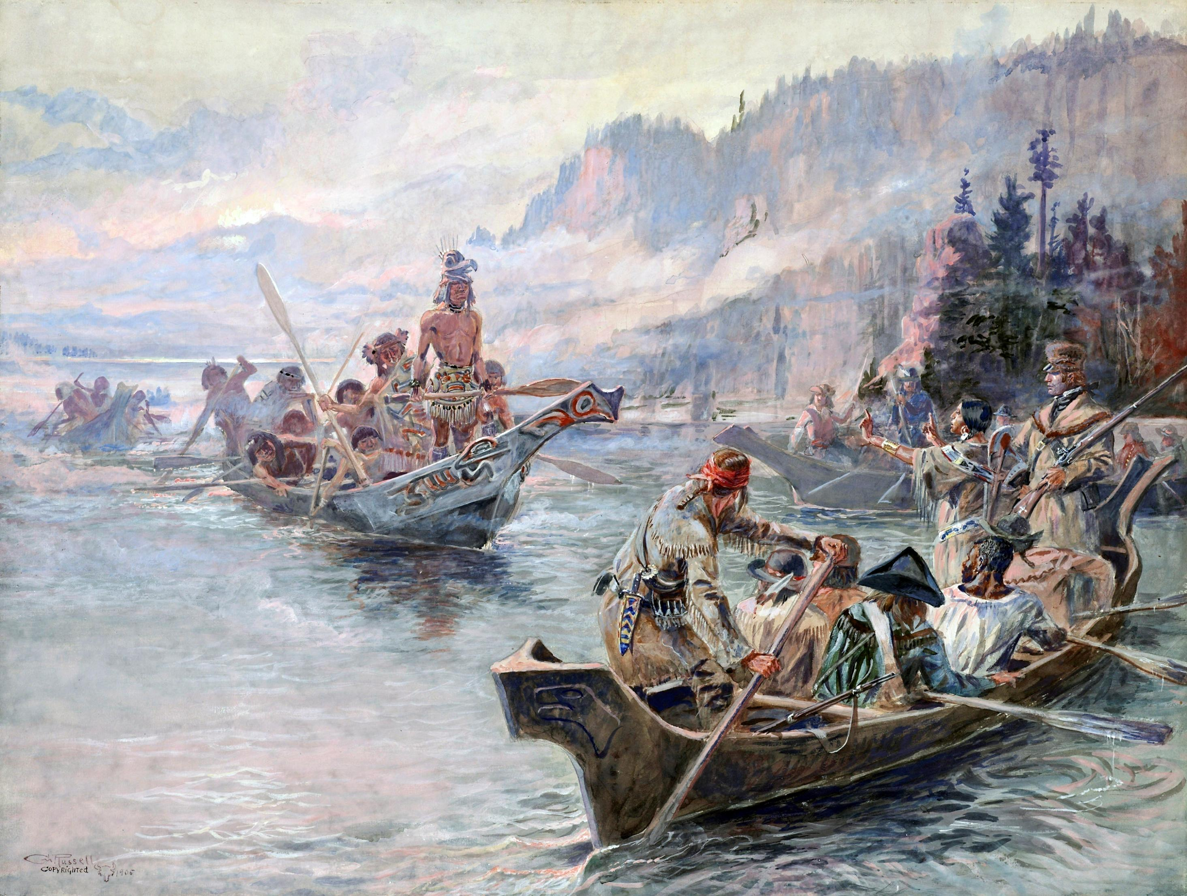
Northwest Journey - Corps of Discovery
Lewis and Clark Expedition
‘Westward Journeys’

Slide 2
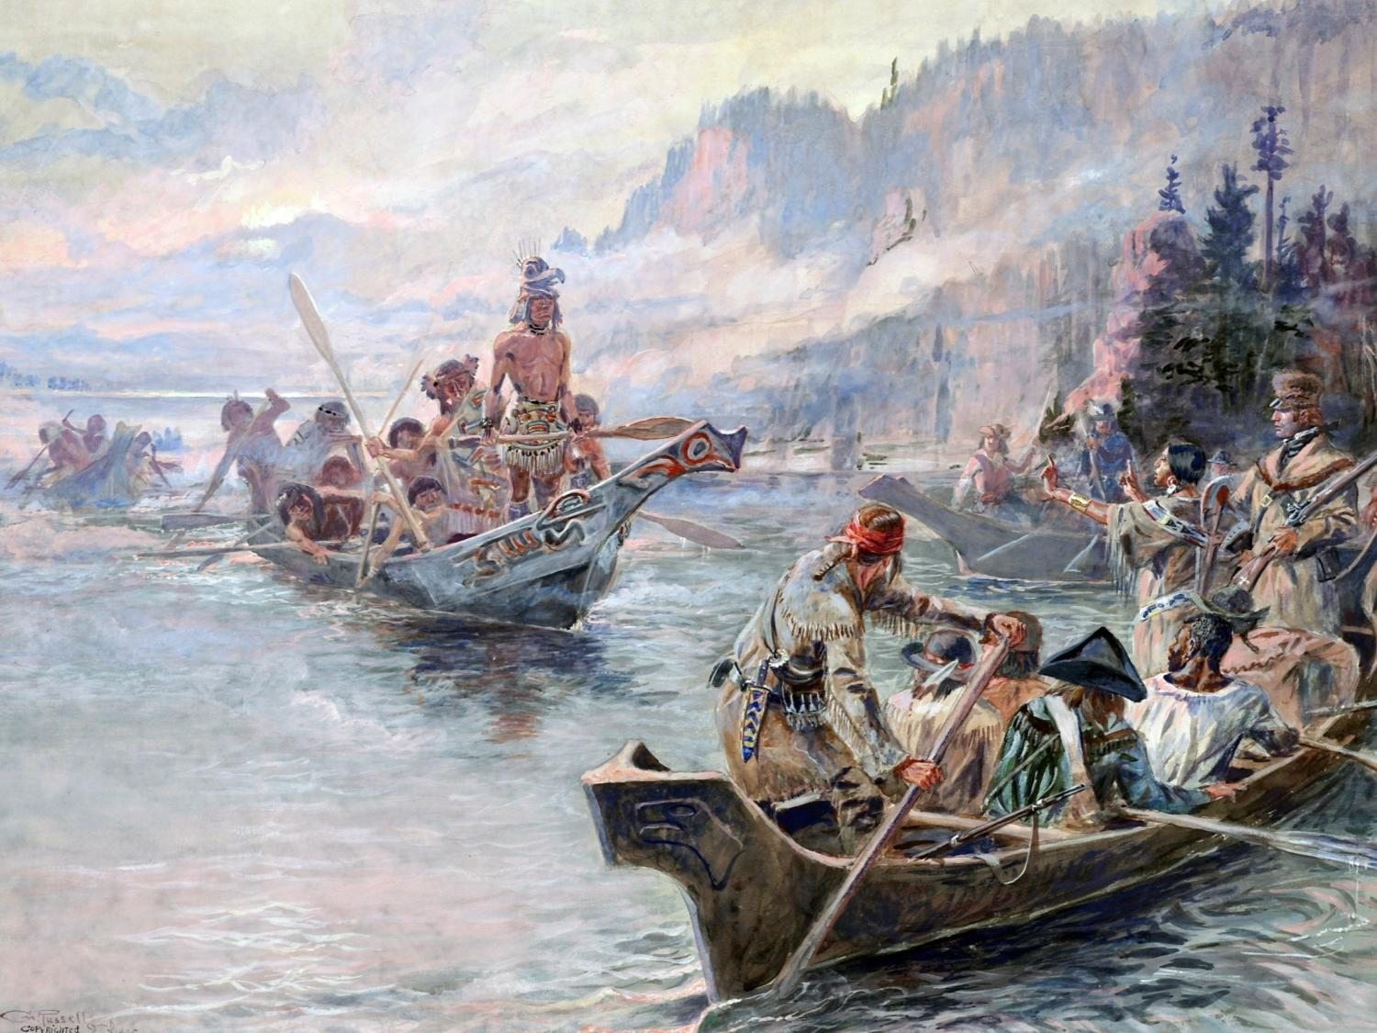
Session 3: The River Trip Begins
Northwest Journey - Corps of Discovery
Lewis and Clark Expedition
Session 1: Setting the Stage
Session 2: The Corps Is Formed
Session 3: The River Trip Begins
Session 3: The River Trip Begins
Session 4: Over the Rockies
Session 5: To the Pacific
Session 6: The Legend Begins

Slide 3
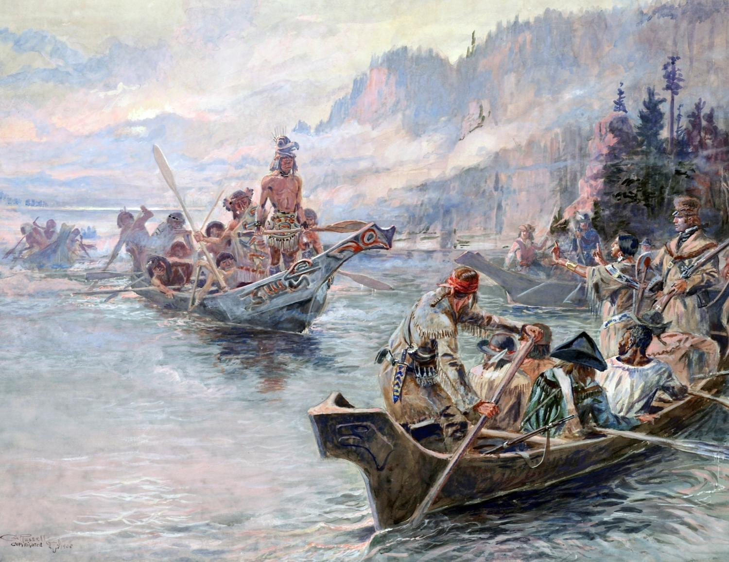
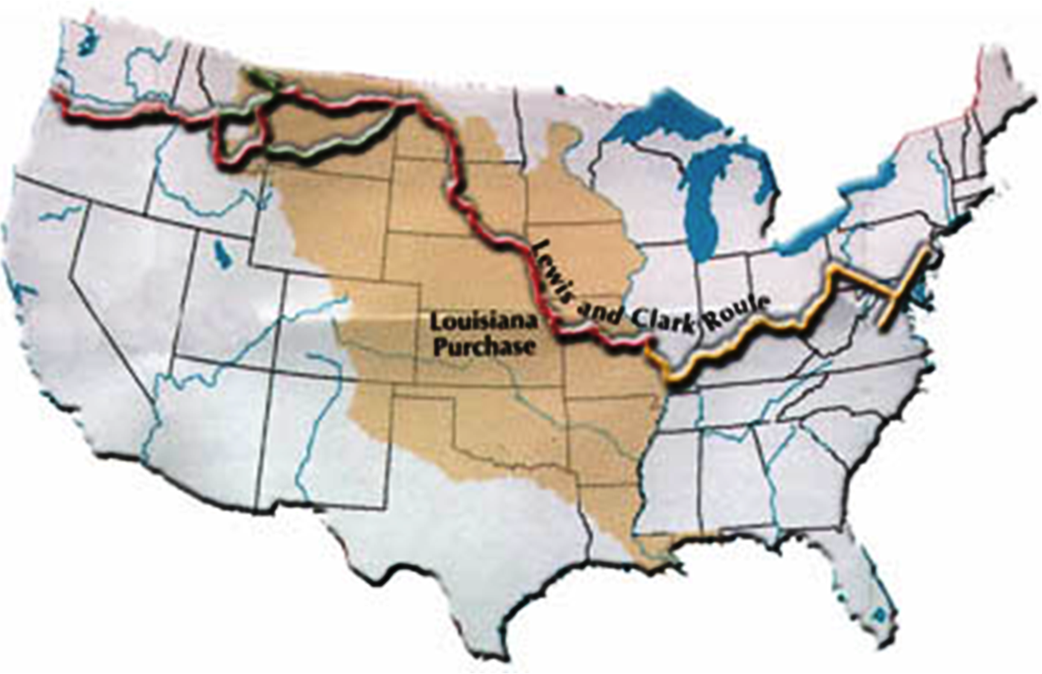
Session 3: The River Trip Begins
The River Trip Begins
To the Pacific
Over the Mountains
River Trip Begins
Corps is Formed

Slide 4

Session 3: The River Trip Begins
TODAY’S TOPICS
GEOLOGY of the GREAT PLAINS
Geologic Setting
- Great Plains
- Missouri River
People, Cultures, & History
- Journey on the Missouri River
- Native American Encounters
GREAT PLAINS

Slide 5
Geologic Setting
TODAY’S GEOLOGY
Great Plains
    Formation – Regional Tectonics
Interior Seas – Source of Rocks
Creating Landscapes –
Weathering & Erosion
Missouri River
River’s Statistics
River’s Origin - Glaciation

Slide 6
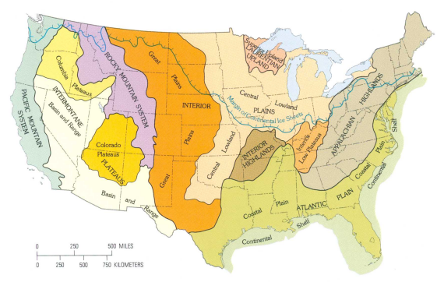
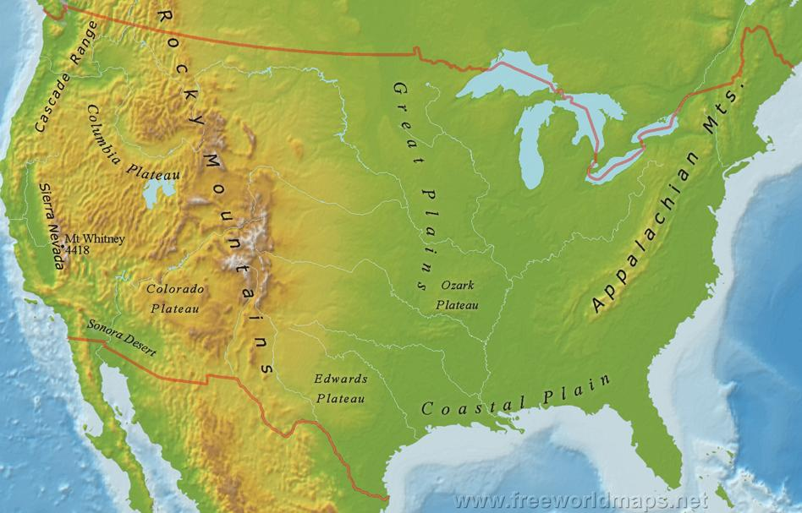
GEOLOGY of the GREAT PLAINS
PHYSIOGRAPHIC MAP
across the Great Plains on the Missouri River
Missouri
River
Central
Lowlands
GREAT
INTERIOR PLAINS
Great
Plains
GREAT PLAINS
Why are these plains here?
Why is this river here?

Slide 7
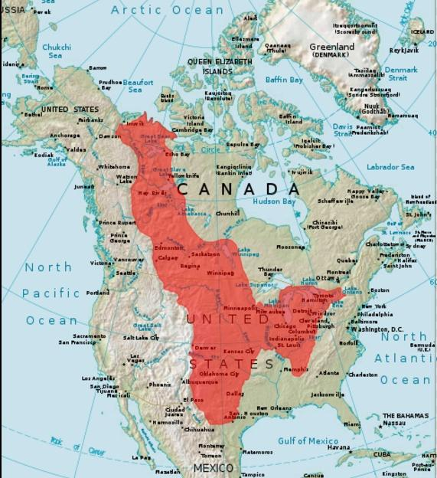
Side Note:
This is the
actual size of the Great Plains…
San Antonio to the Arctic Circle!
Approx.
3,100 mi
Approx.
1,500 mi

Slide 8
Geologic Setting
TODAY’S GEOLOGY
Great Plains
    Formation – Regional Tectonics
Interior Seas – Source of Rocks
Creating Landscapes –
Weathering & Erosion
Missouri River
River’s Statistics
River’s Origin - Glaciation

Slide 9
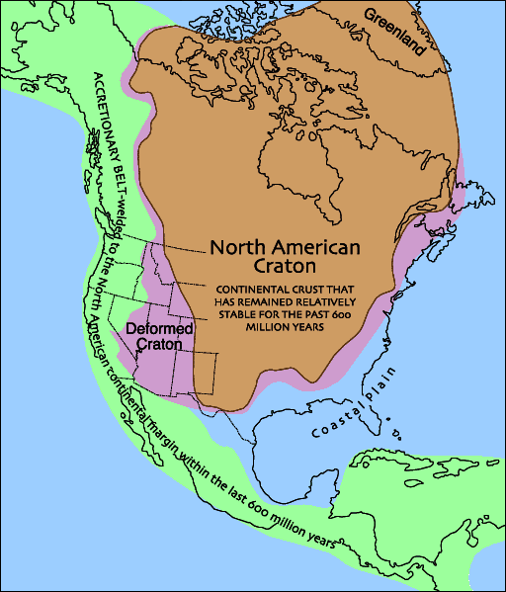

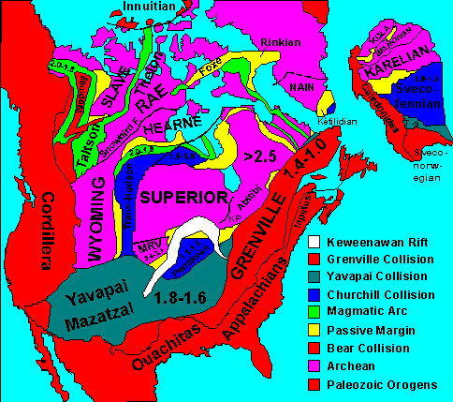
GEOLOGY of the GREAT PLAINS
Formation – Regional Tectonics
Over billions of years, North America was assembled by PLATE TECTONIC processes
Tens of plates called micro-continents slammed into and “welded” onto the core of North America
Forming a continent called the “North American Craton”
Public Domain, https://commons.wikimedia.org/w/index.php?curid=326767

Slide 10
Geologic Setting
TODAY’S GEOLOGY
Great Plains
    Formation – Regional Tectonics
Interior Seas – Source of Rocks
Creating Landscapes –
Weathering & Erosion
Missouri River
River’s Statistics
River’s Origin - Glaciation

Slide 11
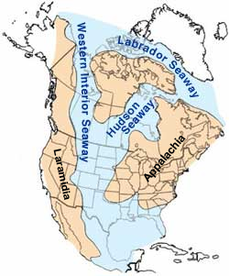
GEOLOGY of the GREAT PLAINS
Source of Rocks
As icecaps and glaciers have come and gone, sea level has risen and fallen
During times of high sea level, Texas, along with much of the center of the USA, has been under “shallow” seas
Most “recent” sea called the “Western Interior Seaway”
Sea extended from the Gulf of Mexico to the Arctic Ocean
Glacial ice is high!
Sea-Levels are low!
Western Interior Seaway during the mid-Cretaceous, about 100 million years ago

Slide 12
GEOLOGY of the GREAT PLAINS
Source of Rocks
When seaways happen, corals, algae and other microscopic marine organisms flourish and then die, depositing their calcium rich skeletons on the sea floor
Over millions of years, these “skeletons” are buried, compressed, de-watered, turned to rock (limestone), then exposed at the surface
Western Interior Seaway during the mid-Cretaceous, about 100 million years ago

Slide 13
https://en.wikipedia.org/wiki/Western_Interior_Seaway
The Western Interior Seaway (also called the Cretaceous Seaway, the Niobraran Sea, and the North American Inland Sea) was a large inland sea that existed during the mid- to late Cretaceous period as well as the very early Paleogene, splitting the continent of North America into two landmasses, Laramidia to the west and Appalachia to the east. The ancient sea stretched from the Gulf of Mexico and through the middle of the modern-day countries of the United States and Canada, meeting with the Arctic Ocean to the north. At its largest, it was 2,500 feet (760 m) deep, 600 miles (970 km) wide and over 2,000 miles (3,200 km) long.
The Seaway was created as the Farallon tectonic plate subducted under the North American Plateduring the Cretaceous. As plate convergence proceeded, the younger and more buoyant lithosphere of the Farallon Plate subducted at a shallow angle, in what is known as a "flat slab". This shallowly subducting slab exerted traction on the base of the lithosphere, pulling it down and producing dynamic topography at the surface that caused the opening of the Western Interior Seaway.^{[1]} This depression and the high eustatic sea levels existing during the Cretaceous allowed waters from the Arctic Ocean in the north and the Gulf of Mexico in the south to meet and flood the central lowlands, forming a sea that transgressed (grew) and regressed (receded) over the course of the Cretaceous.
The earliest phase of the Seaway began in the mid-Cretaceous when an arm of the Arctic Ocean transgressed south over western North America; this formed the Mowry Sea, so named for the Mowry Shale, an organic-rich rock formation.^{[2]} In the south, the Gulf of Mexico was an extension of the Tethys Sea, which met with the Mowry Sea in the late Cretaceous, forming the "complete" Seaway.^{[2]}
At its largest, the Western Interior Seaway stretched from the Rockies east to the Appalachians, some 1,000 km (620 mi) wide. At its deepest, it may have been only 800 or 900 metres (2,600 or 3,000 ft) deep, shallow in terms of seas. Two great continental watersheds drained into it from east and west, diluting its waters and bringing resources in eroded silt that formed shifting delta systems along its low-lying coasts. There was little sedimentation on the eastern shores of the Seaway; the western boundary, however, consisted of a thick clastic wedge eroded eastward from the Sevier orogenic belt.^{[2][3]} The western shore was thus highly variable, depending on variations in sea level and sediment supply.^{[2]}
At the end of the Cretaceous, a continuing uplift in a mountain-building episode called the Laramide orogeny hoisted the sandbanks (sandstone) and muddy brackish lagoons (shale) – the thick sequences of silt and sandstone still seen today as the Laramie Formation – while low-lying basins between them gradually subsided. The Western Interior Seaway divided across the Dakotas and retreated south towards the Gulf of Mexico. This shrunken, regressive phase of the Western Interior Seaway is sometimes called the Pierre Seaway.^{[2]}
During the early Paleocene, parts of the Western Interior Seaway (marine waters) still occupied areas of the Mississippi Embayment, submerging the site of present-day Memphis.

Slide 14
GEOLOGY of the GREAT PLAINS
Source of Rocks
This gives us the limestone that we are seeing at the surface today!
Near-shore environments (beaches) provided sand that is turned to sandstone
Delta environments provided mud (clay) that is turned to shale
Swamp environments provided rich organic material that is turned to coal/lignite
Western Interior Seaway during the mid-Cretaceous, about 100 million years ago

Slide 15
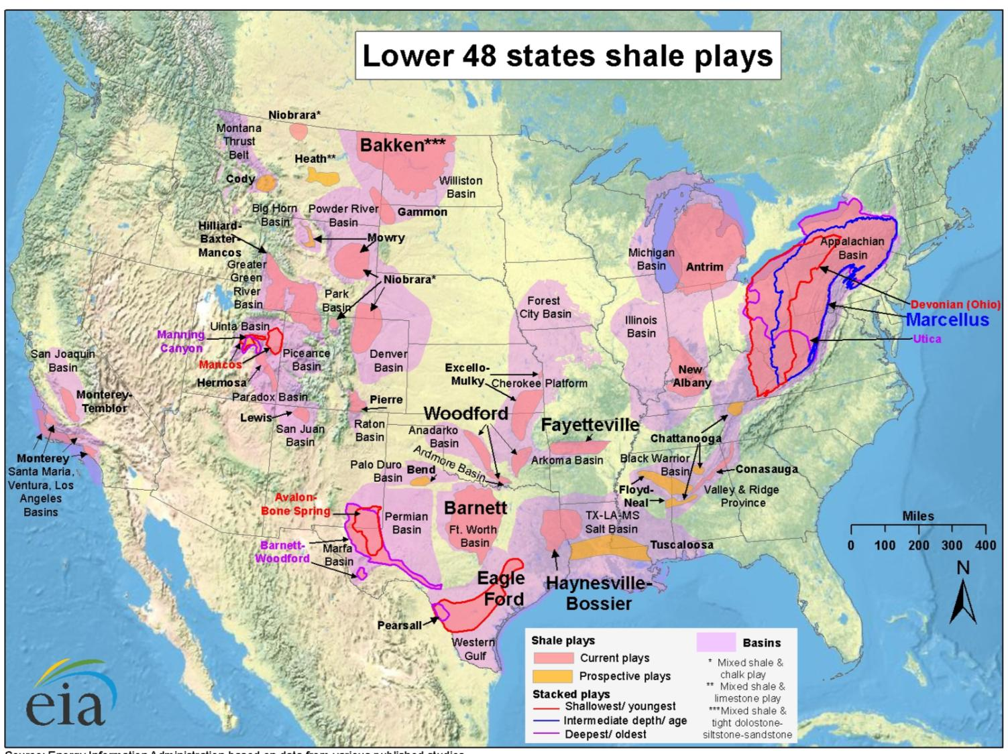
GEOLOGY of the GREAT PLAINS
Source of Rocks: COAL
Source of Rocks: SHALE
GREAT
PLAINS
Coal Sources:
outside Great Plains
inside Great Plains

Slide 16
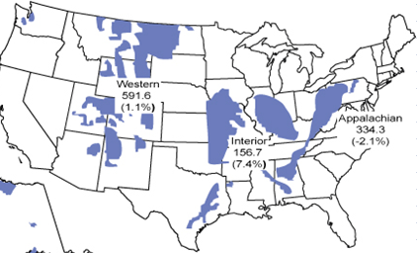
GEOLOGY of the GREAT PLAINS
Source of Rocks: COAL
GREAT
PLAINS
Coal Sources:
outside Great Plains
inside Great Plains

Slide 17
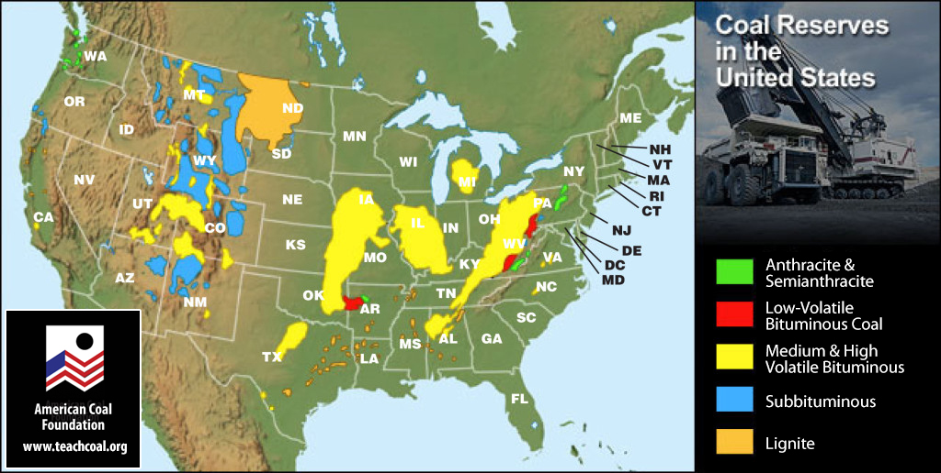

Slide 18
Geologic Setting
TODAY’S GEOLOGY
Great Plains
    Formation – Regional Tectonics
Interior Seas – Source of Rocks
Creating Landscapes –
Weathering & Erosion
Missouri River
River’s Statistics
River’s Origin - Glaciation

Slide 19
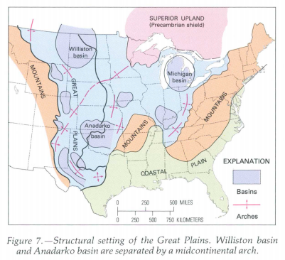
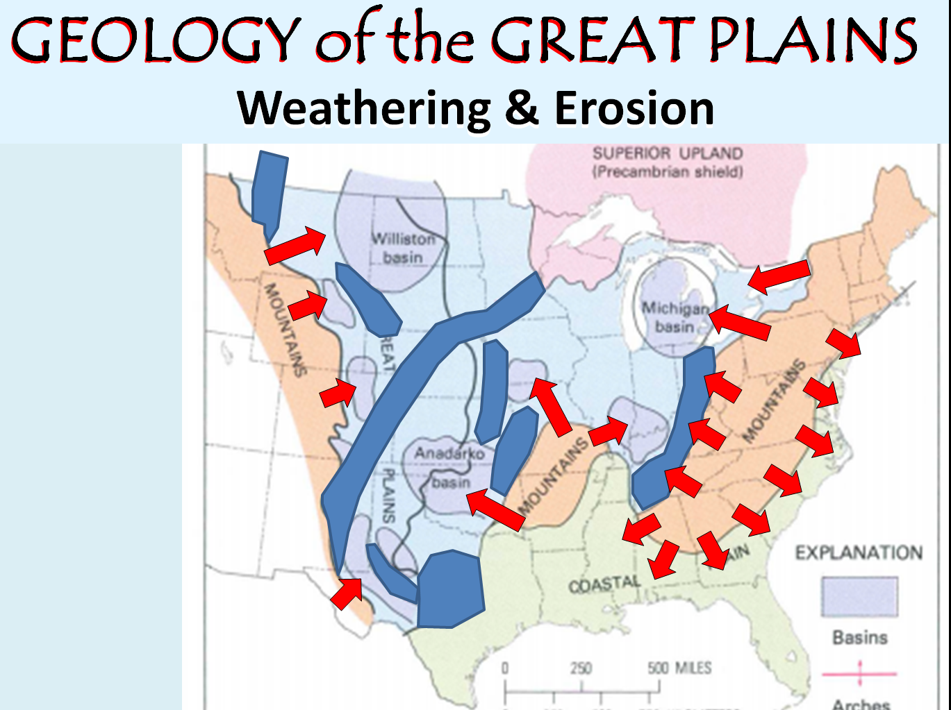
GEOLOGY of the GREAT PLAINS
Weathering & Erosion
GREAT PLAINS

Slide 20
GEOLOGY of the GREAT PLAINS
Weathering & Erosion

Slide 21
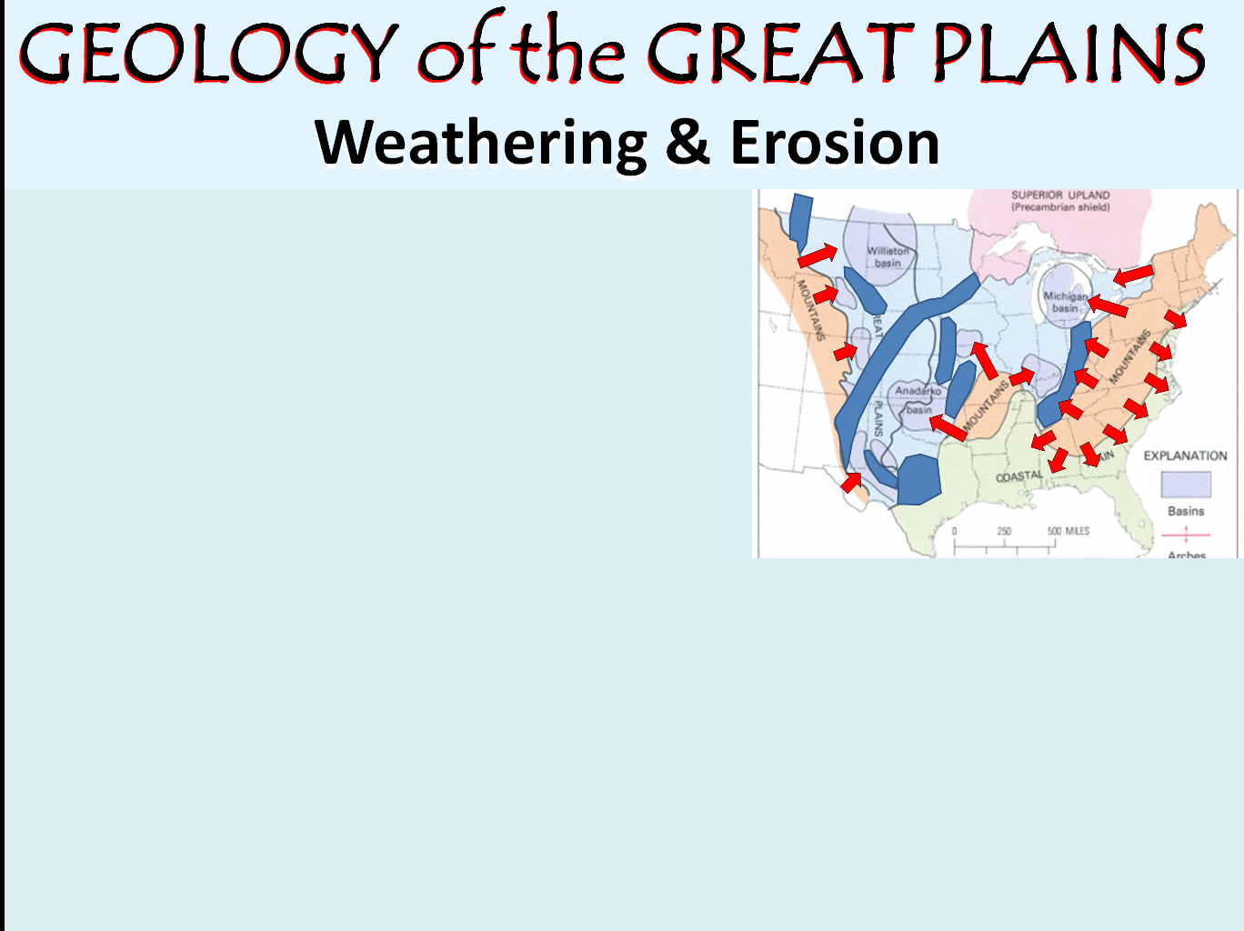
GEOLOGY of the GREAT PLAINS
GEOLOGY of the GREAT PLAINS
Weathering & Erosion
Rising Ouachita-Appalachian Mountains were weathered & eroded for 290 million yrs
Rising Rocky Mountain belt was weathered and eroded for 70 million years
GREAT PLAINS
Sediments (gravel, sand, mud) were transported to and spread on the Great Plains
Sediment thicknesses of 5,000 to 10,000 ft filled the subsiding floor of Great Plains, more in certain places
Initially, sediments were transported to Hudson Bay!

Slide 22
GEOLOGY of the GREAT PLAINS
GEOLOGY of the GREAT PLAINS
Weathering & Erosion
Amount of erosional debris transported to the Great Plains and then moved by rivers to the Gulf of Mexico was so significant as to have pushed the coastline out 100 miles
20-30 mya streams began depositing sand & gravel beyond the divides (arches); lasted for 10 million yrs or more. This layer is known as the Ogallala Formation
Nearly all landforms in the Great Plains have been created by geologic processes during last 2 million yrs

Slide 23
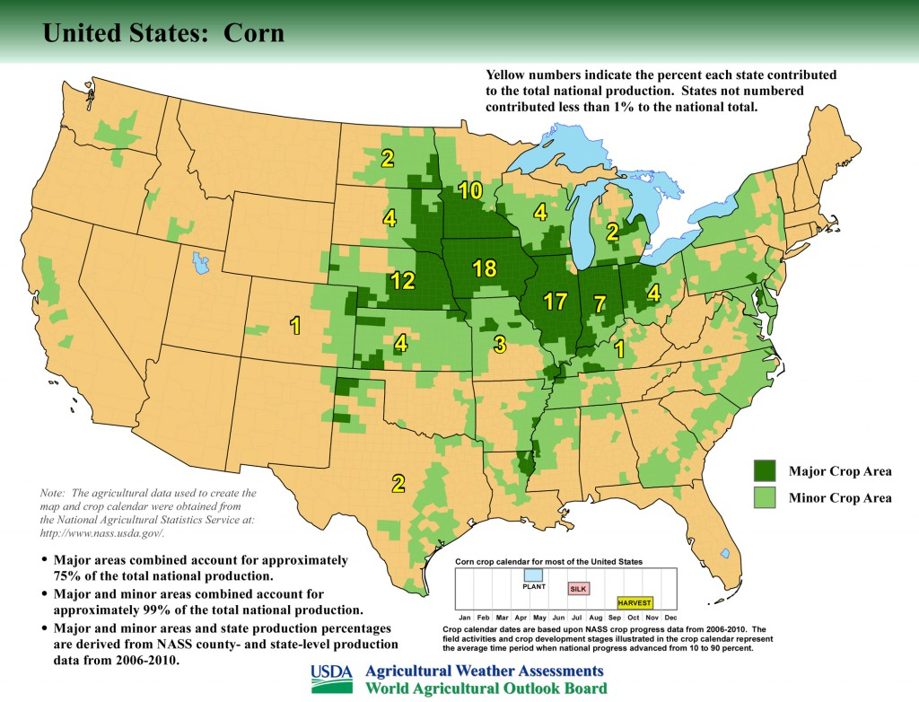
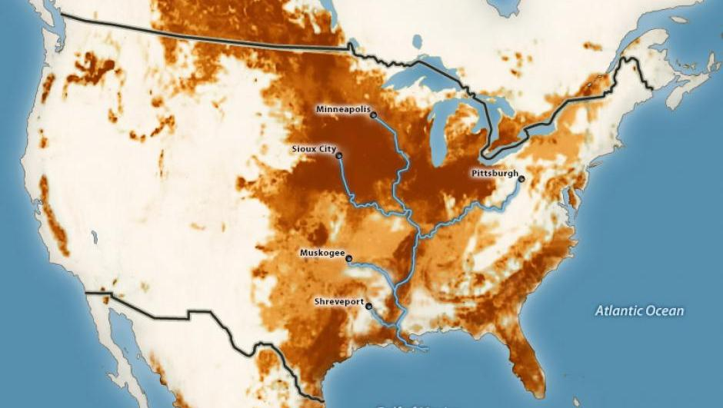
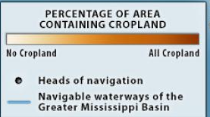
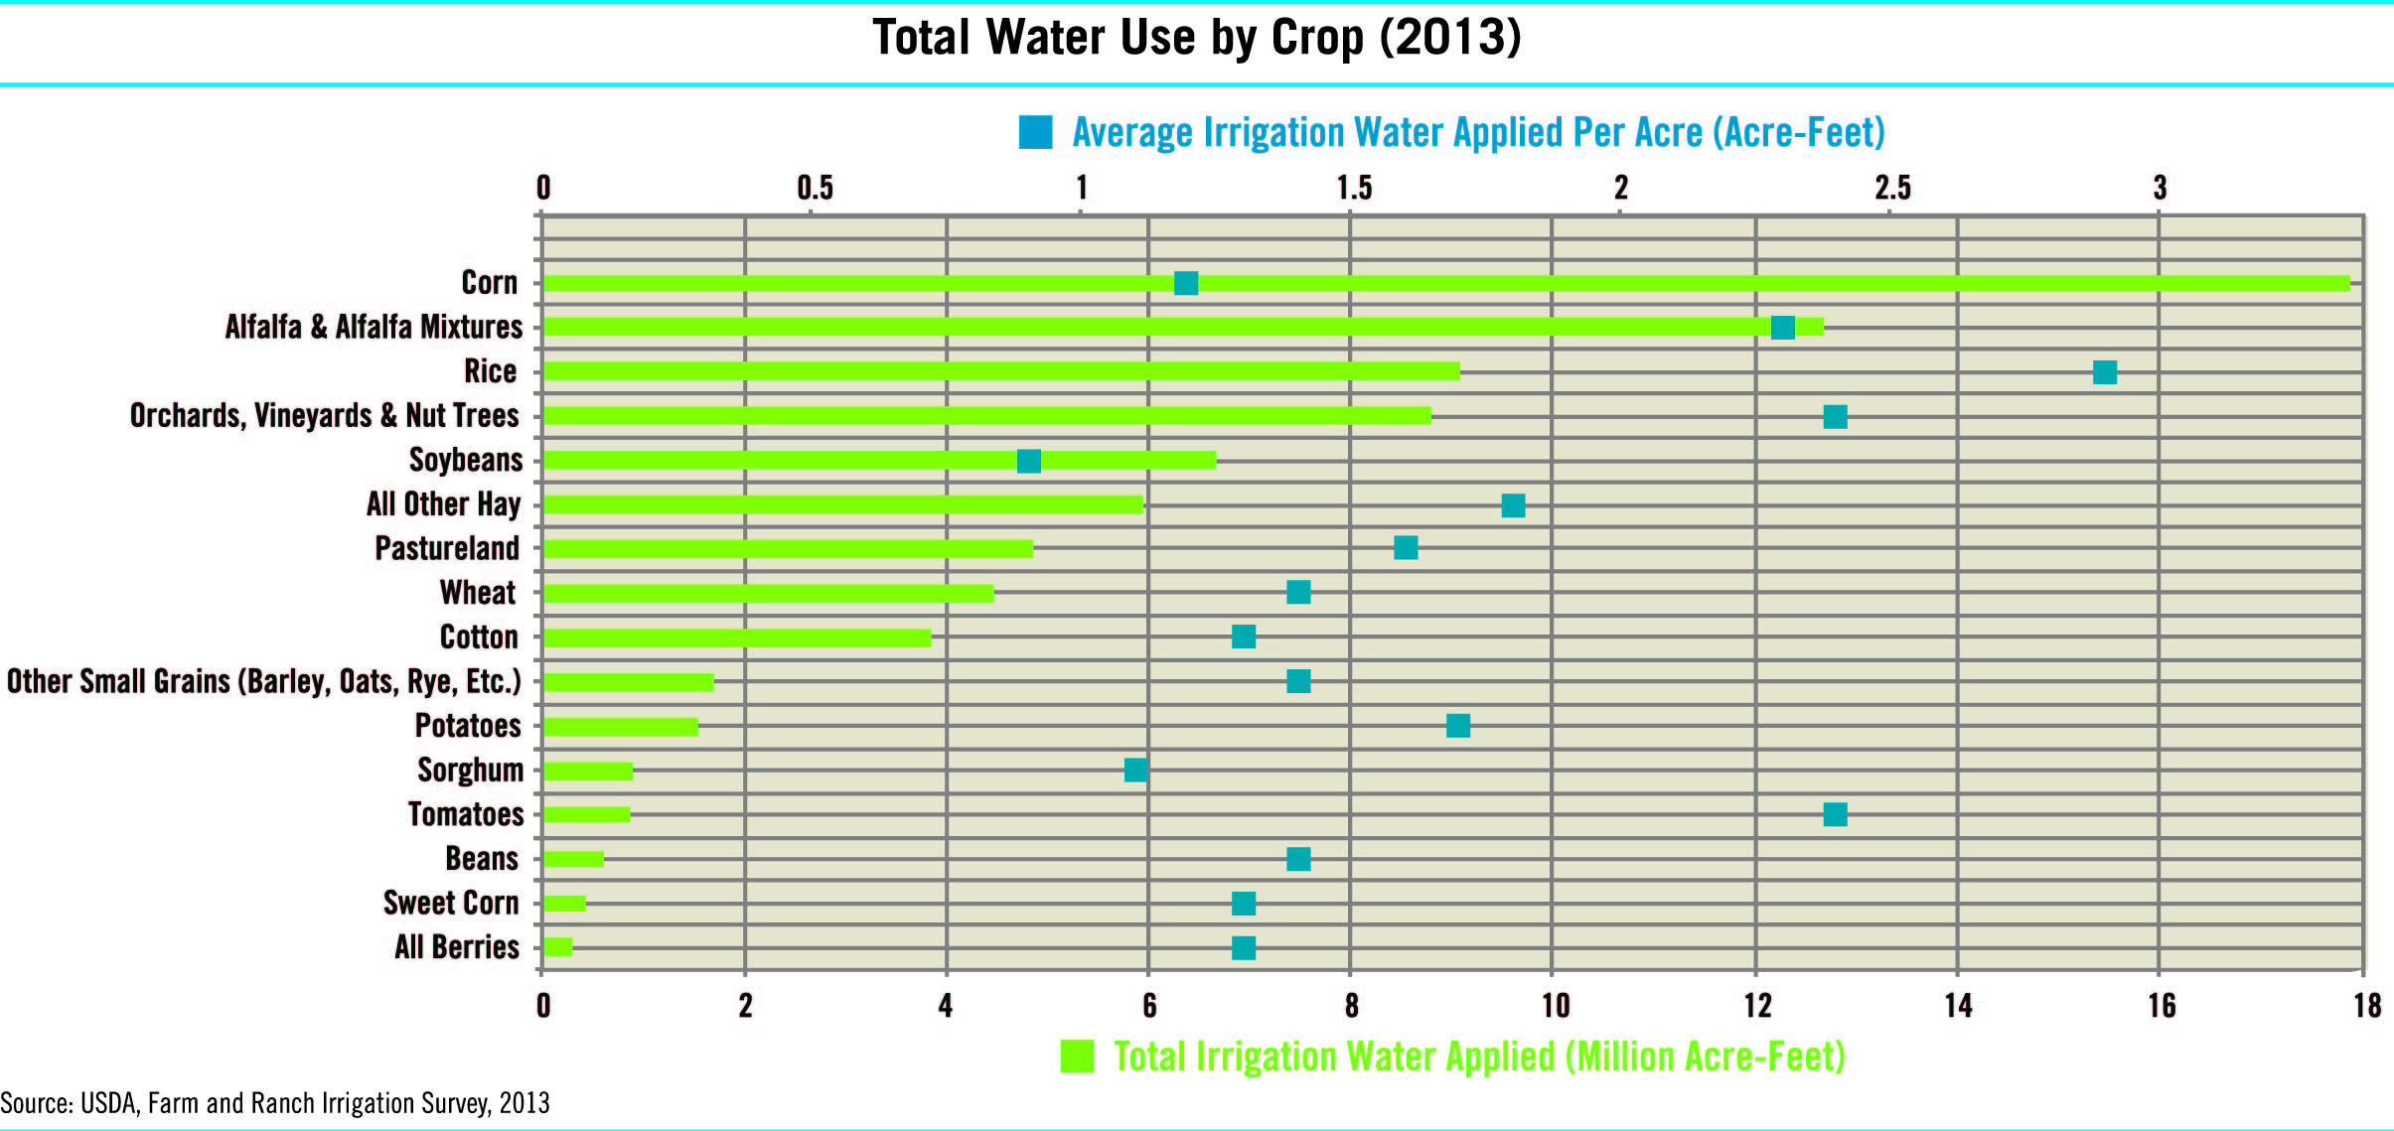
GEOLOGY of the GREAT PLAINS
Weathering & Erosion
Erosional debris weathered into fantastic
crop soils

Slide 24
Geologic Setting
TODAY’S GEOLOGY
Great Plains
    Formation – Regional Tectonics
Interior Seas – Source of Rocks
Creating Landscapes –
Weathering & Erosion
Missouri River
River’s Statistics
River’s Origin - Glaciation

Slide 25
https://en.wikipedia.org/wiki/Missouri_River
The Rocky Mountains of southwestern Montana at the headwaters of the Missouri River first rose in the Laramide Orogeny, a mountain-building episode that occurred from around 70 to 45 million years ago (the end of the Mesozoic through the early Cenozoic). This orogeny uplifted Cretaceous rocks along the western side of the Western Interior Seaway, a vast shallow sea that stretched from the Arctic Ocean to the Gulf of Mexico, and deposited the sediments that now underlie much of the drainage basin of the Missouri River. This Laramide uplift caused the sea to retreat and laid the framework for a vast drainage system of rivers flowing from the Rocky and Appalachian Mountains, the predecessor of the modern-day Mississippi watershed. The Laramide Orogeny is essential to modern Missouri River hydrology, as snow and ice melt from the Rockies provide the majority of the flow in the Missouri and its tributaries.
The Missouri and many of its tributaries cross the Great Plains, flowing over or cutting into the Ogallala Group and older mid-Cenozoic sedimentary rocks. The lowest major Cenozoic unit, the White River Formation, was deposited between roughly 35 and 29 million years ago[and consists of claystone, sandstone, limestone, and conglomerate. Channel sandstones and finer-grained overbank deposits of the fluvial Arikaree Group were deposited between 29 and 19 million years ago. The Miocene-age Ogallala and the slightly younger Pliocene-age Broadwater Formation deposited atop the Arikaree Group, and are formed from material eroded off of the Rocky Mountains during a time of increased generation of topographic relief; these formations stretch from the Rocky Mountains nearly to the Iowa border and give the Great Plains much of their gentle but persistent eastward tilt, and also constitute a major aquifer.
Immediately before the Quaternary Ice Age, the Missouri River was likely split into three segments: an upper portion that drained northwards into Hudson Bay, and middle and lower sections that flowed eastward down the regional slope. As the Earth plunged into the Ice Age, a pre-Illinoian (or possibly the Illinoian) glaciation diverted the Missouri River southeastwards towards its present confluence with the Mississippi and caused it to integrate into a single river system that cuts across the regional slope. In western Montana, the Missouri River is thought to have once flowed north then east around the Bear Paw Mountains. Sapphires are found in some spots along the river in western Montana.Advances of the continental ice sheets diverted the river and its tributaries, causing them to pool up into large temporary lakes such as Glacial Lakes Great Falls, Musselshell and others. As the lakes rose, the water in them often spilled across adjacent local drainage divides, creating now-abandoned channels and coulees including the Shonkin Sag, 100 miles (160 km) long. When the glaciers retreated, the Missouri flowed in a new course along the south side of the Bearpaws, and the lower part of the Milk River tributary took over the original main channel.
The Missouri's nickname, the "Big Muddy", was inspired by its enormous loads of sediment or silt – some of the largest of any North American river. In its pre-development state, the river transported some 175 to 320 million short tons (159 to 290 Mt) per year. The construction of dams and levees has drastically reduced this to 20 to 25 million short tons (18 to 23 Mt) in the present day. Much of this sediment is derived from the river's floodplain, also called the meander belt; every time the river changed course, it would erode tons of soil and rocks from its banks. However, damming and channeling the river has kept it from reaching its natural sediment sources along most of its course. Reservoirs along the Missouri trap roughly 36.4 million short tons (33.0 Mt) of sediment each year. Despite this, the river still transports more than half the total silt that empties into the Gulf of Mexico; the Mississippi River Delta, formed by sediment deposits at the mouth of the Mississippi, constitutes a majority of sediments carried by the Missouri.

Slide 26
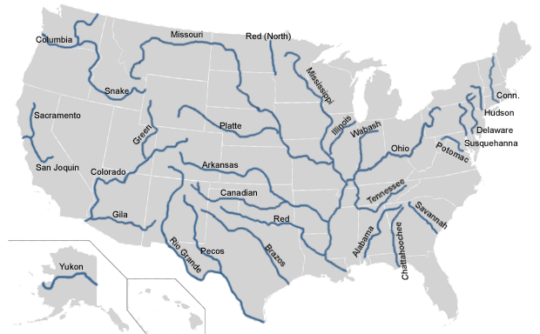
GEOLOGY of the MISSOURI RIVER
MAJOR RIVERS OF THE USA
Columbia
Mississippi
Missouri
Snake
Ohio

Slide 27
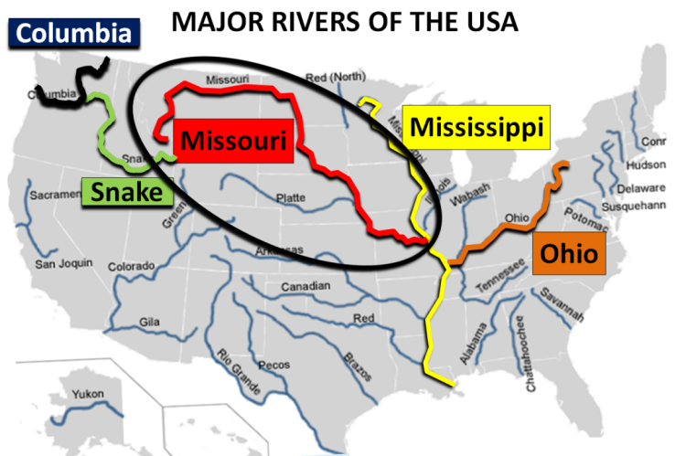
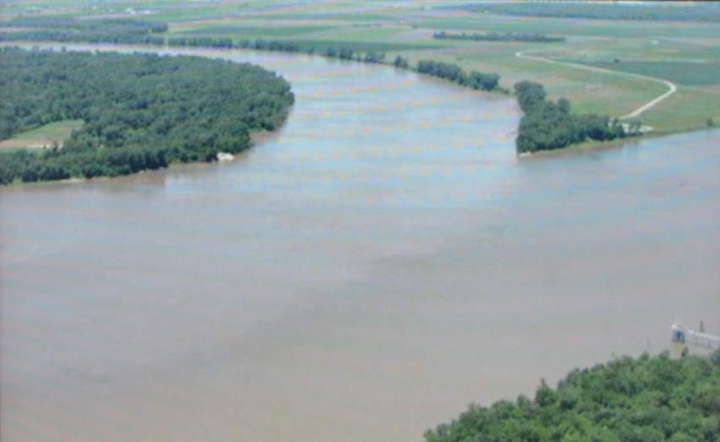
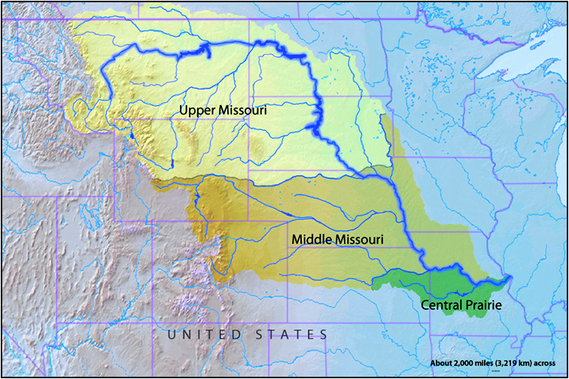
GEOLOGY of the MISSOURI RIVER
Longest river in North America
Starts in the Rocky Mountains (at 9,100ft) of western Montana
flows east and south for 2,341 miles before entering the
Mississippi River north of St. Louis Missouri (at 404ft)
Confluence of Mississippi (right)
and Missouri (center)

Slide 28
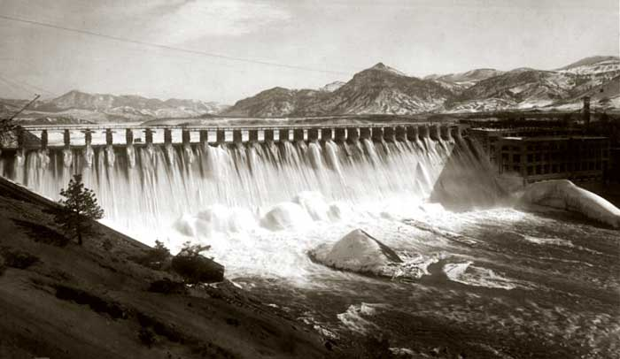
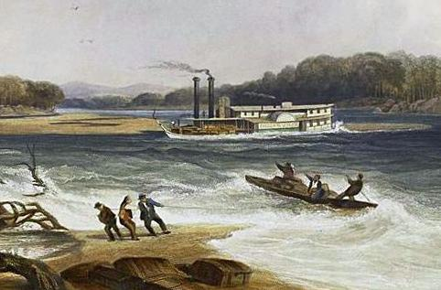
GEOLOGY of the MISSOURI RIVER
By discharge, Missouri is the ninth largest river of the United States, after the Mississippi, St. Lawrence, Ohio, Columbia,Niagara,YukonDetroit, and St. Clair
Missouri accounts for 45 % of annual flow of the Mississippi past St. Louis ( 70 % in certain drought times)
Notes:
Holter Dam
15 dams total

Slide 29
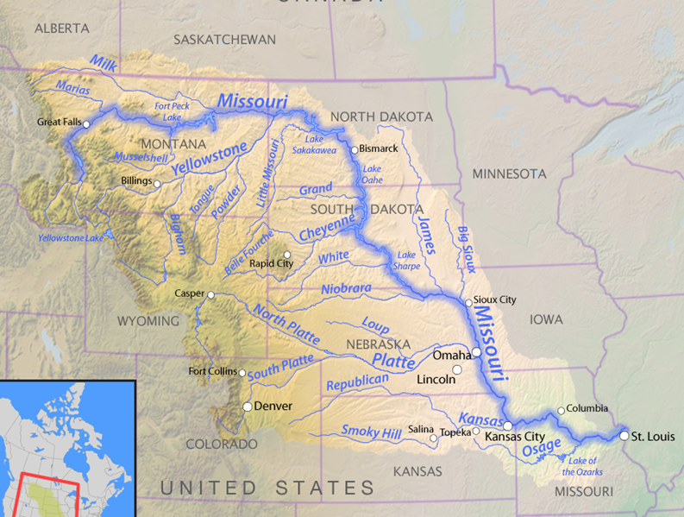
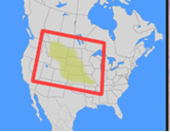
GEOLOGY of the MISSOURI RIVER
takes drainage from a sparsely populated, semi-arid
watershed of more than half a million square miles
Watershed includes parts of ten U.S. states and two Canadian provinces

Slide 30
Geologic Setting
TODAY’S GEOLOGY
Great Plains
    Formation – Regional Tectonics
Interior Seas – Source of Rocks
Creating Landscapes –
Weathering & Erosion
Missouri River
River’s Statistics
River’s Origin - Glaciation

Slide 31
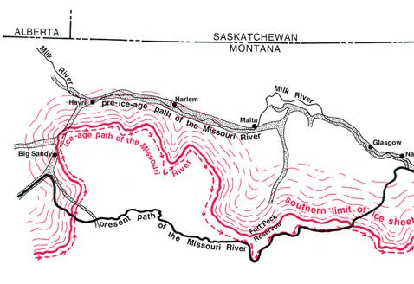
GEOLOGY of the MISSOURI RIVER
River’s Origin - Glaciation
PHYSIOGRAPHIC MAP
As the Earth plunged into the Ice Age, glaciation diverted the Missouri River southeastwards towards its present confluence with the Mississippi and caused it to integrate into a single river system that cuts across the regional slope.
Notes:
Immediately before the last Ice Age, the Missouri River was likely split into three segments: an upper portion that drained northwards into Hudson Bay, and middle and lower sections that flowed eastward down the regional slope.
As the Earth plunged into the Ice Age, a pre-Illinoian (or possibly the Illinoian) glaciation diverted the Missouri River southeastwards towards its present confluence with the Mississippi and caused it to integrate into a single river system that cuts across the regional slope.
Advances of the continental ice sheets diverted the river and its tributaries, causing them to pool up into large temporary lakes
As the lakes rose, the water in them often spilled across adjacent local drainage divides, creating now-abandoned channels and coulees
When the glaciers retreated, the Missouri flowed in its new course

Slide 32
GEOLOGY of the MISSOURI RIVER
River’s Origin - Glaciation
C. Glacier starts to recede towards Canada;
river flow path adjusts
Ancient (pre-ice age) path of the Missouri River
after consolidation to a single river
B. Glacier advances toward the Missouri River
changing it’s flow path
E. Glacier recedes towards Canada;
river flow path adjusts again to present day route
D. Glacier recedes towards Canada;
river flow path adjusts again
Notes:
Immediately before the last Ice Age, the Missouri River was likely split into three segments: an upper portion that drained northwards into Hudson Bay, and middle and lower sections that flowed eastward down the regional slope.
As the Earth plunged into the Ice Age, a pre-Illinoian (or possibly the Illinoian) glaciation diverted the Missouri River southeastwards towards its present confluence with the Mississippi and caused it to integrate into a single river system that cuts across the regional slope.
Advances of the continental ice sheets diverted the river and its tributaries, causing them to pool up into large temporary lakes
As the lakes rose, the water in them often spilled across adjacent local drainage divides, creating now-abandoned channels and coulees
When the glaciers retreated, the Missouri flowed in its new course

Slide 33
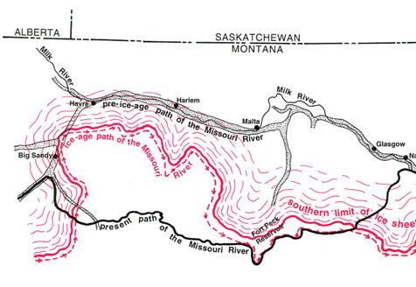
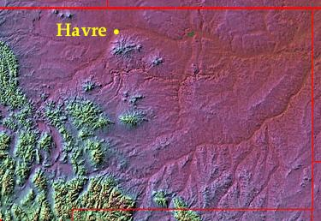
GEOLOGY of the MISSOURI RIVER
River’s Origin - Glaciation
C
B
C
B
A
A
D
D
Same area as seen from space (with IR filter)
Map showing ancient & present paths of Missouri
B. The upper path on the space photo is the ancient path of the Missouri and has been captured by the Milk River coming in at Havre
A. The lower path on the space photo is the current path of the Missouri
Notes:
Immediately before the last Ice Age, the Missouri River was likely split into three segments: an upper portion that drained northwards into Hudson Bay, and middle and lower sections that flowed eastward down the regional slope.
As the Earth plunged into the Ice Age, a pre-Illinoian (or possibly the Illinoian) glaciation diverted the Missouri River southeastwards towards its present confluence with the Mississippi and caused it to integrate into a single river system that cuts across the regional slope.
Advances of the continental ice sheets diverted the river and its tributaries, causing them to pool up into large temporary lakes
As the lakes rose, the water in them often spilled across adjacent local drainage divides, creating now-abandoned channels and coulees
When the glaciers retreated, the Missouri flowed in its new course

Slide 34

Session 3: The River Trip Begins
Journey on the River
TODAY’S TOPICS
Geologic Setting
- Great Plains
- Missouri River
People, Cultures, & Histor
Journey on the River
Native American Encounters
Journey on the River

Slide 35
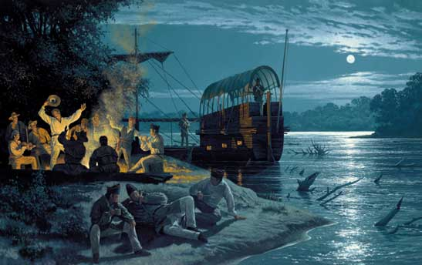
Journey on the River
River Travel vs Highway Travel
Leaving Camp River Dubois
Boats & pirogues
Supplies & Crew
Travel Events:
Travel Highlights
Desertions & Courts martial
Death of Sergeant Floyd
Clark’s 34th and Lewis’ 30th Birthdays
Arriving at the Mandan Village
River Travel vs Highway Travel

Slide 36
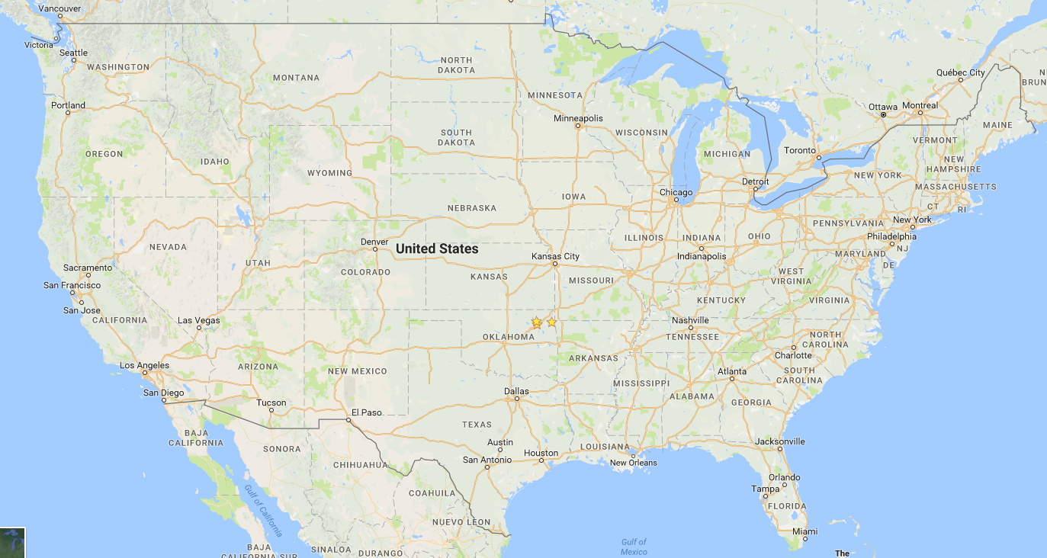
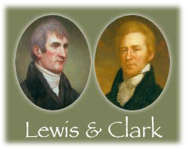

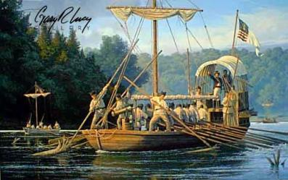
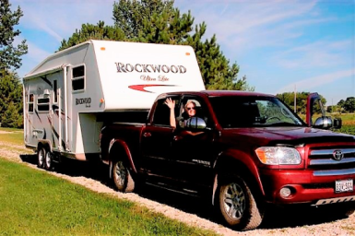
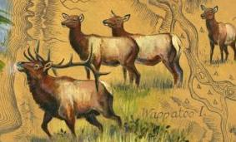
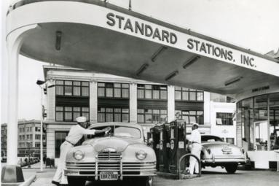
River Travel vs Highway Travel
River Travel
Highway Travel
Leaders……..
Vehicle(s)…..
Fuel…………..

Slide 37
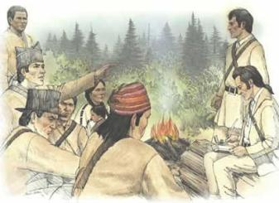
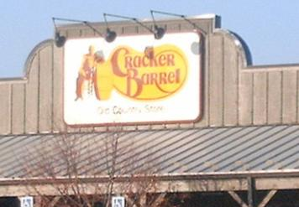
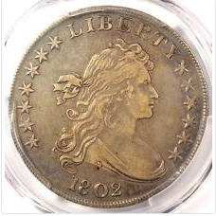

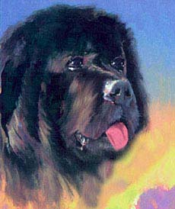

River Travel vs Highway Travel
River Travel
Highway Travel
Meals………..
Payment……
Scout Dog….

Slide 38
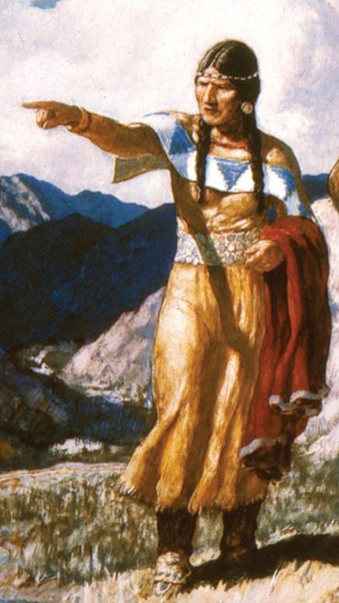

River Travel vs Highway Travel
River Travel
Highway Travel
Female Interpreter…
Sacagawea
Sandigawea

Slide 39
River Travel vs Highway Travel
Will zoom in a little closer to
look at the routes of
Lewis and Clark
and
Rocky & Sandi

Slide 40
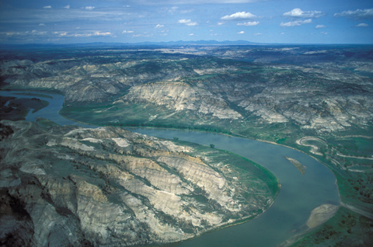
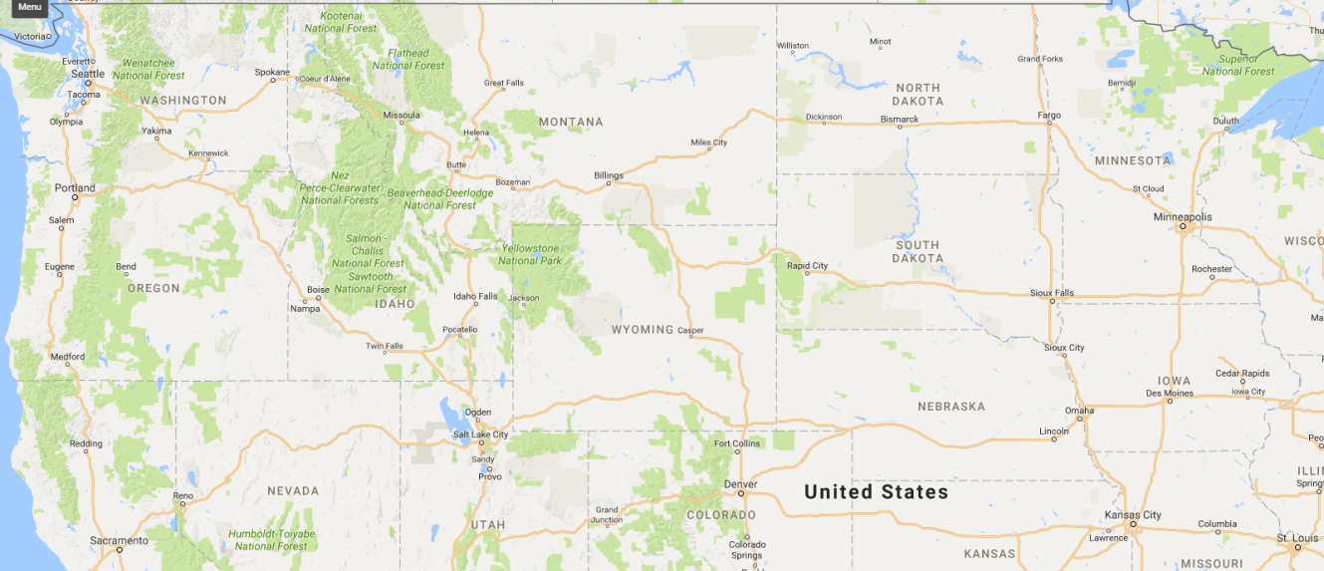
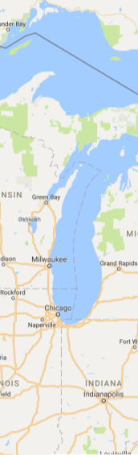
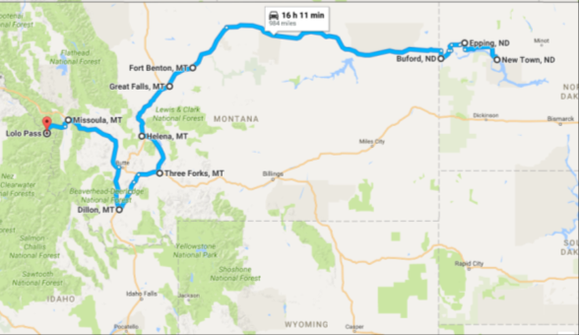
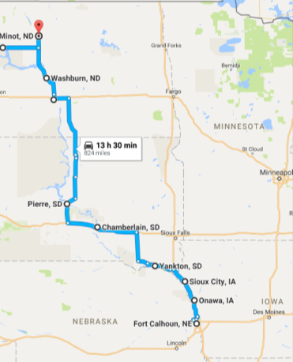
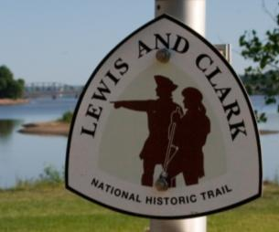
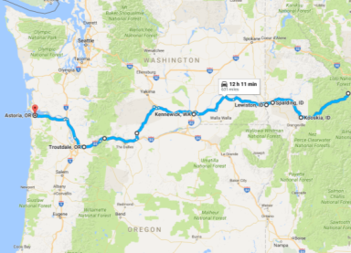



River Travel vs Highway Travel
Great Falls
Bismark
Three Forks, Montana
Headwaters of Missouri
Pacific Ocean
Omaha
Lewis and Clark’s Route (the Missouri) in red
St. Louis
Rocky & Sandi’s Route in blue
Originate
Georgetown

Slide 41

River Travel vs Highway Travel
River Travel vs Highway Travel
Leaving Camp River Dubois
Boats & pirogues
Supplies & Crew
Travel Events:
Travel Highlights
Desertions & Courts martial
Death of Sergeant Floyd
Lewis’ 30 Birthday
Arrival at Mandan Village
Leaving Camp River Dubois

Slide 42






Leaving Camp River Dubois
KEELBOAT - DESIGN

Slide 43





Leaving Camp River Dubois
KEELBOAT - DESIGN
Built in Pittsburgh, 55 ft long, 8ft 4in wide, 3 ft draft (4 ft loaded)
Carries 12 tons (24,000 pounds) of supplies
Usually carried 27 men
Four modes of movement:
Wind: wind direction, water depth & current
Paddling – 22 oarsmen: water depth & current
Pushing – 6 to 12 Pushmen: water depth & current
Pulling – 8 to 20 Pullmen: water depth & current
Notes:
In the spring of 1805, when the rest of the Corps of Discovery set out from Fort Mandan with the two pirogues and six dugout canoes, headed for shallower water on the upper Missouri, the barge was sent back downriver

Slide 44


Leaving Camp River Dubois
KEELBOAT - DESIGN
Mounted Blunderbuss (2)
Canvas Sun-shield (rolled up)
32ft Mast, hinged
Covered
Pilot/
Lookout
Sail
Push Poles
(6 per side)
Rudder
Covered Officers Quarters/Office
Oars
(10 per side)
Mounted Cannon
Notes:
In the spring of 1805, when the rest of the Corps of Discovery set out from Fort Mandan with the two pirogues and six dugout canoes, headed for shallower water on the upper Missouri, the barge was sent back downriver
Six 18-foot-long setting poles are slung on each side, aft. Each has an iron tip on its lower end, for a secure purchase among the mud, sand and rocks of the river. Setting poles were especially useful for fending off drifting logs and snags, and avoiding rocks, shoals and sandbars
, if wading was practical or the bank was relatively free of trees and brush, the barge could be cordelled, or pulled by a small crew on shore with a rope a couple of hundred feet long. If the river was deep near a brushy bank, bushwacking was an option; either the cordelling crew or a crew aboard the boat could pull it ahead by grabbing branches and walking toward the stern. The only other practical strategy was warping, by which one end of a long rope was carried upriver in one of the pirogues, or walked up by an on-shore crew, and tied to a tree; the boat was then pulled up by a crew on the downstream end of the rope aboard the boat, who marched from stem to stern along the cleated lids of the storage lockers. Meanwhile, a second rope was carried farther up the river and tied to a tree, and so on. Only once is this technique mentioned in the journals–when Sergeant Gass reported: "On the 21st [of June, 1804] we had rapid water, and for about a mile had to warp up our boat by a rope."

Slide 45

Leaving Camp River Dubois
KEELBOAT - DESIGN
Looking down into the Captain’s Quarters
Windows
Books & Storage
Entry Door
Desk
Beds
Lewis & Clark lived in this room for 7 months!
Notes:
In the spring of 1805, when the rest of the Corps of Discovery set out from Fort Mandan with the two pirogues and six dugout canoes, headed for shallower water on the upper Missouri, the barge was sent back downriver
Six 18-foot-long setting poles are slung on each side, aft. Each has an iron tip on its lower end, for a secure purchase among the mud, sand and rocks of the river. Setting poles were especially useful for fending off drifting logs and snags, and avoiding rocks, shoals and sandbars
, if wading was practical or the bank was relatively free of trees and brush, the barge could be cordelled, or pulled by a small crew on shore with a rope a couple of hundred feet long. If the river was deep near a brushy bank, bushwacking was an option; either the cordelling crew or a crew aboard the boat could pull it ahead by grabbing branches and walking toward the stern. The only other practical strategy was warping, by which one end of a long rope was carried upriver in one of the pirogues, or walked up by an on-shore crew, and tied to a tree; the boat was then pulled up by a crew on the downstream end of the rope aboard the boat, who marched from stem to stern along the cleated lids of the storage lockers. Meanwhile, a second rope was carried farther up the river and tied to a tree, and so on. Only once is this technique mentioned in the journals–when Sergeant Gass reported: "On the 21st [of June, 1804] we had rapid water, and for about a mile had to warp up our boat by a rope."

Slide 46












Officer’s cabin/office
Look at how narrow! With a rounded bottom
Looking at Starboard side; officer cabin/office windows visible
2 Blunderbuss mounted on yokes for easy swiveling; extra storage added in Pilot station with flip up lids
Door to Officer’s cabin/office
Looking from Stern to Bow; partial Rudder
Canvas-covered Pilot/Lookout Station; push poles & extra oars slung off both sides for easy access
Beautiful bow construction

Slide 47






Leaving Camp River Dubois
RED & WHITE PIROGUES
Acquired at Fort Kaskaskia: 41ft long 7in, 9ft 4in wide, <2 ft draft; White-39 ft long, 8ft 8in wide, <2 ft draft
Capacity: Red-9tons, White-8tons
Notes:
Red- 8 french engages; white – 6 soldiers

Slide 48





Leaving Camp River Dubois
RIVER DANGERS
Logs
Jams
“Snags”
Floating Logs
“Sand Bars”
Sunken Logs
Notes:
Driftwood
In Lewis and Clark's day, a lexicon of hazards made up an intimate dialog between the riverman and the river. Snag, sweep, sawyer, preacher, rapid, riffle, eddy, and whirlpool; rolling sands, rocky shoals, collapsing banks, and overhanging trees. The photo shows a drift or raft of logs—an embarras, or "obstacle," as the French engagés called it. Rising waters in the spring dislodged downed timber, then carried it to the nearest place where it could be caught and collected. Huge drifts could accumulate rapidly. Receding waters left them beached in the mud, to be picked up again the following spring and moved on. The Missouri spawned countless hazards such as these throughout its length, and even contributed some of them to the Mississippi River
Drifts like the one pictured were even more dangerous on the downstream journey than they were going upriver, with the current in this part of the Missouri running at an estimated six and a half to seven miles per hour. To maintain control and avoid slamming into them, the men of the Corps had to keep the boats moving faster than the current. If a craft were caught against the leading edge of a drift, it would be next to impossible for the crew to escape.
In the spring of 1805, when the rest of the Corps of Discovery set out from Fort Mandan with the two pirogues and six dugout canoes, headed for shallower water on the upper Missouri, the barge was sent back downriver
Six 18-foot-long setting poles are slung on each side, aft. Each has an iron tip on its lower end, for a secure purchase among the mud, sand and rocks of the river. Setting poles were especially useful for fending off drifting logs and snags, and avoiding rocks, shoals and sandbars, if wading was practical or the bank was relatively free of trees and brush, the barge could be cordelled, or pulled by a small crew on shore with a rope a couple of hundred feet long. If the river was deep near a brushy bank, bushwacking was an option; either the cordelling crew or a crew aboard the boat could pull it ahead by grabbing branches and walking toward the stern. The only other practical strategy was warping, by which one end of a long rope was carried upriver in one of the pirogues, or walked up by an on-shore crew, and tied to a tree; the boat was then pulled up by a crew on the downstream end of the rope aboard the boat, who marched from stem to stern along the cleated lids of the storage lockers. Meanwhile, a second rope was carried farther up the river and tied to a tree, and so on. Only once is this technique mentioned in the journals–when Sergeant Gass reported: "On the 21st [of June, 1804] we had rapid water, and for about a mile had to warp up our boat by a rope."

Slide 49





Leaving Camp River Dubois
EXPEDITION EXPECTATIONS
French Jesuit priest, traveler, and historian

Slide 50













Leaving Camp River Dubois
KNOWN MAPS AT THE TIME
1798 George Vancouver’s Map of the Pacific Northwest &
1801 Alexander MacKenzie’s Exploration of North America
1784 Map by James Cook of NW North America
1798 David Thompson Map of the Great Bend in the Missouri River
1803 Map by Nicolas King commissioned by Thomas Jefferson
1802 "Map of North America" based on Aaron Arrowsmith's 1802 map
Spanish Surveyor General A. Souland secretly gave Lewis a copy of this map; gave new details about the Missouri River
Notes:
The Map Used by Lewis and Clark
Lewis and Clark took the map displayed below with them. It represented the best knowledge available at that time but included the common misconceptions mentioned previously. The Rocky Mountains are represented on the map by just one ridge, and rivers, such as the Heart River, are shown to have their headwaters in the Rockies. The map indicates very little was known about the location and geography of the Missouri River.
Lewis and Clark map, with annotations in brown ink by Meriwether Lewis, tracing showing the Mississippi, the Missouri for a short distance above Kansas, Lakes Michigan, Superior, and Winnipeg, and the country onwards to the Pacific, 1803.
Library of Congress, Geography and Map Division
incorporate the work of Ellicott, Cook, Vancouver, Arrowsmith, Mackenzie, Thompson, Mitchell, d’Anville, and Delisle into his map.

Slide 51







Leaving Camp River Dubois
Nicolet map – detail of having to make a grid system
Fry & Jefferson Map – Father of Thomas Jefferson
Frazer Map – 1st published map, part of his journal, lost
Clark’s map finally published in 1814!
INTERESTING MAPS
1807 - Robert Frazer publishes first of the expedition travels in his journals. Only the map survives
1814 – William Clark finally publishes his beloved map putting together all known info about his trip
1755 – Fry & Jefferson (Thomas Jefferson’s father) publishes a map of part of VA/PA/NJ/NC
1839 – Joseph Nicollet, Partial Map of the Missouri
(Notice the grid system needed to be accurate)
Notes:
Drawn by surveyors Joshua Fry and Peter Jefferson, father of Thomas Jefferson, this map was the pre-eminent cartographic representation of Virginia during the French and Indian War and the American Revolution. The map was commissioned by the Board of Trade in 1748 in order to determine the extent of Virginia's western settlement and possible French encroachment on English claims. It is the first reasonably accurate map of the colony to show the various ranges of the Allegheny Mountains and the potential connections of the James and Potomac Rivers with the westward flowing tributaries of the Ohio.
Private Robert Frazer was the first member of the Lewis and Clark party to announce publication of an expedition journal. His account never reached print, and the original journal was lost. This manuscript map is the only remnant of that initial publishing attempt. Since Frazer had little or no knowledge of surveying or natural sciences, the map is a strange piece of cartography. He traces the expedition's route, but continues to depict older views of the Rocky Mountains and western rivers. Sometimes ignored, the Frazer map was one of the first to reveal the course of the journey and some of its geographic findings.
This was the first published map to display reasonably accurate geographic information of the trans-Mississippi West. Based on a large map kept by William Clark, the engraved copy accompanied Nicholas Biddle's History of the Expedition (1814). As the landmark cartographic contribution of the expedition, this “track map” held on to old illusions while proclaiming new geographic discoveries. Clark presented a West far more topographically diverse and complex than Jefferson ever imagined. From experience, Clark had learned that the Rockies were a tangle of mountain ranges and that western rivers were not the navigable highways so central to Jefferson's geography of hope.

Slide 52













Leaving Camp River Dubois
TRIP SUPPLIES
Peace Medals given to visiting dignitaries (Indian Chiefs)
Notes:
Driftwood
In Lewis and Clark's day, a lexicon of hazards made up an intimate dialog between the riverman and the river. Snag, sweep, sawyer, preacher, rapid, riffle, eddy, and whirlpool; rolling sands, rocky shoals, collapsing banks, and overhanging trees. The photo shows a drift or raft of logs—an embarras, or "obstacle," as the French engagés called it. Rising waters in the spring dislodged downed timber, then carried it to the nearest place where it could be caught and collected. Huge drifts could accumulate rapidly. Receding waters left them beached in the mud, to be picked up again the following spring and moved on. The Missouri spawned countless hazards such as these throughout its length, and even contributed some of them to the Mississippi River
Drifts like the one pictured were even more dangerous on the downstream journey than they were going upriver, with the current in this part of the Missouri running at an estimated six and a half to seven miles per hour. To maintain control and avoid slamming into them, the men of the Corps had to keep the boats moving faster than the current. If a craft were caught against the leading edge of a drift, it would be next to impossible for the crew to escape.

Slide 53





Leaving Camp River Dubois
SPECIAL TRIP SUPPLIES
Letter Position in message
Jefferson’s
CODE TABLE
for sending and receiving messages while Lewis & Clark are on their expedition
(it was never used)
BRILLIANT!
1
2
3
4
5
6
Notes:
Driftwood
In Lewis and Clark's day, a lexicon of hazards made up an intimate dialog between the riverman and the river. Snag, sweep, sawyer, preacher, rapid, riffle, eddy, and whirlpool; rolling sands, rocky shoals, collapsing banks, and overhanging trees. The photo shows a drift or raft of logs—an embarras, or "obstacle," as the French engagés called it. Rising waters in the spring dislodged downed timber, then carried it to the nearest place where it could be caught and collected. Huge drifts could accumulate rapidly. Receding waters left them beached in the mud, to be picked up again the following spring and moved on. The Missouri spawned countless hazards such as these throughout its length, and even contributed some of them to the Mississippi River
Drifts like the one pictured were even more dangerous on the downstream journey than they were going upriver, with the current in this part of the Missouri running at an estimated six and a half to seven miles per hour. To maintain control and avoid slamming into them, the men of the Corps had to keep the boats moving faster than the current. If a craft were caught against the leading edge of a drift, it would be next to impossible for the crew to escape.

Slide 54

Leaving Camp River Dubois

Slide 55






Leaving Camp River Dubois
HOW TO STORE ALL THIS STUFF
THE KEELBOAT STORES 24,000 LBS OF SUPPLIES!

Slide 56

Leaving Camp River Dubois

Slide 57





Leaving Camp River Dubois
THE CREW

Slide 58






Leaving Camp River Dubois
THE CREW

Slide 59



Leaving Camp River Dubois
THE CREW

Slide 60




Leaving Camp River Dubois
CAMP RIVER DUBOIS

Slide 61




Leaving Camp River Dubois
CAMP RIVER DUBOIS

Slide 62

Leaving Camp River Dubois
CAMP RIVER DUBOIS
Ready to go with them??
Let’s go….

Slide 63

Winter at Camp Dubois: Dec. 1803 – May 1804
May 14 the Expedition leaves Camp Dubois

Slide 64
http://www.garylucy.com/LCwoodriver.html
LEWIS AND CLARK
The Departure from the Wood River Encampment, May 14, 1804
After a long winter camped at the Wood River location across from the mouth of the Missouri River, the army expedition under the leadership of Meriwether Lewis and William Clark depart into a land few white men have ever seen. All hands are commanded to put their back into it and row across the Mississippi River and into the gaping mouth of the muddy Missouri River. The Missouri is a river nothing like the rivers each member of the expedition has known. If the Mississippi River is the grandfather of American rivers and the Ohio River the responsible patriarch, the Missouri River is the drunken uncle, pleasant to be around at times, however, hell on earth when he is on a bender.
With eyes wide open and senses heightened to a fever pitch, the men of the Lewis and Clark Expedition listen to the commands of the sergeants to disregard the pain of the effort required to move a fully loaded 55 foot keelboat against the formidable current that will be their nemesis for 3000 plus miles before they have to climb the Rockies. We are witnessing the beginning of an epic adventure. In the absence of Lewis, away finishing business in St. Louis but soon to join the unit in St. Charles, Clark is in command. What must be going through his mind on the first leg of the journey. The men were, for the first time, really together as a unit. How were the boats going to handle? How would they work as a unit? We know that the leaders had early problems with discipline leading to court martial and the administration of lashes. Lewis almost fell to his death above Tavern Cave. The keelboat was almost lost in rough water; and, the men were getting to know the mean river that ran all the way to the Rockies. Would he and Lewis be able to grab and hold on to the respect of the men and provide the leadership to keep them alive and still accomplish the goals of exploration and diplomacy set forth by President Thomas Jefferson?

Slide 65


Leaving Camp River Dubois
CAMP RIVER DUBOIS
May 14, 1804, 4pm
THEY WILL BE GOING UPRIVER FOR 14 mo!

Slide 66
Leaving Camp River DuBois
River Travel vs Highway Travel
Leaving Camp River Dubois
Boats & piroges
Supplies & Crew
Journey on the Missouri River
Travel Highlights
Desertions, Courts martial
Death of Sergeant Floyd
Clark’s 34 & Lewis’ 30 Birthdays
Arrival at Mandan Village
Journey on the Missouri River
Notes:
A court-martial (plural courts-martial

Slide 67



http://www.lewis-clark.org/channel/256

Slide 68


Journey on the Missouri River
May 16 – 21, 1804
arrive St. Charles; number spectators-French, Indians
keelboat stuck on a log; have to rearrange load
May 17 – Courts martial Collins, Hall & Werner for misconduct; found guilty!
May 20 – some of crew go to church; Lewis arrives
May 21- depart St. Charles
French fur trader passes on port side
Collins, Hall & Werner raise your hand
Notes:
Discovering Lewis & Clark from the Air
Photography by Jim Wark
Text by Joseph Mussulman
The entire story is told from 1200 feet above the ground.

Slide 69



Journey on the Missouri River
May 22 – 25, 1804
Camp of Kickapoo Indians on right side
Lewis climbs to top of high, 300ft cave; falls, catches himself 20ft from bottom!
Pass Daniel Boone property
May 24 – very strong current; break tow rope
May 25-Camp near last white families on river
Notes:
Kickapoo 1880-Wikipedia; they bring L&C 4 deer as presents
Daniel Boone is 65 when he moves to this location on the Missouri
Map from:
Discovering Lewis & Clark from the Air
Photography by Jim Wark
Text by Joseph Mussulman
The entire story is told from 1200 feet above the ground.

Slide 70


Journey on the Missouri River
June 3 - 7, 1804
Clark with bad sore throat
June 4-break mast trying to past trees
June 5-scouts find fresh signs of 10 Indians; probably going to war with Osage
June 6-pass many salt springs
June 7-See limestone inlaid w/flint
Notes:
Map from:
Discovering Lewis & Clark from the Air
Photography by Jim Wark
Text by Joseph Mussulman
The entire story is told from 1200 feet above the ground.

Slide 71

Journey on the Missouri River
June 17 – July 7, 1804
Send men for ash timber for oars; saw 5ft snake
“Ticks and mosquitos are very troublesome”
June 25-pass coal mine; see parakeets
June 29-Court martial Collins & Hall-guilty;
mast breaks again
July 4th-Snake bites Fields
July 7-Kill wolf; man sick, bleed him
Collins & Hall raise your hand
Notes:
Map from:
Discovering Lewis & Clark from the Air
Photography by Jim Wark
Text by Joseph Mussulman
The entire story is told from 1200 feet above the ground.

Slide 72
Journey on the Missouri River
July 13 - August 1, 1804
Clarks’s notes of July 13 blow overboard in storm
July 14 – Storm almost capsizes keelboat
July 21 – At mouth of Platte River; impetuous current; it does not furnish the Missouri with it’s color; sediments are fine, white sand (Lewis’ journal entry)
One of our party wintered here for two winters
Notes:
Map from:
Discovering Lewis & Clark from the Air
Photography by Jim Wark
Text by Joseph Mussulman
The entire story is told from 1200 feet above the ground.

Slide 73

Journey on the Missouri River
July 13 - August 1, 1804
Sent for some Oto Chiefs to let them know of change of government
Copying maps to send to President Jefferson
Drewyer & Cruzatte can not find Otoes
July 26 - Clouds of sand blowing hard
Open tumor on the breast of a soldier – 1 pint of discharge
Notes:
Discovering Lewis & Clark from the Air
Photography by Jim Wark
Text by Joseph Mussulman
The entire story is told from 1200 feet above the ground.

Slide 74
Journey on the Missouri River
July 13 - August 1, 1804
send Frenchman La Liberty to find Oto Chiefs
Willard loses his tommahawk; sent back to find. Last night he lost his rifle in a creek!
July 30 – “Everything in prime order; men in high spirits”
Aug 1 – Clark’s 34TH b’day; order saddle of venison, elk and a beavertail to be cooked
La Liberty
raise your hand
Willard
raise your hand
Notes:
Discovering Lewis & Clark from the Air
Photography by Jim Wark
Text by Joseph Mussulman
The entire story is told from 1200 feet above the ground.

Slide 75

Journey on the Missouri River
August 2, 1804
at sunset Oto & Missouri Chiefs came to camp; we will formally met tomorrow
August 3 – under awning of main sail, meet with Indians. Advised them on how they were to conduct themselves; give Peace medals; shoot air rifle which astonished Indians
this location is known as Council Bluffs, Iowa
Notes:
Discovering Lewis & Clark from the Air
Photography by Jim Wark
Text by Joseph Mussulman
The entire story is told from 1200 feet above the ground.

Slide 76

Journey on the Missouri River
August 6 - 13 , 1804
Every reason to believe that Reed has deserted; Frenchman La Liberty also has not returned
Aug 7 - dispatch team to find Reed; his peaceable return or death
Aug 8 - kill Pelican; able to fill 5 gallons of water in lower jaw
Aug 13 – dispatch team to Omaha Indian village in peace
Reed
raise your hand
Notes:
Discovering Lewis & Clark from the Air
Photography by Jim Wark
Text by Joseph Mussulman
The entire story is told from 1200 feet above the ground.

Slide 77

Journey on the Missouri River
August 13 - 18, 1804
Omahas are out hunting buffalo – no meeting
Aug 14 – small pox killed 400 of their 700 people; Chiefs burned village and killed wives and children of small pox victims so they “will all go to a better country”
Aug 15 – catch 318 fish; crawfish and mussels
Aug 18 - Find Reed; court martial him - guilty; dishonorably discharged
Notes:
Discovering Lewis & Clark from the Air
Photography by Jim Wark
Text by Joseph Mussulman
The entire story is told from 1200 feet above the ground.

Slide 78

Journey on the Missouri River
August 18 - 19, 1804
Lewis’ 30th birthday
Omaha Indians arrive; talk about origins of war – Otoes tries to steal Omaha horses; Otoes killed; Missouri & Otoes revenge kill, war starts
Extra gill of whiskey & dancing till 11pm
Aug 19 - Formal meeting with Omaha; in the speech of Little Thief, he notes his father taught him to be friendly with white man
Notes:
Discovering Lewis & Clark from the Air
Photography by Jim Wark
Text by Joseph Mussulman
The entire story is told from 1200 feet above the ground.

Slide 79




Journey on the Missouri River
August 19 - 23 , 1804
Sergeant Floyd violently sick; very concerned of his situation
Aug 20 - Sergeant Floyd dies; bury him with Honors of War on top of a bluff (Floyd is 1st soldier to die west of the Mississippi & only member of Corps to die)
Aug 22 – Bluff contains alum, copper, cobalt, pyrites
Aug 23 – Jo Fields kills 1st buffalo
Notes:
Discovering Lewis & Clark from the Air
Photography by Jim Wark
Text by Joseph Mussulman
The entire story is told from 1200 feet above the ground.

Slide 80





Journey on the Missouri River
August 24 - 25, 1804
Aug 24 – Spirit Mound – Indians legend says devils live on this mound.
Indians say devils are 18” hi have large heads,, are armed with sharp arrows, can kill at great distance
Clark, Lewis and Seaman climb mound (Seaman is sent back because of the heat)
From top of mound “we beheld a most beautiful landscape”
Notes:
Discovering Lewis & Clark from the Air
Photography by Jim Wark
Text by Joseph Mussulman
The entire story is told from 1200 feet above the ground.

Slide 81

Geologic Origins of Spirit Mound

Slide 82

Journey on the Missouri River
August 26 - 31, 1804
Patrick Gass is elected as new Sergeant to take Floyd’s place
Aug 27 – set prairie on fire to let Sioux Indians know we are on the river; Shannon & horses are missing
Aug 28 – Clark & Lewis “indisposed” due to homney
Aug 29 – Meet with Sioux; fat dog prepared as mark of respect for our party; good taste
Patrick Gass
raise your hand
Shannon
raise your hand
Notes:
Shannon was ahead, not a first rate hunter, so sent one man in pursuit with provisions
Discovering Lewis & Clark from the Air
Photography by Jim Wark
Text by Joseph Mussulman
The entire story is told from 1200 feet above the ground.

Slide 83

Journey on the Missouri River
September 7 - 24, 1804
Find “village” of small animals; kill one for Captain’s dinner and catch one after pouring in 5 barrels of water; will send it to President
Sept 10 – find skeleton of fish 45 ft long
Sept 11 – Shannon finally returns; almost starved to death
Sept 21 – at Missouri Big Bend
Notes:
Sand bar which they camped began to give way under them; get up by light of moon; can see that sand above and below our camp was falling in fast; we pushed off just as the land of our former camp fell in; this would have certainly sunken both perogues
Discovering Lewis & Clark from the Air
Photography by Jim Wark
Text by Joseph Mussulman
The entire story is told from 1200 feet above the ground.

Slide 84

Journey on the Missouri River
September 24, 1804
Find horses stolen
Prepare to meet with Teton Sioux; tell them to return horse before Corps would meet with their Chiefs
Sept 25-No interpreter available; very difficult situation;
Meet with Sioux chiefs; give each ¼ glass of whiskey; they suck jug; soon began to be troublesome
Notes:
Shannon was ahead, not a first rate hunter, so sent one man in pursuit with provisions
Discovering Lewis & Clark from the Air
Photography by Jim Wark
Text by Joseph Mussulman
The entire story is told from 1200 feet above the ground.

Slide 85

Journey on the Missouri River
September 24, 1804
3 young Sioux grab rope of pirogue
Chiefs upset by gifts rec’d
Clark draws his sword; Lewis orders all under arms in the boat
Grand Chief takes rope from young warriors
Clark notes he feels warm but speaks in “verrry positive terms”
Warriors lift bows, string arrows!
Notes:
Shannon was ahead, not a first rate hunter, so sent one man in pursuit with provisions
Discovering Lewis & Clark from the Air
Photography by Jim Wark
Text by Joseph Mussulman
The entire story is told from 1200 feet above the ground.

Slide 86
Journey on the Missouri River
September 24, 1804
Pirogues arrive with 12 more soldiers; load swivel guns & Blunderbuss on Keelboat
Chief calls off his men; Clark offers a handshake; chief refuses and leaves boat
Chief and a couple of his men turn wade back towards boat
Clark takes them on and takes boat about 1 mi away and anchors
Clark tells Chief Corps must and will go on
Notes:
Shannon was ahead, not a first rate hunter, so sent one man in pursuit with provisions
Discovering Lewis & Clark from the Air
Photography by Jim Wark
Text by Joseph Mussulman
The entire story is told from 1200 feet above the ground.

Slide 87

Journey on the Missouri River
September 25 - 30, 1804
Chief says that he has many warriors and will follow and kill Corps
Clark tells them that if anything happens to Corps, his Great Father will destroy the Sioux
Great Chief says he’s sorry; offers women (not accepted)
Chief asked Corps to stay so they can show their good disposition; Corps stays but are on guard at all times
Notes:
Shannon was ahead, not a first rate hunter, so sent one man in pursuit with provisions
Discovering Lewis & Clark from the Air
Photography by Jim Wark
Text by Joseph Mussulman
The entire story is told from 1200 feet above the ground.

Slide 88


Journey on the Missouri River
September 30 – Oct 1, 1804
At Indian camp see a dog yoked to a kind of car (travois); dogs not large, like wolf, will haul about 70lbs
Stern of boat stuck on log; boat leans and is very near filling before we get her righted
Sioux Chief on board asks to be let off and promises no further problems with Sioux.
Meet Frenchman going down river; knows of Cheyennes
Notes:
Shannon was ahead, not a first rate hunter, so sent one man in pursuit with provisions
Discovering Lewis & Clark from the Air
Photography by Jim Wark
Text by Joseph Mussulman
The entire story is told from 1200 feet above the ground.

Slide 89


Journey on the Missouri River
October 4 - 9, 1804
Pass an Arikara village of 80 lodges covered with earth; an octagon form; very close together; inhabited last spring; 3 kinds of squash growing
Oct 8 – Several Frenchmen come up in a pirogue; well versed w/ Arikara Indians
Oct 9 – many circular boats made of single buffalo skin (bullboats) carrying 3-6 men; ride waves very well
Notes:
Shannon was ahead, not a first rate hunter, so sent one man in pursuit with provisions
Discovering Lewis & Clark from the Air
Photography by Jim Wark
Text by Joseph Mussulman
The entire story is told from 1200 feet above the ground.

Slide 90

Journey on the Missouri River
October 10 - 13, 1804
Indians much astonished at “black servant”, York
He makes up stories about how he eats young children and they taste good; shows them his strength
Oct 11 – Walk 3 miles to meet with Arikara Chiefs; given bread made from corn and beans
Beans are taken from the stash of field mice
Pass sacred stones
Notes:
Shannon was ahead, not a first rate hunter, so sent one man in pursuit with provisions
Discovering Lewis & Clark from the Air
Photography by Jim Wark
Text by Joseph Mussulman
The entire story is told from 1200 feet above the ground.

Slide 91

Jouney on the Missouri River
October 13 - 21, 1804
Court martial of Newman for “expression of highly criminal and mutinous nature”; guilty; dishonorably discharged
Oct 14 – Arikara Chief displeased with punishment of Newman; they never whip their children
Oct 15 – Arikara women very fond of caressing our men
Oct 21 – At daylight it begins to snow
John Newman
raise your hand
Notes:
Shannon was ahead, not a first rate hunter, so sent one man in pursuit with provisions
Discovering Lewis & Clark from the Air
Photography by Jim Wark
Text by Joseph Mussulman
The entire story is told from 1200 feet above the ground.

Slide 92



Journey on the Missouri River
October 22 - 24, 1804
Pass a war party of Teton Sioux; likely on their way to the Mandans
Oct 24 – Light snow; meet with Chiefs of Arikaras and Mandans; smoke pipe
hear that Sioux stole horses of the Hidasta; Assiniboine Indians killed the Sioux and took horses
“All leaves off trees now; snow did not lie”;
Arrive at Mandan village!
Notes:
Shannon was ahead, not a first rate hunter, so sent one man in pursuit with provisions
Discovering Lewis & Clark from the Air
Photography by Jim Wark
Text by Joseph Mussulman
The entire story is told from 1200 feet above the ground.

Slide 93
Session 3: The River Trip Begins
Native American Encounters
TODAY’S TOPICS
Geologic Setting
- Great Plains
- Missouri River
People, Cultures, & Histor
Journey on the Missouri River
Native American Encounters
Native American Encounters

Slide 94


Native American Encounters
People, Cultures, & History
Native American Overview
Known tribes
Tribal Differences
War & Plagues
Changing Balance of Power

Slide 95





Native American Encounters
KNOWN TRIBES
Circles in red are tribes Lewis and Clark meet in this section of the Missouri

Slide 96

Native American Encounters
TRIBES ENCOUNTERD
Some tribes the Corps encountered
http://www.pbs.org/lewisandclark/native/

Slide 97

Native American Encounters
TRIBES ENCOUNTERD
93% Reduction
Not complete, but here’s what we know…

Slide 98

Native American Encounters
THE DEVASTATING DISEASE OF SMALLPOX
Date of the appearance of smallpox is not settled; likely evolved from a terrestrial African rodent virus between 68-16 kya
earliest credible clinical evidence of smallpox is found in the smallpox-like disease in medical writings from ancient India (1500 BC)
No credible descriptions of smallpox-like disease in the Americas before the westward exploration by Europeans in the 15th century AD
Fatality rates during outbreaks in Native American populations were as high as 80–90%
Notes:
SECTION 2: SMALLPOX AMONG INDIAN TRIBES
Between 1775 and 1782 (the years of the American Revolution) a smallpox epidemic spread across North America. By 1782, the disease had reached the villages of the Mandans and Hidatsas. The death rate was very high. The Dakotas attacked the weakened Mandan villages including On-a-slant village (today the villiage is in Fort Lincoln State Park) and Double Ditch village. By 1790, the survivors (of both disease and war) left the Heart River area and moved north to establish villages near Painted Woods Creek and at the mouth of the Knife River. The Mandans who had once occupied six large villages now lived in two small villages. There were only two remaining Hidatsa villages and another village where both Mandans and Hidatsas lived. The populations of the two tribes had been reduced by 75 percent.
The Mandans and Hidatsas also suffered cultural losses because of the smallpox outbreaks. The Mandan villages had always shared some common cultural traits, but each village had a slightly different language. As the survivors were forced to move together for security, the differences disappeared. There were similar cultural losses for the Hidatsas.
The Arikaras who lived farther south along the Missouri River also experienced the smallpox epidemic. By 1790, the Arikaras had been reduced from a large population living in 32 villages to a group that occupied two villages. Only 500 men of military age remained of the 4,000 Arikara warriors who had protected their villages in previous decades.
In 1801, smallpox struck the people of the northern Great Plains again. This time, the epidemic killed fewer people. It is possible that the survivors of the 1782 epidemic were still immune to the virus this time.
In 1830, the Army identified smallpox as a dangerous disease at Indian agencies on the lower Missouri River (in modern-day Missouri, Kansas, and Nebraska). The Secretary of War, L. G. Randolph, authorized Indian agents to hire doctors to vaccinate American Indians living at the agencies. However, these agents were not ordered to vaccinate Indians. Many mothers feared the vaccine. They had seen many babies become sick because doctors did not use sterile procedures (which were unknown at the time). Sometimes vaccine was not effective and the children became sick anyway. For a variety of reasons, the Army’s vaccination campaign did little to stop smallpox epidemics among the Indians of the frontier.
Indian agents on the frontier were concerned about smallpox. Non-Indian settlers were approaching the lands where the tribes lived. Disease was spreading and the agents begged the Office of Indian Affairs (part of the War Department) to provide vaccine for Indians. Finally, in 1832, Congress passed the Indian Vaccination Act. The bill appropriated $12,000 to purchase vaccine and hire doctors to vaccinate Indians. Exactly which tribes would be vaccinated was not specified in the bill. Secretary of War Lewis Cass, who administered the program, decided that the vaccination program would be extended to tribes that were friendly to the United States, those with important economic roles, and those tribes (Cherokee, Choctaw, Chickasaw, Creek, and Seminole) that were being forced out of southern states to relocation sites in the West.
Cass specifically excluded the Mandans, Hidatsas, and Arikaras (along with other tribes living farther up the river) from the vaccination program. Cass believed the fur trade on the Upper Missouri River was no longer economically important. He also stated that the treaties that all three tribes signed in 1825 identified them as hostile towards the U. S. and its citizens. (See Document 1.) Other tribes, including the Teton Sioux (Lakota) did not have such statements in their treaties. Cass did chose to not vaccinate the Upper Missouri tribes because he considered them to be far removed (both geographically and socially) from “civilized man.”

Slide 99

Native American Encounters
CHANGING BALANCE OF POWER

Slide 100

Native American Encounters
CHANGING BALANCE OF POWER
We’ll have to find out
next week!…
SPECIFICALLY, HOW WILL PRESENCE OF THE CORPS AFFECT THE MANDANS AND THEIR RELATIONSHIP WITH OTHER TRIBES?
HOW WILL PRESENCE OF THE CORPS AFFECT THE CHANGING BALANCE OF POWER

Slide 101

NEXT SESSION!
Over The Rockies!
The Larimide Orogeny
Charbonneau, Sacagawea,
& Chief Cameahwait
Does the Corps intercede on behalf of the Mandans?

Slide 102
REFERENCES
MUSEUMS
Lewis &Clark Boat House Center, 1050 S. Riverside Drive, St. Charles, MO
Camp River Dubois State Historical Site, One Lewis & Clark Trail, Hartford, IL
Missouri History Museum, Forest Park, St. Louis , MO
Arrow Rock State Historic Site, Arrow Rock, MO
Fort Osage National Historic Landmark, 107 Osage Street, Sibley, MO
National Frontier Trails Center, 318 West Pacific, Independence, MO
Frontier Army Museum, Metropolitan Ave @ 4th St, Fort Leavenworth KS
Independence Park, 990 Skyway Highway, Atchinson, KS
Pony Express Museum, 914 Penn Street, St. Joseph, MO
Missouri River Basin Lewis &Clark Interpretative Museum, 100 Valmont Dr, Nebraska City, NE
Western Historic Trails Center, 3434 Richard Downing Ave, Council Bluffs, IA
Lewis &Clark Nat'l Historic Trail Headquarters, 601 Riverfront Drive, Omaha, NE
Fort Atkinson State Historic Park, 201 S 7th St, Fort Calhoun, NE
Lewis & Clark State Park, Onawa, IA
Sergeant Floyd Monument, I-29 exit 143, Sioux City, IA
Lewis &Clark Interpretative Center, Larson Park Rd, Sioux City, IA
Lewis & Clark Visitor Center, Lewis and Clark Lake, Yankton, SD
Spirit Mound, Hy 19, 6 miles north Vermillion, SD
Lewis &Clark Keel Boat Center, I-90 exit 263/265 Chamberlain, SD
Akta Lakota Museum, 1301 N Main St, Chamberlain, SD
Fort Abe Lincoln State Park & On-A-Slant Indian Village, 480 Fort Lincoln Rd, Mandan, ND
Lewis &Clark Interpretive Center & Fort Mandan, 2576 8th St SW, Washburn, ND
Knife River Indian Villages Nat’l Historic Site & Big Hidatsa Village Site, County Rd 37, Stanton, ND
Three Affiliated Tribes Museum, 404 Frontage Road, New Town, ND
Missouri-Yellowstone Confluence Interpretive Center, 15349 39th NW, Williston, ND
Fort Buford State Historic Site, 15349 39th NW, Williston, ND
Fort Union Trading Post Nat’l Historic Site, 15550 Hwy. 1804, Williston, ND
Missouri Breaks Interpretive Center, 701 7th Street, Fort Benton, Montana
Lewis & Clark National Historic Trail Interpretive Center, Giant Springs Heritage SP, Great Falls, MT
Missouri Headwaters State Park & Nat'l Historic Landmark, Hwy 286 @ Hwy205, Three Forks, MT
Beaverhead Rock State Park, Hwy 41 south 14 miles from Twin Bridges, MT
Clark's Lookout State Park, 25 Clark's Lookout Rd, Dillon, MT
Travelers' Rest Nat’l Historic Landmark, US 93 one mile south of Lolo, Montana
Lolo Pass Visitor Center, Clearwater National Forest, US-12, ID
Nez Perce Nat’l Historic Park, 39063 US Hwy 95, Spalding, ID
Whitman Mission Nat’l Historic Site, 328 Whitman Mission Rd, Walla Walla, WA
Sacajawea State Park Interpretative Center, 2503 Sacajawea Park Rd, Pasco, WA
Columbia Gorge Discovery Center, 5000 Discovery Dr, The Dalles, OR
Columbia Gorge Interpretive Center, 990 SW Rock Creek Dr, Stevenson, WA
Lewis & Clark State Recreation Site, 1 Jordan Rd, Troutdale, OR
Fort Clatsop Nat'l Memorial, 92343 Fort Clatsop Road, Astoria, OR
Clark's Dismal Nitch, Route 401 east of Astoria-Megler Bridge, WA
Cape Disappointment State Park, 244 Robert Gray Dr, Ilwaco, WA
Columbia Pacific Heritage Museum, 115 SE Lake Street, Ilwaco WA.
Salt Works & End of Trail Monument, Ave U Seaside, OR
Fort Stevens State Park, 100 Peter Iredale Rd, Hammond, OR
PERSONAL CONTACTS
Rob Hanna, Park Ranger, Fort Mandan, rhanna@nd.gov
WEBSITES
https://soils.ifas.ufl.edu/faculty/grunwald/teaching/eSoilScience/weathering.shtml
http://teach.albion.edu/jjn10/chemical-weathering/
https://en.wikipedia.org/wiki/sedimentary_rock
ttps://www.reference.com/science/can-metamorphic-rocks-found-3dd4f3f23f019b44
https://en.wikipedia.org/wiki/igneous_rock
https://en.wikipedia.org/wiki/List_of_archaeological_periods_(North_America)
https://en.wikipedia.org/wiki/Paleo-Indians
https://en.wikipedia.org/wiki/Paleo-Indians
http://news.ku.dk/all_news/2012/2012.7/clovis_eske_science/
https://en.wikipedia.org/wiki/Archaic_period_in_North_America
https://www.crowcanyon.org/EducationProducts/peoples_mesa_verde/archaic_overview.asp
https://en.wikipedia.org/wiki/Woodland_period
http://mcclungmuseum.utk.edu/2009/01/01/prehistoric-american-indians/
https://en.wikipedia.org/wiki/Mississippian_culture
http://mcclungmuseum.utk.edu/2009/01/01/prehistoric-american-indians/
http://www.encyclopedia.com/history/news-wires-white-papers-and-books/1600-1754-native-americans-overview
https://en.wikipedia.org/wiki/Population_history_of_indigenous_peoples_of_the_Americas
http://www.let.rug.nl/usa/outlines/history-2005/early-america/native-american-cultures.php
http://www.u-s-history.com/pages/h1004.html
http://www.legendsofamerica.com/na-timeline.html
https://en.wikipedia.org/wiki/Treaty_of_Paris_(1783)
https://www.archives.gov/research/census/native-americans/1790-1930.html
https://www.census.gov/history/www/genealogy/decennial_census_records/censuses_of_american_indians.html
http://www.nps.gov/nr/travel/lewisandclark/index.htm
http://brbl-dl.library.yale.edu/vufind/Record/3763356?image_id=3754152 http://digitalcommons.unl.edu/cgi/viewcontent.cgi?article=2919&context=greatplainsquarterly http://dittmanscience.weebly.com/earth-history.html http://explore.lib.virginia.edu/exhibits/show/lewisclark/westernocean http://formontana.net/hiline.html http://lewisandclarktrail.com/section1/illinoiscities/Woodriver/interpretivecenter.htm http://ndstudies.gov/gr8/content/unit-ii-time-transformation-1201-1860/lesson-4-alliances-and-conflicts/topic-1-smallpox-epidemics-1781-1837-1851/section-2-smallpox-among-indian-tribes http://plainshumanities.unl.edu/encyclopedia/doc/egp.pe.028 http://www.earthbyte.org/Resources/Pdf/Liu2010_NatureGeoscience.pdf http://www.edgate.com/lewisandclark/expedition.html http://www.emersonkent.com/images/maps/native_american_map.jpg http://www.gutenberg.org/files/8419/8419-h/8419-h.htm#link12H_4_0002 http://www.lewis-clark.org/article/1025 http://www.lewis-clark.org/article/1052 http://www.lewis-clark.org/article/1358 http://www.lewis-clark.org/article/1422 http://www.lewis-clark.org/article/1562 http://www.lewis-clark.org/article/1563 http://www.lewis-clark.org/article/1597 http://www.lewis-clark.org/article/1793 http://www.lewis-clark.org/article/2091 http://www.lewis-clark.org/article/2295 http://www.lewis-clark.org/article/2664 http://www.lewis-clark.org/article/2708 http://www.lewis-clark.org/article/2710 http://www.lewis-clark.org/article/2868 http://www.lewis-clark.org/article/3072 http://www.lewis-clark.org/article/3098 http://www.lewis-clark.org/article/393 http://www.lewis-clark.org/article/496 http://www.lewis-clark.org/article/513 http://www.lewis-clark.org/channel/121 http://www.lewis-clark.org/channel/256 http://www.lewis-clark.org/channel/400 http://www.lewis-clark.org/channel/56 http://www.lewis-clark.org/channel/62 http://www.museum.state.il.us/exhibits/lewis_clark_il/htmls/il_country_exp/preps/mackay_evans_map.html http://www.nationalgeographic.com/lewisandclark/ http://www.nationalgeographic.com/lewisandclark/record_tribes_019_2_8.html https://books.google.com/books?id=fkNAAAAAYAAJ&pg=PA55&lpg=PA55&dq=how+to+draw+maps+in+1802&source=bl&ots=AWeXxzhka3&sig=twxQA0K7nfnu55WKec50766oHs8&hl=en&sa=X&ved=0ahUKEwiKwIi-84XSAhVBRmMKHSJ9C4U4ChDoAQgzMAY#v=onepage&q=how%20to%20draw%20maps%20in%201802&f=false
https://dnr.mo.gov/parks/lcbrochure.pdf https://en.wikipedia.org/wiki/Appalachian_Plateau https://en.wikipedia.org/wiki/Geology_of_the_Appalachians https://en.wikipedia.org/wiki/Geology_of_the_United_States https://en.wikipedia.org/wiki/Great_Plains https://en.wikipedia.org/wiki/Interior_Plains https://en.wikipedia.org/wiki/Laramide_orogeny https://en.wikipedia.org/wiki/Lewis_and_Clark_Expedition https://en.wikipedia.org/wiki/Mississippi_embayment https://en.wikipedia.org/wiki/Missouri_River#/media/File:Missouririvermap.jpg https://en.wikipedia.org/wiki/Native_American_disease_and_epidemics https://en.wikipedia.org/wiki/Population_history_of_indigenous_peoples_of_the_Americas https://en.wikipedia.org/wiki/Smallpox https://en.wikipedia.org/wiki/Smallpox#The_Americas https://en.wikipedia.org/wiki/Sundance_Sea https://en.wikipedia.org/wiki/Timeline_of_the_Lewis_and_Clark_Expedition https://en.wikipedia.org/wiki/Trans-Hudson_orogeny https://en.wikipedia.org/wiki/Western_Siouan_languages https://en.wikipedia.org/wiki/Wopmay_orogen https://geomaps.wr.usgs.gov/parks/province/intplain.html https://geomaps.wr.usgs.gov/parks/province/rockymtn.html https://lewisandclarkjournals.unl.edu/item/lc.sup.ronda.01.02 https://lewisclark.net/ https://libraries.wichita.edu/ablah/images/exhibits/lewisandclark/links.html#images https://loveyourbigmuddy.com/ https://pdfs.semanticscholar.org/ab6a/ff91c94b951f9ded60533f178550eb388a3e.pdf https://pubs.usgs.gov/bul/1493/report.pdf https://web.archive.org/web/20060914124516/http://geology.csustan.edu/kuehn/Geol2200/Mesozoic2_4.pdf https://web.archive.org/web/20070907040536/http://www.palaeos.com/Mesozoic/Jurassic/MidJura.html https://www.lib.virginia.edu/exhibits/lewis_clark/exploring/ch4-25.html https://www.loc.gov/exhibits/lewisandclark/lewis-landc.html https://www.loc.gov/resource/g4126s.ct000071/ https://www.nps.gov/fosc/learn/historyculture/images/Tal-lee.jpg https://www.nps.gov/jeff/learn/historyculture/medlc.htm https://www2.usgs.gov/features/lewisandclark/Mapping2.html
BOOKS
Along the Trail with Lewis & Clark, Fifer & Soderberg
Atlas of Native Americans, Dr Ian Barnes,Chartwell Books, 2015
The Geologic Story of the Great Plains, Donald Trimble, The Printers, Inc; 2013
George Drouillard, Skarsten
Lewis & Clark An Illustrated History, Duncan & Burns
The Lewis and Clark Journals, Editor Gary Moulton, University of Nebraska Press, 2003
Mayflower, Nathaniel Philbrick, Penguin Group, 2006
Northwest Exposure: A Geologic Story of the Northwest, David Alt & Donald Hyndman, Mountain Press, 1995
Sacajawea, Howard
Seaman's Journal, Eubank
Sheheke: Mandan & Indian Diplomat, Potter
Traveling the Lewis & Clark Trail , Fanselow
VIDEOS
Across the Great Divide
Beavers: Biggest Dam Movie You Ever Saw
Clatsop Winter Story
Fossil Lake
Great Ice Age Floods
Hagerman Fossil Beds
Lewis & Clark: Confluence of Time & Courage
Lewis & Clark: Great Journey West
Lewis & Clark: Pathways
Maxidiwiac
Nez Perce: Portrait of a People
Of One Heart
People of the Upper Missouri: the Mandans
Sculpted by Floods
White Cliffs, Wild River

Slide 103
Session 3: The River Trip Begins
All class material either is or
will be on
our website at:
www.vagabondgeology.com
ANY QUESTIONS??

Slide 104
End of talk

Slide 105


